Slide 1
Strategic Roads User Survey quarterly report
January 2026

Slide 2
About this report
Within the report we cover the following areas:
  Overall satisfaction trends
  Trends for key drivers of overall satisfaction (including journey time, journey time compared to expectations, traffic levels, delays other than roadworks, feelings of safety, road surface, roadworks). Key drivers are the aspects of the journey that have the greatest influence on road users’ overall satisfaction.
  What’s changed this quarter
  Regional rankings
In this report we show rolling annual data, the mutually agreed way of looking at the KPI, along with in-month data. However, for the majority of the report results are shown for discrete financial quarterly periods. This allows us to see more clearly where movement is occurring, while maintaining robust sample sizes.
This report contains data up to 30 September 2025.The report will be updated quarterly and complements our annual SRUS reports.

Slide 3
Key findings
Overall satisfaction (annual rolling score) sits at 70 per cent in September 2025, in line with the KPI (70 per cent). The Q2 25/26 score is also 70 per cent.
Overall satisfaction with 'A' roads (73 per cent) remains higher than for motorways (68 per cent) this quarter.
The proportion of drivers passing through roadworks is at its lowest for two years (24 per cent), although satisfaction with the management of the roadworks has fallen this quarter (46 per cent).
More drivers experienced delays other than roadworks this quarter (21 per cent), primarily due to traffic congestion.
Satisfaction with upkeep of the roads has improved, both this quarter and year-on-year, particularly for the road surface (73 per cent) and the roads and verges being free of litter (64 per cent).
The South West region remains the best performing region for overall satisfaction and most other key metrics. Yorkshire and North East has improved significantly year-on-year for overall satisfaction, journey time and road surface. However, satisfaction with journey time and feeling safe has fallen significantly in the North West region.

Slide 4
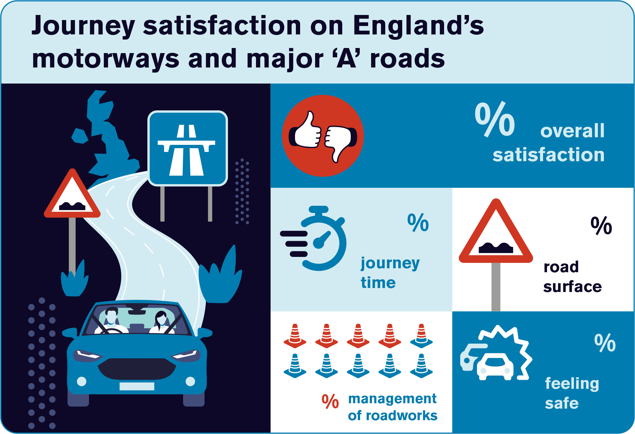
70
68
70
80
48

Slide 5
Focus on trends – overall satisfaction

Slide 6
Overall satisfaction – rolling annual scores
Overall satisfaction continues to recover from the declines seen during the second half of 2024
% very/fairly satisfied; rolling annual data
Base: All respondents giving a rating (base sizes range from 9040 to 9463)

Slide 7
Overall satisfaction – in-month scores
Looking at in-month scores, there was a bit of a dip in overall satisfaction in July/August, but it recovered in September.
% very/fairly satisfied; in-month data
Base: All respondents giving a rating (base sizes range from 676 to 893)

Slide 8
Overall satisfaction – quarterly scores
Focusing on discrete quarterly data, overall satisfaction in Q2 is lower than Q1, but is in line with the KPI and is comparable with Q2 in previous years
% very/fairly satisfied; discrete quarterly data
Base: All respondents giving a rating (base sizes range from 2160 to 2560)

Slide 9
Overall satisfaction – motorways vs 'A' roads
A roads continue to achieve higher overall satisfaction scores than motorways
% very/fairly satisfied. Discrete quarterly data
Base: All respondents giving a rating (base sizes range from: motorways 1176 to 1383; A roads 984 to 1177)

Slide 10
Focus on trends – key drivers of overall satisfaction

Slide 11
Journey time
Journey time has recovered from the lows of Q2 and Q3 24/25, with 68 per cent satisfied and 75 per cent saying the journey was as expected or shorter.
Discrete quarterly data
Base: All respondents giving a rating (base sizes range from: journey time 2165 to 2557; journey time vs. expectations 2022 to 2407)

Slide 12
Overall satisfaction vs traffic levels
Higher levels of traffic during the summer holidays, as usual, which broadly correlates with lower overall satisfaction during these periods of higher traffic.
Discrete quarterly data
Base: All respondents giving a rating (base sizes range from: overall satisfaction 2160 to 2560; traffic 2147 to 2540)

Slide 13
Road surface and feelings of safety
Satisfaction with road surface is at its highest level for almost two years. Feelings of safety are at average levels.
Discrete quarterly data
Base: All respondents giving a rating (base sizes range from: road surface 2145 to 2526; safety 2160 to 2559)

Slide 14
Roadworks
The proportion of drivers passing through roadworks hit the lowest level for two years, although satisfaction with their management remains at similar levels to last year and lower than last quarter.
Discrete quarterly data.
Base: Passed through roadworks - all respondents (base sizes range from 2175 to 2567);
Management of roadworks - those giving a rating who passed through roadworks (base sizes range from 507 to 751)

Slide 15
Delays other than roadworks
Drivers experienced more delays (other than roadworks) this quarter, mainly due to traffic congestion, but satisfaction with the management of these delays remained fairly consistent.
Discrete quarterly data.
Base: Experienced other delays - all respondents (base sizes range from 2175 to 2567);
Management of other delays - those giving a rating who experienced other delays (base sizes range from 304 to 460)

Slide 16
What has changed?

Slide 17
Upkeep of the roads has improved this quarter and year-on-year
As seen earlier, the proportion of drivers passing through roadworks is at its lowest level for some time, 24 per cent in Q2 25/26.
In part this reflects the end of the NEAR programme of roadworks on all lane running smart motorways, which was completed by the end of Q4 24/25.
In addition though, satisfaction with other aspects of the upkeep of the SRN has also risen.
Satisfaction with the road surface is up year-on-year, to 73 per cent in Q2 25/26. This follows a dip in the second half of 25/26.
Satisfaction with the road and verge being free of litter is also recovering after a dip during the last year. It now stands at 64 per cent.
%
Discrete quarterly data.
Base: Passed through roadworks - all respondents (base sizes range from 2200 to 2567);
Road surface/litter - those giving a rating (base sizes range from: roadworks 2171 to 2526; litter 1871 to 2206)

Slide 18
Regional league table

Slide 19







National Highways regions – ranking and satisfaction
The South West region has retained the top spot for overall satisfaction and most other key metrics. Yorks & North East has improved significantly for overall satisfaction, journey time and road surface.
Overall rank | Region | Overall satisfaction | Overall satisfaction: motorways | Overall satisfaction: A-roads | Journey time | Road surface | Management of roadworks | Feeling safe
1 | South West | 1 76 (74) | 1 75 (73) | 1 77 (76) | 1 75 (71) | 2 73 (68) ↑ | 1 55 (55) | 1 85 (84)
2 | East | 2 72 (69) | 2 73 (71) | 3 71 (67) | 2 70 (66) ↑ | 6 66 (63) | 5 45 (43) | 2 83 (80)
3 | North West | 3 70 (72) | 3 70 (71) | 3 71 (73) | 4 67 (72) ↓ | 3 72 (69) | 4 47 (53) | 4 79 (82) ↓
3 | Yorks & North East | 3 70 (67) ↑ | 4 69 (64) ↑ | 2 72 (71) | 3 69 (64) ↑ | 1 76 (73) ↑ | 3 48 (49) | 3 82 (80)
5 | South East | 5 69 (68) | 5 68 (70) | 5 69 (67) | 4 67 (67) | 4 69 (68) | 5 45 (46) | 6 78 (80)
6 | Midlands | 6 67 (70) | 7 65 (68) | 5 69 (73) | 6 66 (66) | 4 69 (69) | 2 51 (45) | 4 79 (81)
6 | M25 | 7 66 (65) | 6 67 (65) | 7 65 (66) | 7 64 (61) | 7 65 (68) | 5 45 (45) | 6 78 (77)
 | All regions | 70 (70) | 69 (69) | 72 (70) | 68 (67) | 70 (68) ↑ | 48 (48) | 80 (81)
Data shown is rolling annual data and shows ranking and per cent satisfied
↑ denotes a significant increase in score (at a 95 per cent level) versus September 2024 score in brackets
↓ denotes a significant decrease in score (at a 95 per cent level) versus September 2024 score in brackets

Slide 20
About the survey
SRUS uses a ‘push to web’ method where households within a representative sample of the driving population in England are sent a letter inviting them to complete the survey, which they then do online.
The survey asks about various aspects of journey experience.
An interactive map is integrated into the questionnaire and ‘understands’ which part of a journey is on the Strategic Road Network.
Results are weighted to ensure they are representative of vehicle mileage across the Strategic Road Network.
Since April 2021 the delivery of the survey has been supported by the research agency BMG Research.
Satisfaction = very satisfied and fairly satisfied combined.
More information, including drivers’ comments, can be viewed in the Transport Focus data hub – new data is added each month.

Slide 21
Contact Transport Focus
Any enquiries about this report should be addressed to:
Josh Whitton
Policy Manager
Josh.Whitton@transportfocus.org.uk
Transport Focus
Piccadilly Gate
Store Street
Manchester
M1 2WD
www.transportfocus.org.uk
Transport Focus is the operating name of the Passengers’ Council

