Slide 1
Strategic Roads User Survey quarterly report : Q3 2025-26 March 2026

Slide 2
Key findings
Overall satisfaction (annual rolling score) sits at 71 per cent in December 2025, just above National Highway’s KPI (70 per cent). The Q3 25/26 score is 72 per cent.
Overall satisfaction with motorways has improved this quarter (72 per cent), narrowing the gap to 'A' roads (73 per cent).
The proportion of drivers passing through roadworks has fallen again this quarter (23 per cent) and satisfaction with the management of the roadworks has improved (51 per cent).
The proportion of drivers experiencing delays other than roadworks fell back to more usual levels this quarter (18 per cent), with satisfaction with their management increasing (29 per cent).
Fully electric car drivers are more satisfied than other car drivers. Overall satisfaction among drivers of fully electric cars has reached its highest level for two years this quarter (78 per cent) and shows a year-on-year increase in rolling annual score, rising from 72 per cent in December 2024 to 74 per cent in December 2025.
The South West region remains the highest scoring region for overall satisfaction and most other key metrics. Yorkshire and North East remains the highest scoring region for satisfaction with the road surface. The South East region has shown some improvements this quarter.

Slide 3
About this report
Within the report we cover the following areas:
Overall satisfaction trends
Trends for key drivers of overall satisfaction (including journey time, journey time compared to expectations, traffic levels, delays other than roadworks, feelings of safety, road surface, roadworks). Key drivers are the aspects of the journey that have the greatest influence on road users’ overall satisfaction.
What’s changed this quarter
Regional rankings
In this report we show rolling annual data, the mutually agreed way of looking at the KPI, along with in-month data. However, for the majority of the report results are shown for discrete financial quarterly periods. This allows us to see more clearly where movement is occurring, while maintaining robust sample sizes.
This report contains data up to 31 December 2025.The report will be updated quarterly and complements our annual SRUS reports.

Slide 4
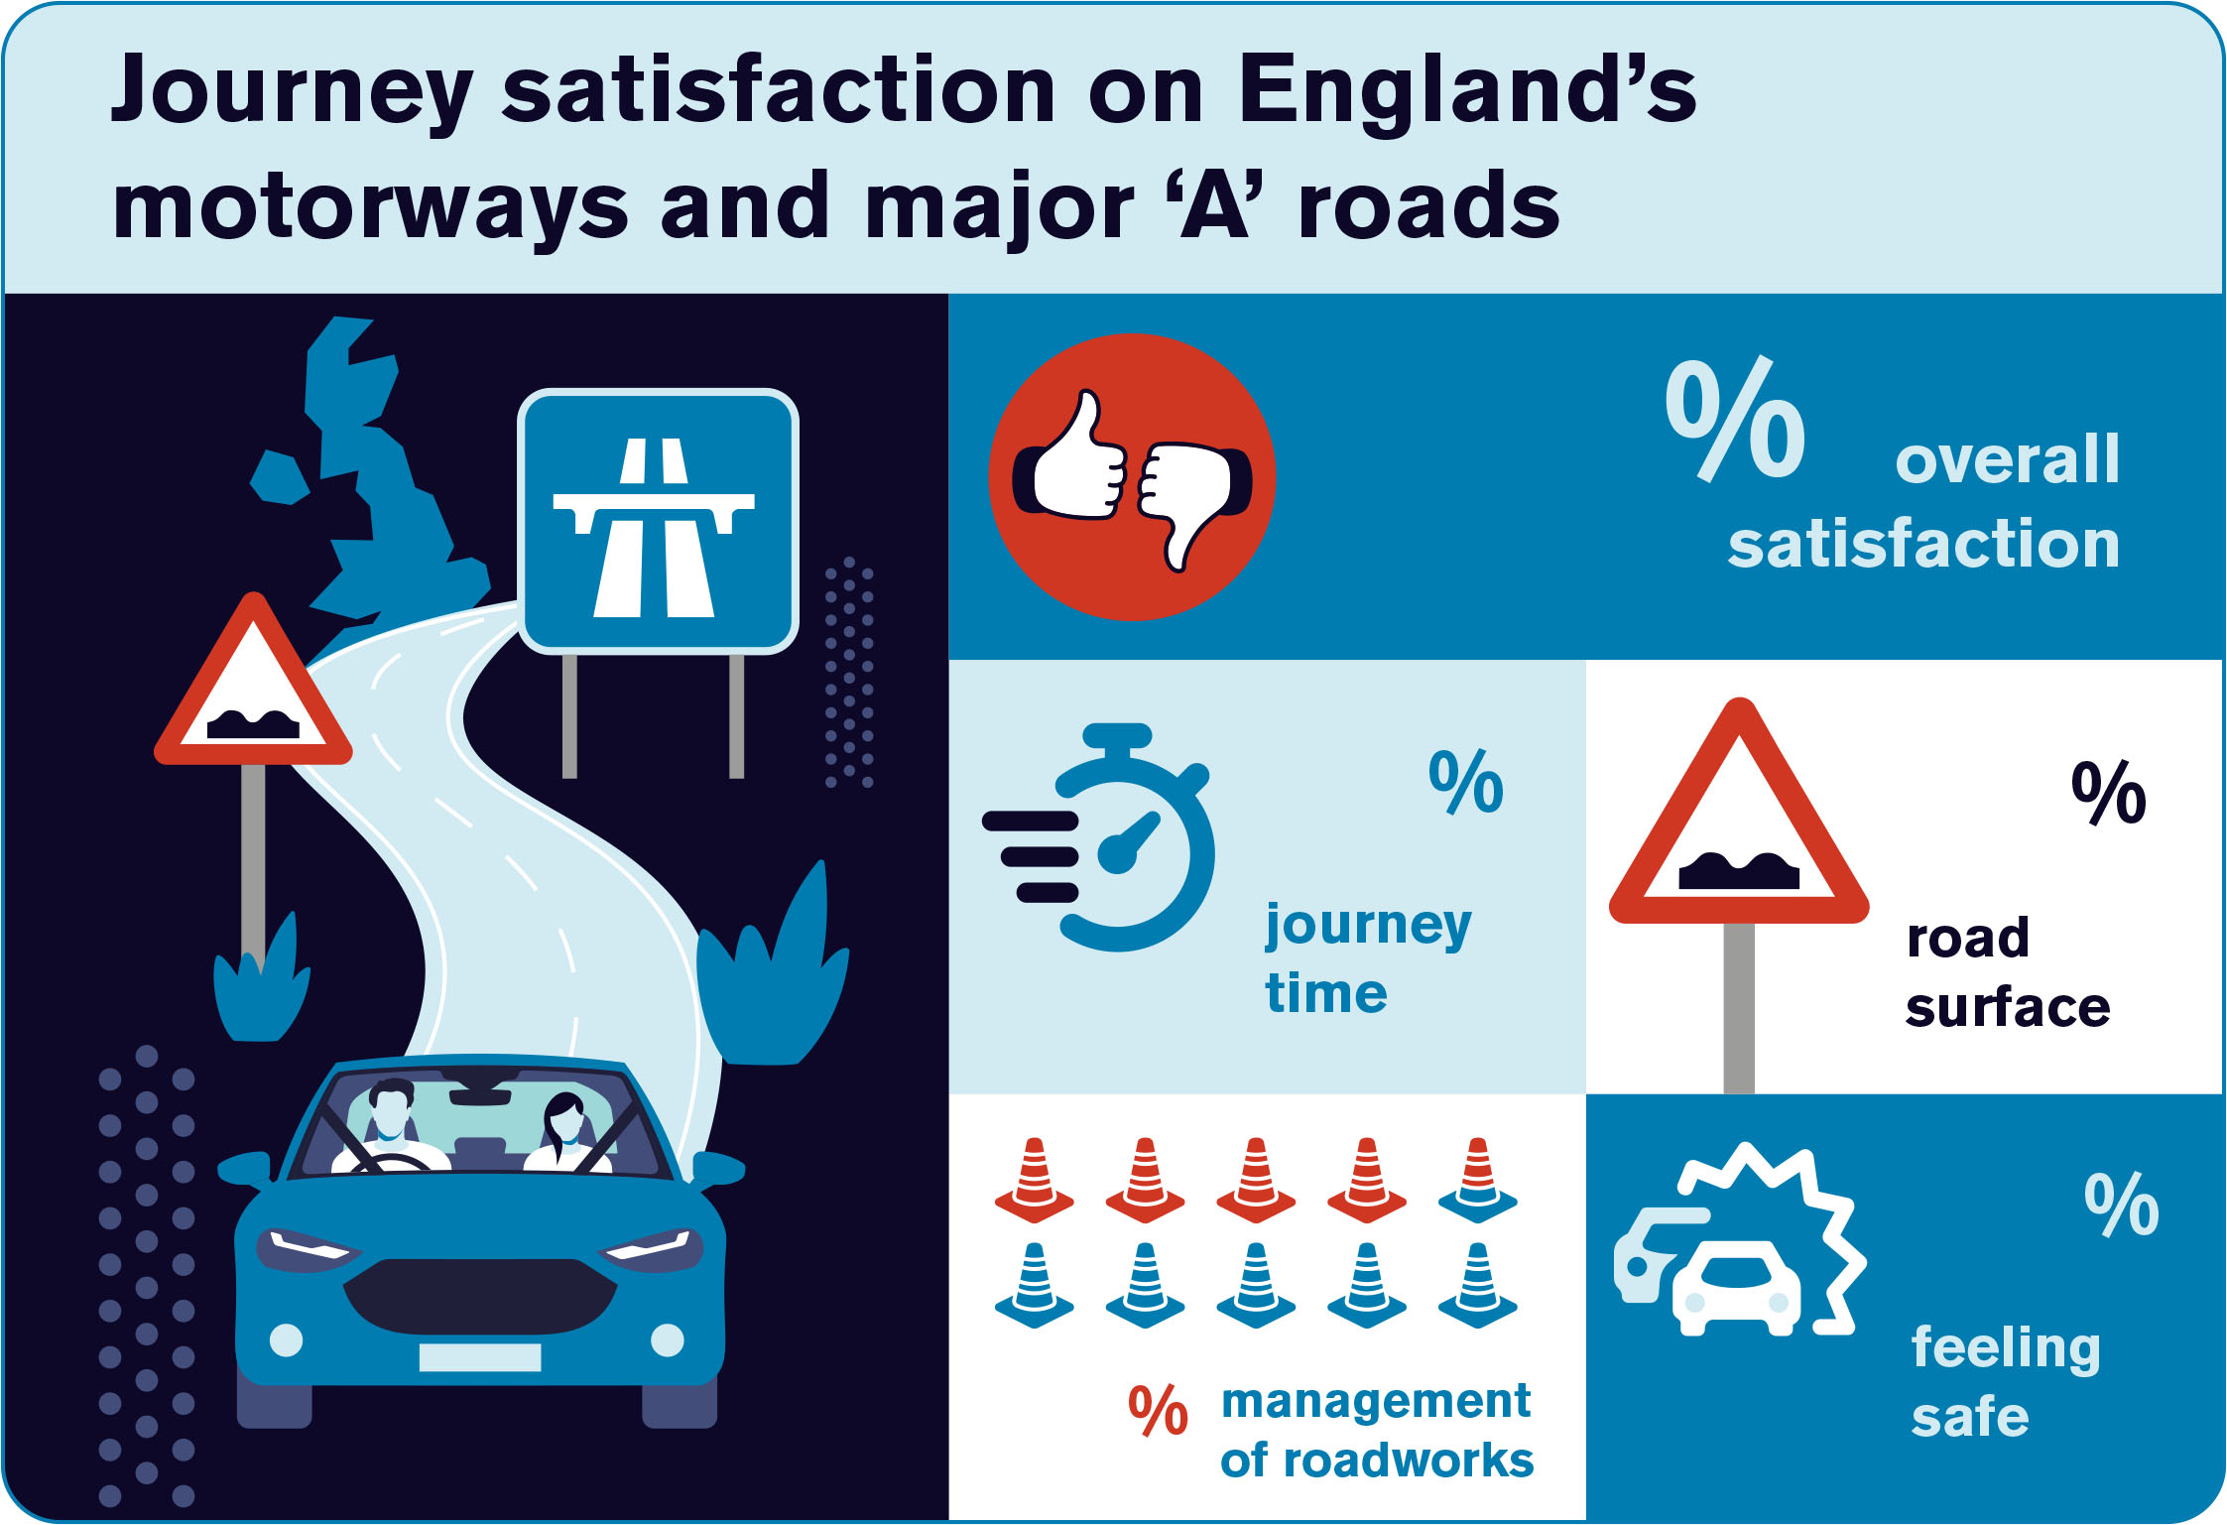
71
69
71
81
49
Rolling annual data
December 2025
Notes:
This is rolling annual data

Slide 5
Focus on trends – overall satisfaction

Slide 6
Overall satisfaction – rolling annual scores
Overall satisfaction has now returned to 71 per cent, the levels seen two years ago. It is now slightly higher than the current KPI target.
% very/fairly satisfied; rolling annual data
Base: All respondents giving a rating (base sizes range from 9040 to 9463)
Annual KPI target 2025/26 = 69.6%

Slide 7
Overall satisfaction – in-month scores
Looking at in-month scores, the latest three months have remained at 71 per cent or more
% very/fairly satisfied; in-month data
Base: All respondents giving a rating (base sizes range from 676 to 893)
Annual KPI target 2025/26 = 69.6%

Slide 8
Overall satisfaction – quarterly scores
Focusing on discrete quarterly data, overall satisfaction in Q3 is 72 per cent; higher than Q2 and above the annual KPI target.
% very/fairly satisfied; discrete quarterly data
Base: All respondents giving a rating (base sizes range from 2160 to 2560)
Annual KPI target 2025/26 = 69.6%

Slide 9
Overall satisfaction – motorways vs 'A' roads
The gap between overall satisfaction with motorways versus A roads has narrowed this quarter, with motorway scores improving
% very/fairly satisfied. Discrete quarterly data
Base: All respondents giving a rating (base sizes range from: motorways 1176 to 1383; A roads 984 to 1177)

Slide 10












Overall satisfaction by sub-group: Q3 25/26 (%)
 | Overall satisfaction | 72 |  |  | Male | 72 |  |  | Commuter | 67
 |  |  |  |  | Female | 73 |  |  | Any work reason | 66
 | Motorway | 72 |  |  | Age 17-34 | 69 |  |  | Leisure | 74
 | Major ‘A’ road | 73 |  |  | Age 35-59 | 71 |  |  | Car | 73
 | Motorway journey - included a ‘smart’ section | 66 |  |  | Age 60+ | 75 |  |  | Vans | 71
 | All-lane running | 69 |  |  | Disabled people | 67 |  |  | Battery electric cars | 78
 | Dynamic hard shoulder | 55 |  |  | Non-disabled people | 73 |  |  | Weekday AM peak | 71
 | Controlled | 63 |  |  | Passed through roadworks | 61 |  |  | Weekday PM peak | 60
 | Motorway journey - no ‘smart’ section | 76 |  |  | Did not pass through roadworks | 78 |  |  | Weekday off-peak | 73
 |  |  |  |  |  |  |  |  | Weekend/bank holiday | 76
% very/fairly satisfied. Quarterly data
Base: All respondents giving a rating (base sizes for sub-groups range from 110 (disabled people) to 1,000+)
Quarterly sample sizes too low to show satisfaction among LGV/HGV drivers

Slide 11
Focus on trends – key drivers of overall satisfaction

Slide 12
Journey time
Journey time has remained fairly stable this quarter, with 69 per cent satisfied. 79 per cent rated the journey time as expected or shorter, comparable with Q3 in the previous two years.
Discrete quarterly data
Base: All respondents giving a rating (base sizes range from: journey time 2165 to 2557; journey time vs. expectations 2022 to 2407)

Slide 13
Overall satisfaction vs traffic levels
Traffic levels this quarter are comparable with those in Q3 in previous years. These remain a key driver of overall satisfaction.
Discrete quarterly data
Base: All respondents giving a rating (base sizes range from: overall satisfaction 2160 to 2560; traffic 2147 to 2540)

Slide 14
Road surface and feelings of safety
Satisfaction with road surface and feelings of safety remain fairly stable this quarter. 72 per cent are satisfied with the road surface; 80 per cent feel safe.
Discrete quarterly data
Base: All respondents giving a rating (base sizes range from: road surface 2145 to 2526; safety 2160 to 2559)

Slide 15
Roadworks
The proportion of drivers passing through roadworks continues to fall. Satisfaction with their management increased to 51 per cent this quarter, close to the highest seen over the last two years.
Discrete quarterly data.
Base: Passed through roadworks - all respondents (base sizes range from 2175 to 2567);
Management of roadworks - those giving a rating who passed through roadworks (base sizes range from 507 to 751)

Slide 16
Delays other than roadworks
The proportion of drivers experiencing delays (other than roadworks) fell back to more usual levels this quarter and satisfaction with the management of these delays increased to the highest level seen in recent years.
Discrete quarterly data.
Base: Experienced other delays - all respondents (base sizes range from 2175 to 2567);
Management of other delays - those giving a rating who experienced other delays (base sizes range from 304 to 460)

Slide 17
Quarterly focus

Slide 18
Satisfaction among electric car drivers remains higher than that for all car drivers and has increased year-on-year
The proportion driving electric vehicles is continuing to increase, with 7 per cent of car journeys in the latest quarter being in fully electric cars.
Overall satisfaction among those driving electric cars has reached its highest level for two years, with 78 per cent satisfied in the last quarter. This is higher than satisfaction among all car drivers (73 per cent). Looking at rolling annual scores, satisfaction has risen year-on-year, from 72 per cent in December 2024 to 74 per cent in December 2025.
This increase in satisfaction among electric car drivers followed a dip in Q3/Q4 last year, likely to be connected to the NEAR programme of roadworks, as was seen for the overall sample.
Electric car drivers also tend to feel slightly safer than other car drivers, with 86 per cent saying they felt safe in the last quarter, compared with 81 per cent among all car drivers.
%
Rolling annual scores to..:
Dec 24: 72%
Dec 25: 74%
Rolling annual scores to...:
Dec 24: 82%
Dec 25: 83%
Discrete quarterly data.
Base: % driving electric cars - all who drove a car on their journey (base sizes range from 1962 to 2274);
Overall satisfaction/feel safe - those giving a rating (base sizes range from: electric cars: 101 to 155; all car drivers 1954 to 2268)

Slide 19
Regional satisfaction

Slide 20







Satisfaction - breakdown by National Highways regions
Overall satisfaction, along with most other metrics, is highest in the South West. Yorks & North East has the highest satisfaction levels for road surface. South East has shown some improvements this quarter.
Overall rank | Region | Overall satisfaction | Overall satisfaction: motorways | Overall satisfaction: A-roads | Journey time | Road surface | Management of roadworks | Feeling safe
1 | South West | 1 77 (76) | 1 77 (75) | 1 76 (77) | 1 74 (75) | 2 75 (73) | 1 55 (55) | 1 86 (85)
2 | East | 2 73 (72) | 2 73 (73) | 2 72 (71) | 3 69 (70) | 7 66 (66) | 7 45 (45) | 2 82 (83)
3 | South East | 3 71 (69) ↑ | 3 71 (68) ↑ | 5 71 (69) | 4 68 (67) | 3 72 (69) ↑ | 5 48 (45) | 4 79 (78)
3 | Yorks & North East | 3 71 (70) | 3 71 (69) | 2 72 (72) | 2 71 (69) | 1 77 (76) | 3 50 (48) | 2 82 (82)
5 | North West | 5 69 (70) | 5 69 (70) | 7 68 (71) | 5 67 (67) | 4 71 (72) | 3 50 (47) | 7 78 (79)
5 | Midlands | 5 69 (67) ↑ | 7 66 (65) | 2 72 (69) ↑ | 5 67 (66) | 5 69 (69) | 2 51 (51) | 4 79 (79)
5 | M25 | 5 69 (67) | 5 69 (67) | 6 69 (65) ↑ | 7 66 (64) | 6 68 (65) ↑ | 6 46 (45) | 4 79 (78)
 | All regions | 71 (70) ↑ | 71 (69) ↑ | 73 (72) ↑ | 69 (68) ↑ | 71 (70) ↑ | 49 (48) | 81 (80)
Data shown is rolling annual data and shows ranking and per cent satisfied
↑ denotes a significant increase in score (at a 95 per cent level) versus September 2025 score in brackets
↓ denotes a significant decrease in score (at a 95 per cent level) versus September 2025 score in brackets

Slide 21
About the survey
SRUS uses a ‘push to web’ method where households within a representative sample of the driving population in England are sent a letter inviting them to complete the survey, which they then do online.
The survey asks about various aspects of journey experience.
An interactive map is integrated into the questionnaire and ‘understands’ which part of a journey is on the Strategic Road Network.
Results are weighted to ensure they are representative of vehicle mileage across the Strategic Road Network.
Since April 2021 the delivery of the survey has been supported by the research agency BMG Research.
Satisfaction = very satisfied and fairly satisfied combined.
More information, including drivers’ comments, can be viewed in the Transport Focus data hub – new data is added each month.

Slide 22
Contact Transport Focus
Any enquiries about this report should be addressed to: Josh Whitton Policy Manager Josh.Whitton@transportfocus.org.uk Transport Focus Piccadilly Gate Store Street Manchester M1 2WD
www.transportfocus.org.uk
Transport Focus is the operating name of the Passengers’ Council

