Slide 1
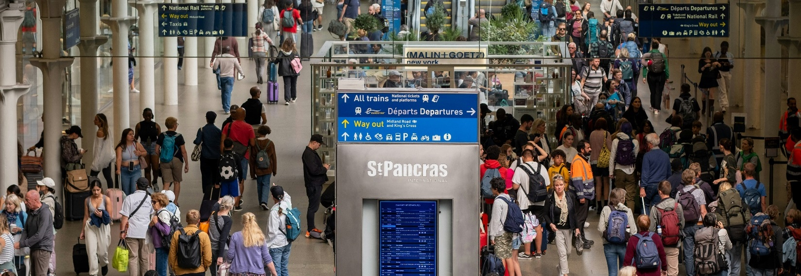

TRANSPORT FOCUS & SMARTER INFORMATION, SMARTER JOURNEYS
Passenger Information During Disruption: Final Report 27th September 2024
PIDD DEBRIEF

Slide 2
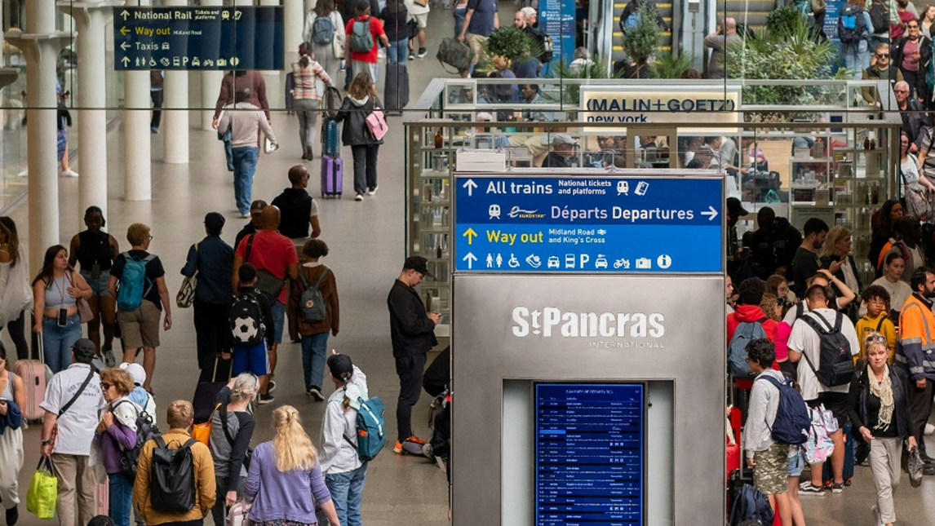

CONTENTS
1 | BACKGROUND, OBJECTIVES AND METHODOLOGY | 3
2 | EXECUTIVE SUMMARY | 9
3 | THE “RULES” FOR ENGAGEMENT | 13
4 | CHANNEL USE | 21
5 | THE LANGUAGE OF DISRUPTION | 31
6 | TICKET ACCEPTANCE | 40
7 | SPECIFIC INTERVENTIONS | 47
8 | APPENDIX | 59
© Quadrangle 2024 internal

Slide 3
CONTENTS
1 | BACKGROUND, OBJECTIVES AND METHODOLOGY | 3
2 | EXECUTIVE SUMMARY | 9
3 | THE “RULES” FOR ENGAGEMENT | 13
4 | CHANNEL USE | 21
5 | THE LANGUAGE OF DISRUPTION | 31
6 | TICKET ACCEPTANCE | 40
7 | SPECIFIC INTERVENTIONS | 47
8 | APPENDIX | 59
© Quadrangle 2024 internal

Slide 4
PRIOR INSIGHT THAT INFORMED THE APPROACH
PASSENGERS WANT:
BUT:
1. To be informed
“Being kept informed about delays and the options I may have” ranks #7 of the things most important to passengers when using the rail network.
(Britain’s Railway, What Matters to Passengers, 2023)
2. To be empowered
Empower the passenger – they need and want to feel in control of the situation and the outcome for them.
(Avanti Disruption Comms I, 2022)
3. Advance notice
For planned disruption, advance notice is the top empowerment priority.
(Avanti Disruption Comms II, 2024)
4. Channel choice
Digital channels are preferred (app, text, email) but consistency is paramount between online and offline channels, including arming staff with up-to-date information.
(Avanti Disruption Comms II, 2024)
5. Rail is falling behind
Rail information is falling behind other types of transportation when it comes to keeping passengers informed about disruption and their choices.
(SISJ, 2023)
PASSENGERS HAVE:
COMMUNICATIONS SHOULD BE:
HOWEVER:
6. Different needs
Those with a disability often have more acute needs e.g. greater necessity to plan journeys in advance and reliance on a narrower set of information channels.
(Various projects, 2022 – 2024)
7. Varying expectations
The more connected and engaged the customer, the higher their expectations and harder they are to please.
(Avanti Disruption Comms II, 2024)
8. Clear and consistent
Unplanned disruption priorities include clarity and consistency of message, onboard information about the delay and details of when normal service will resume, and the validity of tickets on other services or alternative routes.
(Avanti Disruption Comms II, 2024; SISJ, 2023)
9. Empathetic and open
Deliver the message with empathy and openness, appreciate passengers as individuals.
(Avanti Disruption Comms I, 2022)
10. Improvements can have a genuine impact
Rail interventions with the greatest impact on satisfaction often link to disruption e.g. real-time information via smartphone, guarantee tickets can be used on other services, automatic compensation.
(Passenger Interventions I & II, 2022, 2024)
Passenger Information During Disruption – Debrief

Slide 5
10 PRINCIPLES THAT INFORMED THE APPROACH
1. Geography
Recruiting groups of a similar geography and region helps ensure the group feels cohesive, with passengers familiar with the same TOCs being used and discussed in the session.
2. Online access
Online groups help us to recruit from a wide range across the network including both more urban and rural locations, enabling us to hear from more voices.
3. Journey type
Keeping passengers focused on one type of journey they make in the session to go deeper into that situation and avoid confusion e.g. leisure or business or commuting.
4. Open dialogue
Be clear and open with participants about why we are conducting the research and their role in the process, gaining their help, support and input into the topic.
5. Pre-tasks
Ensuring participants are ready to start at the beginning of the session and already tuned into the topic so we can get to the main focus of the session faster.
6. Inclusion
We do not screen out based on requiring assistance at stations or passengers with additional needs, all abilities or disabilities are welcome in the focus group sessions should passengers wish, in addition to the sessions dedicated to those specific needs.
7. Scenarios
Sharing different disruption scenarios can push the conversation further and help to jog passengers’ memories of when they have experienced disruption; they can be used as a projective technique to help put passengers in the moment of disruption.
8. Stimulus
Other stimulus examples of types of messaging and communication can be helpful to give passengers something to respond to, whether “real world” or future examples.
9. Clarity over disruption
Clearly set the ground rules up front of what we mean when we talk about disruption (e.g. not strike action) and planned vs unplanned, to ensure everyone is using a common language and considering the same topic.
10. Deliberative
We have established hierarchies for disruption frameworks and passenger priorities, sharing that with passengers to get their perspective and view and critique of how the rail network does at each stage could be beneficial and ensure we’re uncovering “new news”.
Passenger Information During Disruption – Debrief

Slide 6
A REMINDER OF THE KEY OBJECTIVES
Focused objectives for 2024 include:
Understanding the different channels of communication and information sources passengers use to make decisions during disruption, and how these sources intersect;
Exploring the way that rail passengers interpret information they receive, and how that information can be improved;
Exploring what passengers do when they find themselves in a period of disruption, and how the information sources help to drive these decisions (e.g. using alternative routes);
Understanding how reliable different sources are perceived to be and why;
Utilising a degree of cognitive testing of current disruption messages for comprehension - do passengers really understand the messages they receive, and if so, how helpful are they?;
Understanding preferred ways of receiving information (e.g. visual, text, audio) and what is the right channel or format, at the right time? and finally;
Exploring responses to trialled and planned interventions e.g. online maps and posters, to understand the utility of these for passengers, and if they need and desire more proactive communication.
Passenger Information During Disruption – Debrief

Slide 7
A REMINDER OF THE SAMPLE SPECIFICATION
Group | Location | Rail journey type | Other considerations
Group 1 | Scotland (mix of rural/ urban) | 50/50 split of business travel / personal or leisure at least once every two months | Aim for a mix of men and women Aim for a mix of ages Aim for a mix of journey length and TOCs Aim for a mix of life stages No more than half of each group to use Trainline for booking tickets and information about journey planning Disruption experience: All to have experienced unplanned disruption when travelling on the UK rail network in the last 2 months. This includes e.g. inclement weather, lack of train crew leading to delay or cancellations, fatalities on the track, trespassers, signal failure but, not planned engineering work nor strike action Mix of familiar journeys and unfamiliar journeys
Group 2 |  | Commuting 2+ times per week
Group 3 | Wales (mix of North/ South) | 50/50 split of business travel / personal or leisure at least once every two months
Group 4 |  | Commuting 2+ times per week
Group 5 | England (North and Midlands, aim for mix of rural and urban) | Business travel or personal business at least once every two months
Group 6 |  | Commuting 2+ times per week
Group 7 |  | Leisure at least once every two months
Group 8 | England (South including a mix of rural and urban, aim for majority to live outside M25) | Business travel or personal business at least once every two months
Group 9 |  | Commuting 2+ times per week
Group 10 |  | Leisure at least once every two months
Additional considerations:
All participants completed a short online pre-task ahead of their focus group
All focus groups lasted c. 2 hours and were conducted online via the “Incling” platform
All focus groups were conducted between 15th July and 23rd July 2024
For full screening details, please see separate document, available on request
NB: Groups in Wales conducted through the medium of English
Passenger Information During Disruption – Debrief

Slide 8
A REMINDER OF THE DEPTHS SAMPLE
Depth | Type of impairment | Other factors to be included
Depth 1 | Mobility issues | Aim for a mix of men and women Aim for a mix of ages / life stages Aim for a mix of locations Aim for a mix of journey length and TOCs No more than 50% of respondents to use Trainline for booking tickets and information about journey planning Disruption experience: All to have experienced unplanned disruption when travelling on the UK rail network in the last 2 months. This includes e.g. inclement weather, lack of train crew leading to delay or cancellations, fatalities on the track, trespassers, signal failure but, not planned engineering work nor strike action Mix of familiar journeys and unfamiliar journeys
Depth 2
Depth 3
Depth 4 | Neurodiverse
Depth 5
Depth 6 | Audio impaired (none to have BSL as first language)
Depth 7
Depth 8
Depth 9 | Visually impaired
Depth 10
Depth 11
Depth 12
Depth 13 | Digitally disengaged
Depth 14
Additional considerations:
All participants completed a short paper or pre-task ahead of their focus group
All interviews lasted c. 45 – 60 minutes
Interviews were conducted either via MS Teams or via telephone at participant’s request
All interviews were conducted between 15th July and 5th August 2024
For full screening details, please see separate document, available on request
Passenger Information During Disruption – Debrief

Slide 9
CONTENTS
1 | BACKGROUND, OBJECTIVES AND METHODOLOGY | 3
2 | EXECUTIVE SUMMARY | 9
3 | THE “RULES” FOR ENGAGEMENT | 13
4 | CHANNEL USE | 21
5 | THE LANGUAGE OF DISRUPTION | 31
6 | TICKET ACCEPTANCE | 40
7 | SPECIFIC INTERVENTIONS | 47
8 | APPENDIX | 59
© Quadrangle 2024 internal

Slide 10
Transport Focus & Smarter Information, Smarter Journeys
EXECUTIVE SUMMARY (1/2)
1. AUDIENCE DIFFERENCES
2. THE “RULES” FOR ENGAGMENT
3. STATUS MESSAGING
4. “UNCERTAIN”
5. TICKET ACCEPTANCE
Geographic location, urban vs rural and station size all appear to make a notable difference in how passengers plan and manage their way around disruption through their chosen communication channels.
Passengers with additional needs when travelling have developed their own strategies and assessment of the information provided.
There are few significant observed differences based on age, gender or working status.
In summary, three rules came through across the groups and depth discussions:
Be clear
Be concise
Be consistent with information
Ultimately, passengers want to be armed with the right information, and informed about their journey ahead of time, as much as possible.
Yellow warning triangles are insufficient if the train is also showing as “on time” to alert passengers to a possible delay or disruption.
Passengers are desensitized to these triangles, they focus on their own train, not the warning symbol or disruption headline.
Route familiarity makes a difference – passengers are more likely to pay attention to a disruption headline on a familiar route if they know that it relates to their journey.
Interpreted as a step between “delayed” and “cancelled”, rather than a step between “on time” and “delayed”.
“Potentially delayed” was considered as an acceptable alternative when the TOC may not know if the train will be delayed or not. Knowing there’s a possible issue allows the passenger to plan ahead.
Passengers seek reassurance, “uncertain” raises more questions than it answers.
There is a need for clearer and simpler language around ticket acceptance and communication. Even the phrase “ticket acceptance” in itself, is not always well understood. “Mutual ticket acceptance” in particular, is poorly understood.
“Any reasonable route” is assumed to be any route the passenger considers reasonable – if it gets them from A to B, it should be considered a “reasonable route”, and many are prepared to “risk it” if unsure.
Passenger Information During Disruption – Debrief
© Quadrangle 2024 Internal

Slide 11
Transport Focus & Smarter Information, Smarter Journeys
EXECUTIVE SUMMARY (2/2)
6. ONLINE CHANNEL USE DURING DISRUPTION
7. OFFLINE CHANNEL USE DURING DISRUPTION
8. DISRUPTION VIDEOS
9. LIVE MAPS
10. TOC AND NATIONAL RAIL POSTERS
Many passengers habitually look online, or via an app ahead of leaving for the station to check their train status.
At the station, online becomes a secondary channel to offline channels unless there is conflicting information being offered, or planning an alternative route is required.
On the train, if there is an issue, staff (including over a public address system) are often preferred as a reliable source of information to online channels.
Staff can offer reassurance – sometimes passengers just “want to speak to a human” especially if the journey is either unfamiliar or will be complex to resolve during disruption e.g. during ticket acceptance.
Boards, PIS and public address system announcements should be the most trusted source but in reality, are not always audible and easy to understand – especially at smaller and unstaffed stations.
A good idea in principle, however, the current executions are too long and can overload passengers with information.
Shorter, clearer and more concise videos would be appreciated.
There is general support for videos as communication tools, particularly for those hard of hearing (or who use BSL) or who struggle to retain written information or consider themselves more visual learners.
Live maps can overwhelm with the amount of information displayed, especially for those less familiar with routes and the network.
Passengers would appreciate a search function to see their route and any potential disruption live, however, the likelihood to use is low unless there is widespread disruption, and an alternative route needs to be planned.
A version optimised for mobile would be appreciated.
The idea of a consistent poster style has a polarised response.
On the one hand, they offer consistency, clarity and with time would become familiar. However, they can be overlooked if it is not clear the disruption will impact the passenger and their route.
The current design can lack a sense of urgency with the warning sign in blue; there is a desire for bold text and an attention-grabbing headline (e.g. “Rail Replacement Bus”).
Passenger Information During Disruption – Debrief
© Quadrangle 2024 Internal

Slide 12
IN SUMMARY, FROM OUR PARTICIPANTS
Video of highlight quotes inserted here
“Think about the language used and how it is interpreted”
“Be consistent, accurate and transparent”
“Visual, audio, people take information in multiple ways”
“Use less ambiguous language”
“Tell us straightaway…let commuters know”
“We understand things happen…be honest with us as a consumer”
“Be more honest and clear with us about the problem”
“[Uncertain] train operators aren’t always going to know so but tell us in plain terms”
“You need to get across as many mediums as possible”
Passenger Information During Disruption – Debrief
© Quadrangle 2024 Internal

Slide 13
CONTENTS
1 | BACKGROUND, OBJECTIVES AND METHODOLOGY | 3
2 | EXECUTIVE SUMMARY | 9
3 | THE “RULES” FOR ENGAGEMENT | 13
4 | CHANNEL USE | 21
5 | THE LANGUAGE OF DISRUPTION | 31
6 | TICKET ACCEPTANCE | 40
7 | SPECIFIC INTERVENTIONS | 47
8 | APPENDIX | 59
© Quadrangle 2024 internal

Slide 14
THE DOMINANT “NEED” IS HAVING THE RIGHT INFORMATION TO MAKE A DECISION
Although passengers have multiple needs during times of disruption – both planned and unplanned – ultimately these ladder up to one dominant need that, if met, allows them to decide what to do and when.
It’s about putting the passenger back into a position of control over their journey.
Emotional needs during disruption
Reassurance they will be able to complete their journey
Confidence in the decisions they are making and the route they are taking
Informed about their options
Feel safe while waiting on the platform or at the station
Respected and listened to by staff members
Functional needs during disruption
Relevant and actionable information about how to complete their journey
The time implications of the disruption to their journey and how long the disruption is likely to last for
What has caused the disruption
Information about delay repay and how to claim
Somewhere comfortable to wait
Social needs during disruption
Able to keep others updated and informed as to the progress of their journey (esp. for those traveling with carers or who have additional needs)
Passenger Information During Disruption – Debrief

Slide 15
DELIVERING AGAINST THIS NEED ARE THREE “RULES” FOR COMMUNICATIONS
There is a desire for honesty and transparency from TOCs to customers about the status of their train and future travel plans.
These three rules are apparent throughout the journey from initial planning to arrival at the station.
1.
Be clear
2.
Be concise
3.
Be consistent
“My advice would be really clear language, straightforward communication”
Scotland, Commuter
“I think the language just needs to be really clear and concise so you can quickly read it in a rush”
Wales, Commuter
“However they choose to warn you, it does need to be consistent across all platforms”
Wales, Business/Leisure
Passenger Information During Disruption – Debrief

Slide 16
CLARITY IS ABOUT EASE OF UNDERSTANDING
Passengers want to know what is happening and why, with clear instructions and directions of what the implications are for their journey and what they need to do as a result.
This lack of clarity is a significant issue with Ticket Acceptance (as we will discuss later in this document).
1.
Be clear
How to action:
Simple, easy to understand and unambiguous updates
Give context where possible e.g. stations impacted including the start and end points and not just the TOC or line, give the relevant time of the disruption if known
Avoid jargon and technical language; do not assume passengers will be familiar with language and terminology
This is particularly important during ticket acceptance or when alternative routes will be required to complete the journey
1
“Be honest and clear”
Scotland, Business/Leisure
“The disruption was caused by ‘staff issues’. This meant that the train I was meant to get on was cancelled”
North/Midlands, Business travel
“Clear, specific, easy instructions of the exact delay, the reason for it and the alternative methods or routes”
London/South, Business travel
Passenger Information During Disruption – Debrief

Slide 17
BE CONSCISE AND TO THE POINT
Passengers can get overwhelmed with long messages and updates, it can be hard to take in and identify the key piece of information.
Attention and memory spans are short, there is only so much passengers can take in at once, especially if it is a stressful moment e.g. realising your train is cancelled.
2.
Be concise
How to action:
The shorter the better to help avoid overwhelming passengers
Long-winded explanations can cause more confusion, especially if part of the message is “lost” over a hard to hear public address system, or scrolling update on PIS
If a reason is given for the disruption, keep it simple and jargon free
Provide instruction of how to access additional information if required e.g. directing to a website, member of staff or QR code
1
“If you tell me what the disruption is I can make a guess as to how much it will impact me”
North/Midlands, Commuting
It’s just a balance between information overload, what we don’t want is a running commentary on what’s happened, we want it to be quite concise, but enough for us to make an informed decision”
North/Midlands, Business
Passenger Information During Disruption – Debrief

Slide 18
CONSISTENCY AVOIDS CONFUSION
Changing messages or conflicting messages cause confusion. When this happens, it is often between route planners e.g. Trainline, the station staff and the information shown on boards/PIS.
Occasionally this can also come from other passengers who suggest alternatives or are “in the know”.
How to action:
Avoid differing or multiple messages across channels
Consistency appears to link to honesty and transparency, there needs to be a sense that passengers are receiving accurate information to the best of the TOC’s ability at the time
This includes the information that staff can provide, and at unstaffed stations, the communication between announcements, PIS and online channels e.g. Live Departures needs to be the same to avoid confusion
Include information across different formats to support those with additional needs e.g. BSL or subtitles for videos, written and spoken information
3.
Be consistent
1
“[what would make the situation easier] Probably a bit more honesty”
North/Midlands, Business travel
“Have customer service members on hand to give honest and proper directions”
Scotland, Business/Leisure
“The saving grace are the BSL translator, white background and website link. BSL use on public transport is very important to the deaf community”
London/South, Leisure, travels with a deaf partner
Passenger Information During Disruption – Debrief

Slide 19
TOGETHER, THESE RULES SHOULD HELP REDUCE PASSENGER FRUSTRATION
We see these rules and themes emerge when reviewing language and potential interventions, especially for ticket acceptance, the language of “uncertain” and with the potential future interventions.
“The train company did not update the information on the app or the website. I checked 1 hour before setting off to the station.
Arrived at the station and according to the display boards the train was on time to look again 5 minutes later for it to display that it had been cancelled.
No information was given over the speaker in the station. I went to the information desk to be told that I had to wait for the next train.
The wait would have been another 90 minutes, asked if it would definitely arrive, got told they did not have that information at that moment in time.
Asked if there was a different route back, to be told ‘no’. When in fact after talking to another commuter there was a different route back.”
North/Midlands, Leisure
Across the research, passengers shared multiple stories where communication had been insufficient, confusing or “average”
Although passengers acknowledge that often the TOCs and the station staff are “doing their best”, sometimes this does fall short.
When communication isn’t clear, it can lead to significant frustration and annoyance for the passenger, in addition to the inconvenience of the delay or disruption. It makes an already stressful and poor situation worse.
In many cases, familiarity is a contributing factor. Those on unfamiliar routes or who travel less frequently can need more support. Commuters, on the other hand, claim to “know what to expect”.
Commuters often appear to have a system in place or know more what to expect or what their options are and can claim to need to hear less information – they’ve heard it all before. For them, they need to know just how bad will it be, so they can plan ahead.
Passenger Information During Disruption – Debrief

Slide 20
AT A MINIMUM, SOME COMMUNICATION IS BETTER THAN NO COMMUNICATION
Ideally, updates and changes would be provided in a timely way – as soon as the TOC knows there might be a problem, something needs to be communicated.
“So many people in the same area waiting for all different buses who also didn’t know where to go because it was too busy.”
North/Midlands, Leisure
A number of passengers mentioned having been in situations where limited, if any information was provided
Although passengers understand that sometimes the staff or the train company may not have the full information, an information vacuum can cause worry, frustration and concern.
Passengers do not expect to receive updates when everything is running on time and to plan, but if there is the potential for disruption, the earlier this can be communicated in a clear, concise and consistent way the better.
This is the case both for unplanned and planned disruption. With planned or anticipated disruption (e.g. engineering works) this should be more under the TOC’s control with the ability to provide accurate and actionable information about how the passenger can complete their journey. There is, perhaps, slightly more understanding during unplanned disruption.
“The announcement for the delay came very late, pretty much when the train was about to arrive to pick us up. I think it would have been a lot better if we knew earlier so we could plan ourselves and know what to do and how we can manage the delay.”
North/Midlands, Commuting
“If they would let people know before-hand instead of just cancelling trains.”
North/Midlands, Leisure
Passenger Information During Disruption – Debrief

Slide 21
CONTENTS
1 | BACKGROUND, OBJECTIVES AND METHODOLOGY | 3
2 | EXECUTIVE SUMMARY | 9
3 | THE “RULES” FOR ENGAGEMENT | 13
4 | CHANNEL USE | 21
5 | THE LANGUAGE OF DISRUPTION | 31
6 | TICKET ACCEPTANCE | 40
7 | SPECIFIC INTERVENTIONS | 47
8 | APPENDIX | 59
© Quadrangle 2024 internal

Slide 22
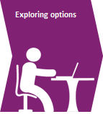

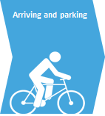
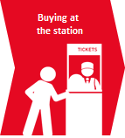
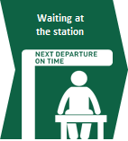
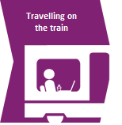
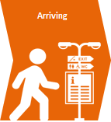
CHANNEL USE VARIES THROUGHOUT THE JOURNEY
The main observed difference in channel depending on if it is planned or unplanned disruption is during pre-travel.
Digitally disengaged passengers will often feel forced to use digital channels and will do so reluctantly but prefer offline support.
PRE-TRAVEL
GET TO THE TRAIN
ONBOARD
DESTINATION
During planned disruption
Keep an eye out for posters or announcements of upcoming disruption at the station
Staff should alert passengers if purchasing in person
Check online/ via app
Check online or via app before leaving for the station, expect to receive a notification or alert if ticket has been pre-booked
Listen for announcements, speak to staff, check PIS, speak to other passengers
Check apps and mobile sites for updates
Look for posters directing to rail replacement buses
Listen to staff on the train
Check apps and mobile sites
Look for posters/ staff for info re. rail replacement buses
During unplanned disruption
Check online/ via app when planning journey or purchasing tickets to check for disruption
Check online or via app before leaving for the station, expect to receive a notification or alert if ticket has been pre-booked
Listen for announcements, speak to staff, check PIS, speak to other passengers
Check apps and mobile sites for updates
Listen to staff on the train
Check apps and mobile sites
Push notifications/ posters about delay repay
Listen for staff announcements for delay replay
Passenger Information During Disruption – Debrief

Slide 23










PASSENGERS USE A WIDE RANGE OF DIGITAL CHANNELS
Trainline appears relatively dominant when it comes to digital channels but it’s not the only source of information.
Passengers typically have one or two “favourite” sources of information they trust and use regularly based on familiarity and route coverage.
TOC channels including apps and websites
National level channels, primarily websites
Third party apps, sites and social media
*
Including: Live departure boards, National Rail Enquiries, Journey Planner
*Network Rail is potentially a misattribution of National Rail journey planner or Live Departure Boards
Specific named examples given during research
Passenger Information During Disruption – Debrief

Slide 24
MANY PASSENGERS ARE DEVELOPING A HABIT TO CHECK IN ADVANCE
PRE-TRAVEL
“I use Google which provides prompt info, live feedback on the time and delays, then if I need to double check I go to the Trainline or West Midlands Rail.”
North/Midlands, Leisure
Online Channels offer clear, easy and timely information on up-coming planned disruption and are trusted to give reliable real-time information about an upcoming journey.
The ability to check online before leaving is a habit that is growing for many, whether regular travellers/commuters or more occasional leisure travellers to give reassurance that their journey will go ahead as planned.
If passengers discover there are delays, this gives time for the passenger to make alternative arrangements and explore alternative routes to work out if it is worth heading to the station or if they should abandon their journey.
Offline channels are helpful for more advance notice with planned engineering works through posters, announcements or staff updates at the station, but these are likely to only be encountered by commuters and more frequent travellers.
“I’ve got a season ticket so I don’t have to purchase every time. I look at the Transport for Wales app on the morning of travel so I can see if there’s a delay.”
Wales, Business/Leisure
Passenger Information During Disruption – Debrief

Slide 25
CHECKING EN-ROUTE TO THE STATION IS A LESS COMMON BEHAVIOUR
GET TO THE TRAIN
“As I drive to the station and park nearby, the only opportunity for me to find out any problems on the way would be to check my phone before the short walk to the station.”
London/South, Leisure
Those that drive to the station are not able to safely use online channels whilst in transit and are unlikely to receive further information until they park.
Those that walk or take the bus, are more easily able to check the status of their train whilst on their way and a few claim to do so, refreshing their preferred app or live departures.
Passengers claim this “checking” behaviour increases if it’s either an important connection (e.g. to a time crucial event) or if they know there may be delays or disruption.
Passengers may potentially hear an update on local radio in extreme cases of disruption but offline channels on the way to the train are limited until they reach the station.
At the station, they might see crowds or other passengers that might alert them to a potential disruption.
“On the way to the station I tend to check either the TOC’s Twitter or the Twitter of the train station. If I had wind of something that might be going on, I’d check the NRE app.”
North/Midlands, Business
Passenger Information During Disruption – Debrief

Slide 26
AT THE STATION THERE IS A PREFERENCE TOWARDS OFFLINE COMMUNCIATION
GET TO THE TRAIN
“On arrival at the station I would check the boards and the train times to see if any had been cancelled.”
North/Midlands, Business
Alerts and updates via push notifications are appreciated, however, this can add additional confusion if the message is telling a different “story” to what passengers see and hear around them.
Online channels become a way to confirm the delay and plan an alternative route – if required and if possible.
Passengers are split regarding how trusted these channels are, especially during unplanned disruption.
At the station is where offline channels become significantly more important and should offer the most reliable, clear and up-to-date information for passengers.
This includes members of staff, PIS and announcements – all of which should be providing the same updates.
Less familiar journeys and less frequent travellers particularly appreciate being able “speak to a human” during disruption.
“When approaching the platform I would listen to announcement, look at the info screens, observe passenger reactions in case I missed any announcement. If there is a significant delay, I would go to the information desk to ask at the ticket office.”
North/Midlands, Leisure
Passenger Information During Disruption – Debrief

Slide 27
ON-BOARD THE TRAIN, STAFF ARE KEY TO EFFECTIVE COMMUNICATIONS
ONBOARD
“If there are any disruptions whilst on the train, the announcement would be made on the speaker by the conductor.”
North/Midlands, Leisure
Depending on the availability of on-train wi-fi or signal, online channels are sometimes inaccessible on the train.
There is a perception that once a train is delayed, online channels may be less up-to-date or accurate.
Staff are arguably the most important offline channels at this point. They should be able to provide the most up-to-date and reliable information, including how passengers can complete their journey (e.g. advise on alternative routes should a connection be missed). This can be through a member of staff going through the train, or announcements.
Updating PIS with information is appreciated, but less valuable than staff that are “in the know”.
Staff are particularly appreciated by more anxious passengers, or those with additional needs to ensure they can receive appropriate support to complete their journey.
“Announcements over the Tannoy and from the guard. Check Trainline if necessary.”
London/South, Commuting
Passenger Information During Disruption – Debrief

Slide 28
COMMUNICATION AT THE DESTINATION IS LOWER PRIORITY FOR PASSENGERS
DESTINATION
“They tell us about delay repay and things like that.”
London/South, Commuting
This could be an area of improvement for online channels.
A minority of passengers mentioned getting an alert or reminder to register for delay repay if they had purchased their ticket in advance and via the TOC directly.
Most passengers at this point want to leave the station and get on with their journey and few spontaneously mention finding information once they have arrived. A few mention checking offline channels for information in specific circumstances e.g. directions for a rail replacement bus, but this is somewhat limited.
A minority mention seeing posters or leaflets about delay repay or speaking to staff about how to complete their return journey, depending on the level of disruption to their journey.
Passenger Information During Disruption – Debrief

Slide 29
DIGITALLY DISENGAGED PASSENGERS USE ONLINE CHANNELS AS A LAST RESORT
Not all digitally disengaged passengers are the same, and there are degrees of comfort with online channels.
However, for all, online is not their first point of call and for those digitally excluded, they rely heavily on others for access to information.
“I find that a little bit disruptive… I only use it (Trainline) if I need to, when I can’t find out any other way.”
North, Leisure, Digitally disengaged
Digitally disengaged passengers are less likely to seek information via online channels unless there is no alternative option, e.g., if their local station is unstaffed.
Using sources like Trainline or National Rail Enquiries would be a last resort, and sometimes this is supported by a friend, family member or carer.
Similarly, those who habitually travel with a companion, rely on them to check online channels for updates.
These passengers prefer to receive disruption information at the station in person through a member of staff (platform or ticket office), on screens or via the public address system system.
Most digitally disengaged passengers often travel without phones and rarely receive unplanned disruption information until arrival at the station. A small minority report they would listen to local radio travel information if travelling to the station by car.
“Staff on the train would be my first port of call and I’d be most likely to trust them.”
North, Leisure, Digitally disengaged
Passenger Information During Disruption – Debrief

Slide 30
THOSE WITH MOBILITY IMPAIRMENTS CAN NEED ADDITIONAL INFORMATION AND SUPPORT
This can also be a concern with those traveling with small children using a pushchair or buggy, or who are very nervous of anxious when travelling.
“I sometimes travel as a carer for someone who suffered from a stroke, I looked into things regarding accessibility and seeing if there were staircases, access to lifts and things like that.”
South, Leisure
Those traveling in a wheelchair or have other mobility impairments or accessibility requirements can need additional support.
Typically, this support needs to come from a member of staff who can help the individual to plan an accessible alternative route e.g. if they need to get to a different station to complete their journey.
In addition, if a journey becomes longer or requires more changes, this can become a challenge for the passenger to complete. They will potentially require additional support at each step of the journey from members of staff.
There can be concerns over being able to take a wheelchair on a bus or a rail replacement bus as an alternative.
Some mobility impaired passengers use and appreciate station accessibility information online and will check their journey ahead of time before they travel. There is the potential to make this easier and more available if alternative routes are required during disruption. Equally, a number travel with a carer who can help, if required, but additional information and making it more accessible would be appreciated.
“[when I was traveling as a carer] the staff were really nice but then on a different journey, I had it where the train was cancelled or delayed and there was a lack of staff and whenever you asked for help going ‘is this the right train or not’ they literally just turned a blind eye.”
South, Leisure
Passenger Information During Disruption – Debrief

Slide 31
CONTENTS
1 | BACKGROUND, OBJECTIVES AND METHODOLOGY | 3
2 | EXECUTIVE SUMMARY | 9
3 | THE “RULES” FOR ENGAGEMENT | 13
4 | CHANNEL USE | 21
5 | THE LANGUAGE OF DISRUPTION | 31
6 | TICKET ACCEPTANCE | 40
7 | SPECIFIC INTERVENTIONS | 47
8 | APPENDIX | 59
© Quadrangle 2024 internal

Slide 32

WARNING TRIANGLES ARE RECOGNISED BUT OVERLOOKED
The symbol is recognisable as an indicator of disruption and familiar to the majority of passengers.
Many passengers claim they would ‘click on’ or ‘hover over’ the warning symbol to find out more information if they saw it whilst planning their journey e.g. on a journey planner app or website.
However, the symbol can be overlooked due to overuse. Passengers report the use of the symbol can cover a range of disruption events which may not be relevant to them, for example: out of order lifts at stations (opposed to major disruption on their journeys).
This desensitisation can lead to the warnings being ignored or missed by passengers. Although alerts for other issues e.g. lifts being out of service, are important, using different symbols to indicate a delay vs another issue could provide additional clarity and encourage passengers to engage with the alert.
“It’s a warning sign, isn’t it? Something you need to know before you travel.”
London/South, Business
“It’s obviously an issue, but it doesn’t direct you to where the issue is.”
Wales, Commuting
“Sometimes it’s just a case of a tube strike rather than actually affecting my rail journey.”
North/Midlands, Business
Passenger Information During Disruption – Debrief

Slide 33
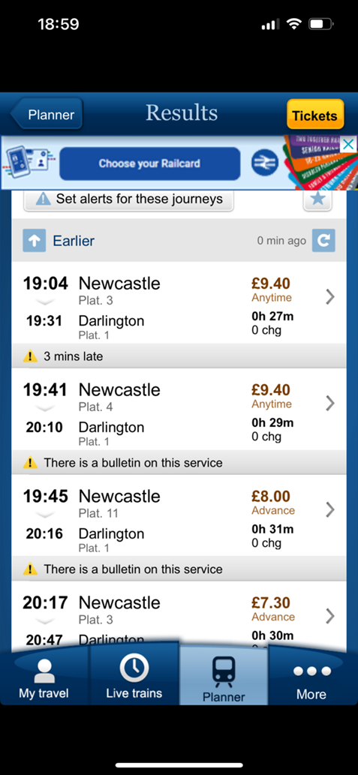


STATUS MESSAGES LACK THE DETAIL PASSENGERS DESIRE
Passengers express a preference for status messages containing specific information about their journey
The more specific the information, the more actionable and informative it is. For example, ‘3 minutes late’ is short, simple, manageable and easily understood, with the expectation the service will run a few minutes late with no knock-on effect to their journey. It sets up an expectation that there could be some minor disruption.
However, when faced with ‘There is a bulletin on this service’, passengers express more confusion and few, if any, understand what is meant by this message and – crucially – why it matters to them and to their journey. A “bulletin” could be a piece of information that has minimal if any real impact on their journey, it is not clear that passengers should investigate to find out more. It lacks clarity over what the issue is and the impact on the passenger.
“Say 3 minutes, that’d be fine to me, I’d just incorporate it into my plans for the day.”
North, Commuting, Additional requirements
“That’s not an alert, it should be normal.”
Wales, Commuting
Passenger Information During Disruption – Debrief

Slide 34
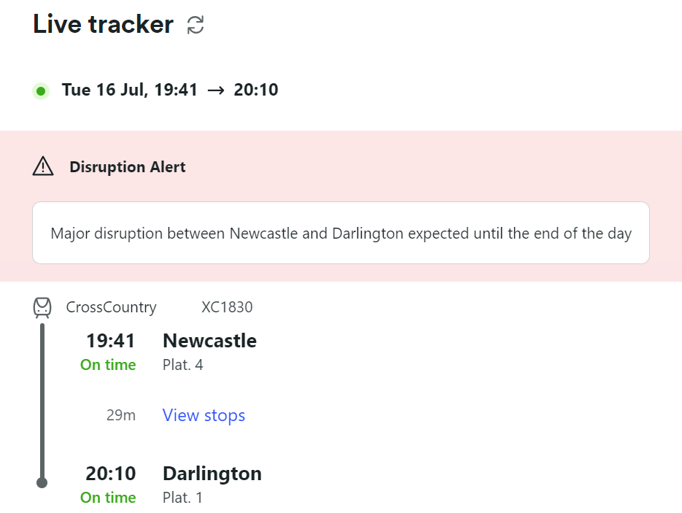
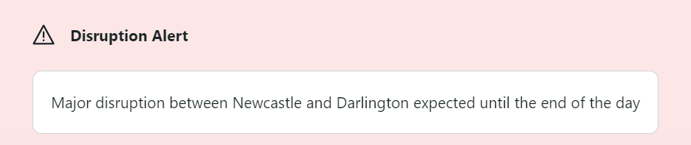
NON-SPECIFIC UPDATES CAUSE FRUSTRATION FOR PASSENGERS
At every state of the journey, when there is disruption, passengers expect to receive clear and concise information, which can help them make alternative arrangements if needed. Currently, many passengers feel they cannot plan effectively due to the lack of clear and easy to action information – or in some cases, access to any actionable information.
Passengers feel the red banner is eye-catching, though small, and some question whether this would be enough to draw their attention.
‘Alert’ draws passenger attention; however, there is still ambiguity around whether the train might be running or not.
Major disruption: Passengers understand the reason is significant to their journey however, it gives no indication of how the line might be disrupted.
“I’d read it, but sometimes it can be a bit misleading in the sense of it says disruption, but it doesn’t actually affect your journey.”
South, Business
“That’s quite vague though…from what I can see there, the actual start and end time doesn’t appear.”
Wales, Business/Personal
“Because of my eyesight problems… I’m not sure it would be possible but to have an audio of this message when I hover over it.”
London, Leisure, Additional requirements
“There’s a timeframe rather than just something that’s completely open-ended.”
London/South, Commuting
Passenger Information During Disruption – Debrief

Slide 35
ADVANCE WARNING IS WELCOMED, BUT A WARNING SIGN IS NOT ENOUGH ON ITS OWN
“That’s not an alert, it should be normal.”
Wales, Commuting
On time
“I find that quite misleading for it to say, ‘on time’, with a warning.
Scotland, Commuting
On time is considered confusing when combined with the warning triangle. The triangle can sow seeds of doubt for passengers and create anxiety and at worst can be considered misleading. Some passengers claim they will focus only on the “on time” message and ignore the warning sign, the most important thing is their train is running, which it currently is stated to be.
“I can trust potentially delayed… because they’re acknowledging something’s happened, there’s an alert.”
Wales, Commuting
Potentially Delayed
“Gives an advanced warning in case there is a delay.”
Scotland, Commuting
Potentially delayed is received well, passengers feel it provides an advance warning that there could be potential future issues, although felt it must be made as clear as possible there is more information yet to come. This also allows passengers the opportunity to assess an alternative route to their destination if they are concerned about the impact of a potential delay.
Passenger Information During Disruption – Debrief

Slide 36
AMBIGUOUS UPDATES CREATE ANXIETY FOR PASSENGERS
“There’s a bulletin on this service and I don’t really know what that means…”
South, Commuting
There is a bulletin on this service
There is a bulletin on this service is not immediately understandable to passengers, raising concerns about the service they are using for their journey. This status alert also raises questions around where to look for the information needed and if the message means their service will be cancelled.
Overall, passengers report this to be unhelpful due to the lack of detailed information available.
“It’s more annoying for them to say that and not explain the politics.”
Wales, Commuting
Currently On Time
“…it’s a bit ominous, like something is going to happen and it’s not going to be on time anymore.”
Wales, Commuting
Similarly to ‘on time’, when combined with the warning symbol passengers feel it is a confusing message as it has a degree of ambiguity and uncertainty which is unwelcome. It can lead to passengers questioning whether any ‘on time’ train would be delayed. Some passengers suggested that paired with a green triangle it may be less confusing and provide greater reassurance.
In contrast to being given a warning that a train may not be on time, passengers were less tolerant of the suggestion that operators could similarly warn (on the day) that a train might not run at all.
The uncertainty that this could create, would lead some passengers to question the competency of the operator (with a mindset of “surely they should know if it’s going to run or not”) and create an expectation that the service will be cancelled.
Passenger Information During Disruption – Debrief

Slide 37
“UNCERTAIN” HAS THE POTENTIAL TO CAUSE CONFUSION
“It just sounds really incompetent and really winds me up.”
South, Commuting
Uncertain
“I’d rather they were just honest and said, ‘we don’t know’.”
South, Commuting
Passengers unanimously dislike ‘uncertain’, feeling it is not only uninformative but (at worst) unhelpful and ambiguous. It lacks a sense of clarity and consistency and prevents the passenger from planning their journey.
It gives passengers no indication of timeframe or firm decision about their service, therefore lacks the information desired. Passengers report it feels as if the TOC does not know the status of the train and raises questions of competency; ‘Uncertain’ also creates the expectation service would be cancelled eventually.
A very small minority of leisure travellers are unphased by “uncertain”, reporting that as they plan a time buffer it would not be an issue or are happy to wait, they would simply use an earlier service and be mindful of changes on the return journey.
“To me that could mean anything, just don’t go near it… I’d expect it to be cancelled.”
North, Leisure, Digitally disengaged
“It means everything and nothing… just like toss a coin if we think it’s going to go on time…”
Wales, Commuting
Passenger Information During Disruption – Debrief

Slide 38
WARNINGS OF DELAYS MUST COME AS SOON AS POSSIBLE
“If it came up that it was going to be uncertain, you’re probably going off. I need to get home…unless it becomes an actual problem within 15 minutes of the actual train…you’re just giving people unnecessary worry.”
Wales, Business/leisure
“I also think that it needs to be really specific because most of the time when you're looking for this information, it's because you're probably already on the platform, we're already on a train. So, you need to just have the information straight away.”
South, Leisure
This advance warning allows passengers to swiftly assess their options and complete their journey with as little disruption as possible.
Passenger Information During Disruption – Debrief

Slide 39
STATUS UPDATES SHOULD HELP THE PASSENGER MAKE A DECISION
The three “rules” of communication can be applied to status updates, not just general communications.
“Uncertain” struggles against each of these three criteria.
Is it clear what the status is?
Ensuring the message is as clear as possible so the passenger can “work with it” and make and informed choice about how they can best complete their journey and what is likely to happen next.
Is the status concise and easy to understand?
Passengers need to be able to absorb the information quickly, especially when in a rush, or on the move.
Simple and concise language can help avoid ambiguity and confusion.
Is the status update consistent?
Passengers appreciate a consistent message about why their service is delayed or disrupted and what the likely outcome will be.
Conflicting information can prevent passengers from making a decision.
“It’s information that you can do something with… At least you’ve got something to work with and your expectations are set in the right place.”
South, Commuting
“If it’s cancelled that’s fine. I know what I need to do. I need to make alternative arrangements.”
South, Commuting
“I like to know what the delay is for… Oh there’s trespassers on the line…that makes me think oh my goodness, that’s quite serious.”
South, Commuting
Passenger Information During Disruption – Debrief

Slide 40
CONTENTS
1 | BACKGROUND, OBJECTIVES AND METHODOLOGY | 3
2 | EXECUTIVE SUMMARY | 9
3 | THE “RULES” FOR ENGAGEMENT | 13
4 | CHANNEL USE | 21
5 | THE LANGUAGE OF DISRUPTION | 31
6 | TICKET ACCEPTANCE | 40
7 | SPECIFIC INTERVENTIONS | 47
8 | APPENDIX | 59
© Quadrangle 2024 internal

Slide 41
SOME AUDIENCES ARE MORE FAMILIAR WITH TICKET ACCEPTANCE AND HOW IT WORKS THAN OTHERS
These differences were observed qualitatively and have not been sized or quantitatively validated.
There are variations between audiences, with prior experience being the main driver of a passenger’s understanding overall.
Rural stations, single TOC
Transport hubs, multiple TOC
Infrequent B/L travellers
Leisure travellers
Business travellers
Regular commuters
Passengers in Scotland
Passengers in Wales
Passengers in England
Least familiar and lowest level of understanding
Most familiar and highest level of understanding
Passenger Information During Disruption – Debrief

Slide 42
SOME AUDIENCES ARE MORE FAMILIAR WITH TICKET ACCEPTANCE THAN OTHERS
These differences were observed qualitatively and have not been sized or quantitatively validated.
There are variations between audiences and past experience is the main driver of understanding overall.
Geography plays a role
Passengers in Scotland and Wales appear significantly less familiar with Ticket Acceptance.
This is potentially because there is one dominant operator in the region, with fewer alternatives than there are in parts of England, even if some of those are local bus routes.
TOC or Route availability
Those whose priority station is a smaller station which is only served by one TOC tend to be less familiar with ticket acceptance.
Those who travel through major transport hubs or have multiple options to complete their journey appear to be significantly more familiar (e.g. London Stations, Birmingham New Street, Manchester Piccadilly).
Frequency of travel
Commuters and those who travel more frequently appear to be more familiar with ticket acceptance or more likely to have an understanding of alternative routes or ways to complete their journey.
Leisure and more occasional business travellers need more help and support to complete their journey during ticket acceptance.
Passenger Information During Disruption – Debrief

Slide 43
TICKET ACCEPTANCE LANGAUGE DOES NOT PASS THE “RULES” OF COMMUNCATION
1.
Be clear
2.
Be concise
3.
Be consistent
Not always clear what is meant by “ticket acceptance”, not everyone is familiar with the phrase.
“Reasonable route” is not clear and actionable.
Often long and complex explanations or information provided that can overwhelm and cause further misunderstanding.
A more consistent approach to ticket acceptance language and when it in effect could help avoid passengers feeling like they need to take matters into their own hands.
Passenger Information During Disruption – Debrief

Slide 44
TICKET ACCEPTANCE LANGAUGE DOES NOT PASS THE “RULES” OF COMMUNCATION
Video of highlight quotes inserted here
Ticket acceptance could be made significantly clearer for passengers including:
What they need to do
Where they need to go for information
How they can complete their journey as quickly as possible
Better terminology with less jargon, more customer-friendly language
Passenger Information During Disruption – Debrief

Slide 45



STAFF ARE CRUCIAL TO COMMUNICATING TICKET ACCEPTANCE
For less familiar journeys and infrequent travellers, staff are essential to provide reassurance and information about what to do.
A stressful situation where you “just need a human”.
COMMUNICATION METHOD:
Face-to-face at the station (platform staff, concourse, information desk) or on the train.
PURPOSE:
Providing passengers with personalised guidance on how to complete their journey.
Offering reassurance and clarity.
Providing instructions for delay repay or any cost implications of alternative routes/ ticket acceptance.
Confirming a “reasonable route”.
COMMUNICATION METHOD:
Public address system announcements at the station or on the train.
PURPOSE:
Updating passengers that ticket acceptance is in operation.
Providing general guidance as to the alternative routes for major stations impacted by disruption.
Advising passengers on where or how to find out additional information.
Providing general information on the timing of ticket acceptance.
COMMUNICATION METHOD:
Online route planners and apps e.g. Trainline, TOC specific apps.
PURPOSE:
Notification that there is significant disruption.
Exploring alternative routes i.e.. by putting in their start and end station and comparing length of time to complete and number of changes.
However, often lacks confirmation that a route is “reasonable” or if ticket acceptance is in place.
Passenger Information During Disruption – Debrief

Slide 46
NB: please be aware the respondent is speaking about a planned disruption event
“When I was disrupted trying to get back from Birmingham Airport, I missed the rail replacement bus, and the next bus wasn't for two hours and that was a ridiculous wait. Now, in the meantime, I could have got, I don't know, four or five trains out of Birmingham Airport and gone all sorts of places…But because I wasn't able to categorically check my ticket would be valid and I didn't want to buy a new ticket to do this, it wasn't an option for me. And I really wish it had been an option because I was just sat there for two hours waiting for a bus which then took an hour and then I had to get 2 trains…I also feel like maybe people would rely on the trains more and buy more train tickets and use it more if they knew that if there was a disruption, you can use your ticket to do what you need to do to get as close to where you need to go.”
(South, Leisure)

Slide 47



OTHER SOURCES OF INFORMATION CAN COME INTO PLAY
However, they appear less trusted or potentially less reliable or helpful during ticket acceptance.
COMMUNICATION METHOD:
Other passengers more familiar with the journey or route.
PURPOSE:
A “safety in numbers” approach or simply following the crowd during disruption.
Able to ask others for advice or help, including planning an alternative route.
“Someone told me” information passing from members of staff to passengers through the platform or the train.
Clarifying a partially missed announcement.
COMMUNICATION METHOD:
Passenger Information Systems.
PURPOSE:
An update on an electronic board, either on the train or on the station.
Often limited in terms of the information other than ticket acceptance is in use.
Few, if any, recall receiving actionable information about ticket acceptance via PIS.
“It’s never been communicated to me, but I usually just cross my fingers and hope for the best or ask someone at the station or just deal with it when I’m there and plead my case.”
South, Business
Passenger Information During Disruption – Debrief

Slide 48


PASSENGERS FALL INTO TWO DISTINCT GROUPS DURING TICKET ACCEPTANCE
Passengers are likely to respond in two ways when ticket acceptance comes into action.
Passengers who are willing to take risks will…
Proceed on any route they deem appropriate to get to their destination, often feeling it is their ‘right’ to get on any service if they have paid for a ticket
Accept and can afford the likelihood of ticket charges if ‘caught’ on a service not indicated
Likely to be business travellers with a good knowledge of route options which may or may not be appropriate at times of disruption
Passengers who are risk adverse will…
Wait for a correct train regardless if they are unsure if information is correct
More likely to be cautious of incurring additional charges and are anxious of getting it wrong
Likely to see further information from station or train staff before travelling
Likely to be travelling for leisure perhaps with less route knowledge
“Right, you’ve delayed me, so I’m taking another route and that should be ok. I deserve to go on that other train.”
South, Commuting
“I could’ve got 4 or 5 trains in that time going to all different places…but because I wasn’t able to categorically check my ticket would be valid…it wasn’t an option for me.”
South, Leisure
Passenger Information During Disruption – Debrief

Slide 49
PASSENGERS APPRECIATE SIMPLICITY AND SPECIFICITY DURING TICKET ACCEPTANCE
Of the language explored, there are some areas of confusion, and potential for simplification.
The key information to include is the key stations impacted so passengers can identify it is their train and make a decision about what to do.
Clear and specific with the key stations named for ease of understanding of the route impacted
Passengers do not expect to pay additional costs should they need to take an alternative route to complete their journey
You can use your ticket at no extra cost on:
Alternative Avanti services via any reasonable route
Alternative London Northwestern services between Milton Keynes and London Euston
Ticket acceptance is in place with:
Avanti between Milton Keynes and London Euston in both directions.
Great Northern via any reasonable route.
Both until further notice.
Helpful to know that it is “until further notice” but most assume it would be in place until told otherwise during disruption
The term “mutual ticket acceptance can be confusing
Those unfamiliar with the names of TOCs and who operates which trains prefer to focus on key stations
To assist you with your journey your London Northwestern ticket will be accepted, at no extra cost to yourself, on the following services:
Mutual Ticket Acceptance is in place between Avanti and London Northwestern on services between London Euston and Milton Keynes
Listing specific services provides reassurance and clarity over which route can be taken and is considered reasonable by the TOCs
Overly convoluted and hard to read, understand and interpret. A concise and simple message would be appreciated.
Customers travelling between Milton Keynes and London Euston (in either direction) may travel on Avanti services instead on which their London Northwestern tickets will be accepted.
You may use your ticket on First Berkshire & The Thames Valley No 8
Assumes the passenger is familiar with local bus services, ideally needs to say this is a local bus service and where the bus can be located
Passenger Information During Disruption – Debrief

Slide 50
KEEP COMMUNICATION AS SIMPLE AS POSSIBLE
There are times where large amounts of information need to be communicated. Keeping the information as concise as possible is appreciated, potentially using bullet points or lists to help break up text.
“I want a clear, concise list of what I can do and in writing that it has no extra cost”
Wales, Commuter
During moments of high stress or frustration a simple message is appreciated and easier to understand
Passengers want messages that “get to the point” and tell them what they need to know to best complete their journey.
Messages that are overly complicated or “wordy” can cause more confusion, bullet points of key information, and a list of named stations or specific trains that are included could be helpful and help make large amounts of information feel easier to understand.
When passengers talk about language being “wordy” or “complex” sometimes they are referring to jargon and the language used being unfamiliar and hard to understand.
“It just seems like it’s really wordy and you don’t want to read an essay, you just want to get straight to the point.”
North, Business
“The wording is overly complicated”
North, Business
“You’re not going to understand what an advanced ticket or what the specific word, what it actually means. You need to Google the definition of the term, or at least I do sometimes.”
Wales, Commuter
“Bullet points, like a list. It’s easier to read”
Wales, Commuter
Passenger Information During Disruption – Debrief

Slide 51
“ANY REASONABLE ROUTE” NEEDS GREATER CLARITY
Multiple passengers admitted to taking alternative routes to complete their journey without knowing for certain if their route was technically permissible.
A “reasonable route” is interpreted as what the passenger considers to be a reasonable route
Passengers accept that their version of a “reasonable route” may, or may not, match what the TOC or the network consider reasonable, but their priority is getting to their destination as quickly as possible, with as little additional disruption as possible.
Few, if any, are sure where they can go for clarity rather than speaking to a member of staff and during disruption there may be too many passengers to handle each individual query, and it will take time which could lead to a further delay in their journey.
For those taking familiar journeys where they know an alternative route, most default to the option they know, rather than checking for alternatives.
“I just wing it to be honest.”
South, Leisure
“I’d take the risk and be prepared to argue my case with a ticket instructor if I need to.”
Scotland, Business/Leisure
“Any reasonable route is a little bit worrying to me. I’d wonder is this route reasonable? Is the ticket inspector going to think the route is reasonable too?”
South, Business
Passenger Information During Disruption – Debrief

Slide 52
INFORMATION ABOUT TICKET ACCEPTANCE ENDING CAN CAUSE CONFUSION
Passengers do not expect to always be told that ticket acceptance was in place earlier in the day but has now ended.
Giving clear guidance as to when ticket acceptance is ending needs to be based on “trains/services due to leave before xxx” rather than “until xxx”
This provides greater clarity if the journey the passenger is planning to take is covered by ticket acceptance or not as they know if their journey is due to start before the cut off time.
Saying “until” a specific time can be confusing – does it count if you are there earlier and have been waiting, or if your train was due to leave before but is then later delayed leaving the station? It can raise more questions than it answers.
Saying “services are returning to normal but subject to delays” can feel contradictory. Knowing there was an earlier delay can explain why services are busier than expected but can be more information than really needed.
“I would expect that if for any unforeseen reason that is not your fault, that if you cannot get home for the night, that the ticket would be valid for the following day also.”
Scotland, Business/Leisure
“Disruption can be so bad sometimes they can’t know; trains end up in wrong places and all sorts to put any timings together.”
Wales, Business/Leisure
“It’s still a bit vague [about “until further notice”], so it’s not telling you until the end of the day or end of the week, but it’s still live.”
Wales, Business/ Leisure
Passenger Information During Disruption – Debrief

Slide 53
CONTENTS
1 | BACKGROUND, OBJECTIVES AND METHODOLOGY | 3
2 | EXECUTIVE SUMMARY | 9
3 | THE “RULES” FOR ENGAGEMENT | 13
4 | CHANNEL USE | 21
5 | THE LANGUAGE OF DISRUPTION | 31
6 | TICKET ACCEPTANCE | 40
7 | SPECIFIC INTERVENTIONS | 47
8 | APPENDIX | 59
© Quadrangle 2024 internal

Slide 54
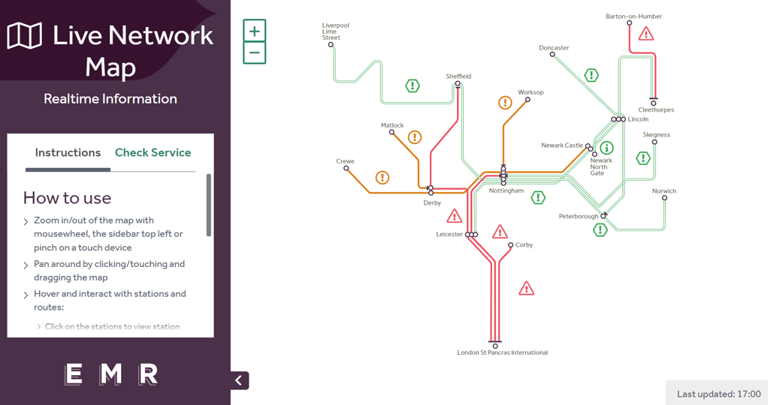
LIVE MAPS
What’s working?
Whilst the majority had not used one before, a live map was liked and appreciated for different situations – if the passenger had lots of time before their trip to inspect this, if it was a more unfamiliar route, a longer route and if they wanted to find out additional information at a particular station (e.g. access facilities)
More likely to be used in advance of a trip with passengers saying it would be very helpful for planning ahead, with the key highlighting upcoming disruption a big hit
What’s not?
There were some concerns about whether it would work well on a mobile, if wi-fi was needed to access the content and if it would be suitable for those who are less digitally savvy
Initially, it was confusing and overwhelming for some as it covered areas they were not familiar with
What this means for communicating with passengers during disruption?
Whilst passengers grasp the idea of a live map, awareness of them needs to be improved as the content was generally liked
“I wish something like this had been available when I used a wheelchair/walker, the tab where you click on the station for accessible access has lots of helpful information.”
England, Leisure
“I like the idea of this but not sure how user friendly this would be for those who are not digitally confident.”
England, Commuting
Passenger Information During Disruption – Debrief

Slide 55
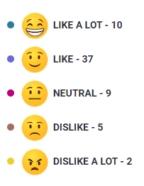
DISRUPTION VIDEO – NON-AI
Pre-task emoji “score” of the video
Passengers were shown a test-case short video which included a presenter explaining up-coming engineering works and expected disruption
What’s working?
The personable nature, interactivity and animated presenting style appealed to passengers
The circling of parts of the map where the disruption is going to be was appreciated as it helped them to understand if their routes were going to be affected
There was a consensus that this video was very clear and informative, all points made by the presenter were easy to follow
What’s not?
There was a concern that it was presented in the same style as a weather report which was distracting and off-putting for some in terms of the tone and style e.g. the presenter moving around the screen and covering the map at times
Due to lots of information being provided, some wondered whether a bullet point summary highlighting key points could be shown to help passengers consolidate information
What this means for communicating with passengers during disruption?
A format and style that balances maintaining engagement but also not overwhelming passengers with detail is needed
“I liked how animated he was and the circling of stations helped draw your attention to the stations affected.”
Scotland, Commuting
“Having a real person interact makes the information more accessible and personal.”
England, Business
“Felt like I was watching a weather report.”
Wales, Commuting
Passenger Information During Disruption – Debrief

Slide 56
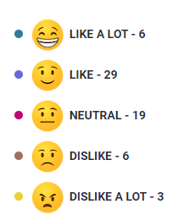
DISRUPTION VIDEO – AI
Pre-task emoji “score” of the video
Passengers were less likely to rate the AI video highly compared with the non-AI video
Passengers were shown a test-case short video which included an AI generated presenter explaining up-coming engineering works and expected disruption
What’s working?
Passengers like how clear the information was, using different colours to highlight the changed routes and affected stations
Passengers also recognise that information may be able to be generated and updated more quickly using AI which is liked
What’s not?
There is a lack of trust and human interaction with the AI video. Passengers say it has a ‘robotic style’ that is a bit distracting. Some have also had experiences where AI has been used in the wrong way to impersonate celebrities and people on social media
Similar to the non-AI video, a lot of information was provided which led to a cognitive overload for some
What this means for communicating with passengers during disruption?
AI videos should be used where situations are rapidly changing so that information can be updated and communicated quickly
To avoid alienating passengers, a mix of AI and real human interaction is needed to build better trust between the information source and passenger
“It’s very informative and quite clear on the instructions needed to travel during disruption.”
England, Business
“[Benefits] Saves time, it’s quicker to get information out.”
England, Business
“Not trustworthy, a lot of negativity attached to AI on social media.”
Surrey, Commuting, Additional needs
Passenger Information During Disruption – Debrief

Slide 57
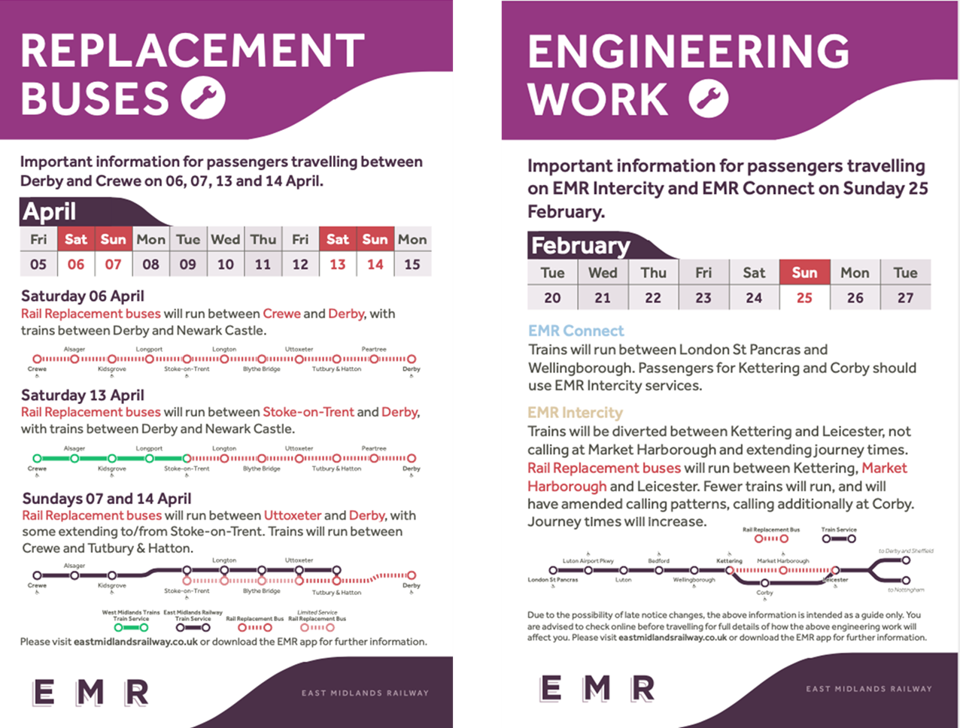
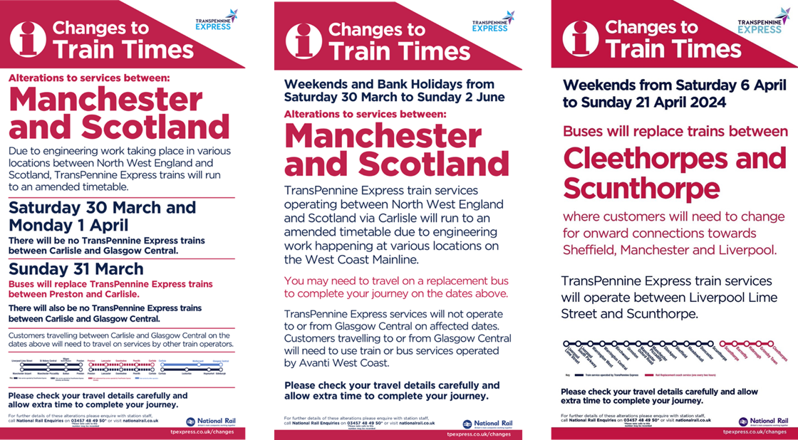
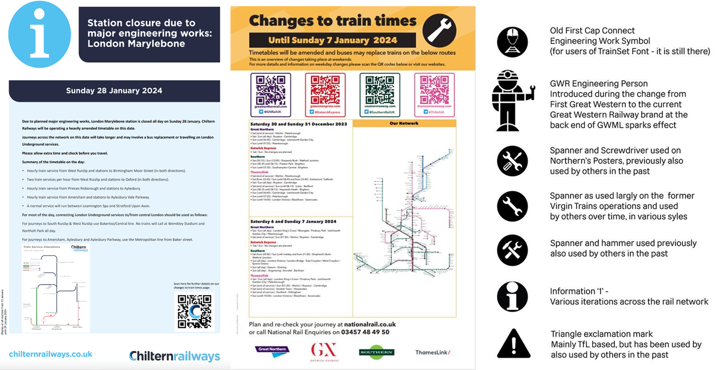
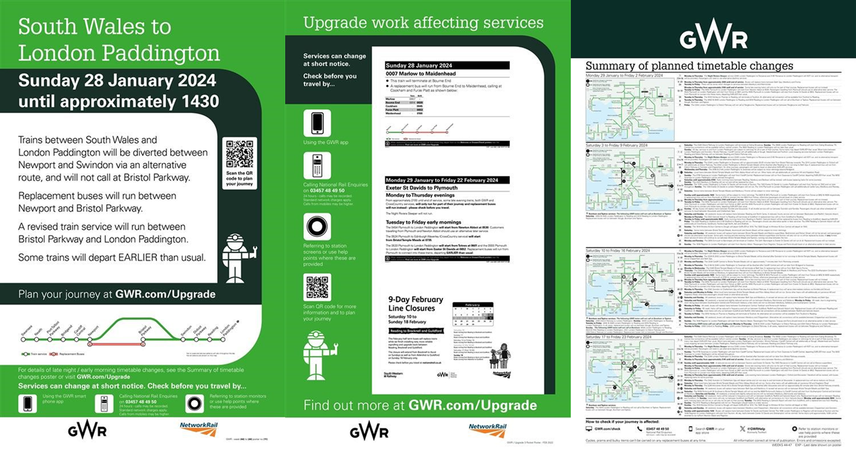
EXISTING POSTER DESIGN
What’s working?
Passengers are able to easily recognise which dates and routes are affected by disruption as the relevant information is in bold and bigger font size
There is appeal for a QR code as it allows passengers to ‘take the information with them’ once they have scanned so that they can continue with their day
The simplified rail diagrams provide a visual on impacted routes which is highly useful for those who engage with this
What’s not?
Some feel as though the posters are too ‘cluttered’ which is making it difficult for passengers to pick out the important or relevant information
There is a concern that a level of adjustment would be needed each time a passenger encounters a different poster for a different TOC
Many agree that certain language used is too vague e.g. ‘some trains will depart earlier’ and ‘journey times will increase’ causing frustration as passengers are not able to plan their journey properly
“The fact these all show info in a different way would make planning a journey across operator services difficult. Can this not be standardised in some way?”
England, Commuting
“The QR code taking you directly to where you can plan your journey instead of typing out a long link is helpful.”
England, Leisure
Passenger Information During Disruption – Debrief

Slide 58
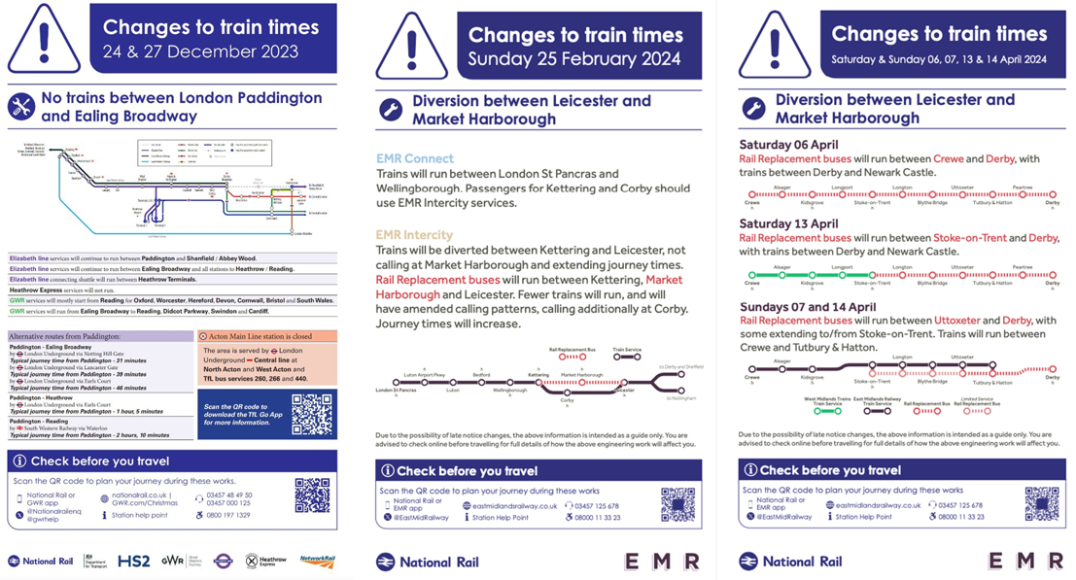
NEW POSTER DESIGN
What’s working?
The first element of the poster that is noticed and admired is the warning triangles as they alert passengers that this is important information and draws their attention
Again, there is appeal for the QR code at the bottom of each example
A consistent poster design reduces the customer effort so that they can easily and quickly find the information they need to help them plan their journey
The alternative routes suggested provide useful information to those who may be unfamiliar with the journey that has been affected and show that there has been some effort from the train company to remedy their inconvenience
What’s not?
For some, the use of the colour blue did not stand out as a warning/alert message about disruption, making them attach less importance to the message
Again, passengers dislike that there are too many words and elements on the poster as it becomes longer to read and harder to pin-point relevant information
“The warning signs/symbols at the top highlights that this is important information I should not miss.”
England, Business
“There is a uniformity across them all, so I am not having to work out where the key info is each time.”
England, Commuting
“The blue colour makes it seem like ordinary information.”
England, Business
Passenger Information During Disruption – Debrief

Slide 59
COMPARISON OF POSTER DESIGN
The current vs. the new poster is polarizing, with passengers finding positives about both types. The pre-task results suggest a mixed view.
Preferred poster
Existing
New
“The current posters stand out more because they correspond to the train operators livery colours.”
England, Leisure
“Text was bigger in the current – easier to read, no info overload.”
England, Leisure
“If everybody uses the same style and form then it creates a lot less confusion.”
England, Leisure, Additional needs
“The new design looks more official and draws my attention to the fact there are disruptions. More cohesive design and less playful colours.”
Wales, Commuting
“A lot easier to extract information.”
England, Commuting
“More distinctive.”
England, Business
“If I was not familiar with the journey affected and I needed to find out what was happening, I would find it much easier to quickly check the info on the current format.”
England, Leisure
“Uniformity is good – quick to read and a familiarity as to where info is located.”
England, Commuting
“More consistent – helpful for multi-operator journeys.”
England, Commuting
Passenger Information During Disruption – Debrief

Slide 60
THERE IS A NEED TO CONSIDER ACCESSIBILITY
Concerns were raised across all three interventions. It is worth keeping the needs of these passengers in mind as the ideas are developed further.
VISUAL NEEDS:
The use of coloured writing on a white background and some of the other colours used on the maps (e.g. blue and green) were hard to read and understand for those who are colourblind.
The volume of information on some of the posters can be hard to read if the font becomes too small or too fine which can be an issue.
“The amount of lines makes it more confusing, it’s hard to know what’s going on. It’s not colourblind accessible, I’m blue-green colourblind and this is so confusing.”
“Because of my eyesight problems…I’m not sure it would be possible but to have an audio of this message when I hover over it [would help].”
HEARING NEEDS:
The inclusion of BSL and subtitles in the videos was positively received and would make this information more accessible and feel inclusive.
However, there can be concerns over how clear public address system announcements are, even for those who use hearing aids or are only slightly (or somewhat) hard of hearing.
For warning messages about disruption on apps, there was a suggestion to have an audio when hovered over them.
“The commentary is audible and clear. The BSL interpreter is inclusive.”
NEURODIVERSE OR PROCESSING DISORDERS:
The volume of information can be overwhelming and hard to take in, especially for those with ADHD or APD.
Those with language processing disorders (e.g. dyslexia) appreciate the ability to have text alongside speech.
“I would really like to see some bullet point text information alongside what is happening and when, and a summary at the end. I have ADHD and the information presented in the video can be a bit overwhelming.”
“I’m severely dyslexic with a language disorder so having something written to speech would be fantastic.”
Passenger Information During Disruption – Debrief

Slide 61
THERE IS A NEED TO CONSIDER ACCESSIBILITY
Concerns were raised across all three interventions. It is worth keeping the needs of these passengers in mind as the ideas are developed further.
Video of highlight quotes inserted here
Accessibility needs and considerations are important and should, in theory, improve communication for all.
Passenger Information During Disruption – Debrief

Slide 62
CONTENTS
1 | BACKGROUND, OBJECTIVES AND METHODOLOGY | 3
2 | EXECUTIVE SUMMARY | 9
3 | THE “RULES” FOR ENGAGEMENT | 13
4 | CHANNEL USE | 22
5 | THE LANGUAGE OF DISRUPTION | 31
6 | TICKET ACCEPTANCE | 40
7 | SPECIFIC INTERVENTIONS | 47
8 | APPENDIX | 59
© Quadrangle 2024 internal

Slide 63

RESEARCH.
FOR DECISION MAKERS.
info@quadrangle.com
RESEARCH SKILLSET + CONSULTANCY MINDSET

