Slide 1
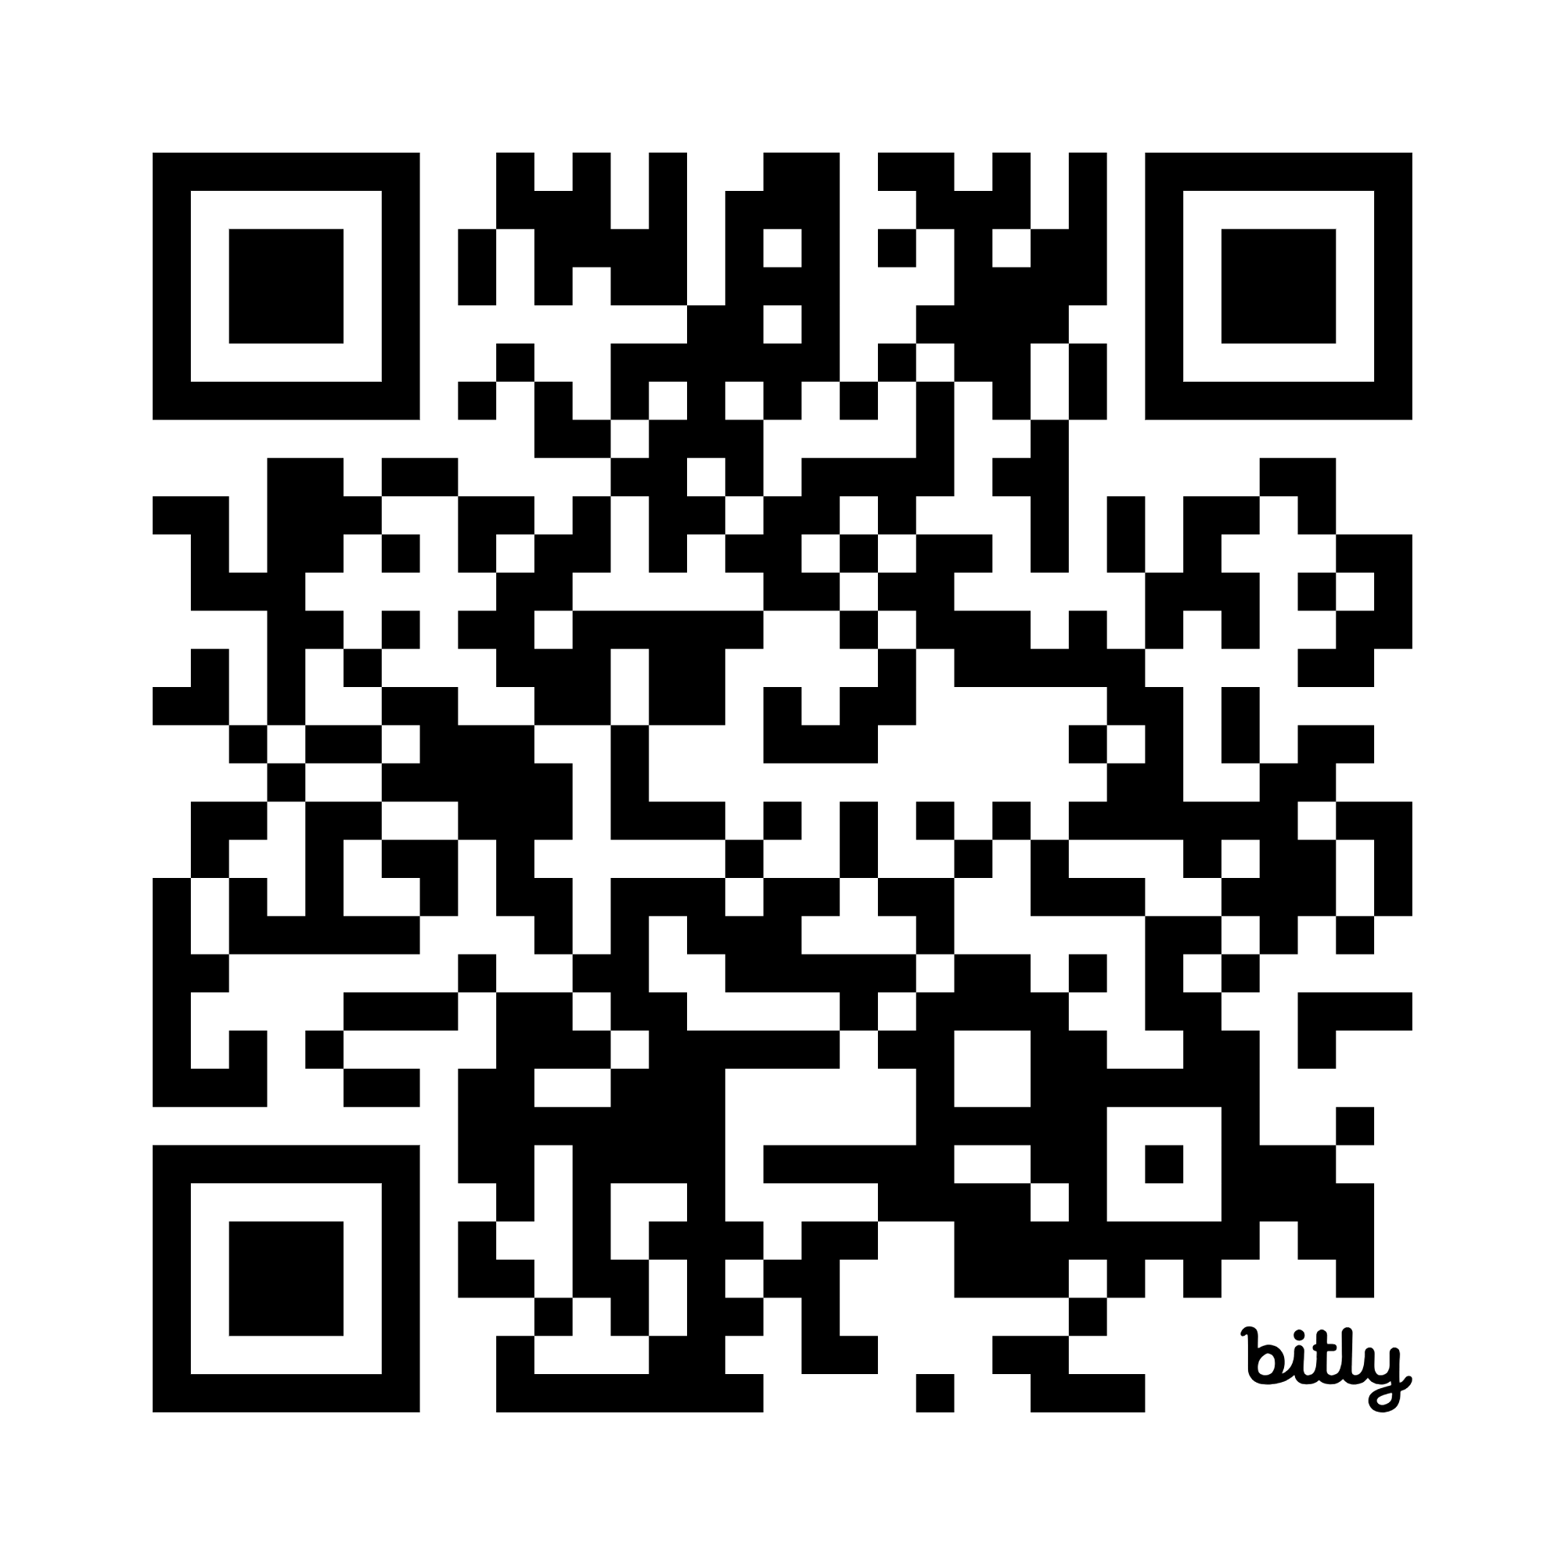
Making great bus journeys

Slide 2
Thousands of passengers tell us about their experience
48,000
Survey covers 55 local authority areas across Great Britain
(A further 33 still to join)
surveys
Represents 75% passenger journeys in England outside of London
All Scottish Regional Transport Partnerships and Welsh regions

Slide 3
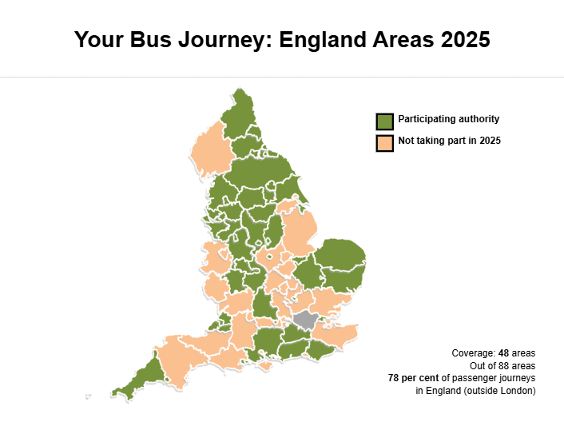

Slide 4
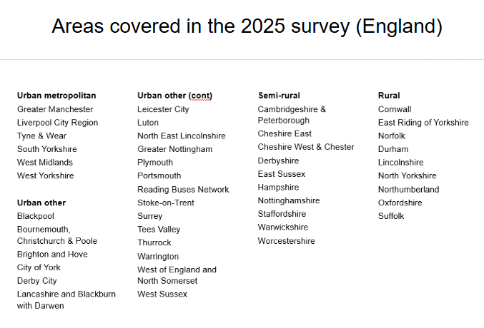

Slide 5
High levels of satisfaction but room for further improvement
83
86
84
England
Scotland
Wales
Overall journey satisfaction (% very or fairly satisfied) 2024
2023
80
86
N/A

Slide 6
England 2024 satisfaction results
Time the journey took
The bus driver
Punctuality at the bus stop
Overall passenger satisfaction with their bus journey that day
Value for money for fare payers
Waiting time at the bus stop
Bus stop
83%
87%
75%
83%
73%
72%
79%
81%
85%
70%
80%
67%
68%
76%

Slide 7
Scotland 2024 satisfaction results
Time the journey took
The bus driver
Punctuality at the bus stop
Overall passenger satisfaction with their bus journey that day
Value for money for fare payers
Waiting time at the bus stop
Bus stop
85%
90%
80%
86%
75%
78%
82%
83%
89%
81%
86%
68%
77%
80%

Slide 8
Wales 2024 satisfaction results
Time the journey took
The bus driver
Punctuality at the bus stop
Overall passenger satisfaction with their bus journey that day
Value for money for fare payers
Waiting time at the bus stop
Bus stop
84%
88%
77%
84%
62%
72%
77%

Slide 9
Overall journey satisfaction by area type (in England)
86
88
86
80
Rural
Semi-rural
Urban (other)
Urban Metropolitan
Overall journey satisfaction (% very or fairly satisfied) 2024

Slide 10
Some local authority areas to celebrate – most improved since 2023
East Sussex
County Durham
87%
82%
Up
Up
Warrington
8%
Derbyshire
7%
85%
91%
Up
Up
8%
7%
Overall journey satisfaction (% very or fairly satisfied), 2024

Slide 11
Some examples* of areas where we’d particularly like to see satisfaction improve
77%
West Yorkshire
(ranked lowest metropolitan area, and lowest overall in England)
80%
Luton
(ranked lowest Urban (other) area in England)
80%
Northumberland
(ranked lowest rural overall in England down 3% from 2023)
79%
South Yorkshire
*We are working hard with all local authorities to drive improvements - these are some key examples.

Slide 12
Key driver analysis: what really influences journey experience
What makes a good journey?
Drivers of being fairly/very satisfied with overall journey
Punctuality | Journey length | Bus driver | Value for money | Bus stop | On board security | Boarding the bus | Bus comfort | Bus environment
Circle sizes indicate the relative association with – and therefore, influence on – overall journey satisfaction

Slide 13
What stands out about good journeys?
Punctuality
“This bus is always on time. Allows me to get to work on time.”
The biggest themes in passengers’ unprompted feedback
Bus driver
“It was during rush hour but the driver was polite and didn’t brake too hard.”
Journey times
Capacity on board
“As a relative newcomer to public transport, it got me to where I wanted to go within 15 minutes.”
“Bus was a double decker which was great as it isn't always and gets very busy in the morning.”

Slide 14
What stands out about dissatisfactory journeys?
Punctuality
“…terrible, always late or doesn’t turn up …you have to set out 1 hour early to make sure you can get a bus.”
The biggest themes in passengers’ unprompted feedback
Capacity on board
“Single-decker bus instead of the usual double. This keeps happening at the busiest time of the day …passengers have to cram in.”
Frequency/hours of operation
Capacity on board
“The bus was very busy as there is only one bus an hour!! We definitely need two an hour.”
“Most of the bus drivers are rude. They don’t even say morning or afternoon. Sometimes they don’t even give you any eye contact.”

Slide 15
Disabled passengers have a poorer experience than others
82
85
Disabled
Not disabled
Overall journey satisfaction (%, 2024, all England)

Slide 16
Younger passengers report a poorer bus journey experience
77
83
89
16-25
26-64
65+
Overall journey satisfaction (%, 2024, all England)

Slide 17
Punctuality – passengers’ top priority
5%
up
Among the most improved aspects of bus service in England since 2023
…but still room to improve further
Satisfaction with punctuality (%, 2024, all England)

Slide 18
Passenger comments
“Usually this bus comes on time, but it gets crowed very quickly. Hard to find a space during busy hours which is unfortunate as it can mean that I might be late for work.”
“I was meant to take number 1 from the centre of town to Hospital. It never came, there were a lot of people stating that the 13.14 didn’t show up and the 13.29 didn’t show up either.”

Slide 19
Waiting time
72%
Satisfied with waiting time at the bus stop in 2024
29%
Waited longer than they expected to
66%
Wait less than 10 mins

Slide 20
What stands out about a good bus stop?
The biggest themes in passengers’ unprompted feedback
Information quality | Cleanliness / condition / presentation | Shelter / seating | Other
Circle sizes indicate the relative importance of each theme

Slide 21
Personal security
Some passenger groups feel less safe, and perceive more anti-social behaviour than others:
75%
Feel safe at the bus stop
younger passengers
disabled passengers
to a lesser extent, women
7%
Say other passengers made them feel uncomfortable

