Slide 1
Motorway and major ’A’ road diversions
Research report prepared for
Proposal
John Connaughton - CEO john.connaughton@illuminas.com
Andy Glazier, Director
Andy.glazier@illuminas.com
March 2024
illuminas.com linkedin.com/company/illuminas @Illuminas

Slide 2
A deep dive into diversion journeys
This document was created to supplement the findings of the larger ‘Motorway and Major ‘A’ Road Diversions’ research commissioned by Transport Focus. A deep dive into the ‘journey experience’ portion of the research, this document examines each of the 15 drives in detail and highlights the positive and negative feedback provided by the drivers.
15 Recorded Journeys
M11
2 nighttime drives near Harlow
A1
2 nighttime drives near Baldock
Information given to drivers:
Each driver was sent a dash camera and an information packet informing them of the start/end point of their journey along with basic driving instructions for the route.
To ensure we were not placing the participants under any undue stress, we informed them they would encounter a diversion somewhere along the route and requested that they follow the diversion signs until they got back on the main road.
We also requested that participants keep their SatNav off during the drive and that they avoid looking up the diversion route before their journey.
Participants were instructed to vocalise their thoughts during the drive, including their interpretation of diversion signs, any confusion or concerns about the drive and any positives about the journey.
A11
3 nighttime drives near Wymondham
A5
2 nighttime drives near Hinckley
A52
2 nighttime drives near Nottingham
M25
4 daytime drives near Woking
2

Slide 3
M11 diversion near Harlow

Slide 4
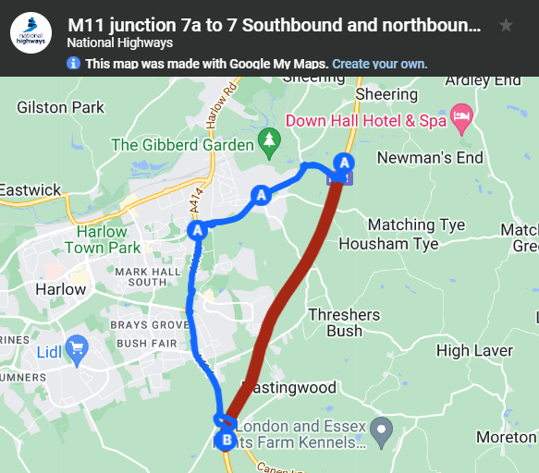
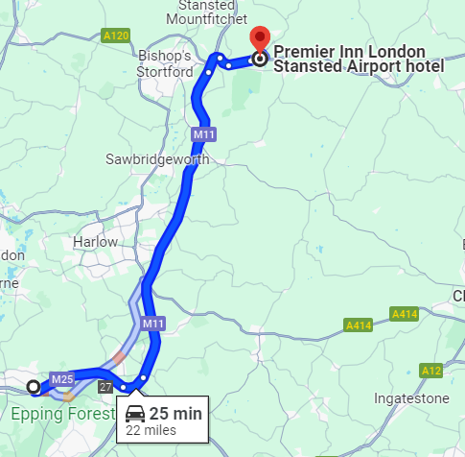
Overview of diversion:
Description of works:
“We’re doing essential resurfacing work on the M11 between junctions 7 and 8, this will include road markings, and studs. Once complete, drivers will benefit from a safer and smoother road surface.
We plan to complete this work in 4 phases over 5 months between Monday 19 February until the end of June. We will mainly work between 9pm to 6am on weeknights only, although some weekends may also be required, weather conditions permitting.”
Official diversion route:
Journey we asked participants to make:
Description of works and diversion route provided by National Highways: M11 junction 6 to 13 maintenance work - National Highways

Slide 5
M11 diversion: overall, a good diversion route with some points for improvement
Both drivers for the M11 diversion felt the diversion route was well selected, not taking too much extra time. The route was well lit, had access to petrol stations, and had frequent signage. The first driver was unfamiliar with the circle symbol used to represent the diversion which caused some confusion. There was one sign in particular (pictured below) that both drivers felt to be ambiguous, where the circle symbol was placed between two exits. Some additional signs at the final two roundabouts, and a sign indicating the end of the diversion would have also been appreciated.
Positives:
Frequency of diversion signs
Access to petrol stations along the
diversion route
Well lit diversion route
The diversion route did not take too
much extra time
Negatives:
Drivers not knowing what the circle symbol indicates
Some signs had the diversion symbol in an ambiguous place between two exits
A lack of signs at the final two roundabouts
No sign stating that the diversion is over and you are back on the normal route
5

Slide 6
A1 diversion between Biggleswade and Baldock

Slide 7
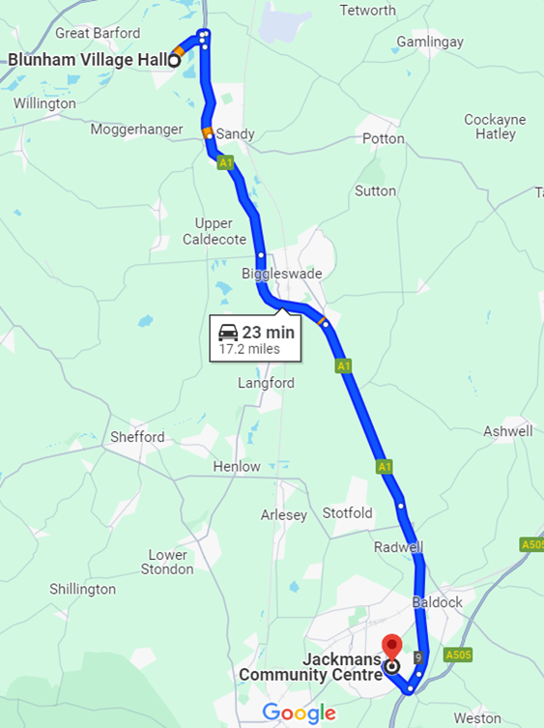
Overview of diversion:
Journey we asked participants to make:
Official diversion route:
“To do the work safely, we will need to close the A1 in one direction at a time, and divert traffic as follows:
Drivers going northbound will exit the A1M at Stotfold, take the A507 Ampthill Road westbound, then the A6 northbound at Clophill. Follow the A421 eastbound from Elstow Interchange, then exit onto the A603 Sandy Road and Bedford Road eastbound to rejoin the A1 at Sandy.
Drivers going southbound will follow this diversion in reverse.”
Description of works:
“We’ll be resurfacing the A1 northbound between A1(M) junction 10 (Stotfold) and Biggleswade South from Monday 4 March to Thursday 3 April overnight between 8pm and 5am, weeknights only, weather permitting.”
Description of works and diversion route provided by National Highways: A1 Biggleswade North to A1(M) Junction 10 Stotfold resurfacing - National Highways

Slide 8
A1 diversion: a good route with a need for more signs
While both drivers agreed the route chosen for the diversion was good, with reasonable lighting and frequent diversion signs along the route itself, they also felt more signs should have been used prior to the start of the diversion. Given that the diversion route was along a single carriageway road, the inclusion of ‘no overtaking’ signs would have been appreciated to ensure the safety of the drive. Finally, while both drivers knew they were meant to be following the triangle symbol, there was one point where multiple diversion routes merged, causing some confusion.
Positives:
Frequency of diversion signs
Well placed diversion route
Well lit diversion route
A ‘diversion end’ sign indicating the end of the diversion
Negatives:
No warning sign for the diversion
Obscured diversion signs along the route
Confusion over the merging of multiple diversion routes resulting in 3 different symbols being used
A lack of ‘no overtaking’ signs along the diversion route
8

Slide 9
A11 diversion between Wymondham and Attleborough

Slide 10
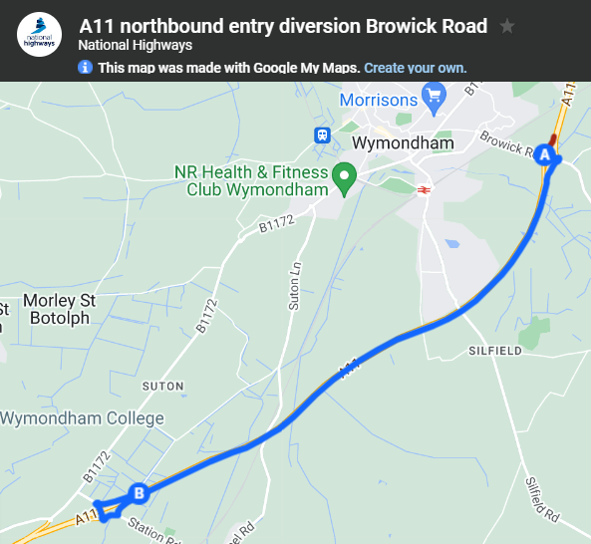
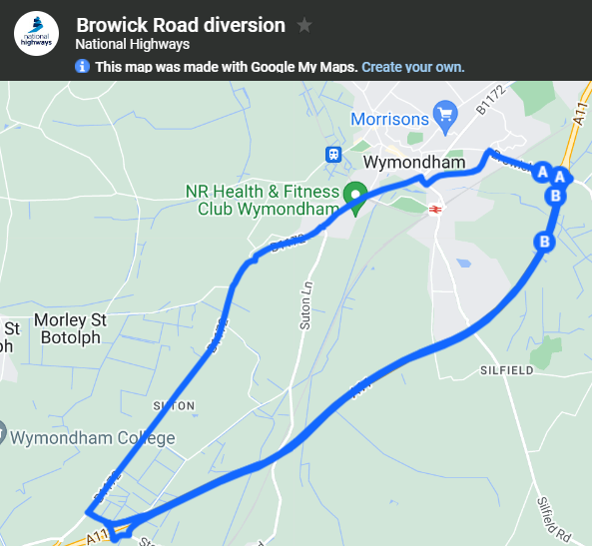
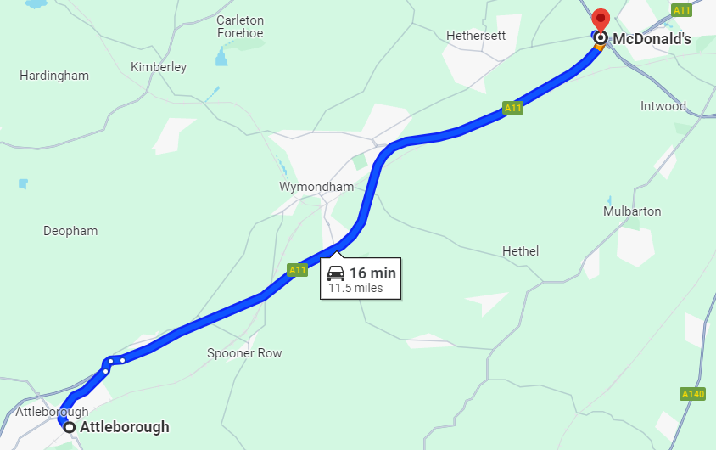
Overview of diversion:
Official diversion routes:
Description of works:
“We are starting work on replacing the street lights at the junctions of Tuttles Lane, Browick Road and Spooner Row Interchanges. We're changing the lights to LED ones which are more efficient and greener.
The work will take around six weeks, starting on Monday 19 February. We will be working overnight between 8pm and 6am, weather permitting.”
Journey we asked participants to make:
Description of works and diversion route provided by National Highways: A11 Thetford to Norwich maintenance and LED lighting upgrade - National Highways

Slide 11
A11 diversion: a late setup with obscured and confusing signs
Unfortunately, two of our three drivers completed their drive before the diversion route was fully set up despite starting the drive over an hour after the National Highway website stated the diversion would be in place. The one driver that did encounter the diversion had a difficult time of it—driving for over two hours and getting lost multiple times. While signs were frequently placed on the route itself, they were often insufficiently in advance of the diversion route, causing the driver to nearly miss turns. Our driver, who entered the route heading south only saw directions leading them to re-enter the A11 on the opposite side to drive north. This led our driver to drive in continuous circles.
Positives:
Conveniently placed diversion route
Well lit diversion route
Negatives:
Signs seemed to redirect drivers to the incorrect direction
Signs were small and easily missed including one hidden behind a larger sign
A lack of signs in advance of the diversion (southern side)
A lack of signs stating where the route would bring them
11

Slide 12
A5 diversion near Hinckley

Slide 13
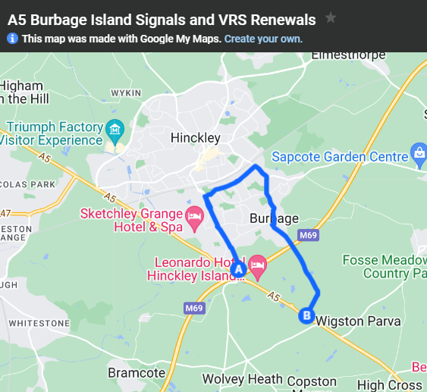
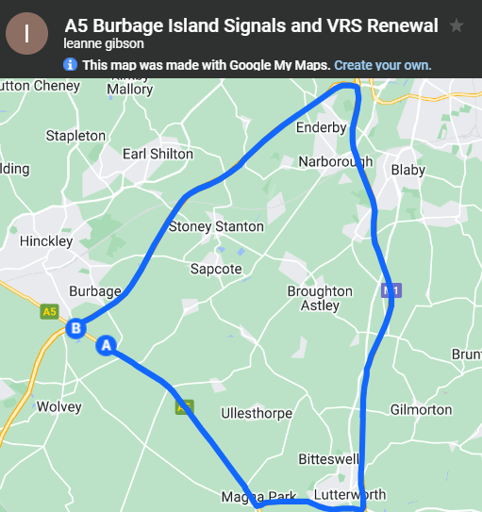
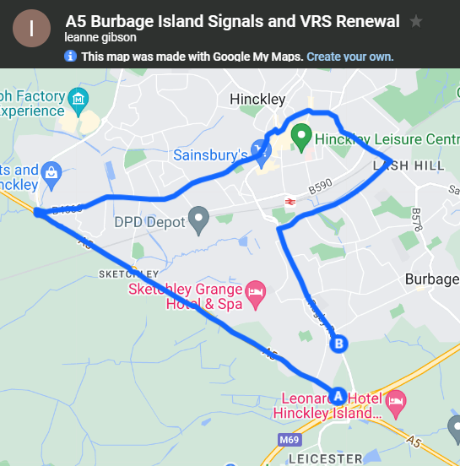
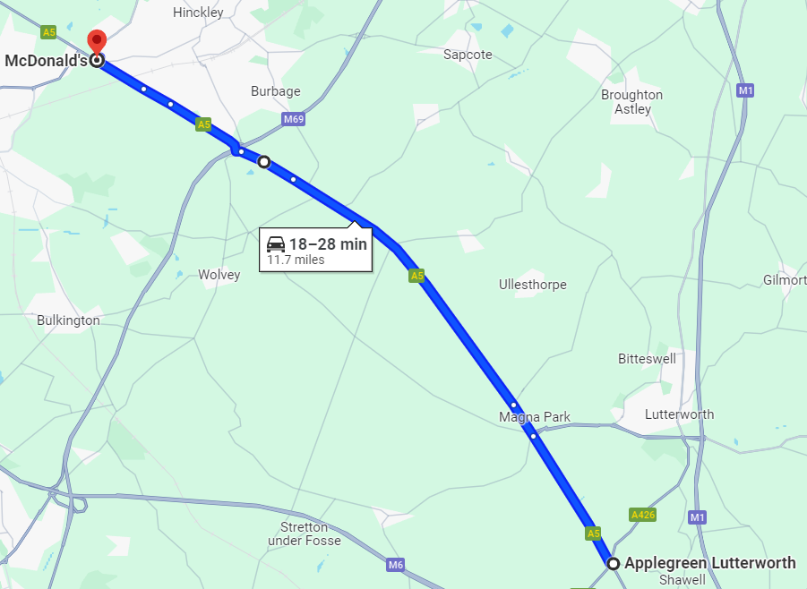
Overview of diversion:
Official diversion routes:
Description of works:
“We'll be carrying out essential maintenance works to A5/M69 Burbage Island and associated slip roads and approaches. During our scheme of work, we'll:
renew traffic signal equipment
renew the safety barrier on the roundabout and beneath the M69 overbridges
remove vegetation to reduce sign obstruction and to allow future maintenance access
resurface the carriageway including associated road markings and road studs in various locations”
Journey we asked participants to make:
Description of works and diversion route provided by National Highways: East Midlands - Maintenance schemes - National Highways

Slide 14
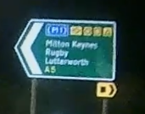
A5 diversion: a dark route with few signs leading to a busy roundabout
While the diversion route was not a difficult one, both of our drivers felt there was a lack of signs to reassure them they were going in the right direction. This uncertainty was compounded by the darkness of the route, which seemed to travel along quiet, rural roads. Once our drivers reached the Burbage Island roundabout, they were met with multiple converging diversions, heavy traffic, and lots of construction which was quite overwhelming and unexpected.
Positives:
Access to petrol stations along the
diversion route
The diversion route did not take too
much extra time
Negatives:
Multiple diversions going through the same roundabout, causing confusion about which route to follow
Poor lighting along the diversion route
Lack of signs along the diversion route
14

Slide 15
A52 diversion near Nottingham

Slide 16
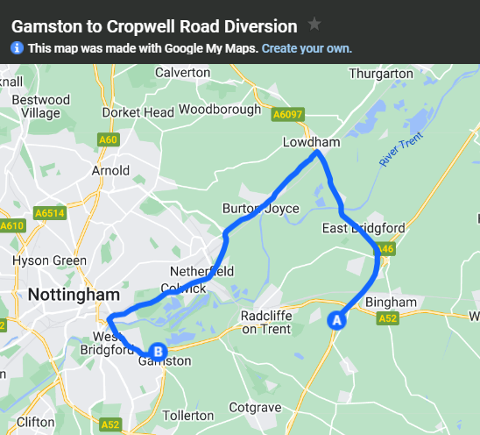
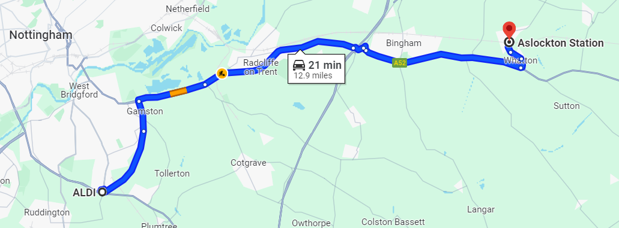
Overview of diversion:
Description of works:
“We'll be undertaking some essential maintenance works including resurfacing, drainage and safety barrier works on the A52 between Gamston roundabout to Cropwell Road.
In order to carry out this work safely, we’ll install a full closure in both directions from Gamston roundabout to Cropwell road. There will be local access between A46 and Cropwell Road, however, Bassingfield Lane and Stragglethorpe road junctions with the A52 will be closed during these works.”
Official diversion route:
Journey we asked participants to make:
Description of works and diversion route provided by National Highways: East Midlands - Maintenance schemes - National Highways

Slide 17
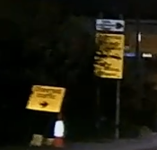
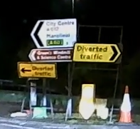
A52 diversion: a confusing start, an uncertain route, and a potentially dangerous road
Situated in a busy and populated area, the beginning of the A52 diversion route seemed to cross with multiple other diversions causing confusion for both of our drivers. While the first stretch of the diversion was placed along well lit, main roads, with access to petrol stations, the route quickly became dark and uncertain as our drivers left Nottingham. Along these more rural roads there were long stretches without signs, some of which were obscured by trees. One of our drivers commented that if he was on his motorcycle the potholes on the diversion route road would have surely thrown him off.
Positives:
Access to petrol stations along the
diversion route
Negatives:
Obscured diversion signs
Diversion route had lots of potholes and was quite dark – dangerous for motorcycles
Multiple diversions without indication of which one to take
A lack of signs along the diversion route
17

Slide 18
M25 diversion near Woking

Slide 19
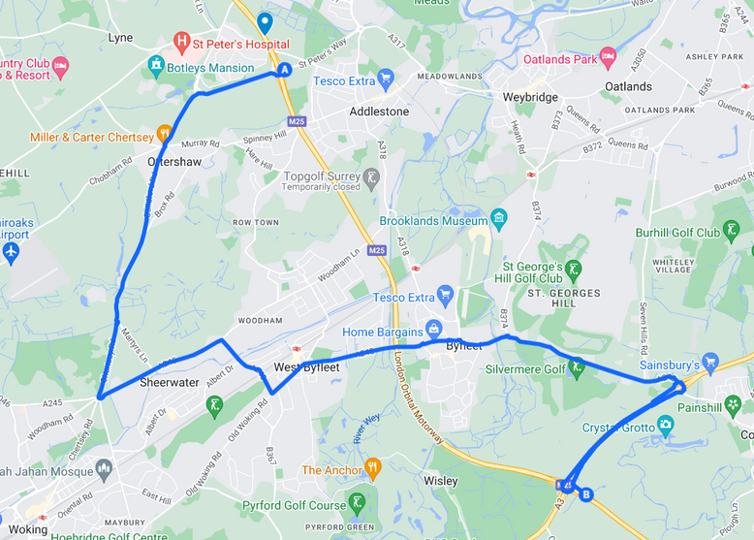
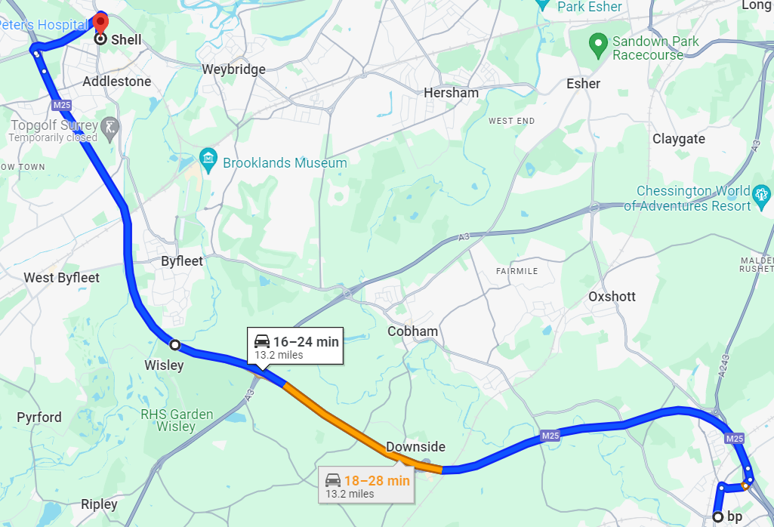
Overview of diversion:
Description of works:
“National Highways will shut the M25 in both directions between junctions 10 (A3 Wisley) and 11 (A320 Chertsey Interchange) from 9pm Friday 15 March to 6am Monday 18 March 2024 to demolish the Clearmount bridleway bridge and install a very large gantry.
The Junction 10 improvement scheme will see an increase in the number of lanes to make journeys safer and improve traffic flow. It will also make it easier and safer to enter and exit the M25, provide safer entry roads for Wisley, Pyrford, Old Byfleet and RHS Wisley.”
Official diversion route:
Journey we asked participants to make:
Description of works and diversion route provided by National Highways: M25 junction 10 - National Highways

Slide 20
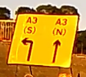
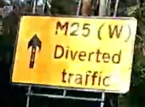
M25 diversion: a well advertised and well signposted diversion with some confusion over cardinal direction
All four of our drivers noted their confusion over the use of compass points (i.e. W or E) at the start of the M25 diversion, stating that a clarifying sign at the beginning of the diversion would have been useful.
Despite this uncertain start, the drivers felt the diversion route itself was extremely well signposted
along safe roads with good access to petrol stations and other amenities. There seemed to be a
consensus that announcements of the diversion leading up to the closure weekend work quite well to
limit the amount of traffic on the roads.
Positives:
Frequency of diversion signs
Access to petrol stations along the
diversion route
Diversion signs that clearly state the route is for the M25 (W) / M25 (E)
Warning of the diversion in the weeks before it took place
Negatives:
No clear sign indicating which A3 route corresponds to M25 (W) versus M25 (E)
No diversion sign at the start stating M25 (W) towards Heathrow / M25 (E) towards Gatwick
20

Slide 21
Conclusion

Slide 22
Clear and frequent signs are key to a successful diversion
While the six diversions explored in this research were all quite different, there were some key themes and take away points that linked each of them:
Properly lit diversion routes help drivers feel safe when traveling at night. This is particularly important for motorcyclists who need to check the road for any potholes. If lights are scarce on the diversion route, having extra diversion signs may help reassure drivers they are going the correct way.
The intersection of multiple diversions was often unexpected and confusing for drivers. A warning that multiple diversions are merging and a reminder of which symbol to follow would be beneficial.
Signs should be placed frequently along the route to reassure drivers they are going in the right direction, even if it is just a straight road. Signs indicating the end of a diversion and ‘no overtaking’ signs would also be appreciated, where appropriate.
Obscured diversion signs, whether blown over, placed too close behind another sign, or near a tree/bush cause drivers concern as they are unsure what the sign said and what they should do next.
The use of compass points or other roads as references without explicitly stating the connection to the diversion route can cause confusion, especially for drivers unfamiliar with the area.
Access to petrol stations along the diversion route is important, especially when the diversion is a long one. This not only provides drivers a place to refill their cars but allows them to pull off the road safely if they are feeling lost or overwhelmed.
22

Slide 23
Motorway and major ’A’ road diversions
Research report prepared for
Proposal
John Connaughton - CEO john.connaughton@illuminas.com
Andy Glazier, Director
Andy.glazier@illuminas.com
March 2024
illuminas.com linkedin.com/company/illuminas @Illuminas

