Slide 1
Motorway and major ’A’ road diversions
Research report v2.1 prepared for
Proposal
John Connaughton - CEO john.connaughton@illuminas.com
Andy Glazier, Director
Andy.glazier@illuminas.com
March 2024
illuminas.com linkedin.com/company/illuminas @Illuminas

Slide 2
Background
Road closures of all types, whether planned or otherwise, are an on-going source of frustration for motorists*. When such closures necessitate a diversion off the intended route the potential impact can be significant e.g. loss of working time, missed appointments, increased expenditure on fuel (particularly for those making regular journeys around recurring road closures)
While previous reports have been published on users’ experiences of roadworks, Transport Focus now seeks to sharpen its focus on road users’ experiences and expectations of diversions due to roadworks on the SRN
This understanding will facilitate further work with National Highways to improve the SRN user experience
* Source: Transport Focus’ Strategic Roads User Survey (SRUS)
2

Slide 3
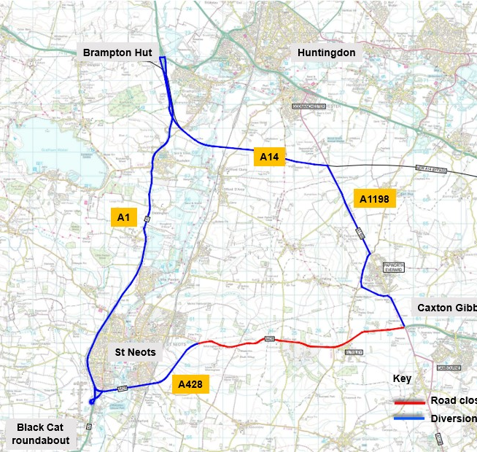
Our overarching goal
To improve the SRN user experience when their intended road has been closed for roadworks.
For this to happen we must ensure that those involved in executing roadworks necessitating diversions fully understand road users’ experiences, expectations and desired improvements, and that these are taken into account when planning and implementing future diversions
This has the potential to feed directly into updates to National Highways’ current implementation toolkit ‘Diversion routes – a customer view’
3

Slide 4
Specific objectives
To explore drivers’ experience of using a diversion necessitated by roadworks on the SRN and the feelings this evokes, paying particular attention to these considerations:
How this varies by ‘one off’ diversions as against recurring diversions
The impact of overnight as against daytime diversions
The impact of weekday as against weekend diversions, the latter often including Bank Holidays
How differing volumes of traffic on a diversion route impact on the user experience
The feelings of different types of user e.g. car, van, motorcycle, HGV, drivers with disabilities
How knowledge of the local area impacts on the experience and subsequent feelings
Those using SatNav vs ‘traditional’ means of route-finding vs those simply following the diversion signs
To deep-dive into pain-points experienced by users of diversion routes and how they feel these could be minimised:
The means by which diversions are made known to users, and with how much/any notice
The length and suitability of diversion routes
Signage along the diversion route and the provision of essential/desirable facilities
The location of the diversion route – e.g. urban vs rural – and the availability of alternatives
To explore attitudes and preferences for a concentrated weekend closure versus multiple week-night diversions
To explore attitudes and preferences for extended lane closures as against full blockades
4

Slide 5
Overview of research approach
Primary research with a cross-section of SRN users who have very recently experienced a diversion due to a scheduled road closure along their intended route
Three concurrent tranches of primary research with SRN users
GROUPS
DEPTHS
JOURNEY EXPERIENCE/DEPTHS
6 GROUP DISCUSSIONS SPANNING DIFFERENT TYPES OF SRN USER
9 DEPTH INTERVIEWS WITH SPECIFIC, TARGETED SRN USER TYPES
15 ‘IN THE MOMENT’ RECORDED JOURNEYS FOLLOWED BY DIAGNOSTIC DEPTH INTERVIEWS WITH THOSE SAME SRN USERS
A
B
C
5

Slide 6
Types of SRN user consulted in the research
SRN user types aligned with most suitable, insightful research approach
A
C
6 groups with:
15 recorded journeys with:
B
9 depths with:
3 disabled drivers, including both cognitive and mobility related disabilities
Users of SRN primarily for non-work related purposes
Leisure
With disabilities
Users of SRN making business journeys, inc. commuters
4 motorcyclists (mix of journey purpose types)
4 drives took place during daylight hours
Business
Motorcyclists
Daytime
Users of SRN primarily for professional purposes (mainly but not exclusively vans)
11 drives took place during nighttime hours
Professional
5 disabled drivers
Nighttime
With disabilities
Commercial drivers of a heavy goods vehicle, typically over 3.5 tonnes
1 motorcyclist was recruited to drive*
HGV
Motorcyclists
*Unfortunately, on the night of the drive the rider deemed the weather to be too wet to risk taking his motorcycle along a diversion route with potentially poor road surfaces, so he drove his car instead
6

Slide 7
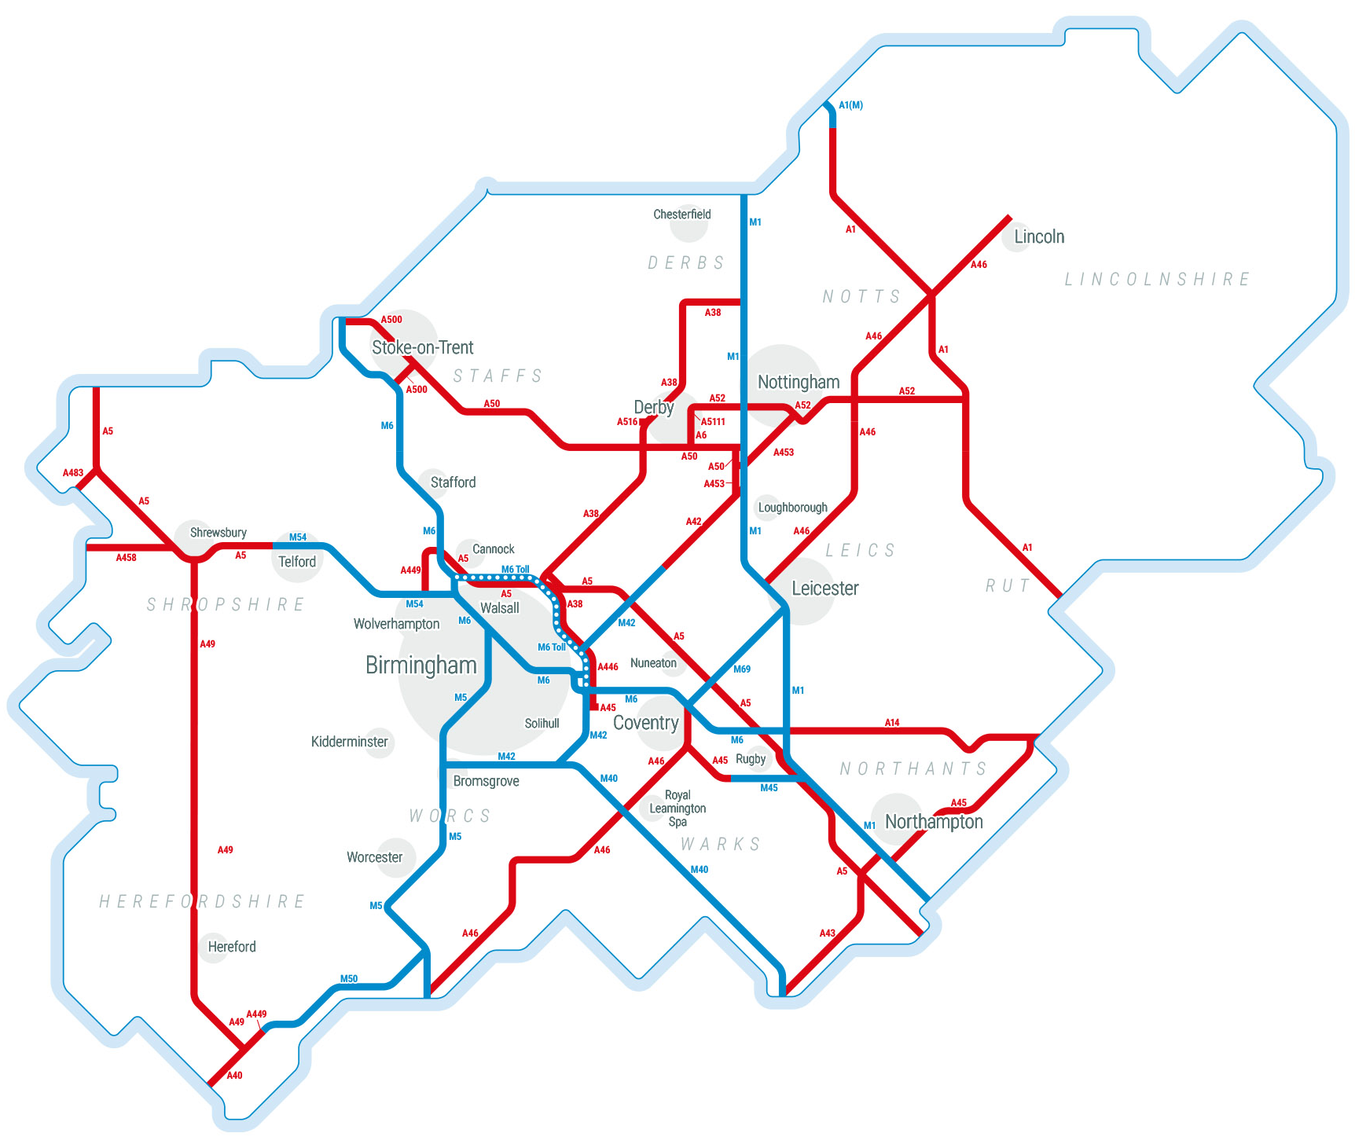
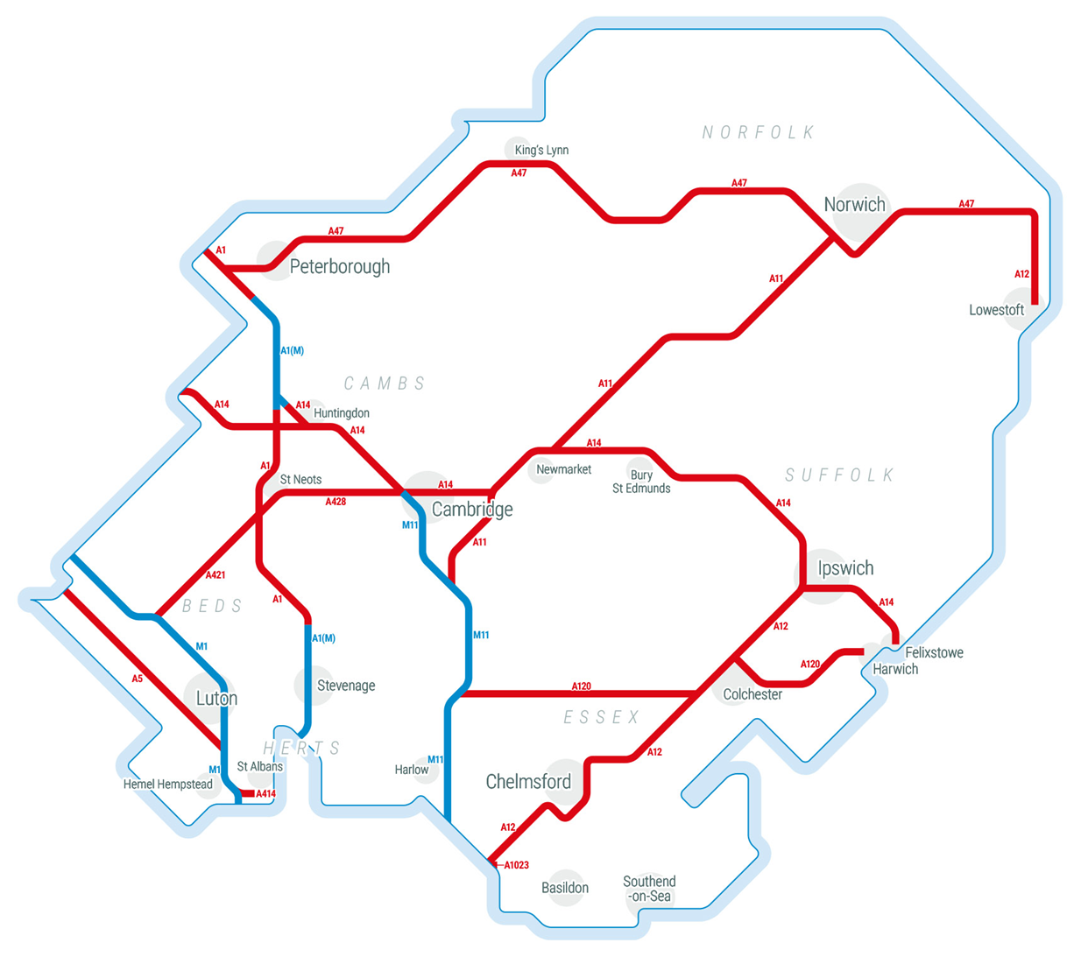
Geographic coverage – group discussions and depths
Group discussion and depth interview recruitment was targeted on locations where a planned diversion on a motorway or major ‘A’ road has been, or still is, in place. However, those participating inevitably drew on broader experiences
*Midlands
East
*Research focused specifically on the East Midlands i.e. Derbyshire, Leicestershire, Northamptonshire and Nottinghamshire

Slide 8
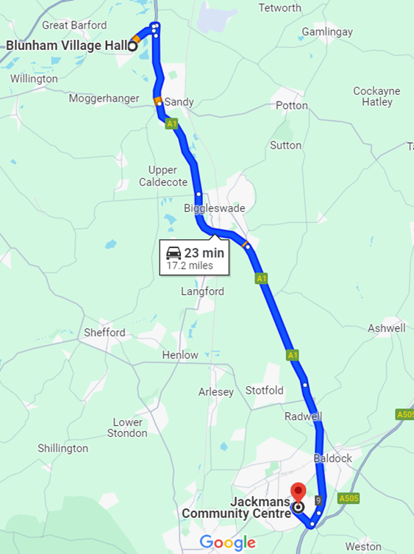
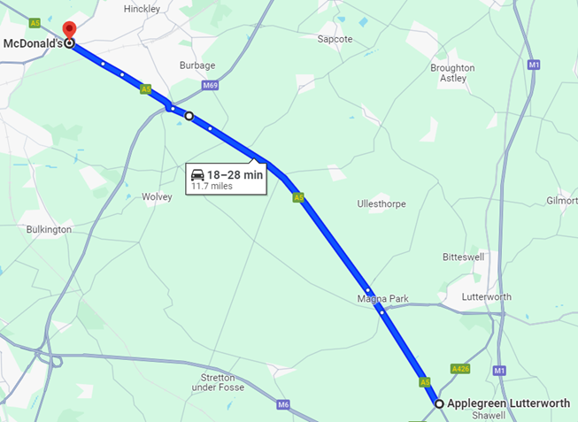
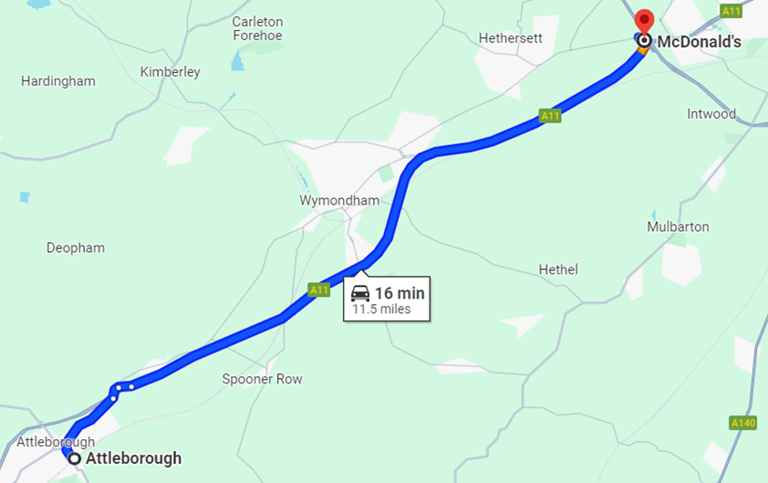
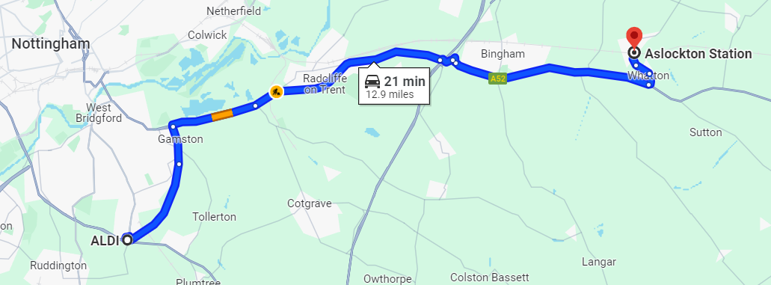
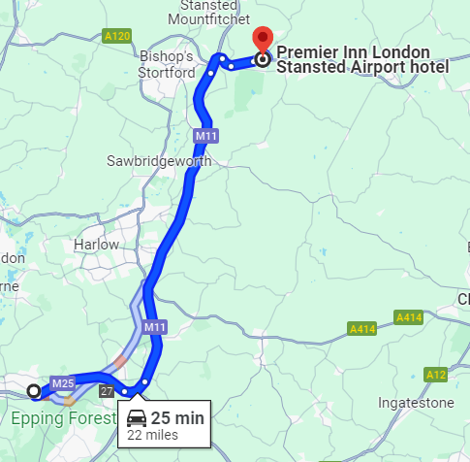
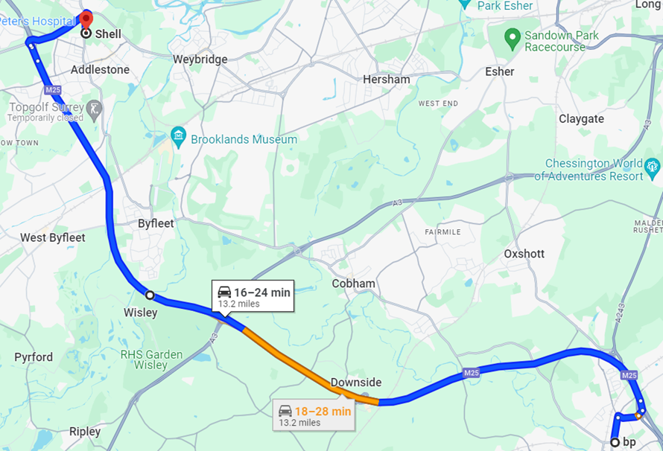
Journeys made that involved a diversion
Journey-specific interviewees were assigned a specific journey to make. They recorded their journey using dashcam, which also captured verbal comments made at the time. Recordings were subsequently uploaded by the driver and an interview conducted with each within 24 hours of the journey
The journeys made are shown below (as they would have been made if there were no diversion)
2 x A1: Biggleswade to Baldock
2 x A5: Lutterworth to Hinckley
3 x A11: Wymondham to Attleborough
2 x A52: near Nottingham
2 x M11: near Harlow
4 x M25: near Woking
Driver safety was of utmost importance at all times. If at any point a driver felt uncomfortable or unsafe on their journey, they were instructed to safely pull over to reorient themselves. If at any point the driver felt lost on their journey, they were instructed to use their preferred GPS device to aid navigation

Slide 9
Drivers’ current frustrations

Slide 10
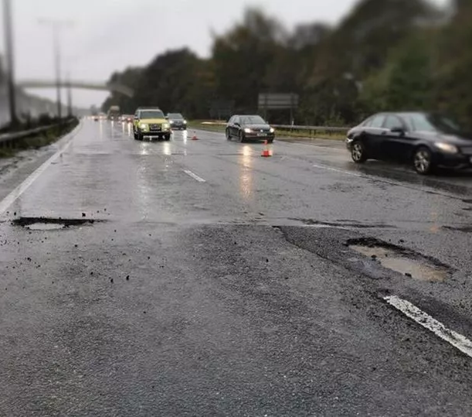
Drivers’ overall frustrations in 2024 – potholes and poor drivers
Potholes are particularly frustrating for those drivers we spoke with. While there is some appreciation that road surfaces will deteriorate over time, the sheer volume of potholes on the roads is a major frustration
The condition of the nation’s roads was the major issue for those SRN users we spoke with, a sentiment probably fuelled by on-going news coverage of the severity of the situation
“Potholes are the biggest problem on the road … when you can't see them and you have to have your suspension repaired that many times because you've missed swerving around it. They do so many other things, like speed restrictions which is good, but why don't they fix the potholes first and get the roads in good condition, then put the other things up?”
East Midlands, Leisure, Infrequent
That potholes can be a genuine physical danger to those who (additionally) use a motorcycle or bicycle, raises the stakes
The perception that there has been a decline in other people’s driving standards is commonplace, and while this is human nature to a degree, it is pervasive all the same
Failure to use indicators, tail-gating and mobile phone usage are commonly cited behaviours
Roadworks and diversions are mentioned as a frustration, but we should remember that drivers participating in this research were recruited on the basis of having experienced a diversion very recently. While undoubtedly a frustration, we should be cautious assigning its relative weight compared to other issues

Slide 11
Drivers’ frustrations in 2024 – traffic, roadworks and diversions
The volume of traffic on our roads is a constant frustration, but, as with roadworks and related diversions, is for most seen as inevitable. In this respect, roadworks and diversions feel different to potholes as a ‘frustration’ per se
For the most part, drivers acknowledge that our roads do need to be maintained and our road network developed, affording roadworks and subsequent diversions a little grace in drivers’ eyes
When roadworks are of particular annoyance, however, are the occasions when no actual work appears to be being undertaken
This feeds into mistrust and a feeling that the motorist is not at the heart of planning. This is counter to how people feel roadworks ‘should’ be viewed i.e. a way to invest public money in making roads safer and better
“It’s a thankless task, road-planning; roadworks have to be done and we’d only moan if they weren’t!”
Disabled Driver, East Midlands
The occasions on which roadworks and diversions cause anxiety and stress are for the most part if a journey is time-critical e.g. when work or personal appointments or commitments are at stake
"A lot of times, you see miles of roadworks but there's nothing happening. It just gets quite frustrating."
East Midlands, Business/Professional, Frequent
“There’s a lot of disruption with the Black Cat roundabout which has made the commute more stressful; traffic can back up for a long time, so it's unpredictable whether you're going to get to the office on time.”
East, Business/Professional, Frequent

Slide 12
Planning & navigation

Slide 13
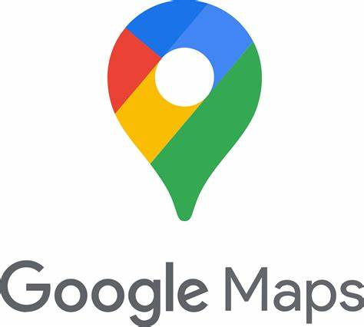
SatNav usage
Usage of SatNav has become habitual and unconscious for many. It is a part of the driving experience, even for familiar journeys
Most use navigation aids routinely, even for journeys they know very well such as their commute or to a relative’s house (if over a few miles). Not only does SatNav provide an ETA, it also highlights any potential traffic jams/incidents along the route ahead and offers potential alternatives
SatNav is of particular importance for time-sensitive journeys and work meetings
In addition to built-in navigation aids – which can often be perceived as out-of-date, with software updates too much ‘hassle’ to bother with – tools most often used include:
“I use Google Maps on my phone most of the time. Even if I know where I'm going, I still put it on because I want to see my ETA. If there’s any disruption, then maybe I take another route. So I normally put SatNav, the Google Maps on before I leave just to check and then periodically I'll use it if I need to.”
East, Business/ Professional, Frequent
Waze felt to be particularly up-to-date e.g. warnings of potholes on route. User-generated content helps in this respect

Slide 14
SatNav usage and implications for journey planning
The degree to which journeys are planned in advance has changed since the use of SatNav – and to a degree, social media – became commonplace, as has the decline in use of traditional, hard-copy means of navigation e.g. atlases
The days of studiously planning a journey – even a lengthy, unfamiliar route – are for most a thing of the past. Cursory information-sourcing may take place e.g. to gauge the approximate length of a trip, often informally (word-of-mouth) or more formally (AA’s Route Planner) but little in the way of detail
Some report checking-in a little while before they would usually plan to leave – typically via Google Maps or similar – to gauge their departure time or to check if they need to avoid an incident/roadworks
Occasionally some check several days in advance and, potentially, across a few navigation tools to be totally sure
Social media – local Facebook groups or work-based WhatsApp groups – have an important role to play for some, not for long-term planning but for ‘on the day’ notifications of problems on the road
Tellingly, there was no mention of National Highways activity on any social media platform used
“On Facebook there are local groups, like in Wellingborough, Northampton … they will pop up and people will put on there, ‘Don't go on the A45’, ‘diversion’ or ‘traffic here’ etc. So that's quite good. So I'll have a quick flip through before I get up in the morning and if it pops up you think, ‘Oh, God, I'll avoid the A45 now because you can't get through this way or that way.’”
East Midlands, Leisure, Frequent
Some drivers of commercial vehicles receive notification of the journeys required of them at very short notice e.g. on the morning of their working day or even during that day. For these drivers, with little or no opportunity to plan routes in advance, SatNav and local knowledge are of critical importance

Slide 15
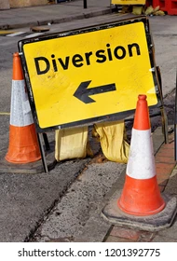
SatNav usage and implications for diversions
The increasingly ingrained usage of SatNav has significant implications for those implementing diversions, planned routes potentially conflicting with SatNav recommendations that are seen as more up-to-date and trustworthy
As a result of having access to up-to-the-moment navigation tools – or at least tools that are perceived to be up-to-the-moment – many drivers take responsibility for navigation themselves rather than following diversion signs
"So the diversion might take you one way and everyone might follow that road diversion, but then you're going to get traffic because everybody's taking that diversion. So the SatNav will pick it up and say, ‘Oh that's not the best route’ and take you an alternative way and that's probably going to be faster. So I'll probably take that route 9 times out of 10.“
East Midlands, Leisure, Infrequent
Drivers’ impressions of diversion signs fuel their inclination to rely on their SatNav. The traditional yellow and black ‘arrow’ signs in particular, can often be seen as ‘not to be trusted taken seriously’ i.e. not current (e.g. not removed after a previous diversion), could to have been deliberately moved as a prank or have been moved/blown over by increasingly common strong winds
Previous experience can also foster mistrust e.g. following diversion signs when no work is actually being conducted
For drivers of commercial vehicles the stakes are raised significantly, in particular for HGV drivers
There is an underlying concern that neither SatNav nor diversion signs take into account vehicle size, diversion signs typically winning the day if conflicting routes are offered. The potential reputational damage to the employer of a driver choosing a route that is not suitable for their vehicle, either off their own bat or via SatNav, could result in that driver losing their job

Slide 16
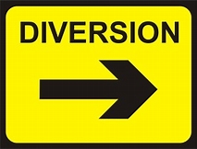
Routes

Slide 17
Perceptions of the ‘directness’ of diversion routes
There is a pervasive suspicion on the part of the driver that following diversion signs is a ‘last resort’ and is likely not to be the most direct or efficient way of circumnavigating a road closure
While often not corroborated by direct experience, drivers’ default belief is that diversion routes are less direct than other possible routes and are somehow for the less ‘savvy’
However, for the most part, it is appreciated that there may be valid reasons why an apparently quicker route wasn’t chosen e.g. narrow roads not suitable for larger vehicles, roads susceptible to flooding, routes passing through villages etc.
While most drivers acknowledge considerations such as avoiding residential areas, it does not mean they practice what they preach, the desire to reach their destination as quickly as possible is the overriding goal
The reality is that drivers prefer to feel in control of the journey and follow advice that gives them visibility of the likely route in full. SatNav offers such visibility and helps to nurture a sense of having control of the journey ahead
Diversions, however, can be a ‘leap of faith’ with no indication (in most cases) as to where it will take them, on what sort of roads or how long it might add to the journey
Those without the knowledge to identify for themselves a quicker route for a diversion assume that SatNav would identify one for them if they chose to use it
“If a diversion looks like it’s sending me in a direction that I'm not as sure about, I think that with local knowledge I can actually do something. I think very often that the diversions, because lorries could be involved, they plan in a certain way to avoid built-up areas, or smaller villages. I think that's where local knowledge can make life a lot easier and you can create a shorter diversion for yourself.”
East, Business/Professional, Frequent
“If you know the area, you’ll probably know the backways that will get you there sooner than following the diversion. But if it’s somewhere you’re not familiar with, you’re more inclined to follow the diversion, but then you’ll also be looking at what the SatNav is saying.”
East Midlands, Leisure, Infrequent
17

Slide 18
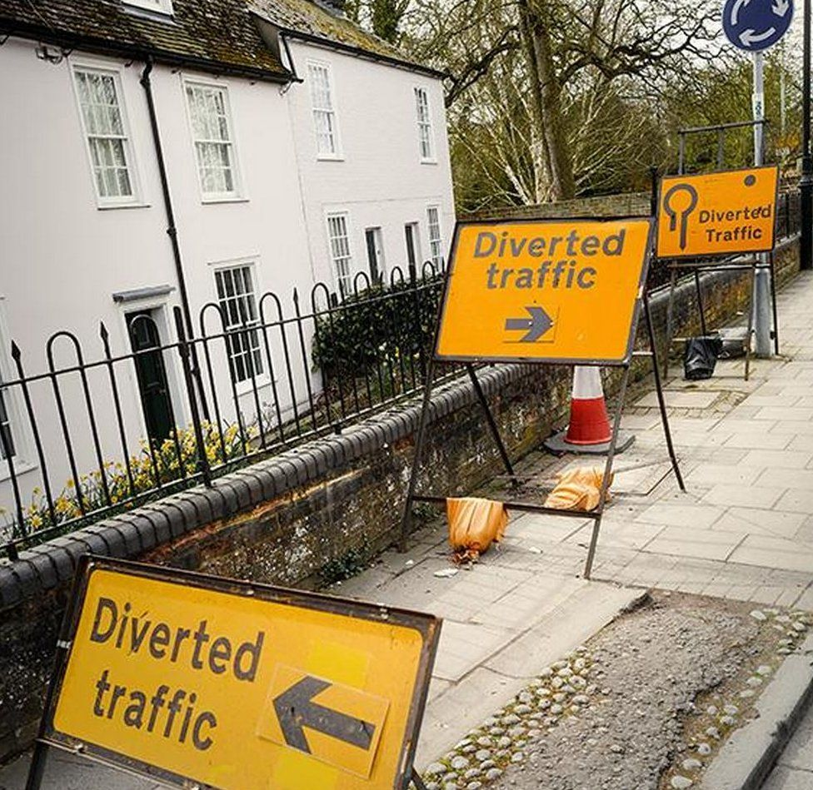
Overlapping diversions
While experienced by only a small minority of road users, overlapping diversions can suggest a lack of joined-up thinking on the part of those putting them in place
Of particular frustration is when multiple diversions overlap; incorrect routes can inadvertently be followed and it suggests a lack of strategic planning
Similarly, diversion routes that direct people through areas affected by other sets of roadworks suggest a lack of joined-up thinking
“Around Leicester when I was coming up from Daventry up the M1, I think it was around Junction 20, they were diverting you off around Leicester and you come into a traffic island and it’d say, ‘diverted traffic left' and 'diverted traffic right'. Now I was thinking, ‘Which way do I go?’ There were two or three diversions running and overlapping - I found it very confusing.”
East Midlands, Business/Professional, Frequent
18

Slide 19
The suitability of roads used on diversion routes
For non-commercial road users, recent diversions experienced have presented few issues in terms of the roads on to which they were diverted
In spite of a prevalence of night-time road closures being experienced, often in wet weather, there is little evidence of drivers encountering roads that could be considered ‘unsuitable’ e.g. poor visibility, overly narrow, unlit*
Neither were drivers in need of fuel or refreshments on their diverted drive or felt they would have had no options to pull over if the need arose
Specific instances where improvements could be made can, however, be identified:
Ensure traffic-light phasing takes into account increased traffic usage along a diversion route
Increased traffic volumes – inc. HGVs – can tempt drivers to rashly overtake vehicles ahead. Consider introducing ‘no-overtaking’ areas/signage
Diversion routes can in some ways be easier for motorcyclists to follow than car drivers. However, signage flagging poor road conditions would help
“Overall there were no real pinch-points, but I do remember sitting at a set of lights watching no traffic at all coming out of a seemingly quiet sideroad while we all queued at a red light!”
East Midlands, Business/Professional, Frequent
“The diversion route in itself was fine, but the traffic was pretty heavy. And of course there was a boy-racer ‘car-hopping’ one vehicle at a time. I could see him in my rear-view mirror and thought ‘what a p****er.’”
East Midlands, Leisure, Frequent
“I get really nervous riding my motorbike down backroads. Not because they’re narrow or dark, but because of the roads; you just don’t know what’s under a puddle and that can be disastrous.”
East Midlands, Leisure, Frequent
*Note that roads used for diversion routes include roads not on the Strategic Road Network
19

Slide 20
The suitability of roads used on diversion routes – drivers with disabilities
For many disabled drivers there are no requirements of diversion routes specific to them and their needs. However, this very much depends on the disability or disabilities in question
For some disabled drivers it is imperative that they are able to pull over when making a journey, whether to rest or to make use of facilities. It is not uncommon therefore for disabled drivers to more thoroughly plan journeys in advance compared to drivers without such disabilities
Diversions can interfere with the planning process, in particular on longer journeys where essential breaks are factored in ahead of the trip. Advance notice of diversions becomes of elevated importance in these instances
"I went to Stoke for a basketball game and on the way back there was a big diversion in place. When I drove there I didn't see anything, but when I was driving back it had been put in place for the weekend. It took me around 15 to 20 minutes to get back on the route, so not too long, but it still didn’t help; I’m a disabled person and I need to be able to just stop for a comfort break, to go to the toilet. I didn't see anywhere I could pull over to use the toilet or just to be able to pull over to use my [medical] bag.”
Disabled driver, East Midlands
On longer diversion routes, there would ideally be places for people to be able to park to take a break from driving. While disabled drivers appreciate it is not always practical, toilet facilities would be beneficial, even if temporary facilities*
*Note that roads used for diversion routes include roads not on the Strategic Road Network
20

Slide 21
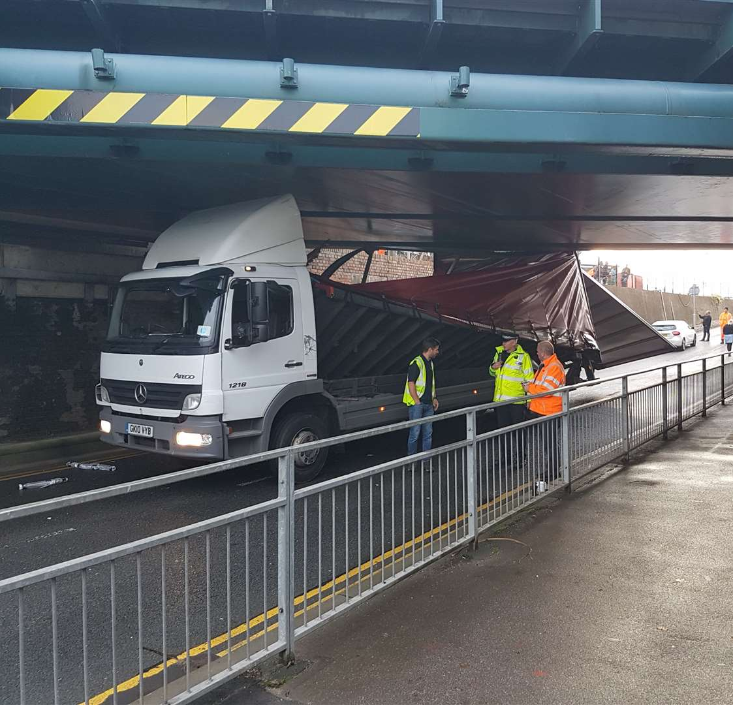
The suitability of roads used on diversion routes – HGVs
HGV drivers wear multiple ‘driving hats’ and offer a broader perspective on the suitability of diversion routes* for both commercial and non-commercial vehicles
With vehicles of a potential Authorised Weight of 44 tonnes, HGV drivers have a specific set of route requirements
The fact that these drivers are representatives of the companies they work for, and by extension are putting their careers on the line, adds a significant element of jeopardy if such requirements are not met
An HGV directed along a route that is too narrow or has prohibitive height restrictions can result in the driver facing a career-threatening predicament
"You don’t want to risk silly things … if I'm in a Class One vehicle and my wheels hit a wet verge, the whole truck could sink or go over; if a sign says ‘don't do it’, you don't do it in a works vehicle. You're an ambassador for the company, it has your company’s name on the side of it, the last thing I want is to damage the reputation of the company and have my name next to it. Realistically as a driver, if you do something wrong, you're no longer a driver, you're sacked.”
East Midlands, HGV, Frequent
Such jeopardy means HGV drivers are more likely to follow ‘official’ diversion signage; it offers defence against ‘driver/SatNav error’ should there be an incident along the journey due to the unsuitability of a road
Ideally, diversion routes should be identified that are HGV-specific – which would help alleviate congestion on the ‘main’ diversion route – as well as HGV-specific signage
*Note that roads used for diversion routes include roads not on the Strategic Road Network
21

Slide 22
Timing

Slide 23
The timing and duration of diversions
Preferences for when diversions are implemented – weekday vs weekend, daytime vs overnight etc – are driven by personal and professional circumstance; there is no one size fits all solution
It is impossible to find a period or periods of time in which to implement diversions that does not impact on one or more types of road-user; it’s a case of finding the least bad option
For the most part, road users assume that those implementing the closures and diversions have the greatest oversight of road usage patterns and take into account the probable impact of different timings and durations
Notwithstanding this, most prefer overnight closures where possible, and would rather a series of evening closures than a shorter overall period where daytime is impacted
The notion of trading-off numbers of evening closures against a smaller number of daytime closures is a difficult concept for drivers to grasp as the inconvenience caused is so dependent on the specifics of each journey being made. For those commuting during the daytime, for example, no end of nighttime closures – within reason – are preferable to a single daytime closure
Weekday vs weekend is a similarly circumstance-driven choice for users. Overall, weekend closures are preferable to weekday, certainly for those reliant on motorways and A-roads for work
For those less ‘pressured’ by weekday work commitments, losing leisure time to roadworks causes more resentment overall
“I feel a little bit relaxed taking diversions on the weekends as I don’t have to be at work, so if it takes me an extra 10 to 15 minutes then it’s not a problem. I am one of those who leaves early rather than on time, so I'm a bit more relaxed at evenings or weekends … if I’m trying to get to a meeting or to the airport, which is a really tight timeframe, it gets the anxiety going a little bit.”
East, Business/Professional, Frequent

Slide 24
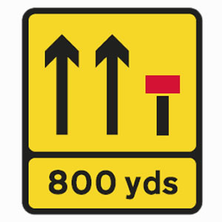
Road closures and diversions vs lane closures
The fear of the unknown, for many, is a serious enough consideration when making a journey so that multiple delayed journeys are preferable to being taken off-route
If suitable alternative routes are readily available then a total closure can be deemed preferable to closing a single lane. This needs to be assessed on a case by case basis
There is a value in staying on one (known) road and avoiding the cognitive toll of an unfamiliar route. Even if progress on the usual route is slow, it is preferable to engaging with and concentrating on the ‘unknown’
Some (minority) are of the view that a short painful period of total closure is better than longer smaller pieces of work that cause delays over a long period and can seem never-ending
“I think that depends to a large extent on geography actually, because I think some situations lend themselves to that sort of complete closure better than others. If say it's a situation where they've got to close the road and there's only one alternative. If that is for a whole weekend and there's only one alternative, I think that that could become easily problematic. So I think something like that has to be judged on a case-by-case basis.”
East, Business/ Professional, Frequent

Slide 25
Case study – A full closure on a major road
While not a view shared by everyone, the least disruptive solution can sometimes be to ‘bite the bullet’ and close a road completely, even a major arterial motorway. The recent closure of the M25 at J10 is for some a good example of this, though it was an atypical closure; the widespread publicity and media coverage relating to this event forearmed many more road users than might typically be the case
“It’s a really difficult one because I use that junction quite a lot and know how it can be avoided. If something needs doing then I guess the weekend probably is the best time, but people are going to complain with a weekend or a weekday. The thing is, if work needs doing, it needs doing. Yeah, it was a bit of a kerfuffle, but I think ultimately it was only for one weekend. When other roads have had closures, sometimes they go on for months and months and so in a way, I think it was better to have it over one weekend and be done with it.”
M25 Diversion, Daytime drive, Car
25

Slide 26
Signage

Slide 27
Signage forewarning drivers of road closures and diversions
The prevalence of SatNav and other forms of digital comms materially impacts not only the extent to which drivers plan their journeys, but the extent to which advanced warning of road closures is deemed appropriate
Most drivers do expect advanced notification of planned road closures – typically two to four weeks ahead – but we should temper this with perceptions that:
‘I don’t need to worry because SatNav or social media will sort it out for me nearer the time’, or
‘It probably won’t go ahead anyway’
Signage should refer to certain key features of the diversion, as succinctly as possible:
The dates and times when the diversion is in place
The section of the driver’s usual route that is closed. There is no universal agreement, however, on how this should be phrased. On motorways, referring to junction numbers is reasonable to most, while on A-roads, particularly with regular users, referring to names is more appropriate and intuitive e.g. Black Cat Roundabout
“One day before is all I would need. No earlier than that. Again, it's just personal circumstances because I'm making so many journeys. A day before so that it's fresh in the mind. Any earlier and I’ll just forget.”
East, Business/Professional, Frequent
“I think about four weeks is about right. It's quite nice to drive by the signs and think, ‘Oh on the 18th the sh*t’s going to hit the fan. The road’s going to be closed from this date to this date.’”
East Midlands, Leisure, Infrequent
There is a degree of appetite for signage to indicate the amount of time that may be added to the journey because of the closure and diversion, but it is appreciated that an estimated range is all that could be realistically provided
There is less appetite for information relating to the reason for the closure; for most this is seen as information overload
27

Slide 28
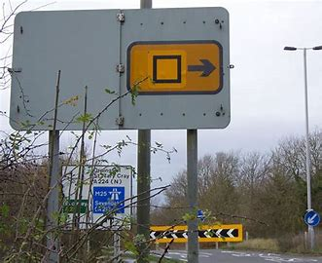
Preferences for signage style – at the point of diversion and along the route
In some respects, as long as signs appear frequently, at every decision-point in the journey, are visible and clear to read, the style is immaterial. However, these truths do not tell the full story
The hygiene factors of road signage are intuitive:
Instructions need to be succinct and conveyed as simply as possible
All visuals must be clear and stand out
Placement of signs must allow for uninterrupted viewing
There must be signage at every decision point in the journey at the very least
The style of signage used along the journey must be consistent
Yellow and black signs are seen by most as the norm, though digital signs are becoming more common
Digital signs are, overall, felt to be more trustworthy. Their modernity suggests they are likely to be up-to-date and as such are felt to be more credible
Yellow and black signs carry with them the fear that they are out-of-date, have been interfered with and/or have been disturbed by the weather (of increasing concern because of more frequent storms)
Symbols were not familiar to most of the drivers we spoke with … not even those who have taken their Theory Test. There is a good deal of confusion as to what these symbols actually mean

Slide 29
Styles of signage – Summary of the pros and cons
Given the widespread adoption of SatNav as an up-to-date navigation aid, it is perhaps not surprising that the perceived modernity of digital signage gives it an advantage over yellow and black metal signs
Digital | Diversion + | Symbol +
Can be updated with latest info | Succinct and intuitive | Succinct
Easy to see and read, including at night | Recognisable and hard to miss | Affordable
Conveys authority/certainty | Affordable | Not recognised, therefore not intuitive
May be too much to read when driving | Suggests ‘oldness’/being out-of-date | Suggests ‘oldness’/being out-of-date
Cost implication for provider | Can be moved/disturbed/removed | Can be moved/disturbed/removed
May still not be as up-to-date as should be
"I wouldn't even know what the symbols mean, honestly, like when I passed my driving test it was all out of a book, so you didn't have like these theories and what the signals and stuff were....So if I saw that sign now, I wouldn't know what it meant unless it's had some information underneath it."
Disabled driver, Leisure, Wellingborough/Buckinghamshire
"I prefer the electronic ones because they do give you the dates and times and so they inform you a bit better rather than just 'road closed' to follow."
East, Leisure, Infrequent

Slide 30
Case study – When signage goes wrong …
On occasions signage can be entirely baffling and nonsensical. On this occasion our driver trying to navigate the A11 nighttime diversion remained at a complete loss as to what she had done wrong and took two and a half hours to make it back to her starting point
The fact that this was an ‘artificial’ scenario – i.e. a specific research task with no deadlines – undoubtedly impacted on her reactions to the predicament she was in. She remained relatively relaxed, but by her own admittance would have been ‘tearing her hair out’ if she had been committed to any sort of appointment or meeting
“This was mind-boggling. There's probably a dashcam video of me ringing my partner going, ‘I'm not being stupid.’ I swear to God, I literally pulled off the junction, turned right, went to a roundabout. I think I went all the way around it, then followed it all the way around to the other side and it said ‘Diversion’ with the arrow and took me back onto the A11, but the opposite side. But then literally I was talking to my partner when I got in because I was, I think 2 1/2 hours; I was doing it because I was like, I really don't want to do it wrong.”
A11 Diversion, Nighttime drive, Car
30

Slide 31
Information

Slide 32
Information sources used before making a journey
Beyond travel updates on TV or radio – national or local – or advanced roadside signage, awareness of ‘formal’ information sources related to road closures and diversions is limited. Regular usage or consumption is rarer still
Drivers are aware of travel updates on radio stations – in particular Radio 2 – and on regional TV news, but they are rarely go-to sources of information
Roadside signage is typically how drivers become aware of planned road closures and diversions, though travel apps – bus information, for example – can also flag up-coming closures
There is very little awareness or usage of National Highways email alerts or of ‘Live Traffic Info.’, though there is some appetite for the latter
Of far greater importance is recourse to up-to-the-moment SatNav and social media platforms, in particular Facebook and WhatsApp
“I mean, you get it on the radio as well. You get the traffic report, but that's normally when something's happened, not when something's going to happen. Sometimes on Radio 2 they'll tell you ‘this road is going to be closed’, but not everybody hears that … they're just driving along, with the radio on in the background … they don't always take it in, so they probably need clearer information, such as when the road’s closing and the possibilities of diversions being put in place for people.”
East Midlands, Leisure, Infrequent
32

Slide 33
The emotional impact

Slide 34
The impact on the driver of encountering a diversion
For most, the dominant immediate response when a diversion is initially encountered is frustrated resignation, paired with nervousness and trepidation as to what lies ahead
Feelings of frustration and trepidation are universal to those encountering a diversion, and while ample prior warning – or even previous experience – can mitigate against these feelings, that they are present to some degree is unavoidable
How these initial feelings might potentially develop follows a classic Stress Response model in many respects:
Physiological Response
e.g. increased heart rate, tenseness
Cognitive Response
e.g. worry, lapses in concentration, forgetfulness
Emotional Response
e.g. anger, sense of dread, exasperation
Behavioural Response
e.g. impatience, a need to rush or hurry
To some degree the personality of the driver and the circumstances surrounding the journey will shape each individual driver’s response. However, it is incumbent on those implementing the diversion to put in place all reasonable measures to help the driver manage their response to the diversion
34

Slide 35
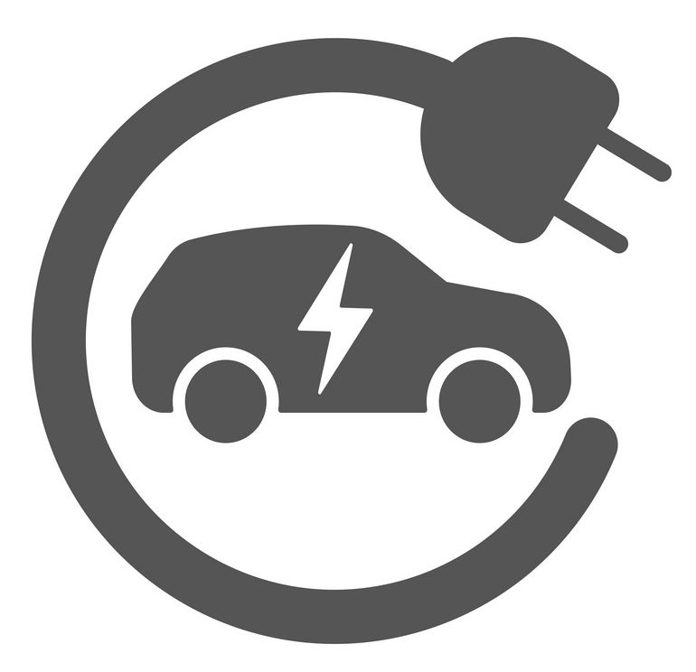
Helping drivers manage their response to the stress caused by a diversion
Of paramount importance is that all is done to mitigate against a potentially life-threatening behavioural response. To do this effectively we must take into account numerous variables relating to the driver and their vehicle
Highly dependent on the nature of the disability, but access to rest areas and well-lit routes – due to concerns over vulnerability – are key considerations
“Whenever they're planning diversions, if they consider disabled groups, I mean get them round the table and get some advice, that would be really helpful. At least we would know all the research has been done before we went out; I mean at least 4% to 5% of people are disabled.​
We need facilities put in place more than anything, a place for people with bladder problems like myself when I'm driving. I need to stop at least every 45 minutes otherwise I would struggle."
Disabled driver, East Midlands
Again, access to rest areas, refreshments, toilets and baby-changing facilities are important to young families
The availability of charging points along lengthy diversions is becoming an increasingly necessary consideration in respect of EV drivers
“If there was traffic and diversions, you're sitting there in the traffic thinking, ‘Oh my gosh, is this going to get me home?’ And obviously, with electricity points, the hookups are very rare. You have to find them and you have to sit and wait while your car's charging.”
East, Leisure, Infrequent
Routing that avoids narrow roads, width restrictions, low bridges and/or compact town centres is important to HGV drivers
While diversion routes can be easier in certain respects for motorcyclists, poor conditions – e.g. potholes – can be highly dangerous
35

Slide 36
Conclusions

Slide 37
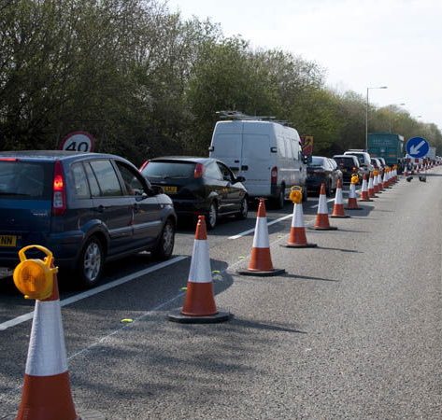
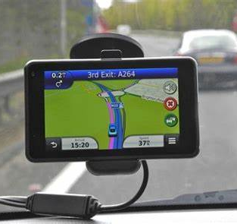
Conclusions – key themes
For the most part, drivers are sympathetic to the fact that roadworks need to be conducted from time to time and diversions put in place as a result
That road traffic volume is in itself a major issue for drivers sub-consciously reinforces an appreciation that ‘wear and tear’ – at the very least – is inevitable
Frustration is triggered instantly when roadworks are put in place yet no-one is seen to be working on them
Frustration also rises to the surface when drivers feel their wants and needs have not been taken into account when a diversion has been implemented, particularly so when such considerations are seen as ‘common sense’
It is human nature that, if not managed carefully, such frustrations when driving can lead to stress, anxiety and potentially dangerous behavioural changes
That many drivers are accustomed to using real time SatNav devices, even on routes familiar to them, can add to the stress caused by diversions
What should a driver do if a diversion sign points them one way, but their SatNav points to a different route? Other than for drivers of large commercial vehicles, that SatNav wins the day as it is perceived to be more ‘up to date’ wins the day for SatNav
37

Slide 38
Conclusions – providing advance notice of diversions to drivers
Drivers feel that signage stating the dates and times when a diversion is scheduled to be in force should be in place at least one week before diversion implementation
Digital signage is preferred; it is perceived to be more up-to-date and trustworthy than traditional yellow and black metal signs
Junction numbers (for motorways) or most commonly referred to location names (for major ‘A’ roads) around which the diversion will be in place are the preferred terms to use on signage
Where feasible an estimation of the length of time that could potentially be added to the driver’s journey is deemed by some drivers to be beneficial
Drivers of EVs and those with vulnerable passengers would value advanced notice in the event that a planned diversion has the potential to add significantly to a journey’s duration
SatNav is a key source of information for many drivers; flagging in advance planned road closures and diversions via SatNav would benefit many drivers
Awareness of the ‘Live Traffic Info.’ app is low, but there is some appetite for it amongst drivers. Some also feel that local/national TV and radio stations should include as standard advance notice of road closures and diversions in their travel bulletins
38

Slide 39
Conclusions – implementing diversions
Drivers believe that diversion routes should balance considerations for all drivers i.e. that they are not unnecessarily circuitous, yet avoid narrow or unlit roads or roads in (overly) poor condition
HGV drivers favour bespoke routes for HGVs, which take into account their particular considerations
While not practical to ensure all diversion routes provide refreshments, toilets or charging stations, drivers feel that signage along longer routes indicating where such facilities can be located would be beneficial
Diversion routes that are aligned with instructions given by SatNav would benefit many drivers
Signage must not be obstructed and must be present, at least, at every decision point along the diversion route
Signage should ideally be digital and should use terminology which feels intuitive to drivers e.g. N, E, S, W are not intuitive for many road users
HGV drivers favour bespoke signage for them and their specific requirements; this would help allay concerns that the route along which they are being diverted is not suitable for their vehicle
Some drivers feel that ‘no overtaking’ restrictions on some single carriageway diversion routes would be beneficial e.g. sections of a route along which overtaking is typically permitted may become atypically busy and/or be used by higher than usual numbers of HGVs and as such drivers should be instructed not to overtake
39

Slide 40
Appendix

Slide 41
Group discussions – location by user type
Location | User type | Use of SRN
Leicester / East Midlands Airport / Grantham / Nottingham/ Peterborough | Leisure | Infrequent
Leicester / East Midlands Airport / Grantham / Nottingham/ Peterborough | HGV | Frequent
Leicester / East Midlands Airport / Grantham / Nottingham/ Peterborough | Business, Professional | Frequent
Northampton / Wellingborough/ Bedford | Leisure | Frequent
Northampton / Wellingborough/ Bedford | Business, Professional | Infrequent
Northampton / Wellingborough/ Bedford | Leisure | Infrequent
41

Slide 42
Motorway and major ’A’ road diversions
Research report v2.1 prepared for
Proposal
John Connaughton - CEO john.connaughton@illuminas.com
Andy Glazier, Director
Andy.glazier@illuminas.com
March 2024
illuminas.com linkedin.com/company/illuminas @Illuminas

