Slide 1
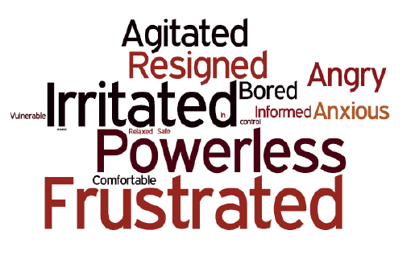
Passenger Information during disruption
Dan Taylor, Senior Policy Advisor

Slide 2
About Transport Focus
Transport Focus is the independent consumer watchdog
We represent the interests of:
Rail passengers in Great Britain
Bus, coach and tram users across England outside London
All users of England’s motorways and major ‘A’ roads (the Strategic Road Network)
We aim to be useful and to make a difference
Robust evidence-based research and policy – we publish all our work
Present users’ priorities and experiences … pro consumer
Notes:
We try not to just shout from the side lines. We aim to be useful and make a difference to passengers by using robust evidence to back up our work.

Slide 3
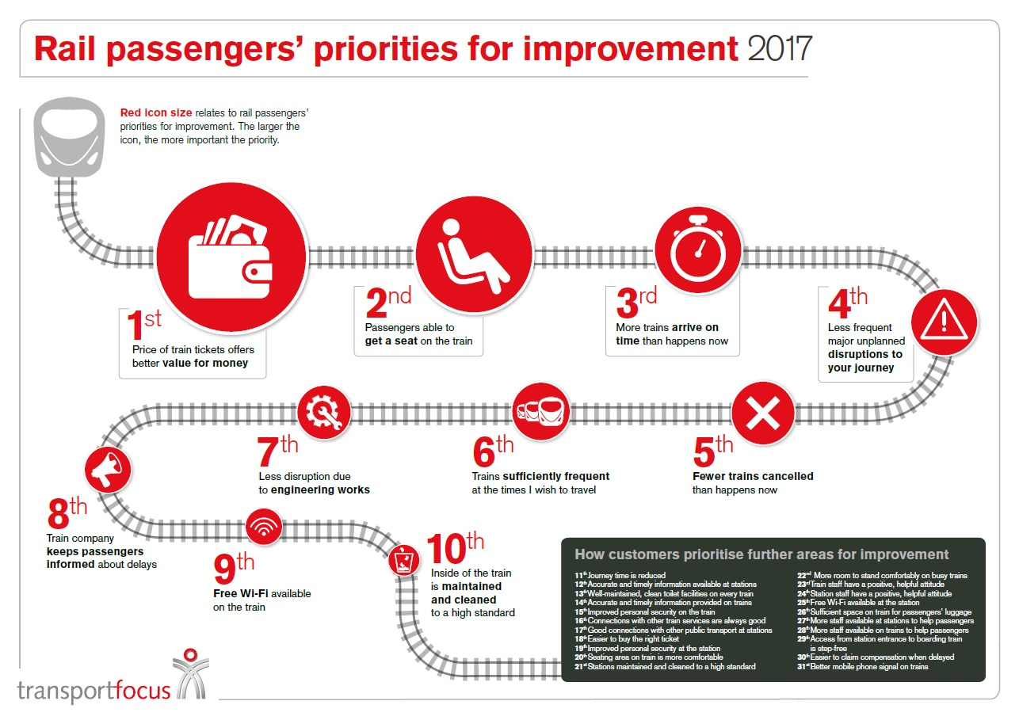
Improving the railway
Notes:
Getting information right during delays can help mitigate a lot of the frustration of passengers. It might not make them satisfied but there is a good chance it will lessen the dissatisfaction that can result from a badly handled delay.
Of all the factors in the top 10 it’s the only one about the human impact.
Can determine how negative the reaction from passengers might be.

Slide 4
Poor delay handling is driving dissatisfaction
Rating of how the train company dealt with any delays is the biggest single driver of passenger dissatisfaction.
NRPS, Autumn 2018
Notes:
Biggest driver of dissatisfaction
A bad journey gets remember for a long time. Even passengers who tell us they were satisfied with their last journey take the opportunity to tell us in the “any other comments box” about a delay. These often refer to poor information.

Slide 5
Passenger satisfaction
“Female conductor made manual PA announcements and was honest about cause of delays outside Manchester & Liverpool, rather than relying on automated announcements. She also sounded genuinely sorry.” (Leeds to Liverpool Lime Street, 5 – 10 minutes delay, very satisfied
Passenger satisfaction with journey attributes.
Dealing with delays - Satisfaction falls even lower in London South East, where the average was 29%, Aut 2018.
National Rail Passenger Survey – National figures Spring 2014 to Autumn 2018
Notes:
There’s no magic bullet but addressing some of the issues that are about to be highlighted might help restore some trust and improve the relationship between operator and passenger.

Slide 6
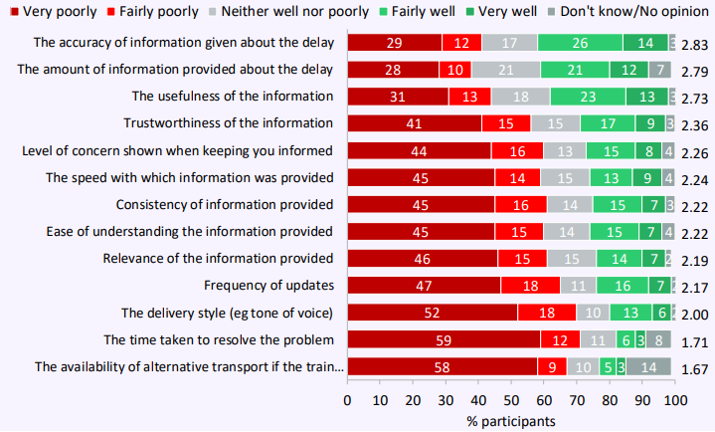
More than satisfying
Overall ratings of information are higher when it’s obtained by speaking to a member of train crew, or from an on-board announcement. Third is email/text. Whilst personalisation is likely the key, the tone and ease of understanding must also play a part.
You can’t magic up a bus but you can change the way you speak to passengers.
Overall rating of information provision
Delivery style – 70% rated it fairly/very poorly
Ease of understanding – 60% rated it fairly/very poor
Rail Delivery Group, PIDD-29 Research Waves 7-10, Dec 2018
Notes:
70% of delayed passengers rate style of delivery as poor
60% rate the ease of understanding as poor
Figures from RDG confirm that passenger ratings tend to be higher when they receive information on-board the train. They are lower in respect of online and apps.
Personalisation is likely to be the key. You’re going to be told what the impact is for the train you are on. But tone of voice and ease of understanding are also rated higher on-board.
The following examples help explain why that might be……

Slide 7
The railway’s wall of words
We anticipate platform 14 at Station A will be out of use until the end of service, with a view to assisting the train off the track, and potentially carrying out remedial work on the track at the earliest opportunity.
Looking ahead, we are also expecting this evening's peak to be impacted at Station B, with services being cancelled to ease congestion, due to the reduced number of platforms at the station. Plans are being worked on to operate as full a service as possible, but please note control are still working on the current services, and plans may be changed if progress is made on fixing the affected train earlier
Passengers requiring Station A are advised to circulate via London Station B or change at Station C for Rail services to Station D
Network Rail has received confirmed reports of a technical issue with the traction current, which has lead to an empty train being unable to obtain power at ……
Notes:
All of these examples have been anonymised as we try to work with operators rather than name and shame. Whilst not all messages are written in this way it was not hard to find these examples.
In the world of accessibility people often talk about inclusive design, language is no different. Write it in short, clear, plain English sentences and everyone should understand it.
The average reading age in the UK is nine years old. The average reading age of an adult in the UK is 11. Reading age doesn’t reflect comprehension age. Writing to a reading age is about speed. Not dumbing down but speeding up.

Slide 8
Disruption: what do passengers want?
Passengers say:
Treat me with respect – Speak to me, not at me. Language and manner of communication. Passengers talk about insincere, dismissive messages. Formulaic platitudes.
Recognise my plight – Words like abandoned and ignored often feature in accounts of delays by passengers. They perceive the industry to be focused on solving a logistical problem, overlooking the human impact.
Help me avoid the problem in the first place
You got me into this, help get me out – enable informed decisions. Provide robust estimates. “Help me decide what to do!”
Act joined up – We’re told it feels like there’s no co-ordinated approach. Inconsistency reduces confidence.
If the solutions passengers regard as 'obvious' aren't possible operators need to say why and what is being done instead
Notes:
Sometimes it is a question of explaining why what passengers consider to be an obvious answer isn’t possible e.g. passengers often don’t understand why when their train is cancelled you can’t just ask the following train to make some additional stops. When that train then speeds through the platform they just get frustrated.
Passengers do not want over the top sympathy
They want practical advice on what to do
If I’m trying to get to an airport and the route I want is blocked, don’t just tell me I can travel via another station. Tell me roughly how long that might take, as I need to know whether I’m going to make my flight or not.
Replacement buses – messages are usually sparse on detail. They often fail to say where the buses will stop and whether they are running to a timetable or not.

Slide 9
The need for plain English
In 2017 we sent a series of disruption alerts to the Plain English Campaign and asked them for feedback.
They told us:
There is far too much unnecessary jargon
There is too much repetition
The text is generally cold and distant –
All of which “can worsen the mood of already disappointed passengers”.
Some examples from the messages we sent:
“All lines have reopened” – It sounds very flat and impersonal not to mention distant, and impassive. Why not say “We have reopened”, it is more hands on and can-do.
“Require assistance” sounds robotic and unnecessarily complex. “If you need help”, simply feels more human.
No place for words such as ‘aforementioned’, ‘compounds’, and ‘rectified’. By including words that may confuse some of your audience you have a time-sapping knock-on-effect. This will further frustrate passengers.
Sentence length is a problem. At times sentences run to thirty-plus words. For optimum comprehension sentences shouldn’t exceed a 20-word maximum. Beyond that the message can often get lost.
Notes:
Jargon , it’s not always obvious words.
Use the ‘facilities’ example. Passengers not realising the guard was talking about the toilets being out of order.
Repetition slows you down and can inhibit comprehension
Sentence length often double the recommended number of words in disruption messages.

Slide 10
The language of the railway
Railway jargon:
Too often control rooms slip into using railway phrases that wouldn’t be used when face to face with passengers e.g. mutual ticket acceptance, ticket easement, rectified, conveying, en-route, adhesion problems, ‘precarious tree’! …
“Network Rail, who own and maintain the railway infrastructure, have been advised of this issue and their engineers are en route site to rectify the problem with the set of points.”
”if you have a valid ticket you can use it on Dan’s Trams between…”
How do passengers know whether their ticket is valid? Very few train tickets are valid on other modes.
What’s wrong with “During the disruption you can use your Dan’s Trains ticket on Adam’s Trams to help complete your journey…”
Notes:
Is jargon partly the result of being in the high pressure environment of control. When under pressure it is easier to slip into comfortable, familiar, language.
Is it also a feeling of professional pride – “I have to act professionally” gets confused with writing formally.
Words and phrases need to be 100% self-explanatory.
Ticket acceptance
What’s a valid ticket e.g. advance fare only valid on one train, do all passengers know they’re entitled to catch the next train is theirs is cancelled.?

Slide 11
If there’s a need to explain it….
“We currently have the following ticket acceptance in place with other train operators, meaning you can use your existing ticket to travel with them on the below routes”
This is better than just saying “ticket acceptance”, but why use it and then have to explain its meaning? You don’t need to educate passengers, just speak to them as though you were face to face.
Due to a track circuit failure between Station A and Station B trains have to run at reduced speed on some lines.
Our control centre has received reports of signalling problems between Station A and Station B. The problem is a track circuit failure which means that signals remain red as the signalling system cannot verify that the track beyond the signal is clear.
As a result, all trains have to stop at each affected signal and seek verbal permission from the signaller and complete paperwork confirming their authority to continue prior to proceeding.
This process takes approximately 10 minutes at each affected signal per train, so the effect of this type of delay compounds quickly for all trains affected.”
Notes:
Getting it right means you shouldn’t have to explain what you mean.
Some operators want to provide an extra level of detail. Can more be made of the “delays explained” pages on Network Rail.
The longer and more detailed a message is, the harder it is to keep up to date as things change.

Slide 12

Information overload
Written explanations need to be crystal clear, ‘at a glance’ – many passengers will read them on a smartphone whilst rushing to the station. Most people read only 20% of the content on a web page.
The first paragraph seems a very wordy way of saying: “we need to replace 60 metres of cable. It’s a complex job and will take a long time”.
Specialist engineers have successfully replaced the faulty component, however there have been further issues stabilising the power supply. After a thorough inspection of the track on this route it has been discovered that an object has become wedged underneath the third rail, causing a short circuit due as a result of cable damage that has occurred as a result. Works are being started now and will require the replacement of approximately 60ft of cabling, which has to be specially cut and brought up from xxxxxxxx. In order for this to take place a number of other components will also need to be removed and replaced to enable the new cabling to be installed. (113 words)
OR
Network Rail replaced a faulty part, but other faults have since been found. These have damaged the cable supplying power to the track. Engineers need to replace 60 feet of electric cable. This has to be delivered from xxxxxxxx, and will take a long time to fit as other parts have to be removed to gain access. (55 words)
= 20%
Notes:
Passenger need to be able to read it once and understand the point of the message straight away.
Web users skim pages for information. Text and pages should be designed to help that.
Look at the BBC News pages.
This example – the readability of the longer paragraph compares to the editorial in the Guardian/Telegraph.
Visitors to webpages only read 20% of the text as they skim the page looking for the information that they need. Why make their life more difficult by including lots of unnecessary text.
Including the extra detail also makes it harder to keep up to date if the incident drags on throughout the day. Incorrect text undermines the trust that the reader has in the rest of the information on the page.

Slide 13
Mixed messages
“Please continue to travel as normal but allow extra time to complete your journey”
The expected ‘problem fix’ time is often very different to when disruption will come to an end. Make the difference clear.
Passengers are often told services are returning to normal when there are still significant delays and cancellations. Sometimes up to 45 minutes.
“We expect disruption until”
Headline: Due to a fault with the signalling system at Station A, all lines are blocked.
(They’ve been blocked for two hours)
Impact: Train services may be cancelled, delayed or revised”.
Advice: Customers are advised Not to travel.
Why doesn’t the impact support the headline or advice? There’s nothing running on that stretch of track, but no where does it say trains are at a standstill.
Notes:
What’s normal?
Are some of the descriptions limited by the templates provided by messaging software.
Push the providers to offer a more flexible product.
May be cancelled – Hard to balance when some services are unaffected but when nothing has run for 2 hours it should be possible to be more definite.

Slide 14
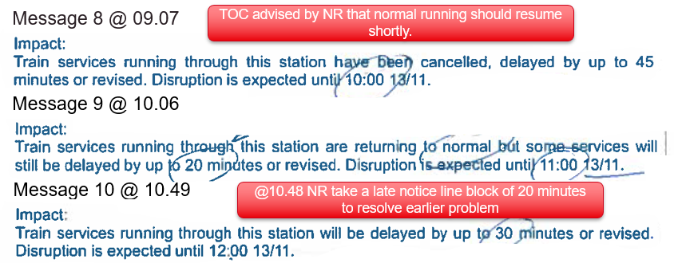
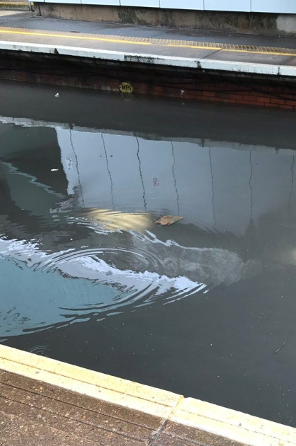
Communication breakdown
Estimates – Provide the key to passengers being able to decide what to do. But often milestones are missed or revised with little notice.
Guard against over-optimism and work with Network Rail to identify a way of improving the flow of information and accuracy of the estimates provided.
Context – “A fault with the signalling system”?
Notes:
Estimates for delay are the foundation for decisions made by passengers in respect of whether to continue their journey
Context aids understanding a
Both hand back an element of control to the passenger.
Disruption is expected until – No distinction between the track will be fixed at, and trains will be delayed whilst we get things running again.
Moving goalposts

Slide 15
The human touch
Passengers use the following words to describe the style and tone that they want for disruption announcements: genuine, engaged, alive, caring, apologetic.
A conversational tone helps prevent messages appearing scripted and robotic.
The importance of tone is easily overlooked when the focus is on facts.
Passengers want someone to ‘own’ their problem and be proactive in giving out information. When communication is poor they are left with the impression that operators are not willing or capable of doing so.
“I was going to say about these automated voices, I think because they’re not human you feel disconnected from it so you don’t trust what you are hearing. So if you hear an automated voice you’re thinking, well, they’re just playing something to placate people”
“Female conductor made manual PA announcements and was honest about the cause of delays outside Manchester and Liverpool, rather than relying on automated announcements. She sounded genuinely sorry”
Notes:
Don’t underestimate the importance of tone
Passengers like hearing from humans so why make text sound robotic
Contrast the two quotes – disconnected, placating vs honest and genuinely sorry

Slide 16
Frontline staff
At the station
Customer information screens are the first place passengers look, but passengers assume live audio announcements override them. These are also more likely to be tailored to the situation. Visible presence is also key.
“ One reason for delay given at the station and on line – two different reasons given on the train”.
[Peterborough to York]
On the train
Passengers want delays acknowledged by onboard staff within two minutes of an unscheduled stop. After that they want new information or reassurance that it’s being asked for.
“Very professionally managed by a conscientious conductor. First Class compartment declassified, compensation forms given out, regular PA announcements explaining the reasons for delay and providing updated ETAs in addition to regularly passing through the train, maintaining high levels of visibility, re-assuring passengers and providing help/advice with connections”.
Huddersfield to Manchester Piccadilly, 16 – 30 minutes delay, very satisfied.
Inconsistency and being told nothing results in strong negative reactions from passengers.
Notes:
Saying nothing leads to very strong negative reactions
On-board information needs to get better
Staff provide valuable reassurance
On-board there has been a noticeable improvement when train comes to a stop, but what about in between signals when you know as a passenger there is something wrong, but you’ve no way of knowing impact.
Consistency across the front line staff and those writing disruption messages.
Put staff in passenger shoes.

Slide 17
The core message
There’s a strong case for focusing on core message quality – everything else is derived from it during significant disruption.
Do you understand your own performance?
- Do you review the passenger information after major incidents?
- Currently no reliable measure of accuracy at the time passengers are consuming info from info screens etc.
- Checks on third party sites: National Rail Communication Centre, third party retailers, BBC etc. What are they telling your customers about you?
- Are the messaging systems/templates you use giving passengers what they need?
Are your staff able to focus solely on passenger information?
How can individuals be helped to improve?
How do you replace experience?
Notes:
When chatting to information managers about poor messages, they often say “I know who wrote that”. Everyone might have their own style and character, but is it acceptable that passengers receive different levels of information (details) depending on who’s on shift in control?
There’s a good case for an organisational style guide, and reviewing the way you speak to passengers across different channels. But it requires hearts and minds to be shifted.

Slide 18
Contact Transport Focus
Dan Taylor
dan.taylor@transportfocus.org.uk
0300 123 0838
transportfocus.org.uk

