Slide 1
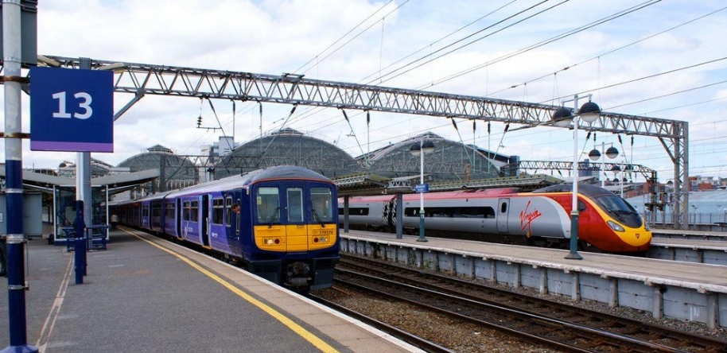
Transport User Panel: Train Power Survey
August 2018

Slide 2
Headline findings
On Friday 6 July Transport Focus sent a survey to their ‘Transport User Panel’ which asked those who had used the national rail network within the last month for their views on the way in which trains are powered. The survey closed on Thursday 2 August. This report presents the survey findings based on 4,145 completed questionnaires. Where figures do not sum to 100 percent this is due to computer rounding.
More than 80 percent of panelists were able to identify whether the last train on which they travelled was electric or diesel-powered. Only slightly more than one in ten say that they wouldn’t be able to recognise how the train was powered at all. As panelists tend to be engaged with rail issues, we would expect this group to be better than the wider train-using public to be able to recognise how the train is powered.
More than 90 percent of panelists say that they try to do what they can for the benefit of the environment and almost 80 percent agree that electric trains are better for the environment. However, almost half agree that if the train is on time and comfortable they don’t care how it is powered.
Cheaper fares, greater reliability and frequency, and reduced journey times are most likely to lead to an increased use of trains. Making trains more environmentally friendly is less likely than other factors to have this impact. 16 percent say that they are much more likely to use trains if they were made more environmentally friendly; a slightly higher proportion, 18 percent, say the same if all trains offered free and high quality WIFI.
It would appear therefore that passengers put more importance on the potential operational benefits of electrification (i.e. improved reliability and speed) than they do on the positive environmental impact of this change.

Slide 3
Recognising the type of train
Panelists were generally able to identify whether the last train that they used was electric or diesel-powered. More than 80 percent select one of these options when asked how the train was powered, while only slightly more than one in ten say that wouldn’t be able to tell the difference.
Thinking about the last time that you made a journey by train and thinking about the train itself, do you recall whether it was..?
I wouldn’t be able to tell the difference
I don’t recall which it was
An electric-powered train
A diesel-powered train
Base: Panelists who have made a journey by train in the last month (4,145)

Slide 4
Attitudes towards train power
More than 90 percent of Panelists say that they try to act in the interests of the environment and almost 80 percent believe that electric trains are better in this respect. However, almost a half agree that if the train is on time and comfortable they don’t care how it is powered.
Agree
To what extent do you agree or disagree with the following statements?
I try to do what I can for the benefit of the environment
92%
Electric trains are better for the environment
77%
If the train is on time and comfortable I don’t care how it is powered
48%
All new trains that are built are electric
24%
Diesel-powered trains are more reliable than electric ones
8%
Base: Panelists who have made a journey by train in the last month (4,145)

Slide 5
Increasing use of train
Cheaper fares, improved reliability and frequency, and quicker journey times are most likely to lead to increased use of trains. More so than making trains more environmentally friendly. 16 percent of panelists say that they are much more likely to use trains if they are made more environmentally friendly; a slightly larger proportion say the same if all trains were to offer free, high quality, WIFI.
To what extent would you be more likely to travel by train if..?
Base: Panelists who have made a journey by train in the last month (4,145)

Slide 6
Panelists views on train power
Panelists were asked to share any views that they had about the use of electric or diesel trains. A variety of positions were stated. Some of these are indicated below.
“[I have] no preference as there is pollution from generating electricity. Reliability is important.”
“Diesel is necessary where routes are not electrified however, they should be much cleaner. Battery, hybrid, bi-mode tech is an expensive sticking plaster to mitigate failed electrification programmes. I also don't believe their whole life environmental impact is any better than modern diesel.”
“Electric trains are ok until they fail or the supplies fail – then you need a diesel to drag them out of the way. New trains should have the option to be self propelled in the event of supply failures.”
“I prefer electric trains, they're quieter and more environmentally friendly.”
“The greatest problem with electrics is inflexibility when line problems arise. Diesel and Bi-mode can possibly be diverted to non electrified routes whereas of course electrics cannot. I would like to see studies made comparing the environmental impact of ultra low emission diesels against the generation of the large quantity of electricity needed for our, hopefully, expanding rail network.”
“I was sorry to see the government abandon some of its electrification plans e.g. to Sheffield and Swansea on environmental grounds and for what it means for those cities affected - hybrid trains are for me at best a compromise solution. Other countries have been far more wedded to electrification for many years and it is clear to me that, once it is installed, it is preferable on environmental grounds, cost, wear and tear and journey times.”

