Slide 1
Luggage on long distance services
August 2017

Slide 2
Research summary
HS2 is currently planning train design
A crucial component will be luggage storage
In order to aid the design process Transport Focus are undertaking research to ascertain
The volume and type of luggage taken on long distance services
Quantitative counts
Qualitative observations and intercepts
The experience and views of luggage on passengers on long distance services
3 days of fieldwork:
Kings Cross
Euston
Paddington
Details on following slide
Caution: qualitative findings are based on a small number (approximately 25) intercept interviews as well as observations. Services observed and sampled may not be typical of all long distance experiences. Therefore whilst findings are indicative, extreme caution should be applied when making decisions based on this research alone.

Slide 3
Luggage Count Quantitative Research

Slide 4
Quantitative research method breakdown
A total of 63 shifts in total, 21 each at Euston, Kings Cross and Paddington
At each station, three shifts was completed every day of the week. Times of the shifts were:
6am – 11am
11am – 4pm
4pm – 9pm
In each shift interviewers were instructed to cover selected trains and to count passengers and luggage for each of these trains. They were positioned at the platform and completed paper record sheets
In total 103,046 passenger observations were made. 30,640 at Euston, 37,125 at Kings Cross and 35,281 at Paddington
Shifts were done in July before the school holiday start (10th-22nd July)

Slide 5
At all stations, almost 9 in 10 passengers travelled with an item
% of passengers with and without any luggage
Base: all observations (103,046)

Slide 6
Across all times of day more than 8 in 10 passengers had luggage
By time of day
Base: all observations (103,046)

Slide 7
Across all stations and times of day more than 8 in 10 passengers had luggage
Euston
Base: all observations (103,046)

Slide 8
Across all stations and times of day more than 8 in 10 passengers had luggage
King’s Cross
Base: all observations (103,046)

Slide 9
Across all stations and times of day more than 8 in 10 passengers had luggage
Paddington
Base: all observations (103,046)

Slide 10
More than a quarter of passengers travelled with more than 1 item
Mean number of items: 1.4 per person (of all passengers with luggage)
Mean number of items: 1.2 per person (of all passengers)
Base: all observations (103,046)

Slide 11
At all stations, over 80% of passengers had 1 or 2 items
Euston
King’s Cross
Paddington
Base: all observations (103,046)

Slide 12
There were significantly more passengers with 2 pieces of luggage in the ‘morning’ and ‘afternoon’ time slots than at other times of day
Travelling with more than one piece of luggage
Overall Mean:
1.3 items
Overall Mean:
1.2 items
Overall Mean:
1.1 items
Overall Mean:
1.1 items
Overall Mean:
1.2 items
Base: all observations (103,046)

Slide 13
77% of all passengers travelled with a small carry on suitcase/
holdall/backpack and 15% with a large suitcase/holdall/backpack
Base: all observations (103,046)

Slide 14
The most popular item of luggage across all stations was a small carry on suitcase/holdall/backpack
Base: all observations (103,046)

Slide 15
11% of passengers with small carry on suitcase/holdall/backpack also travelled with a large piece of luggage
Base: those with small carry on suitcase/holdall/backpack (79,412)

Slide 16
55% of passengers with large suitcase/holdall/backpack also travelled with a small carry on suitcase/holdall/backpack
Base: those with large suitcase/holdall/backpack (15,864)

Slide 17
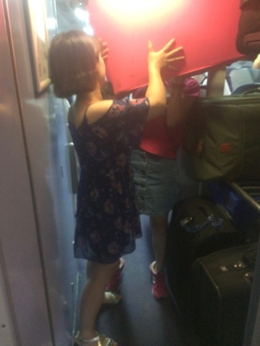
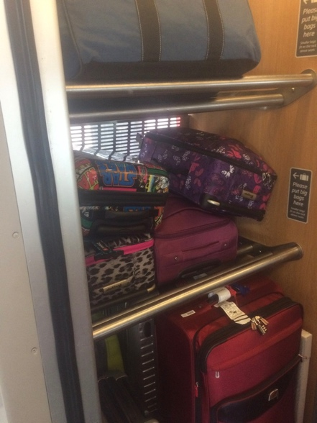
Luggage and the Journey Qualitative Research

Slide 18
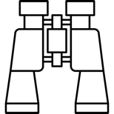
Qualitative research method breakdown
Observations:
Behaviour of groups and individual passengers with luggage
In station on concourse
Boarding trains
On trains
Alighting trains
Intercepts:
5-15 minute interviews with passengers with luggage and those without
On concourse
On trains
 | Kings Cross | Euston | Paddington
Date | 7/7/2017 | 13/7/2017 | 11/7/2017
Trains observed | 1300, 1700 Edinburgh 1719 Hull | 19.00 Manchester c.18.30 Birmingham | 16.06 Penzance
Trains boarded | 1330 Edinburgh to Newark Northgate 1456 Kings Cross (started York) | 15.20 Manchester (Milton Keynes) 16.00 Euston (Manchester) 17.20 Manchester (Milton Keynes) 18.00 Euston (Manchester | 18.06 Penzance 11.15 Cardiff to Bristol Parkway 13.32 Paddington (started Cardiff)
7/7/2017 additionally boarded:
11.03 Reading to Paddington (Carmarthen service)
17.06 Paddington to Reading (Penzance service)

Slide 19
Luggage on long distance services: Contents
Research method
Luggage and the journey
Stages of the process
Traveller types
Security
Views on luggage
Preferred
Importance
Types of storage
Pragmatism
Current
Ideal
Summary

Slide 20
Context of luggage is in overall travel experience…
WiFi
Getting buggy on
Getting work done
Keeping family together
Cost
Starting the holiday
Baby changing facilities
Meeting up with people
Heating/ air conditioning on train
Connections
Whether get a seat
Keeping my belongings safe
Experience of traveller
Reason for travelling
Finding seat
Reserved seat
Finding somewhere to place bag
Getting there on time
Help getting on train

Slide 21
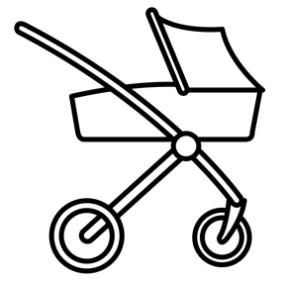
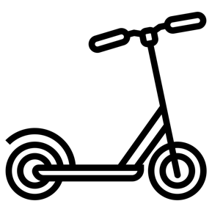
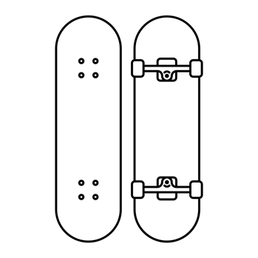
Many different items are taken on trains! Some of the items witnessed…
Handbag/ rucksack and wheelie case is most typical

Slide 22
There is often a sense that trains are getting busier because more people are travelling and with more luggage
More people on trains and more luggage
Responses:
Lack of luggage space is driven by overcrowding: TOCs should not sell tickets where there is not a seat available
They do well with the available space/ storage fine/ can’t lose seats
Area for luggage is not big enough/ need to change the luggage space
People are travelling with more things – trains aren’t keeping up
Leisure traveller
People are encouraged to travel by public transport – something needs to be done
Business traveller

Slide 23
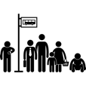
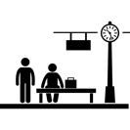
Several stages to a journey. Strategies and implications for luggage at each stage
Planning the journey
Getting to the station
At the station
Getting to the platform
1
2
3
4
5
Finding a seat & storing luggage
Disem-barking
Boarding the train
8
Journey
7
6
9
Travelling with luggage is not pleasant. When on the train its okay – its getting there (Business, frequent)
Each stage is important – its not all about being on the train
Reaching destination

Slide 24
Planning the journey is primarily about cost and timing
ARRIVAL:
Train arrival needs to be at convenient moment
(e.g. to allow evening out, to get back as quickly as possible after a meeting, to go after work)
Planning the journey
1
PEAK vs. OFF PEAK:
‘Peak’ – means ‘busy’ to some
‘Off peak’ – means ‘busy’ to others
eg: service to Manchester, Penzance and Edinburgh at around 5pm were quieter than those during the day because they were priced for ‘peak’ fares
COST:
Leisure travellers (and some business) want to find the most cost effective fare
(Price was the important factor for many in terms of their choice of train and would weather some discomfort in order to be able to access lower fares/ travel at a less convenient time)
Trade off between all three dynamics but ultimately most want to get a train that suits their needs and so would compromise
If the train I wanted was at a busier time I would just get on with it (Leisure, frequent)

Slide 25
Luggage and seats are part of the more detailed planning
RESERVING/ BOOKING SEATS:
Having a seat is fundamental to journey satisfaction and reserving is often central to that.
May attempt/ wish to reserve seats next to rack or have other requests/ requirements (not travelling backwards)
BUT not everyone is able to plan and/ or feels confident enough to be able to reserve a seat
BOOKING ASSISTANCE
Planning the journey
1
ORGANISING A SOCIAL OCCASION:
Picnic/ drinks/ part of the trip
APPROPRIATE LUGGAGE:
Able to be carried if necessary/ enough for needs of visit/ maneuverable/ small enough to store over head/ able to get to end destination/ interchange/ be able to lift
May think about previous experience travelling and plan accordingly
If a lot of luggage required/ longer stay/ complicated journey would:
Go by plan
Travel by car
Perception that travelling by train at short notice is very expensive and again may be a reason for not using for leisure purposes rather than luggage related issues
MORE PLANNING/ THOUGHT REQUIRED WITH LUGGAGE THAN IF TRAVELLING WITHOUT

Slide 26
Travelling to the station and to the destination have similar challenges
Getting to the station
Reaching destination
2
8
Consideration of luggage is not just getting it on the train but getting it to the station of departure and arriving at the destination
Travelling on the underground cited as difficult with bags
Escalators not working, crowded trains, having to carry bags up stairs, getting through barriers
For this reason people like to be confident they can carry the bag if necessary, they like to have time to get to their destination or will go early to avoid a rush
Rucksacks or non standard luggage can be more of a challenge on the underground
We won’t just take as much as possible, we have got to get to the hotel (Leisure, infrequent)

Slide 27
At the station waiting for the platform announcement is key for those with luggage
Most people waiting on the concourse have an item of luggage. All stations researched do not announce platforms until trains are ready to board and so this means all eyes are on the departures screen with sudden surges of people when platforms are called
At Euston this was at its most boisterous – likened by one passenger to a ’stampede of Wilderbeast’
Regular business travellers may ‘know’ which platforms are used and will wait at the gates to the platform
At Kings Cross items seemed to mostly be smaller, cabin style bags. Euston and Paddington there were more with larger bags/ more items and trollies were available
People talked about the availability of ‘lifts’ at stations as being helpful even if they didn’t use them. This compared favourably to LU or stations that did not have lifts and also to smaller branch stations
Stress points particularly for single passengers include using facilities and buying tickets – where watching luggage can be tricky to achieve
It can be an anxious experience waiting for the announcement or getting to the platform if the passenger expects the train to be busy and/ or has not got a reserved seat. Regular passengers will position themselves in a good place to ‘run’ once platform announcement made
Sense that arriving 30-40 minutes in advance of departure is necessary
Lady with mobility issue felt vulnerable/ that she was holding people up
At the station
3
Getting to the platform
4

Slide 28
Boarding the train about finding the reserved seat
As noted at stage 4 boarding tends to happen en-masse because platforms are not announced until trains are ready
Virgin Trains provide information about where to board the train, FGW do not and there are no markings (visible to researcher) at Paddington to show where individual carriages are located
A purposeful but reasonable pace is used by most passengers who are focussed on finding the carriage where their reserved seat is located. Few are looking in the windows for for available seats (although with an electronic display this would not be possible to discern)
Boarding at station which is not at the start of the journey can be more challenging – more time pressured and there may be no indication on the platform or through announcements where it is that you need to stand to find a seat or particular service (ie disabled carriage)
Those who have mobility issues can find boarding more tricky – they are concerned about holding people up, of making a ’traffic jam’ but it could also be a concern – for example getting knocked or falling over
People may need help in getting bags lifted onto train.
DISEMBARKING: People with luggage tend to start getting their belongings together in good time before the station is announced and retrieve their luggage – they might wait in the vestibule
Boarding the train
5
Disem-barking
8

Slide 29
Finding a seat is key and place for luggage mostly secondary to that
Finding a seat is the absolutely key priority for all those who are boarding. There might be some anxiety around if someone is sitting in their reserved seat, or if no reserved seat and a busy service, finding a seat at all
Where to place bags is the second priority. OR couples or groups may work in a team to do both ‘jobs’ simultaneously
People may place their bag in the luggage rack and return for it once they have found their seat if it can be stored over head
Those with no reserved seat might check for unreserved carriage or get on and walk through the train until they find one
People with reserved seats tend to stick in them – and say they would do so even if a quieter carriage was available
Where there are a lot of passengers boarding at once there is a bit of ‘chat’ ’are you going that way’ ‘good luck with that [pointing at bag]’. A general sense of tolerance, patience and cooperation
Although those having difficulty finding a place to store their bag can be visibly stressed/ frustrated. They might have to hop and off the train
Process can be fraught but it is acknowledged it is soon forgotten
Finding a seat & storing luggage
6

Slide 30
During the journey ensuring luggage is safe is key although some are happy to put at the back of their mind
Most people divide any luggage into a ‘day bag’ with what they need for their journey and the larger bag which once stored is not returned to other than to check it is still ‘there’ if this is a concern. Valuables such as laptops are often removed if they have been stored in the larger bag
Those who were regular train users (or commuters) that had experienced travelling on services with luggage were generally understanding about the issues it could cause – being knocked, having to help people, having bags in aisles/ by doors. In most instances the issue for them was that the train was ’busy’ and not the luggage itself – although some did mention more anti-social behaviours such as storing bags on seats and suggested some gentle education might be useful as well as more storage available
Generally once a seat has been located and any luggage stored there is not a great appetite to move.
A barrier for those with luggage on busy services will be physically getting through the train (as vestibules can get blocked with those standing)
There is also a feeling that moving through the train with luggage is in itself a difficult proposition and something to be avoided
An anxiety that the seat you have taken will be gone if you return
This lack of mobility can mean that people could be ‘stuck’ in a carriage that they have boarded even if there are seats elsewhere
Sometimes people may re-store bags – so for example if they see that a bag on the rack could be stored above them
8
Journey

Slide 31
Issues with luggage during the journey observed and fed back
Larger/ odd sized/ backpacks are more difficult to place in racks and cannot be stored over head
Having to store bags away from seat can be stressful or simply impossible to bear so people might have very big bags on their laps or under tables, or stand next to them
Having to store luggage where can’t see it and then needing to check it at regular intervals/ feeling anxious
Juggling different items whilst blocking doors and gangways can feel very pressured – although this feeling might fade once bags are then stored and the passenger is seated
Walking through the train with luggage – for some out of the question because they can’t wheel their case, and generally thought to be tricky and to cause issues with banging into other people
Having to lift bags to store them – some can’t reach or can’t lift bags
Finding somewhere to sit and store bags but being in a reserved seat so having the potential for someone to claim it and have to move
Having mobility issues adds difficulty to the above
Getting to the station and on to train where there are crowds

Slide 32
Traveller types

Slide 33
Pragmatic
They are not necessarily mutually exclusive but there are four different types of experiences to luggage amongst travellers
Planner
Teamwork
Anxious

Slide 34
Pragmatic
Pragmatic travellers will be looking for a seat (in the right place) and for somewhere close to store their bag but are adaptable
They are adaptable – they might have an ideal scenario but have experienced when things have not gone this way and can ‘cope’
They won’t or can’t make a compromise on their journey based on comfort – they might experience difficult journeys
They might be more regular travellers
They would like to be able to see their bag – but value having a seat more. If they are more ‘anxious’ they might check it periodically during the journey. Others would be happy for it to be in a different carriage
Regular travelling family who strongly preferred to have the ‘disabled’ space on FGW services as it meant that everyone could stay together
Student regular traveller to Edinburgh with backpack and several small bags which she stowed wherever she could
I will sit on my bag if I need to (Younger regular leisure traveller)
Multigenerational family travelling to airport from Newport with luggage to airport. Had experienced standing during journey
Older couple travelling with luggage but did not use service with booked seats because of a change in their plans
We just hope and don’t worry (Older leisure travellers)

Slide 35
Planners think about their journey and try to make it as easy as possible
They want to have a seat and to have somewhere to store their bag
Planners may take bags that they know will be easy to store – so overhead or even if this is not possible or available as an option, by their feet
They might book first class – so they have more room
They might book seats next to luggage racks so they can easily keep an eye on their bags
They make sure they are at the station early, ready for boarding
They have knowledge of when services are likely to be busy
Regular business traveller to London from Manchester. Liked to be able to see bags and found travelling with luggage to be hard work
“I always take as little as possible on the train, even when you get off the train you still have to lug it” Older female leisure traveller
I’ve got a seat so I don’t need to worry. I can see the reservation level on the train is low so I know the service is not too busy’ Male younger leisure traveller
Younger male leisure traveller. Always booked his seat and packed carefully
‘Peak services are better. Off peak, there is not one seat. You have no chance with luggage to store where its not obstructive’ Regular business traveller
Mother and daughter from York to London – pack to ensure not carrying too much to make journey easier

Slide 36
Anxious travellers have to have bags close to them
Key to have bags close and visible at all times
If this means that they need to stand next to it, then they will do so and will not risk leaving a bag unattended for any length of time
They might sit with a bag on their lap (even a very large one), or in front of them
Being in the same carriage is not good enough, would need to be in the same half and within sight
Walking through the train to look for a seat with their luggage may not be an option if their case is too big or they don’t feel able to negotiate that
Irregular leisure traveller – stood next to medium sized bag for duration of journey
I know people who have had bags taken
Physically impaired irregular leisure traveller who took small bag so it could go on seat next to her
I don’t like crowds, I travel when it is less busy

Slide 37
Team work means finding a seat and storing luggage is more straightforward
Teamwork might be in a family or in a small travelling group
Tasks are divided – often without prior agreement, just what ‘happens’
One person will be responsible for locating the seats and the other for either watching bags during this process (and children) or keeping them ‘safe’
Either motivated through efficiency (eg having to move bags if not stored in appropriate place), or not wanting to have to move bags through the train
It is a less ’stressful’ process than if on their own
If travelling with a buggy and luggage would be unable to do the journey on their own
Travelling with others makes it easier (Regular leisure traveller)
Family travelling with several bags and 2 young children to Manchester
If am by myself its stressful, but if the two of us its not (Female, irregular leisure traveller)
Leisure couple (40s) travelling to London for the weekend with several cases. Wife cannot lift bags so she finds the seats
Travelling with bags not a fun experience, one will get on the train with the kids, one will sort the luggage (Family of 4, regular leisure)

Slide 38
Views on luggage

Slide 39
The key concerns about luggage – having it safe, secure and accessible
Security – lots of bags about, who do they belong to?
I can’t leave my bag unattended – all the security announcements tell me that
Where am I going to put my bag, I can’t lift it up there
I don’t want my things to get stolen
There are lots of bags in that rack – will I be able to get mine out in time?
How am I going to get out at my station when all these bags are blocking the exit
Look at all those bags piled on top of mine – my stuff is going to get damaged!
If someone gets on and asks me to move my stuff what am I going to do?
What if someone takes my case by accident, I had better keep an eye out at the next station stop
If I put my bag up there its going to fall out

Slide 40
What is important for luggage storage?
Having a bag close:
In same carriage
Next to
In same half of carriage
Easy to put on
Being able to see the bag
The bag being secure and not squashed
Easy to get in and out of the space
Not too high
Out
of the way
Safe (not getting removed/ stolen

Slide 41
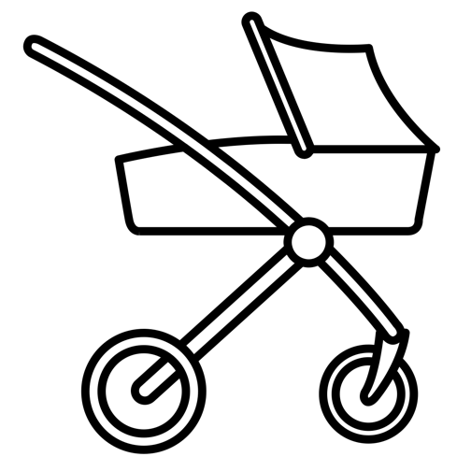
Challenges with luggage
Buggies and prams only fit in the vestibule area or in areas designated for disabled people. There is no signage to indicate they have any priority after disabled people for this area. It is not always clear where these areas are so boarding they can be ‘blind’ or try and spot the sign on the outside of the train
Keeping items like laptops safe if need to visit the toilet
Large rucksacks can be difficult to store – they are irregular sized
Larger suitcases may not fit into luggage space (too high/ full/ only higher shelves available) and it can then be very difficult to carry them through the carriage
Cabin style bags are assumed to fit overhead but don’t always

Slide 42
Storage solutions

Slide 43
Above the seat storage is not always consistent and can be difficult for some to access
Overhead storage is a good solution for some – it provides a clear vantage point for luggage so satisfies the need to be able to see bag, have it close and keep it safe
Not everyone can access these – those who are less tall in stature and also who are less strong or have back problems feel less confident. They might choose to have the bag on the seat instead of using them if they were anxious about having it close or use a luggage rack
There is an assumption that a cabin sized bag should fit in them, however this is not always the case and some trains would only fit a handbag/ coat size item. This was compared by some travellers between TOCs.
Having a air cabin style system was suggested by some – as this made it more easy to access and prevented bags from falling out
Virgin East Coast had labelling on the luggage racks indicating they were for larger items and directing people to use the overhead storage for smaller items
This might help guide some of those who choose to place items in racks who could store ahead but not for those who find them difficult to access

Slide 44
Check in/ luggage van a popular idea and addresses some issues and preferred to separate transportation
Check in/ separate secure storage
Separate transportation
Mid carriage
Very positive reception to this idea. Many thought it would only work from start station to end station as otherwise it would cause too many delays
Keeps bags safe and secure
Mostly do not access bags during journey
Not having to lift
Would not travel with more bags – would still need to get to the station/ from the station
Useful to know if service was available to pack accordingly
Most were strongly negative about this idea
May add time
Worried about loss of control
Concern bags would get lost and delayed
Adds an extra dimension to the journey
Solves issue of end to end luggage potentially and for some this was appealing/ would be appealing
Potentially solves safe and secure but lack of control counterweights this
Many suggested this idea spontaneously
Means can see luggage so reduces need to check and anxiety
Perceived to reduce the ‘blocking’ of the entrance and exit of the carriage
A few raise concern that it would result in more carrying bags down the aisle ‘the biggest irritant’
Virgin Trains have these in place

Slide 45
Between the seats mentioned spontaneously as a good solution
Between the seats
Under seats
Limits per person
Not specifically prompted for but many mentioned behind seats/ between seats storage
Able to see bags/ have them close
No lifting
People mentioned it as something that had been on trains in the past that they had used but was now not available or was smaller. Described by one leisure respondent as ‘ideal’
People were positive about this in that it could allow more possibilities to store bags close
Able to see bags/ have them close
No lifting
Would also mean more leg room
Compared to storage on airlines. Some acknowledged that this would mean fewer seats
Negative/ hostile response
Difficult to enforce
If paid for a ticket should be able to take what you want
If passenger can carry/ manage luggage they can take what they want
Size of bags was thought to be more of an issue and educating people on how/ where to store

Slide 46
Other thoughts on what could make travelling with luggage easier
Space between seats (to store bag in front of knees)
Being able to book seats near a luggage rack (NB: some people said that they do this)
Drop down cabin style compartments for above seat storage
More direction/ notes/ suggestions about where to store items
Having lockable storage
Adding those with buggies as 2nd priority after disabled people on designated disabled spaces
Removing gap between platform and train to aid boarding and disembarking with wheelie cases
More similar to ‘aircraft’
Wider aisles

Slide 47
What makes a good versus a bad experience travelling with luggage
When the service was quiet and there was available storage of the type they preferred*
When there are people available to help
Using assistance
Where services are crowded and they have not been able to find a seat and/ or anywhere to store their bag
When trains are cancelled and therefore services are more busy
When they have had to stand next to luggage or sit on luggage for long periods
When they have not been able to board services
Where they have felt like they cannot get off services because of crowding and luggage
Good = less busy
Bad = very busy

Slide 48
Comparing TOCs
(From Euston)
(From Kings Cross)
Where respondents made a comparison they were often more positive about/ favourable towards Virgin Trains. Observations on Virgin Trains (from Euston) were that there were places to deposit luggage at regular intervals, coat hooks, labels and signage to indicate where things were and what to store where. Above seat storage was big enough to store flight bags. People liked the information about where to board
Not specifically prompted for in intercepts or observed for but…
Variety in types of arrangements on trains boarded. Some (on shorter distances) appeared to have more pressure on the available space. Overhead spaces not always large enough for cabin bags
One respondent compared Virgin Trains (Manchester service) favourably to XC because there was more space between seats (to store bag in front of knees) and overhead
There were mixed responses about shorter distance services. Those travelling at non-rush hour times who had luggage and made reference to other services indicated there were no issues. However a service which covered an airport (Manchester) was criticised for luggage space preventing commuters from using the service

Slide 49
Illustrations of findings

Slide 50
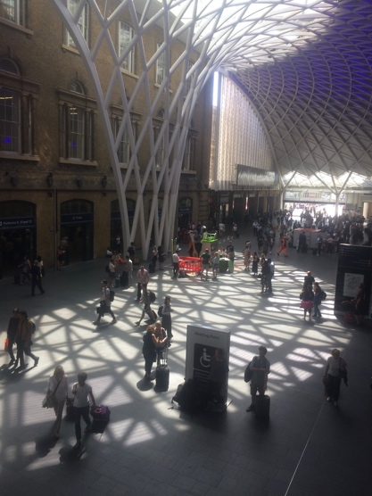
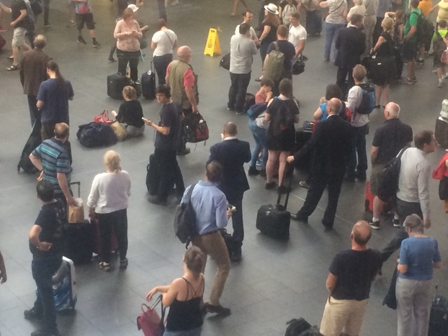
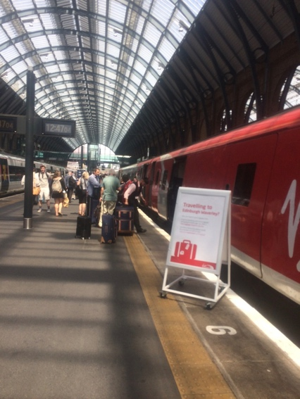
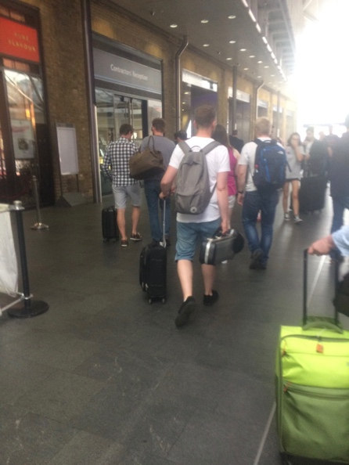
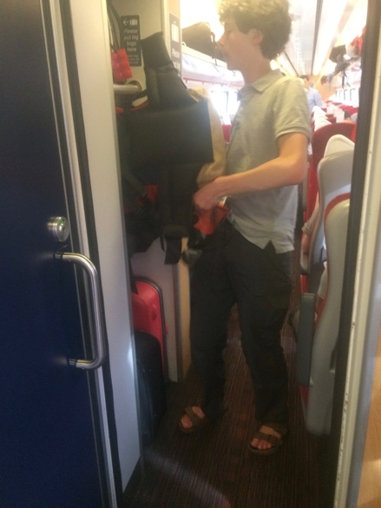
Kings Cross
13.00 to Edinburgh – very busy service. Bag drop offered
Concourse at 12.30 – not packed but people congregating around board
Orderly procession to the train
This chap tried several times to get his rucksack to fit in before disembarking and trying another carriage
Some quite small bags in the luggage rack

Slide 51
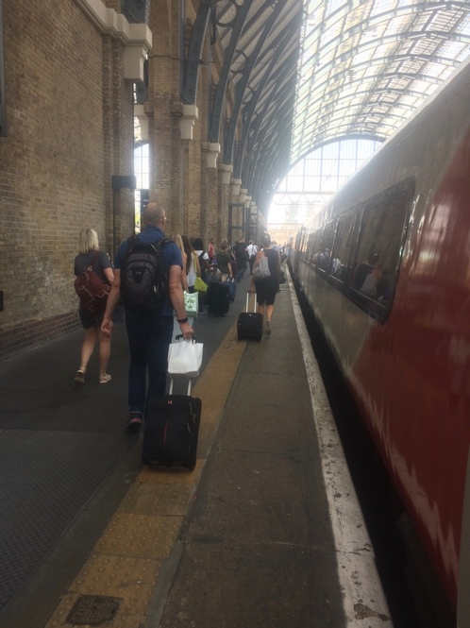
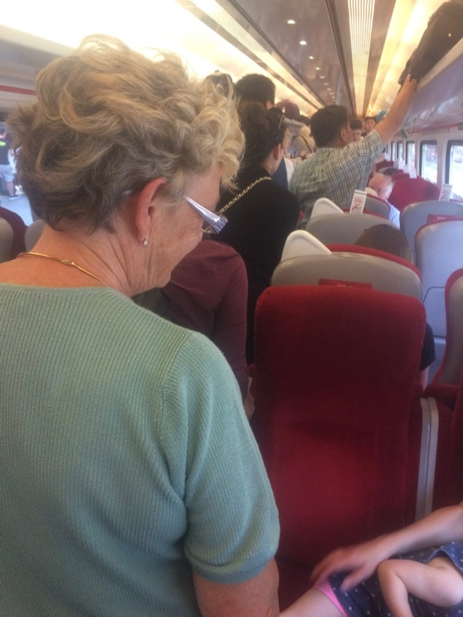
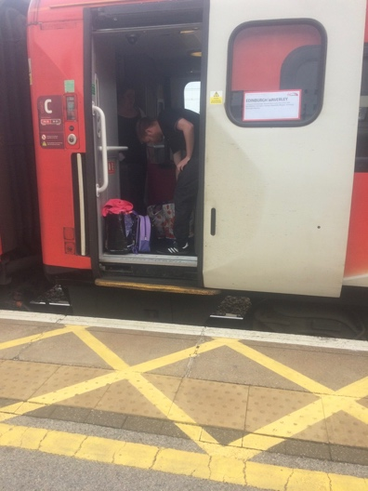
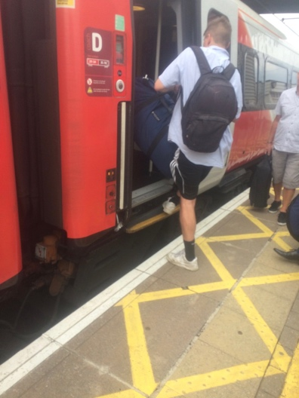
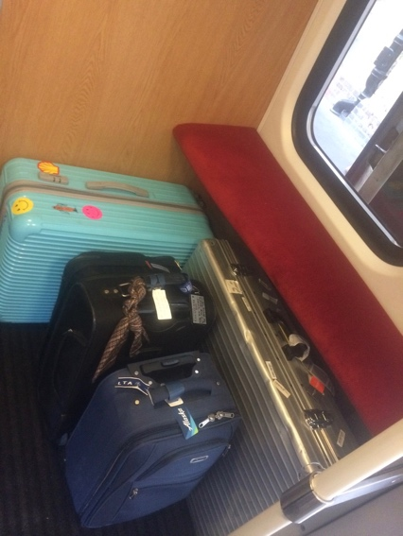
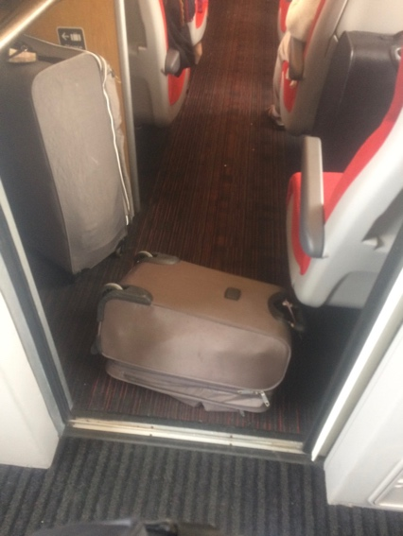
Boarding 13.30 Edinburgh service
Boarding service at Newark Northgate

Slide 52
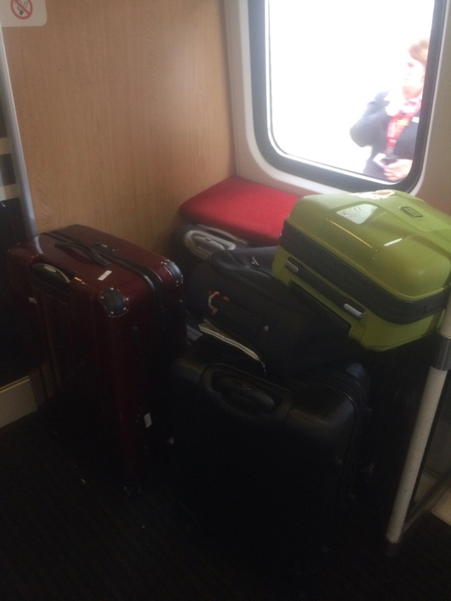
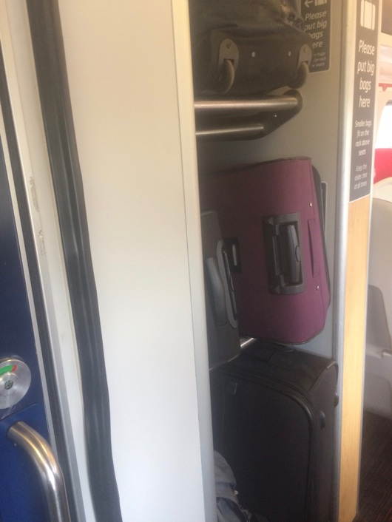
More on Virgin East Coast
York to Kings Cross service – luggage distribution very patchy

Slide 53
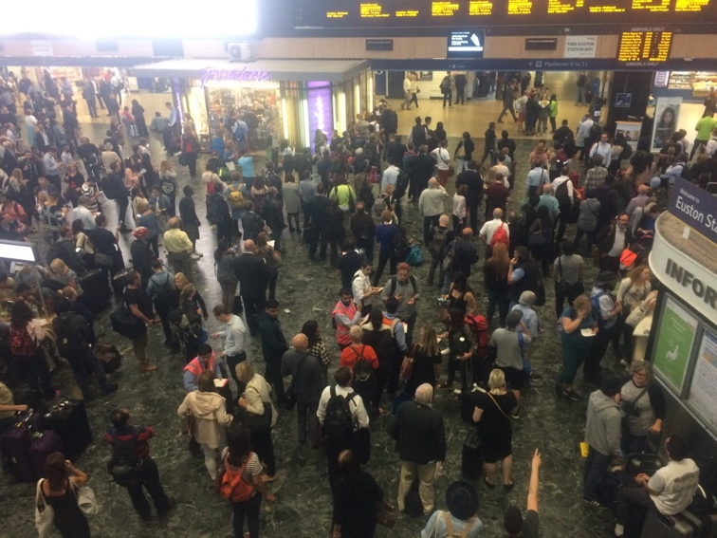
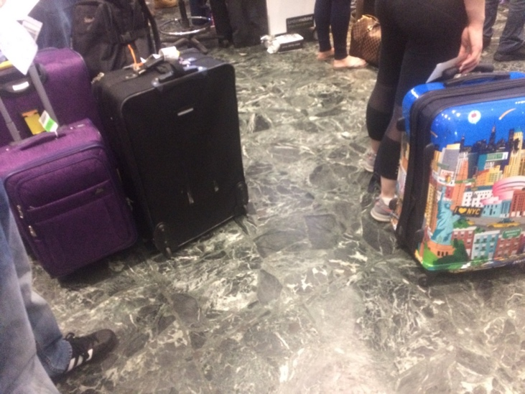
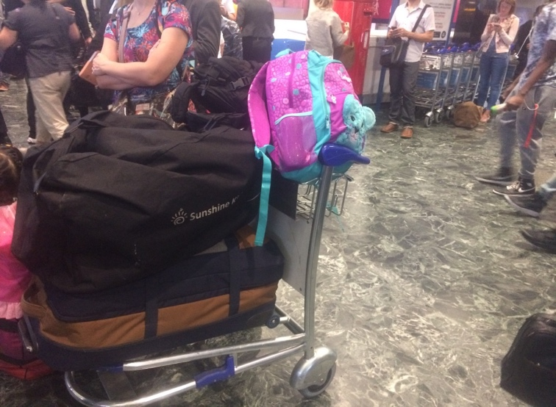
Euston – very busy with a lot of passengers with luggage on day of cancellations

Slide 54
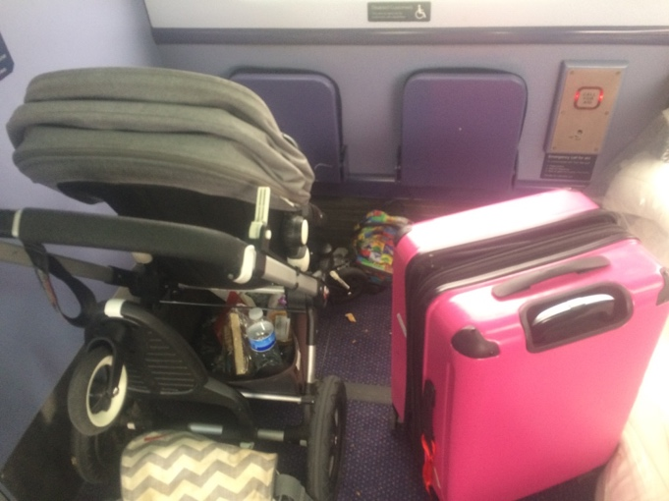
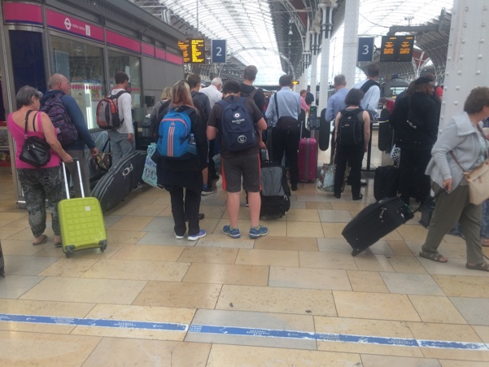
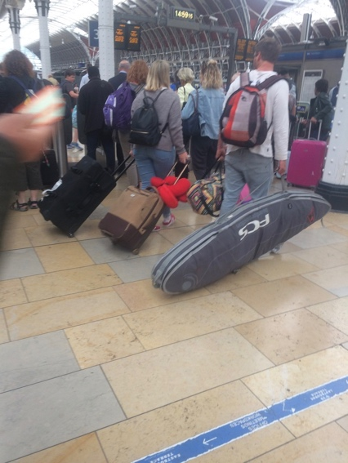
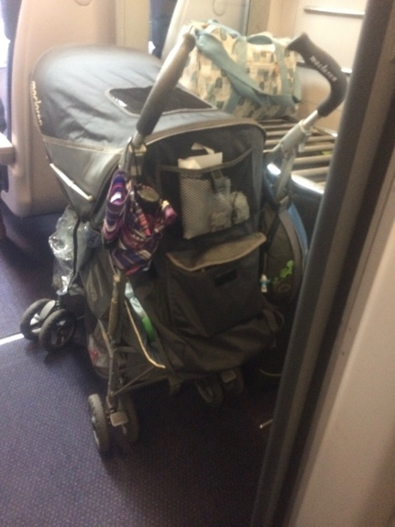
Paddington – boarding the 16.06 Penzance service
Buggies are often stored in the disabled area but have no stated priority
Guy with surfboard attempted boarding in 3 different locations before being moved by the guard to the van – causing a small delay to the departure of the train!

Slide 55
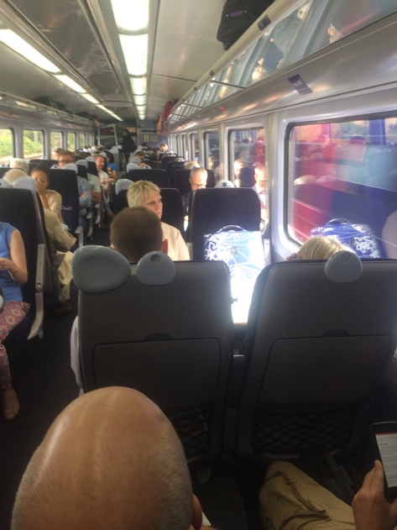
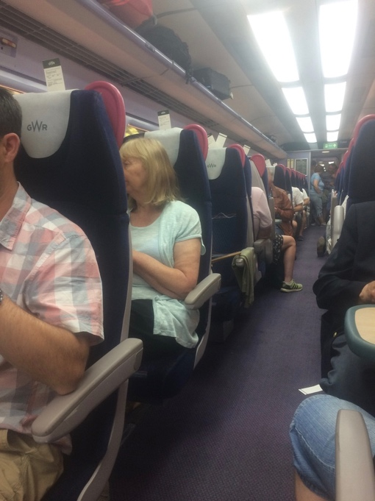
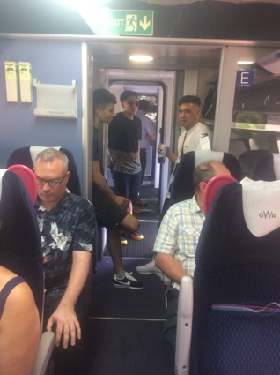
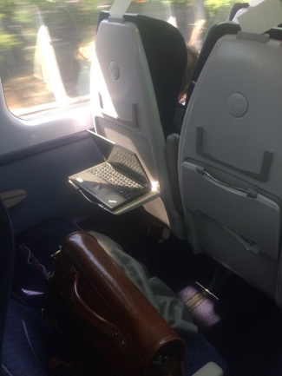
Other observations on FGW
Hereford/ Worcester service to Paddington – a lot of luggage but less space than other FGW longer distance services
Carmarthen service – people standing in vestibules make it difficult to pass. 2 different examples
Some people are less anxious about leaving their belongings unattended!!

Slide 56
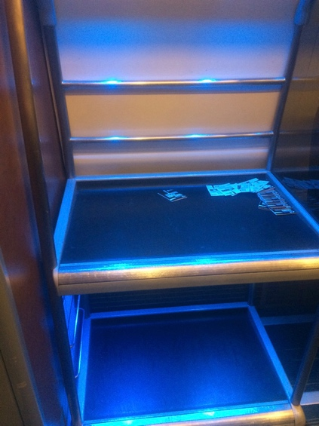
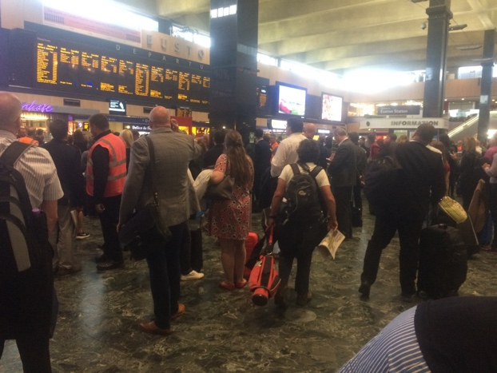
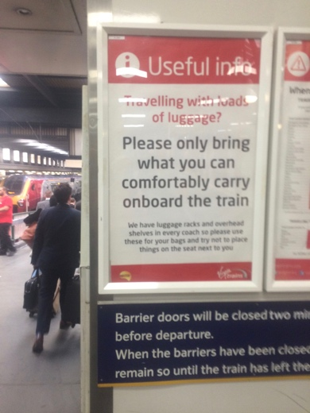
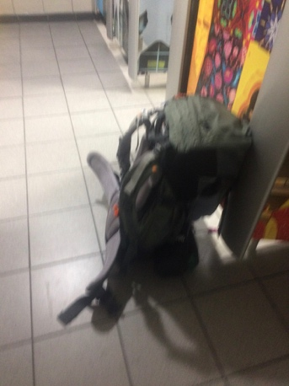
Euston
Very busy on both occasions visited
Crowd at Euston waiting for boarding announcements. When they are made – surges to the platform
Cancellations on services meant that services out of Euston were very busy and photos were not appropriate. Later services were very quiet. Luggage racks in first class, for example were often empty
Not everyone has suitcases!
Strategy for using the ladies with luggage – put it so can see under the door

Slide 57
Summary and conclusions

Slide 58
Luggage is important but a journey is not necessarily planned around it
Luggage is one part of a train journey. Whilst travelling with luggage can be tricky at times, most will not compromise on other parts of the journey, e.g. cost or timings, in order to have an ’easier’ experience
It is important to bear in mind that the train journey is one part of the overall journey – so those who are thoughtful packers do not necessarily only do so for that part, they would also consider transfers and getting to and from the station. But most pack what they need and are not totally fixated on travelling as light as they can
The key thing for travellers in having a good experience on the train is having a seat and the train not being crowded – so having space, and this will mean there is room for bags and that they are not impacted by other people’s bags
Not having a seat and there being less space can also mean that there are fewer places to store your bags and it can also mean that looking for a seat or somewhere to place your bag is more tricky
‘Peak’ services which are more expensive can be less busy and ‘off peak’ at particular times of day can be more crowded. This ties in with findings from most leisure travellers that cost is a key factor and that luggage will fit around that. Travel plans will also fit around planned activities. Business travellers might prefer quieter services but if the timing was right, they would sacrifice some comfort for arriving home quicker.
Not everyone can reserve a seat in advance – they might not have the knowledge of how to do so or be able to plan a journey. Management of luggage is more difficult in these circumstances, particularly on busy services

Slide 59
Safe and secure storage is key - but the degree to which this is ‘enforced’ by passengers differs widely
Of key importance is having your bag safe, secure and close. Some passengers can compromise on being able to see their luggage if it means they will have a more comfortable journey, but others find that more difficult. This is especially the case because having luggage makes you less mobile in terms of finding a seat
Above seat storage delivers visible and close luggage but is not consistent across all services in dimensions and can be difficult to access. Carrying bags down an aisle can be challenging. This can result in smaller bags in luggage racks, on seats or under tables and can result in less space for larger or more awkward sized bags
Checked on bags/luggage van would be acceptable but would not work for all journeys
‘Between’ seats, under seats and more space in front of seats suit those who would like low down close space
Mid carriage satisfies those who want to be able to keep an eye, but a few passengers think it could result in more ‘bumping’ with bags
It is more tricky travelling with bags alone – using the toilet, for example. But also those travelling in groups might adopt strategies in terms of dividing tasks when boarding a train
’Planners’ think a lot about all aspects of a journey and will take a bag that they know will be easy to travel with and keep safe and secure
Assumption that ‘cabin bags’ are storable overhead, or that they should be

Slide 60
CONCLUSIONS AND RECOMMENDATIONS
Plans for luggage management for HS2 should have ‘safe’ and ‘secure’ at the front of mind. This mostly means being able to see a bag but many would trade that for an alternative (such as storing on a separate van) if they felt that their bag would not get taken
Above seat storage addresses many of the needs of travellers and does not take floor space. But is not accessible to everyone. Any means of making it easier to put bags in this area and that would stop them falling out would be a positive development and might help ease space in the racks aimed at larger items
Travelling by train for leisure purposes limits the amount that people can take because of most wanting to be able to ‘carry if necessary’. It is not just the journey by train that does this but also getting to and from the station and any interchanges involved. This might have implications on the types of leisure journeys that people will take on HS2.
Families with buggies/prams have no natural ‘home’ on long distance services at present and rely on disabled spaces being available or standing in the vestibule area. If HS2 is going to aim at people taking younger families, these issues might need to be addressed
Enabling and facilitating movement on trains (e.g. announcements indicating where spaces are) or better targeting when boarding for people who are looking for a seat or room would help ease the issue of people standing with bags, which in turn makes mobility more tricky. Wider aisles might help empower people to move through the train with a bag – but only if they had knowledge there would be a seat at the end of it
For those who really value travelling on a quiet train, educating people that ‘peak’ can sometimes mean ‘expensive’ but also ‘quieter’ might be worth exploring

