Slide 1
Transport Focus
Satisfaction with the Strategic Road Network: Cyclists, Pedestrians & Equestrians
Populus Report
West Midlands – Area 9
Notes:
1

Slide 2
Agenda
1. | Background and Methodology
2. | Summary of SRN Users Needs
3. | Quantitative Study West Midlands (Area 9)
4. | Qualitative Case Studies West Midlands (Area 9)
5. | Combined Quant/Qual Broad Learnings
2
Notes:
2

Slide 3
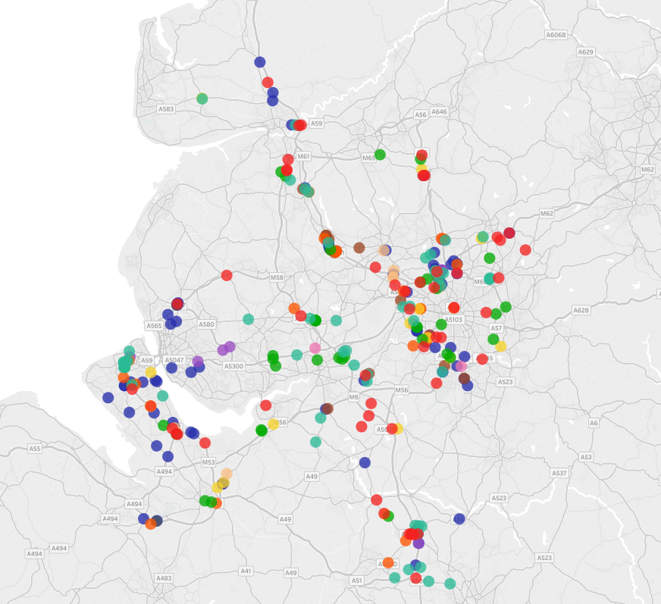
Background and Approach
Project background
Understand the priorities of cyclists, pedestrians and equestrians in relation to the parts of the SRN they use. Specifically:
Identifying and measuring journey satisfaction of the parts of the SRN used by cyclists and pedestrians
Identifying what measures to take to improve satisfaction with parts of the SRN
Provide contextual information about the local area and the provision within which the quantitative data is gathered
Project background
Two stage project approach - focused by specific area
Stage 1: Online survey measuring satisfaction
Stage 2: In-depth face to face interviews
Online methodology with 1266 respondents (821 pedestrians and 445 cyclists) who have travelled on, alongside or over an SRN within the last month
Area 3 – 400 Pedestrians, 224 Cyclists
Area 9 – 421 Pedestrians, 221 Cyclists
Populus integrated an interactive map into the survey in order for respondents to manually map out the journey they took that interacted with the SRN and identify hotspot issues
10 minute interview
Screener
Interactive map
Experience questions
Problems experienced
36 interviews (18 per area) identified via stage 1 online survey / free found
 | Area 9 | Area 3
Pedestrians | 6 | 6
Cyclists | 6 | 6
Equestrians | 6 | 6
Prior to interviewing participants our moderators took part in a series of site visits in order to generate material e.g. photographs and video footage to discuss face to face
3
Notes:
3

Slide 4
Quantitative Questionnaire Flow (12 min average length)
1. Questionnaire screener
Respondents had to have travelled on, alongside or over a motorway or major ‘A’ road in the last month/ 3 months
The SRN roads had to be within the two chosen areas – Area 3 and Area 9
Respondents had to have travelled either on foot or bicycle
2. Map screener
Respondents were then taken into the mapping system (right) and asked to enter the start and end postcode (or location) of their journey
If the route did not interact with the SRN, respondents were screened out
5. Follow up questions
Respondents completed a few follow up questions which asked about issues including:
Safety concerns
Future needs
3. Main survey questions
Respondents answered key questions relating to their journey, which included:
Reason for and frequency of journey
Overall satisfaction with journey
Likelihood to revisit
4. Map hotspots
Respondents were then taken back into the mapping system to indicate if they had experienced any hotspot issues along their journey
4

Slide 5
Qualitative Methodology
Site Visits
Prior to conducting the interviews, moderators conducted site visits for the areas of the SRN, that were identified in the quant as problematic (e.g. had clusters of hotspots) These site visits served two main purposes
To collect stimulus material (.e.g. photographs and video footage) of the area to be shown and played back to respondents in the interviews
To help our moderators contextualise themselves with each area, providing a level of familiarity which helped to have more o an detailed discussion
F2F Interviews (45 – 60 minute interview)
Respondents were probed on their overall experiences as a walker/cyclist on their journey that interacted with a SRN road
Using an interactive map, respondents and interviewer mapped together issues they experienced along their journey, generating around 10-15 individual route points
Lastly, respondents were asked what was the most important thing they feel should be improved for their interactions with the SRN
Recruitment process - 2 stage:
10 respondents (5 in each area) were recruited off the back of the quantitative survey (respondents gave their contact details expressing their interest in participating in a subsequent qualitative stage)
26 respondents were recruited based on free find
Recruitment screener
The screener for recruiting qual respondents was in line with the quant research with a few amendments:
Needed to have cycled/walked/ridden in the last 6 months
Locations were read out from a list of sub areas e.g. for Area 3: Portsmouth area. And then the applicable roads e.g. A3 J3 &J4 & A27 J12
Respondents confirmed whether they had made a journey that interacted with any of the above
Screened out if very satisfied with their SRN experience (in the quant survey they needed to have a hotspot)
5

Slide 6
Transport Focus
Summary of SRN users needs

Slide 7
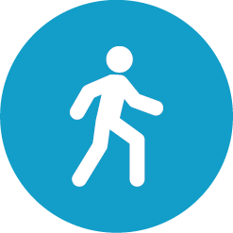
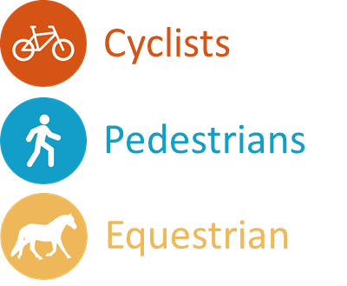
Audience hierarchy of principle concerns when using the SRN
Although each audience has specific reasons and needs for using the SRN they share some key areas of concern with regards to their journey
Safety
Their main need is to stay ‘safe’ whilst using the network. Safety can be interpreted as personal safety e.g. protected from injury or crime OR perceived safety of the infrastructure e.g. the maintenance of bridges or height or parapets
= An adequate experience
+
Environmental Factors
Then they hope for an enjoyable, relaxing experience, environmental factors such as litter, traffic volume, signage, and lighting can all play a part in providing this
= A good experience
+
Space
The amount of physical space they have whilst using the SRN is also a factor and is linked to their main priority of personal safety e.g. room to manoeuvre out of a dangerous situation
= A very good experience
Surface
+
Lastly they
consider issues
such as potholes, uneven surfaces , overgrown vegetation
etc.
= An ideal experience
7

Slide 8
Equestrians, Pedestrians and Cyclists would prefer not to use the SRN and would like more to be done to develop routes exclusively for their use
Currently the majority of these road users use the SRN out of necessity rather than choice
Of the three audiences cyclists were the most likely to actively want to use the SRN (although many would still prefer to have separate cycle ways)
This was due to the fact that they are more used to using smaller roads and so they see their use of the SRN as an extension of this
However, they currently feel that they are not prioritised as users of the SRN and can find navigating certain areas challenging
Pedestrians commonly cross the SRN out of necessity in a range of scenarios
In order to get to their final destination e.g. school, shops, friends house etc.
When walking for leisure and having to cross the SRN in order to continue
Although the majority of pedestrians we spoke to were reasonably satisfied with their experience on the SRN, they would prefer to use byways or paths if these were available and ‘safe’ (referring to their own personal safety)
Equestrians are the least likely of our audiences to actively ‘want’ to use the SRN and only do out of necessity in circumstances such as
Their horse needs to be ridden on a harder surface to stay healthy
They need to cross the SRN to get to a known area for horse riding
Ultimately, equestrians would always prefer to use bridleways rather than the SRN
8

Slide 9
Transport Focus
Cyclists

Slide 10
Cyclists are mostly concerned with route accessibility and road quality
They want to see …
More cycle lanes on major A roads
Easier access to cycle lanes particularly when crossing junctions or roundabouts
More ‘complete’ cycle lanes – i.e. ones that don’t stop half way down a road or half way around a roundabout
“Oh, it's quite hectic. I wouldn't ever take the grandchildren, I can only do it on my own but, yes, it is pretty tricky just because…There's not actually a cycle path there”
“You've got to negotiate, that's your right of way.. Recently a lorry near crushed me against the kerb. So I lost my temper a bit, I put my bike on the pavement, and I asked him what he was doing …he said, 'I'm ever so sorry mate, but I had to avoid that, you were the lesser option, you'd have caused less damage to my vehicle.' “
Better road / cycle lane surfaces with less potholes
Less litter on roads and cycle lanes
More consideration about how road surface maintenance impacts them, for instance in the winter gritted roads often results in punctured tyres
Possible actions…
Ensure cycle lanes are properly routed
Display signage specifically for cyclists if there is something on the route that will impact them i.e. recently gritted road or cycle lane ends in x miles
10

Slide 11
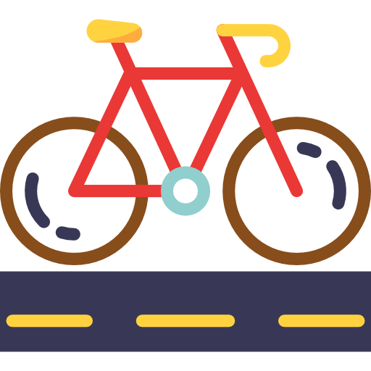
Using the SRN as a cyclist
Current travel patterns
Cycling in the future
Driving is the ‘main’ mode of transport for most respondents
Cycling is not typically chosen for convenience and is rarely out of necessity. It is mainly:
Used for leisure and fitness, or commuting to work
For a few, considerations of traffic and the environment encourage them to cycle
Respondents are polarised, with some indicating that in 5 years cycling will be more common due to better provisions and others believe it will only become more dangerous
Positive changes: Greater availability of cycle lanes, dedicated routes away from traffic, well maintained roads / cycle paths, more people encouraged to adopt cycling
Don’t envisage any major changes: Cars will still be used for commuting and cycling will remain for recreational purposes. There is also a level of cynicism about whether changing the SRN to be more ‘cycle friendly’ is really a priority
Negative changes: With a larger population there will be more cars, accidents, potholes and wear and tear along the road if not maintained
11
Notes:
11

Slide 12
Expectations of improvements
Nearly all respondents believe that improving safety is paramount in the future and this involves car users
They have realistic expectations about how infrastructure can be amended to suit the needs of non-car users
They suggest education and encouraging a cycle friendly culture could help to bring about improvements
Measures to control speeding cars to keep number of collisions to a minimum
Ensuring cycle routes are ‘fully complete’ e.g. do not end abruptly
Clearly marked signs for all users
More cycle lanes generally
Greater advertisement of routes
Cycling literature / HE to partner with local cycling groups
Cycling proficiency sessions to build confidence
12
Notes:
12

Slide 13
Transport Focus
Pedestrians

Slide 14
Pedestrians care most about their own personal safety and pavement surfaces
They want to see …
Higher barriers between them and traffic, on both roads and bridges
Crossing points that prioritise their safety i.e. pelican and zebra crossings where possible
Non slip surfaces for bad weather
Awareness of ‘isolated’ areas where crime has become a problem
“It's quite busy. My kids are getting older now so it's much easier, and with buggies and things, it's always a bit of a nuisance, but it's fine, it just gets a bit overgrown”
“It's a very busy roundabout. Imagine if I was walking, maybe myself and my husband would do it, but I just wouldn't take my kids on there. I don't think it's safe enough, really.”
Wider pavements
Paving to be maintained regularly e.g. even surfaces and no overgrown vegetation
“You are somewhere where there's relatively few people and just to know, if there's someone around, and you know where they are, in comparison to me. Not in a paranoid kind of way, but in a safety conscious way”
Possible actions…
In areas with high pedestrian volume prioritise their safety over vehicles needs
Ensure pavements are maintained
Ensure isolated areas are ‘open’ and well lit
14

Slide 15
Using the SRN as a pedestrian
Current travel patterns
Walking in the future
Driving is the ‘main’ mode of transport for most respondents
Walking is not typically chosen for convenience but more often chosen for:
Enjoyment – e.g. going on a walk for the sake of it with family and friends
Efficiency – e.g. when a journey would be quicker to walk rather than drive
Respondents are polarised with some indicating that in 5 years walking will be more common due to better provisions and others believe there will be little change
Positive changes: Greater availability of pathways, safer routes around major infrastructure such as roundabouts, well maintained, people feel safer
Don’t envisage any major changes: Cars will still be the main mode of transport for the majority. There is also a level of cynicism about how much of a priority changing the SRN to be more user friendly for walkers is
Negative changes: With increase in population there will be more cars, accidents, potholes and wear and tear along the road and it will become less safe to walk on
15
Notes:
15

Slide 16
Expectations of improvements
Nearly all respondents believe that improving safety is paramount in the future and this involves car users
They have realistic expectations about how infrastructure can be amended to suit the needs of non-car users
They suggest education and encouraging a pedestrian friendly culture help to bring about improvements
Measures to control speeding cars to keep number of collisions to a minimum
More traffic light/ pedestrian crossings on and around major infrastructure
More done to increase levels of personal safety
More street lighting installed (especially in ‘isolated’ spots)
Greater advertisement for and access to existing routes
More signage warning cars to expect pedestrians in the area
16
Notes:
16

Slide 17
Transport Focus
Equestrians

Slide 18
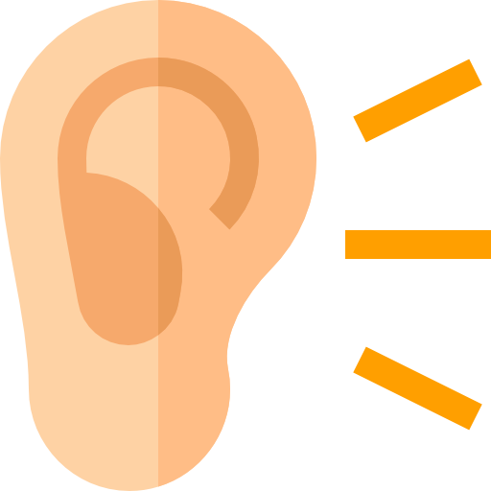
Priorities for Equestrians
Equestrians feel that they take measures to keep themselves safe but that there are a range of external influences that impact whether their ride is safe and enjoyable
Sensory
Considerations
Understanding
from drivers
Personal
Space
Infrastructure
requirement
Horses react to the environment that they are in and many equestrians explained that ‘sensory overload’ can cause problems when using the SRN e.g. the view of the traffic below a bridge compounded by the noise levels. They would suggest using material to ‘block’ the view where possible
Equestrians need drivers not only to understand how to react to them on the roads but also to realise the real danger drivers are in if an incident was to occur e.g. a collision with an equestrian wont only damage the rider and animal but is also likely to damage their vehicle/ themselves
Equestrians need a considerable amount of space to manoeuvre on the SRN in case their horse reacts unpredictably, and if it’s not provided they will go to lengths to obtain it e.g. riding two horse together in the centre of the road or having cars trail them to halt traffic
Height of parapets and crossing lights is a major concern for equestrians as they are considerably higher than cyclists or pedestrians when using bridges over the SRN or automated crossings. When confronted with infrastructure that is not designed with their needs in mind they have to dismount the horse – which isn’t an easy task
18

Slide 19
Equestrians would like other SRN users to be made more aware of their presence
They want to see …
Dedicated ‘bridleways’ on routes, exclusively for their use
Drivers and other SRN users to be more aware of the needs and experiences of equestrians
Crossing points designed with their needs in mind
Efforts to be focused on areas where the SRN intersects with a known bridleway
Partnerships with local groups to help build more bridleways/equestrian friendly routes
“Most of them are all right with the actual traffic, it's more if a dog jumps into the hedge and then they jump into the road in front of that vehicle that's going too fast, that's so dangerous, like that's the end of all of you pretty much”
“I know when I did my HGV they asked, 'As a horse rider, how would you like us to train?' It's very, it's difficult, you have to just know that horses are unpredictable, they're all different, look at the rider, see what they're communicating to you, do you need to slow down, do you need to move wider, do you need to wait?”
Possible actions…
Educate SRN users on how to treat an equestrian on the SRN i.e. correct way to overtake, speed guidelines etc.
Ensure crossings in areas with a high population of equestrians have crossings where the operation button is ‘high up’
19

Slide 20
Using the SRN as an Equestrian
Current travel patterns
Riding in the future
The majority of our equestrians’ primary mode of transport is the car, however they use the SRN for riding for two main reasons
To exercise their horse on a ‘harder’ surface which is vital for the animals strength e.g. the muscles in their legs
To cross over to a known area for horse riding e.g. fields or bridleways
Equestrians are sceptical as to whether the SRN will become more of a viable option for them in the future as they currently do not believe they are a priority audience
Positive changes:
Equestrians hope for:
More education amongst car drivers on how to correctly pass a horse on the SRN and the enforcement of restricted speed limits
Car uses to educate themselves on the dangers to themselves of not considering equestrians e.g. any accident will likely effect the driver as well as the rider and animal
Negative cha nges:
Equestrians fear that without more education the SRN will continue to be a ‘risky’ option for riders
20
Notes:
20

Slide 21
Expectations of improvements
Nearly all respondents believe that improving safety is paramount in the future and this involves car users
They have realistic expectations about how infrastructure can be amended to suit the needs of non-car users
They suggest education and encouraging an equestrian friendly culture could help to bring about improvements
Measures to control speeding cars to keep number of collisions to a minimum
Education to communicate the likely impact to car users in the event of a collision
More ‘space’ for equestrian use
Higher parapets and ‘caged’ bridges where possible
Greater advertisement of routes
More interaction with local groups e.g. Local Access Forums
Education amongst equestrians and other SRN users about how to correctly share the road space
21
Notes:
21

Slide 22
Transport Focus
Quantitative Research – West Midlands
(Area 9)

Slide 23
Respondent Profile [I]
Cyclists/ Pedestrians
Age
Disability
Cyclists
Pedestrians
Cyclists
Pedestrians
(Mean age: 42)
(Mean age: 49)
Gender
Contact with the SRN
Cyclists | Pedestrians
63% | 55%
37% | 45%
Male
Female
S1. Region S2. Cyclist/ Pedestrian Q1. Contact with the SRN Q17. Age Q18. Gender
Base: All Respondents (642) Cyclists (221) Pedestrians (421)

Slide 24
Respondent Profile [II]
Journey Purpose
Time of day
Weather conditions
Frequency of Journey
Q2. Purpose of Journey Q3. Time of day Q4. Frequency of journey Q4b. Weather conditions
Base: All Respondents (642) Cyclists (221) Pedestrians (421)

Slide 25
Around 7 in 10 cyclists and pedestrians are satisfied with their experience on the part of the journey that interacts with the SRN. Cyclists who travel ‘on’ the SRN are significantly less satisfied than traveling ‘alongside/crossed’
Overall satisfaction of journey
70%
71%
70%
NET: Satisfied
% Satisfaction
Cyclists
Pedestrians
Satisfaction scores are consistent with the South East (71%), however slightly behind the North West (78%) and East Midlands (79%)
For cyclists only, those who travelled in poor weather conditions (rain/snow/wind etc.) found the journey less satisfying than those in sunny/cloudy conditions
Q5. Overall, how satisfied or dissatisfied were you with your experience on this part of your journey? BASE: All Respondents (642) Cyclists (221) Pedestrians (421)
- Statistically higher/lower

Slide 26
Having a relaxing/enjoyable route that is well maintained and safe is key for overall satisfaction of both cyclists and pedestrians. Minimal traffic is a more important issue for cyclists than pedestrians
Reasons for overall satisfaction of journey [spontaneous]
Cyclists
Pedestrians
The route was a relaxing/enjoyable
The route was well maintained & clean
I felt safe
Minimal traffic
The route was easy
Provisions that made the journey better e.g. bridges
I enjoyed being outside
Felt active/ good exercise
It was a scenic route
It got me to my destination
Q6. What is the main reason you were satisfied/dissatisfied with your experience on this part of the journey? BASE: All Respondents (642) Cyclists (221) Pedestrians (421)
N.B. ordered by cyclist high to low

Slide 27
Top three mentions for overall satisfaction refer to the route being relaxing, well maintained & clean and enjoyable to be outside
Reasons for overall satisfaction of journey [spontaneous]
The route was a relaxing/enjoyable
The route was well maintained & clean
I felt safe
‘Left the car and enjoyed walking for a change - no problems happened’
(Pedestrian)
‘Its a fairly safe road not a lot of traffic on it and its pretty well maintained’
(Cyclist)
‘Felt safe, plenty of space, good road conditions’
(Cyclist)
‘Nice and relaxing. Different walking path. Peaceful’
(Pedestrian)
‘Road was clean and well maintained’
(Cyclist)
‘It was a pleasant walk where I felt safe and at ease’
(Pedestrian)
‘Enjoyed riding alone to clear my head. Felt refreshed and rejuvenated afterwards’
(Cyclist)
‘The pavement was clean and tidy. It wasn't very busy so it was easy to walk. I felt safe and didn't feel like any harm would come to me’
(Pedestrian)
‘It was safe, the pathway was fairly well maintained and there was a fair amount of open spaces along the way’
(Cyclist)
Q6. What is the main reason you were satisfied/dissatisfied with your experience on this part of the journey? BASE: All Respondents (569) Cyclists (242) Pedestrians (327)

Slide 28
Top three mentions for overall dissatisfaction refer to a lack of satisfactory provisions on the path, poorly maintained route and feeling unsafe
Reasons for overall dissatisfaction of journey [spontaneous]
Lack of satisfactory provisions e.g. bridges
Route is poorly maintained/uneven surfaces
I did not feel safe/ journey was dangerous
‘It is quite a small bridge that you have to cross and on my own it can be a bit daunting’
(Walker)
‘The path is poorly maintained with lots of bumps and holes’
(Cyclist)
‘It involves crossing a major motorway and it feels far too dangerous in rush hour’
(Walker)
‘There is no zebra crossing or traffic lights as you have to cross over the slip road… dangerous’
(Walker)
‘Limited footpath access and poorly maintained condition’
(Walker)
‘Overgrown bushes often make the pavement non-existent…this is very dangerous because many motorists do not stick to the speed limits’
(Walker)
‘The underpass is very gloomy and I find it rather a frightening experience each time I use it’
(Cyclist)
‘A lot of potholes and poor surface conditions on the road’
(Cyclist)
‘Found it to be dangerous due to the volume and speed of traffic’
(Walker)
Q6. What is the main reason you were satisfied/dissatisfied with your experience on this part of the journey? BASE: All Respondents (569) Cyclists (242) Pedestrians (327)

Slide 29
Cyclists are more likely to continue using the route compared to pedestrians. Those the travel ‘on’ the SRN are most likely to continue using the route
Likelihood to continue using the route
% Likely
70%
74%
67%
NET: Likely
Cyclists
Pedestrians
Likelihood scores are consistent with the South East (71%), however slightly behind the North West (78%) and East Midlands (75%)
Q7. How likely or unlikely are you to continue using this [insert walking/cycling] journey route in the future? BASE: All Respondents (642) Cyclists (221) Pedestrians (421)
- Statistically higher/lower

Slide 30
When asked to rate aspects of the journey, cyclists and pedestrians needs differ somewhat, with pedestrians far more satisfied with the availability and accessing of paths, but less satisfied with the lighting
Satisfaction with aspects of the SRN (% very/fairly)
Cyclists
Pedestrians
Visibility on the route ahead
Signage for road vehicles users
Directness of road crossing points
Ease of use of road crossing points
Availability of road crossing points
Quality of the path
Lighting – where provided
Freedom from litter
Signage for pedestrians/cyclists
Ease of getting onto paths
Availability of path/cycle lanes
Q8. Again, thinking about your experience on this part of the journey where you went on the motorway/ major ‘A’ road, please rate the following. BASE: All Respondents (642) Cyclists (221) Pedestrians (421)
N.B. ordered by cyclist high to low

Slide 31
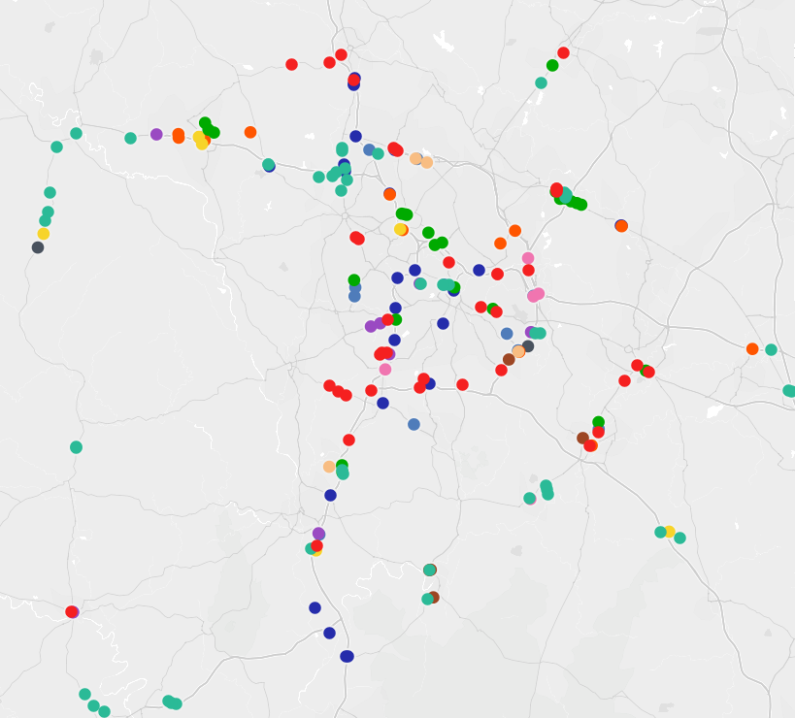
Just over a quarter of cyclists & pedestrians record having hotspots on the part of the journey that interacts with the SRN. Significantly more cyclists than pedestrians experienced problematic hotspots
Hotspot Issues
26%
experienced problematic hotspots in the area
Cyclists
Pedestrian
Quality of the path
Availability of path
Freedom from litter
Ease of getting on path
Visibility of route ahead
Availability of crossing
Ease of use of crossing
Signage for pedestrians/cyclists
Signage for vehicles
Lighting
Dangerous, heavy traffic
Overgrown shrubbery
Q11. Did you experience any issues or problematic hotspots on this part of your journey? Q12 What would you say are the issues at this location you have indicated? BASE: All Respondents (642) Cyclists (221) Pedestrians (421)
- Statistically higher/lower

Slide 32
Pain points for cyclists and pedestrians differ somewhat; key pain point for cyclists is the quality of cycle path, where as for pedestrians the key issue relates to availability of path
Reason for problematic hotspot
Cyclists
Pedestrians
‘Poor quality pavement and over grown shrubbery’
(Walker)
Quality of the path
Availability of path
Dangerous/ unsafe/ heavy traffic
Freedom from litter
Ease of getting onto path
Availability of road crossing points
Lighting
Visibility on the route ahead
Signage for pedestrians/cyclists
Overgrown shrubbery
Signage for road vehicles users
‘No footpaths or cycle lanes and quite dangerous due to speed of cars’
(Cyclist)
‘There is no pedestrian crossing point and it is very dangerous’
(Walker)
‘No signage for pedestrians to warm them of a busy road’
(Walker)
Q12 What would you say are the issues at this location you have indicated? BASE: All hotspots left by respondents (239) Cyclists (106) Pedestrians (133)

Slide 33
Cyclists feel significantly more unsafe than pedestrians on their journey. This is predominantly owing to the speed and proximity of traffic
Overall how safe felt
Reason for safety concerns
32%
40%
33%
NET: Not safe (scores 1-6)
Based on respondent who rated 1-8 on how safe they felt
Cyclists (178) Pedestrians (313)
% of those feeling unsafe is fairly in line with the East Midlands (31%) South East (29%) and North West (28%)
Q14. Overall how safe do you feel on your journey? Q15. Please indicate which of the following are reasons for your safety concerns? BASE: All Respondents (642) Cyclists (221) Pedestrians (421)
- Statistically higher/lower

Slide 34
The most common suggestions for improvement for both cyclists and pedestrians are to improve or create more cycle lanes, better lighting & more crossings
Improvements to journey
12% said there was nothing in particular that needed improving. Of the remaining 83% the most common themes are listed below…
Lower speed limits
Better/more lighting
Better / more signage
‘Lower the speed limits for cars. They drive much too fast in close proximity to pedestrians.’
(Cyclist)
‘More street lighting where there is a great need for it to make cyclists and walkers look safe’
(Pedestrian)
‘Better signage to warn drivers of cyclists and pedestrians’
(Cyclist)
‘Lower speed limits which are monitored’
(Cyclist)
‘Lighting for when riding in the dark’
(Cyclist)
‘More signage further down the road so they know pedestrians are crossing and are able to slow in time.’
(Pedestrian)
‘Caution signs and speed limitations at crossing points on main roads as some are accident black spots causing accidents’
(Pedestrian)
‘Making sure the lights are working and or changing bulbs if they are out.’
(Pedestrian)
‘Signage for cars to slow down at junctions, especially where two roads with cycle lanes meet and cyclists may be crossing lanes’
(Pedestrian)
Q16. What improvements would you like to see made in order to make your journey safer? BASE: All Respondents (642) Cyclists (221) Pedestrians (421)

Slide 35
Respondents mentioned their satisfaction with the roads being clean and tidy, and trees being well trimmed providing good visibility

Slide 36
Transport Focus
Qualitative Research – West Midlands
(Area 9)

Slide 37
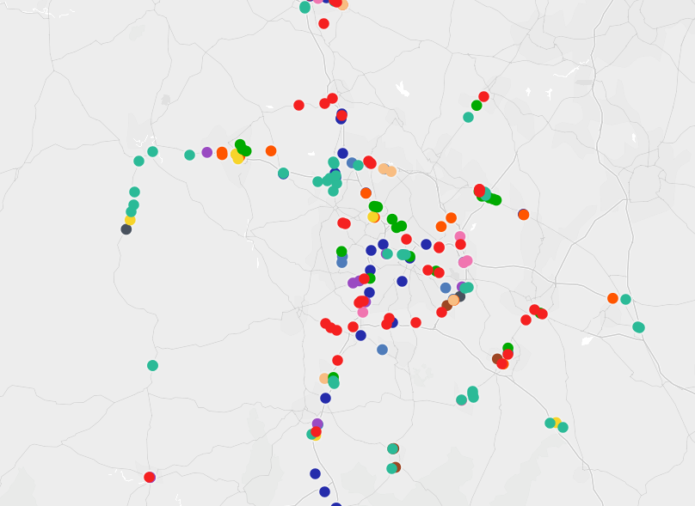
Qualitative Case Studies for the West Midlands (Area 9)
Spoke to Cyclists,
Pedestrians
and Equestrians
in these areas

Slide 38
Area 9
Cyclists, Pedestrians and Equestrians
Qualitative Case studies

Slide 39
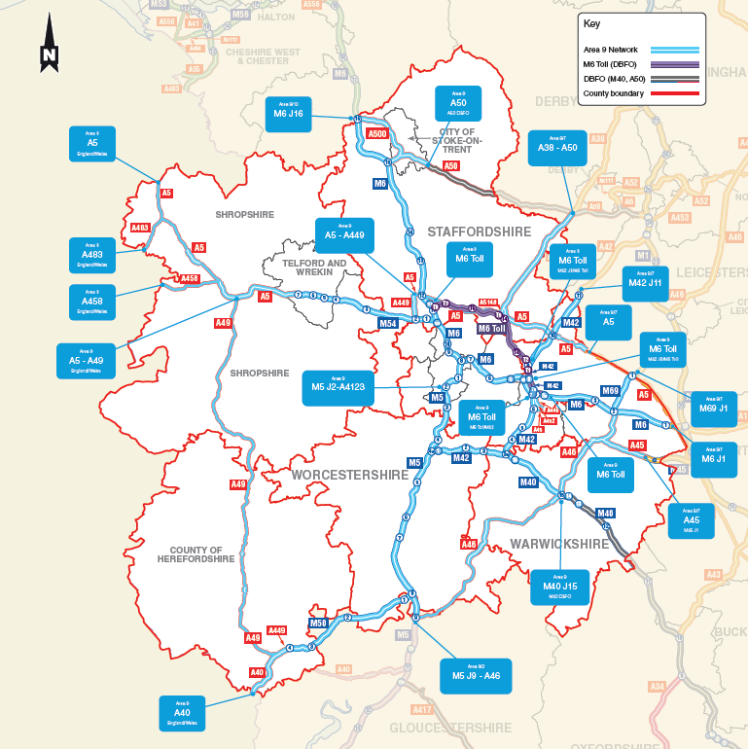
Personal safety is the key concern for all audiences in this area. Recommended improvements include increased cycle paths, pedestrian crossings and bridal paths
Area 9 is a predominantly rural area with high volumes of traffic using both the M54 and A5 roads
There is a high proportion of equestrians in the West near the M54 due to the close proximity of several neighbouring stables in the area
Whereas in the North East the A5 is used predominantly by cyclists and pedestrians who are accessing the nearby Chasewater Park and Cannock retail parks
9
Area 9
Gloucs,Shrops, Staffs Warks, West Midlands, Worcester, Herefordshire
Dedicated cycle paths create a safe and secure way for cyclists to access the area, which has motorists travelling very high speeds on the A5 and M54
Increased pedestrian crossings at busy and congested roundabouts means a reliable and safer option
Equestrians prioritize safety overall so would prefer using linked up bridal paths throughout the area to avoid using SRN roads and roundabouts completely

Slide 40
Area 9 Sub Area M54
Qualitative Case studies

Slide 41
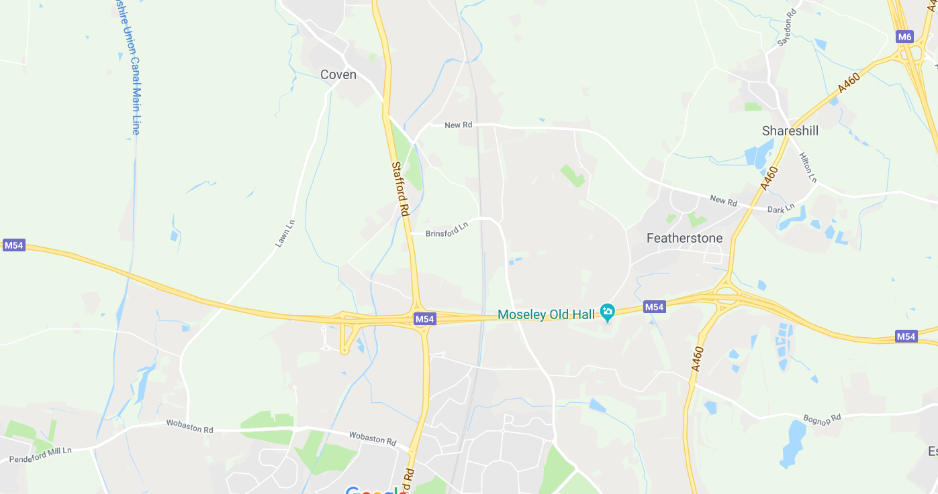
M54 - Map
Area 9: sub area M54
2 Small Roundabouts Near Coven
M54 Junction 2
Lawn Lane
M54 Junction 1
41
Notes:
41

Slide 42
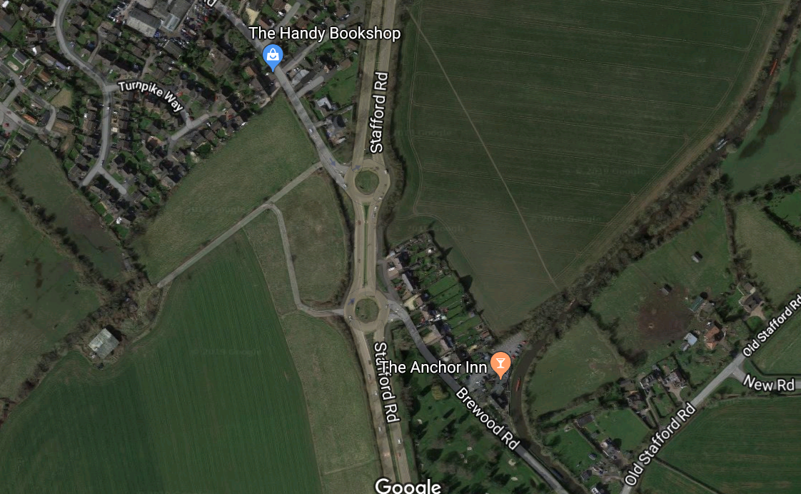
Area 9: sub area M54
M54 2 Small Roundabouts Near Coven – Aerial view
Point 1
Roundabouts have lots of traffic going at high speeds and no lighting available
Point 2
Users enter/ exit onto Stafford road which has fast traffic and can be very noisy
Point 3
Bridal paths are poorly maintained
42
Notes:
42

Slide 43
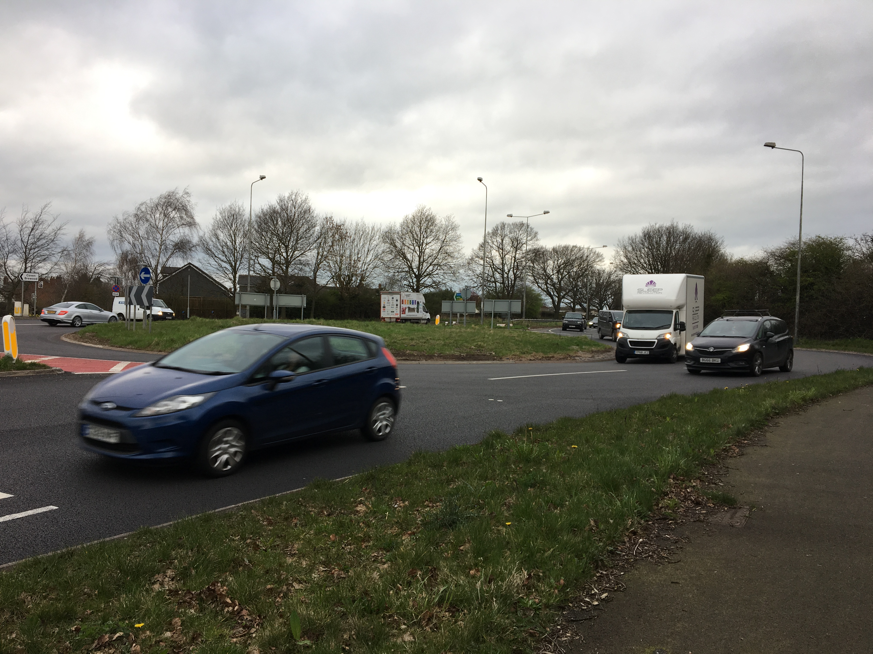
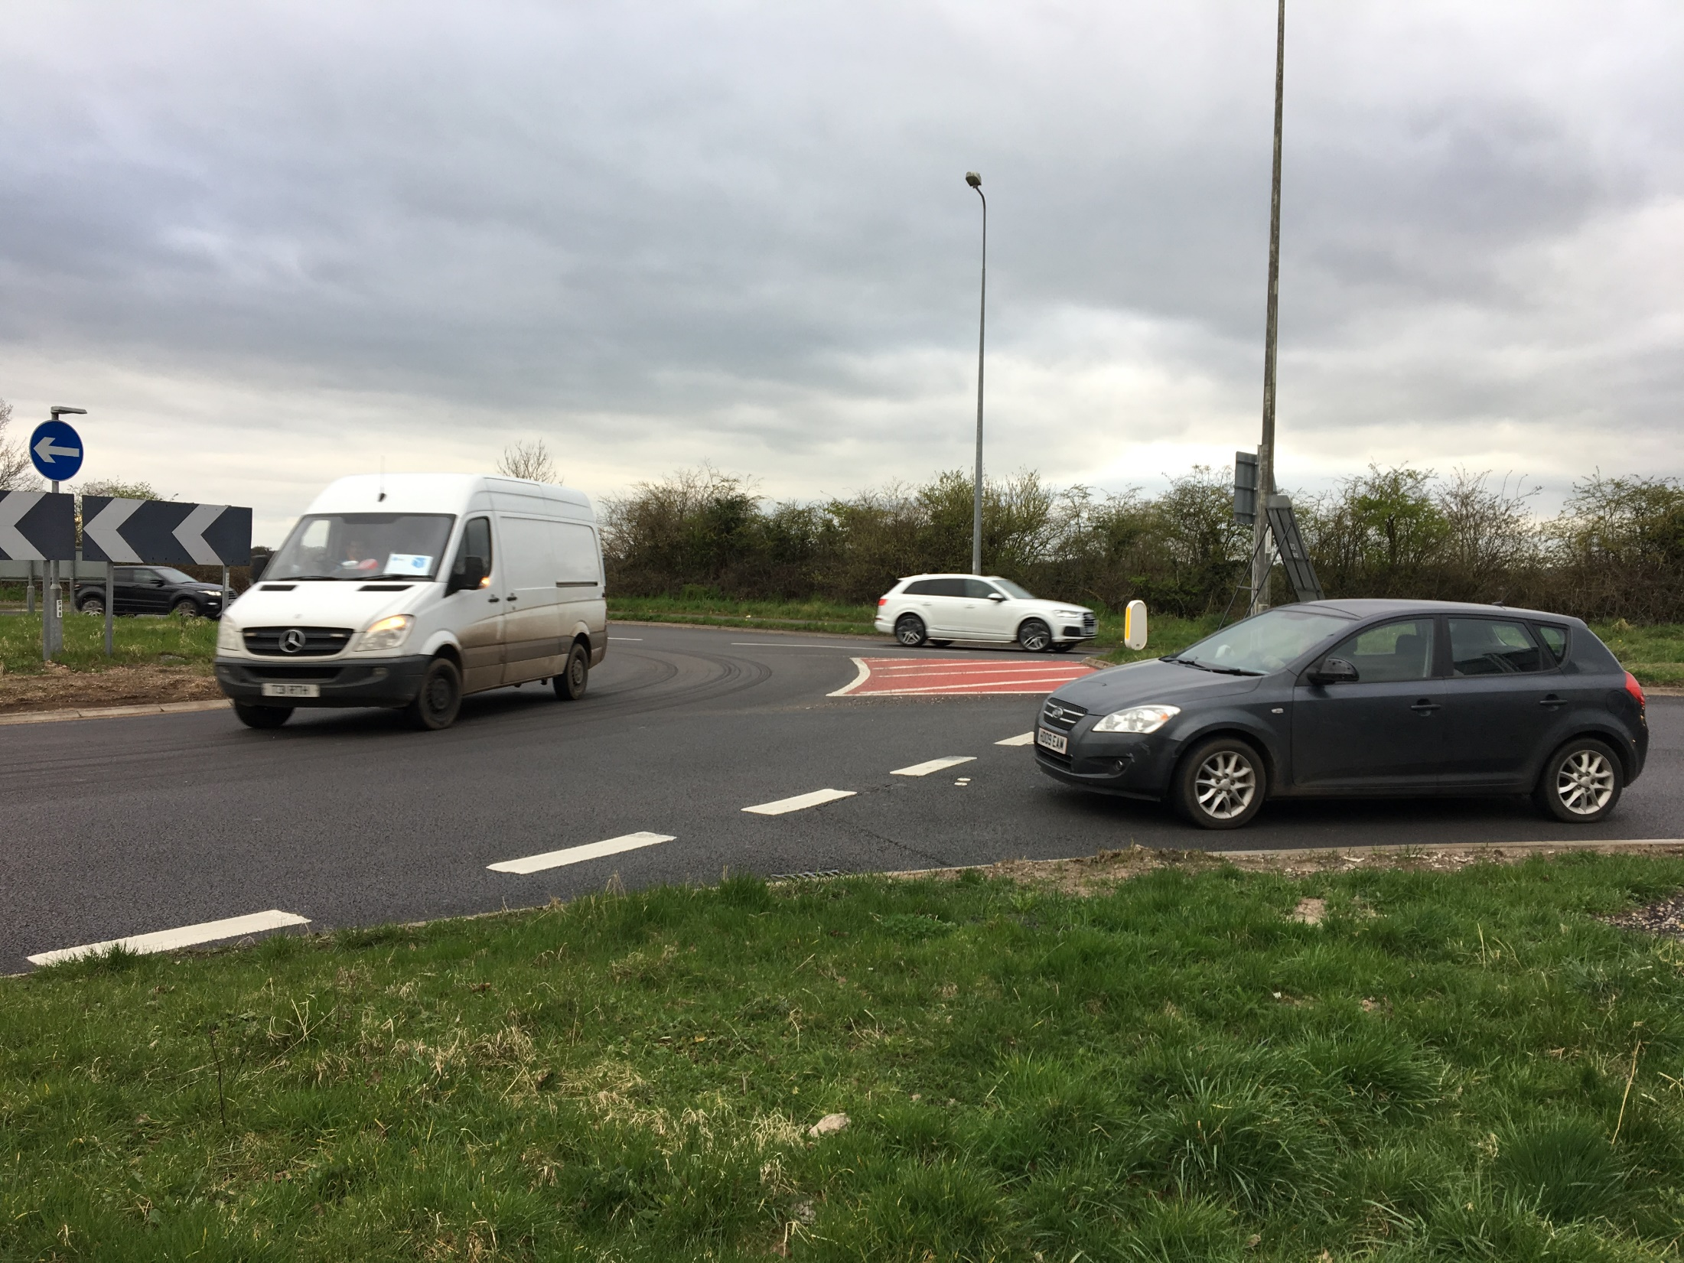
M54 2 Small Roundabouts Near Coven - Point 1
Area 9: sub area M54
Equestrians and Cyclists
Roundabouts have a high amount of traffic going fast at speeds of 40-60 mph. Speed cameras would slow down traffic
Low awareness / signage that equestrians & cyclists are using this roundabout.
The quality of Brewood Road leading north to the roundabout is of poor quality with lots of potholes
No traffic lights are present. Traffic lights would be safer as traffic is forced to stop so a crossing opportunity is guaranteed for users. Equestrians requested a special traffic light button you can activate with your crop to avoid dismounting
Lack of lighting means users don’t use this at night
Only experienced riders would use this roundabout as you have to ride with the traffic. If there were lights that would mean we would have time to cross. There are special buttons that you push with your crop so you don’t have to get off your horse
EQUESTRIAN
43
Notes:
43

Slide 44
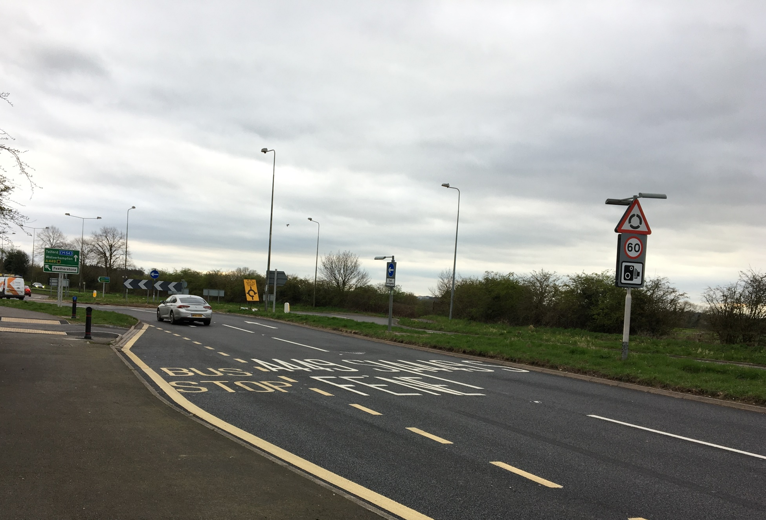
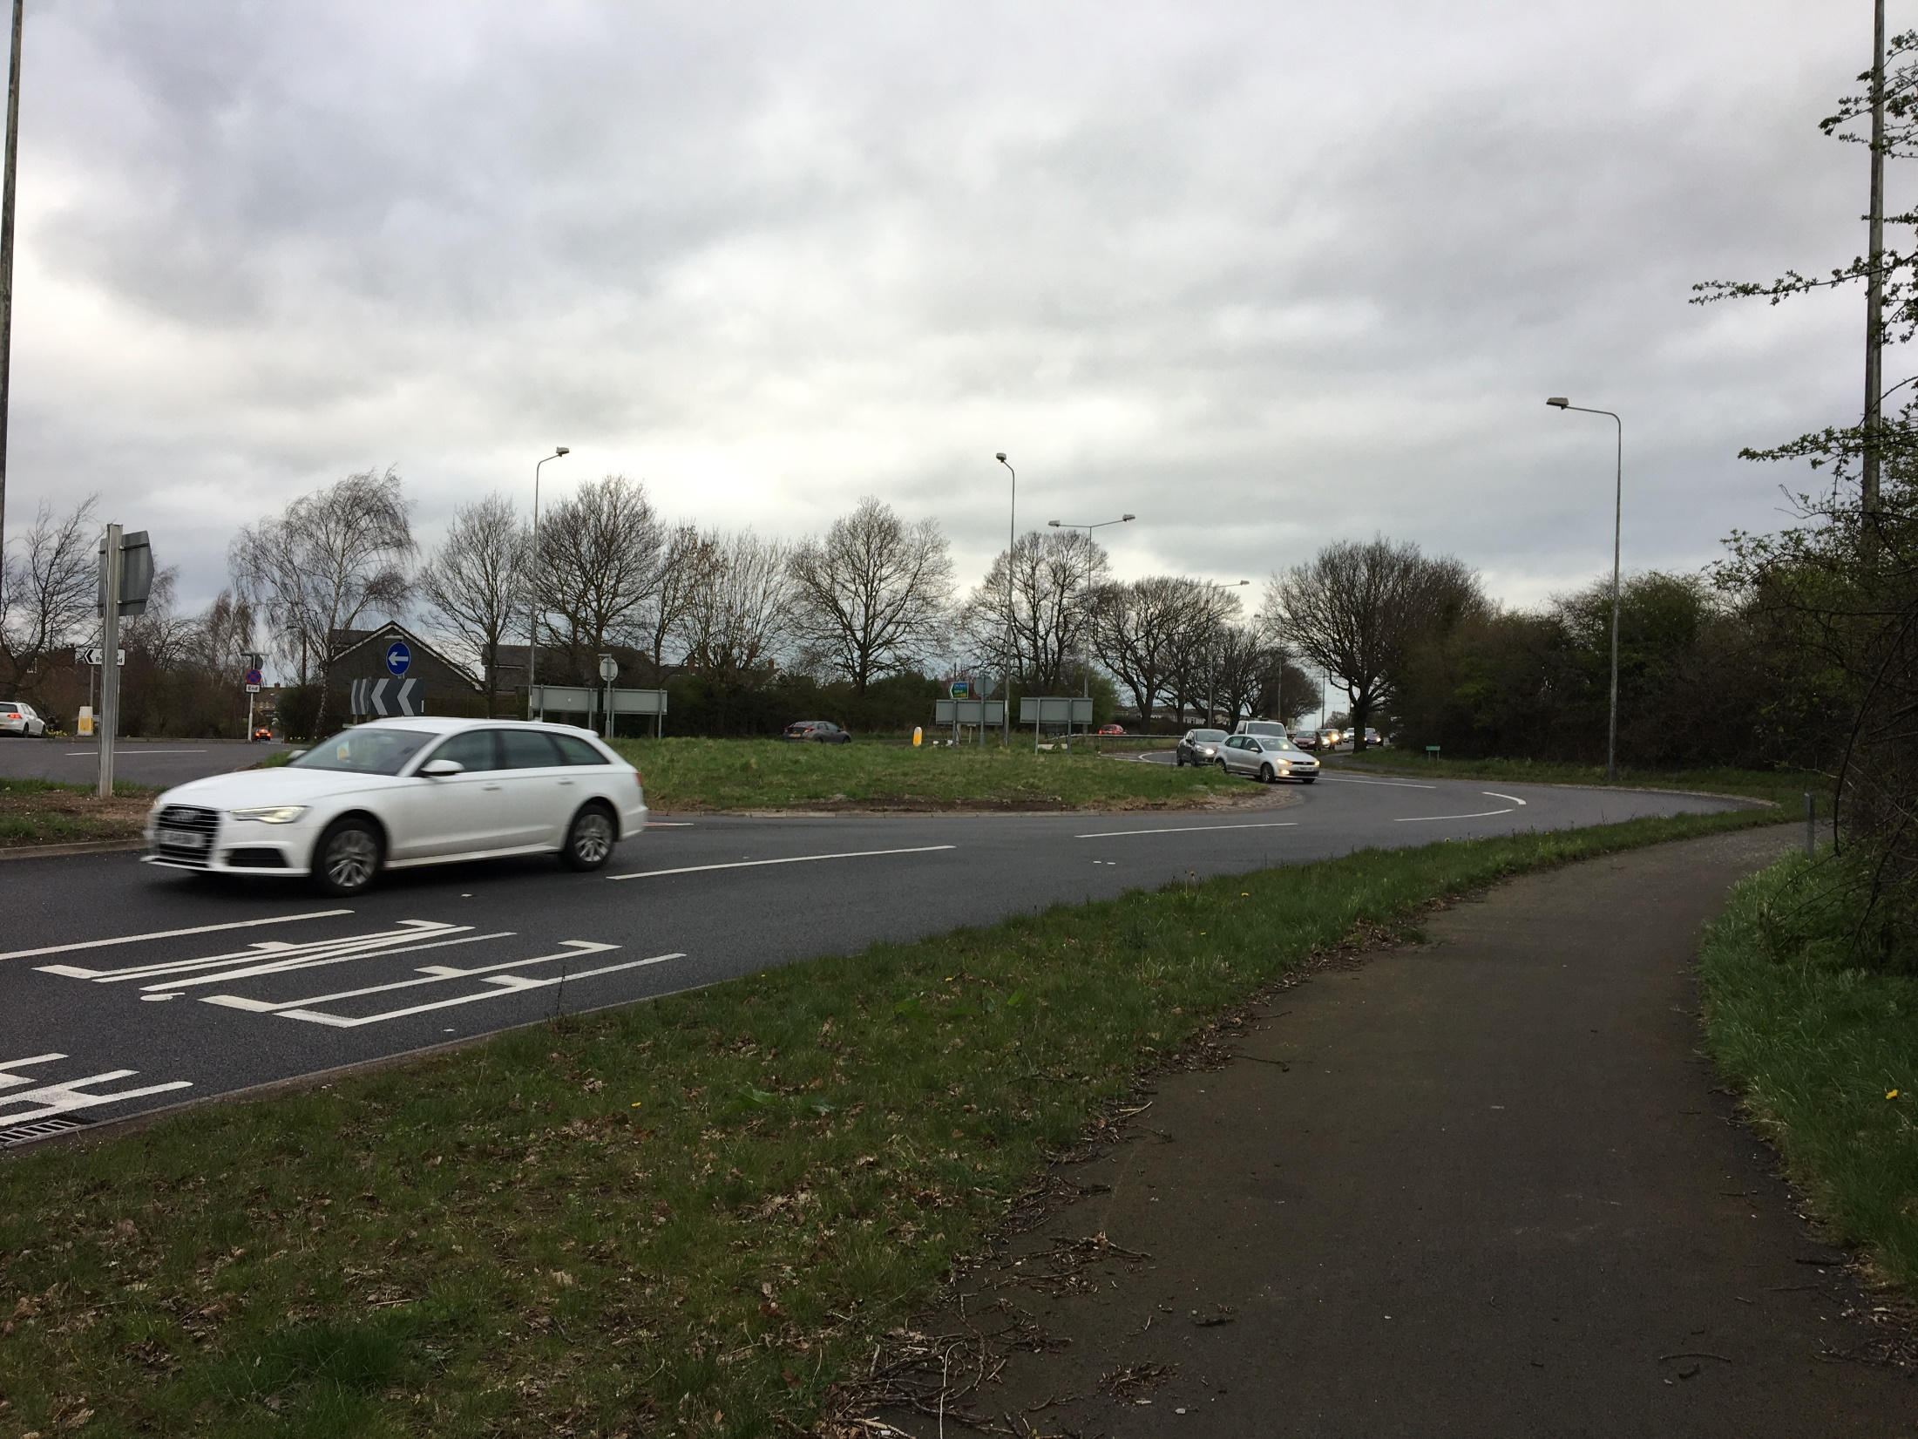
M54 2 Small Roundabouts Near Coven – Point 2
Area 9: sub area M54
Equestrians and Cyclists
Users enter/ exit onto Stafford road which has a lot of traffic as it’s a dual carriageway
The speed of traffic is very fast 60 mph+ and horses have to ride single file. A barrier between the road & cycle path would reassure users
This can be very noisy for all users but especially for horses/ equestrians
Only safe time for equestrians and cyclists to use this road is on Sunday when there is reduced traffic
No mountain blocks available on side of footpath to safely dismount when equestrians are riding alone
It’s a duel carriageway so I would never ride my bike here in rush-hour, they go so fast! The only time I'm here is on a Sunday morning when it’s less busy
CYCLIST
44

Slide 45
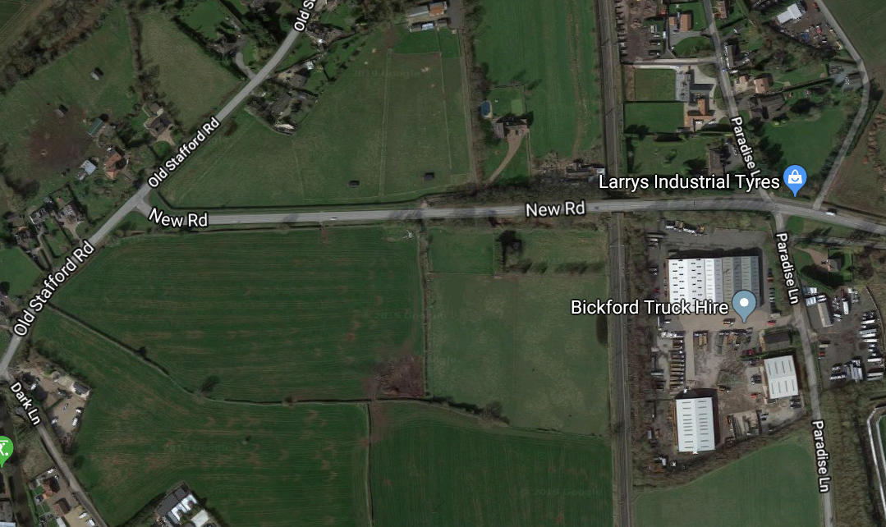
M54 2 Small Roundabouts Near Coven – Point 3
Area 9: sub area M54
Equestrians
Bridal Paths near New Road are not well maintained- they are overgrown which is unsafe as branches can hit equestrians in the face or the bridal path is blocked so you have to dismount or turn back
In general equestrians would like to avoid using the roundabout and would prefer linked up bridal paths in the area
Fly tipping on these paths mean horses can’t pass/ use them
There are no signs to warn other users equestrians are present (e.g. barking dogs can scare and make the horses anxious)
Some of the bridal paths are very overgrown so you have to turn round, or get off and get your horse through and then get back on. Also branches can hit you in the face, so overall it’s not very safe for riders
EQUESTRAIN
45

Slide 46
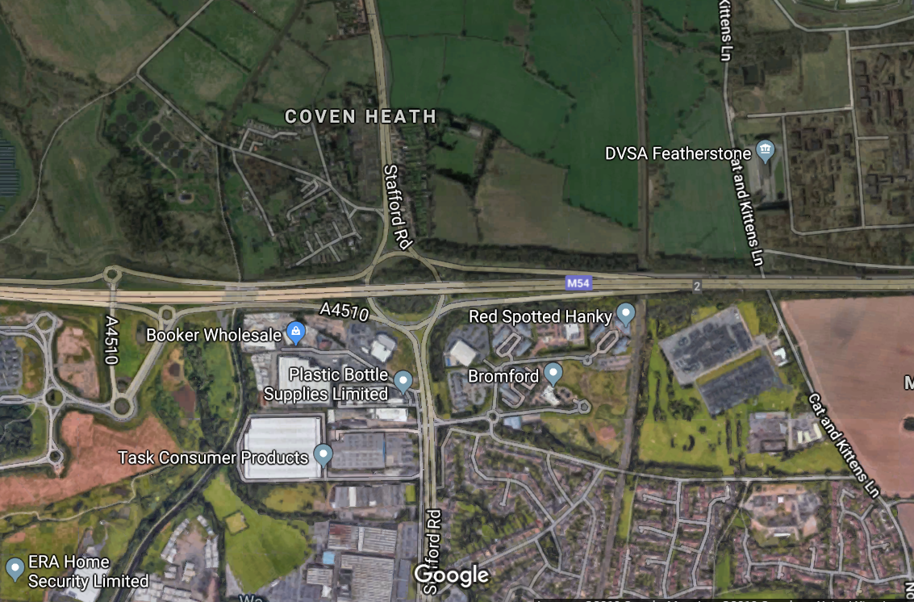
Area 9: sub area M54
M54 Junction 2 – Aerial view
Point 1
Bridge has very fast traffic going underneath which can spook horses
Point 2
Cycle path stops before the roundabout
Signage to indicate cyclists and equestrians use the area are hard to see/absent
Point 3
Cyclists have to use busy roundabout with fast moving traffic
46
Notes:
46

Slide 47
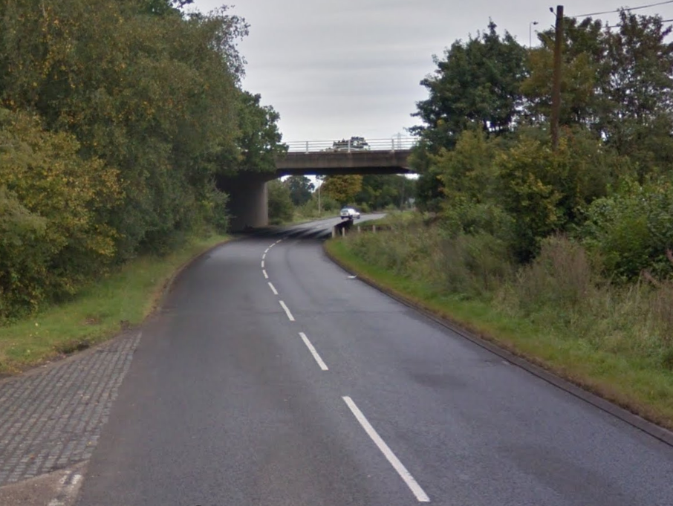
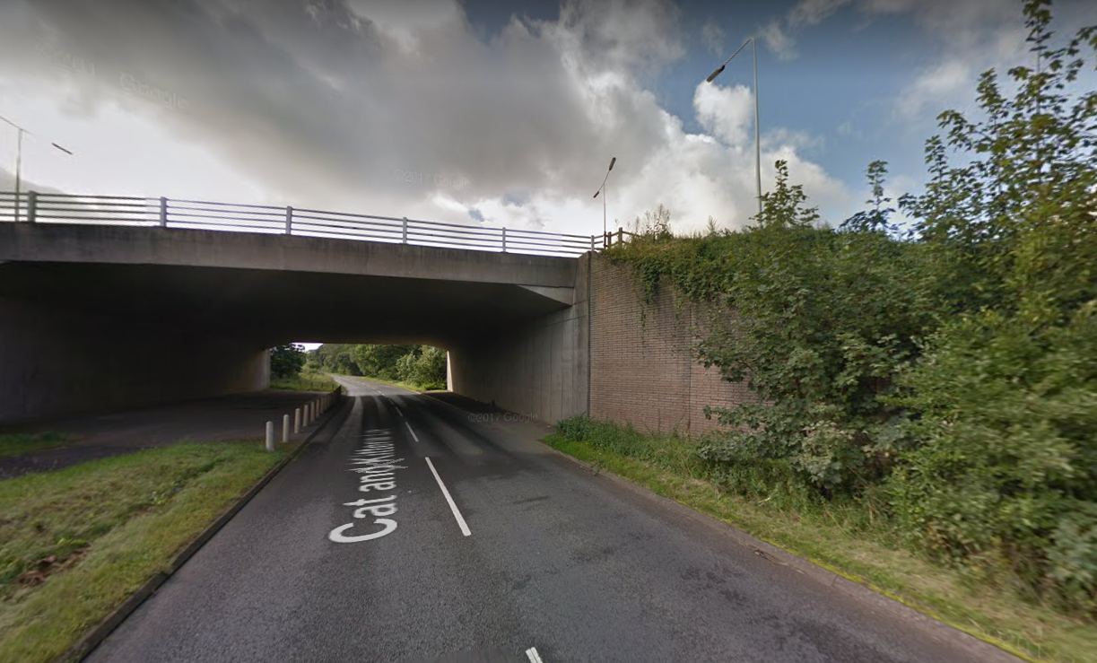
M54 Junction 2 – Point 1
Area 9: sub area M54
Equestrians
Bridge has very fast traffic going underneath it at 40-50 mph so equestrians use footpath instead of the road to feel safer when riding
No signs to indicate equestrians use this underpass. Signs indicating drivers to slow down/ be aware are needed so horses don’t get anxious/ jump unexpectedly
Large mirrors preferred at junction to improve visibility of traffic for equestrians
Hedges and trees on either side of underpass are overgrown and block visibility for all users
Maybe put large mirrors at junctions to improve visibility so I can see what’s coming. Also the trees and hedges need trimming as this can also get in the way of visibility. Safety is everything when you are riding
EQUESTRIAN
47

Slide 48
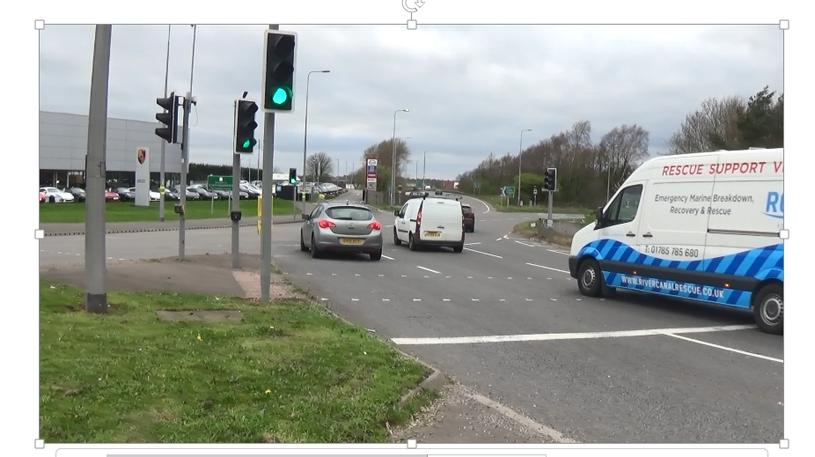
M54 Junction 2 – Point 2
Area 9: sub area M54
Equestrians and Cyclists
Cycle path stops when approaching the roundabout so users have to turn around or use the road
Lack of signs to warn other users that equestrians and cyclists also use this area makes the journey feel risky
Signs are wanted to reassure users that ahead there is a dedicated path to cross or use the roundabout securely
I’d like to see more signs to make others aware we are here. Something that says
‘beware of cyclists’
CYCLIST
48

Slide 49
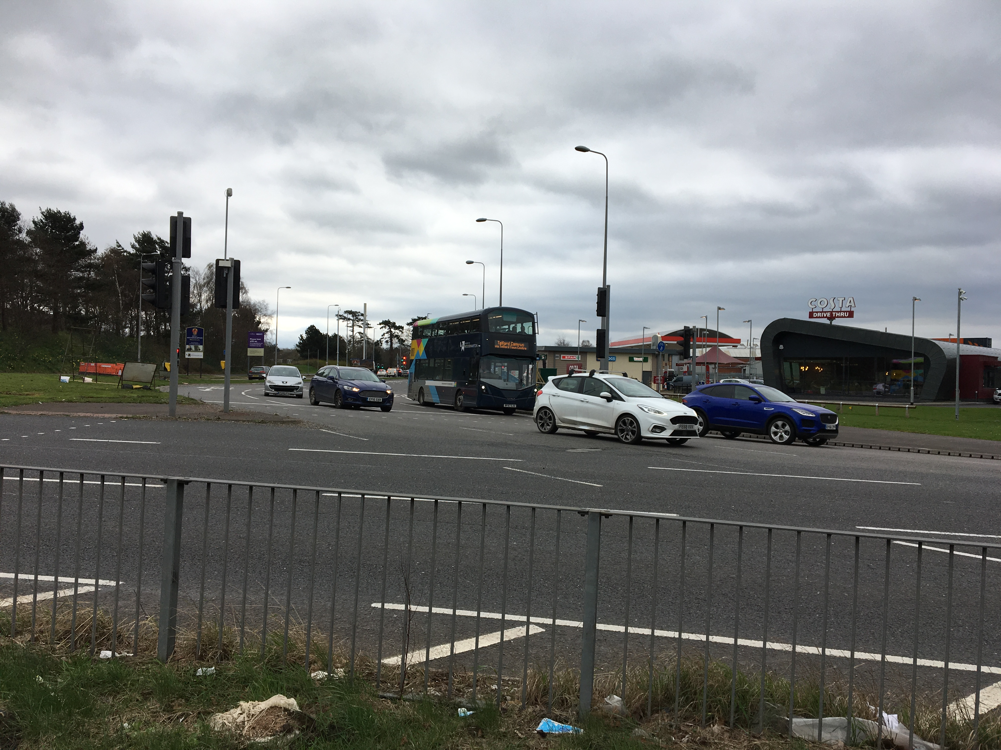
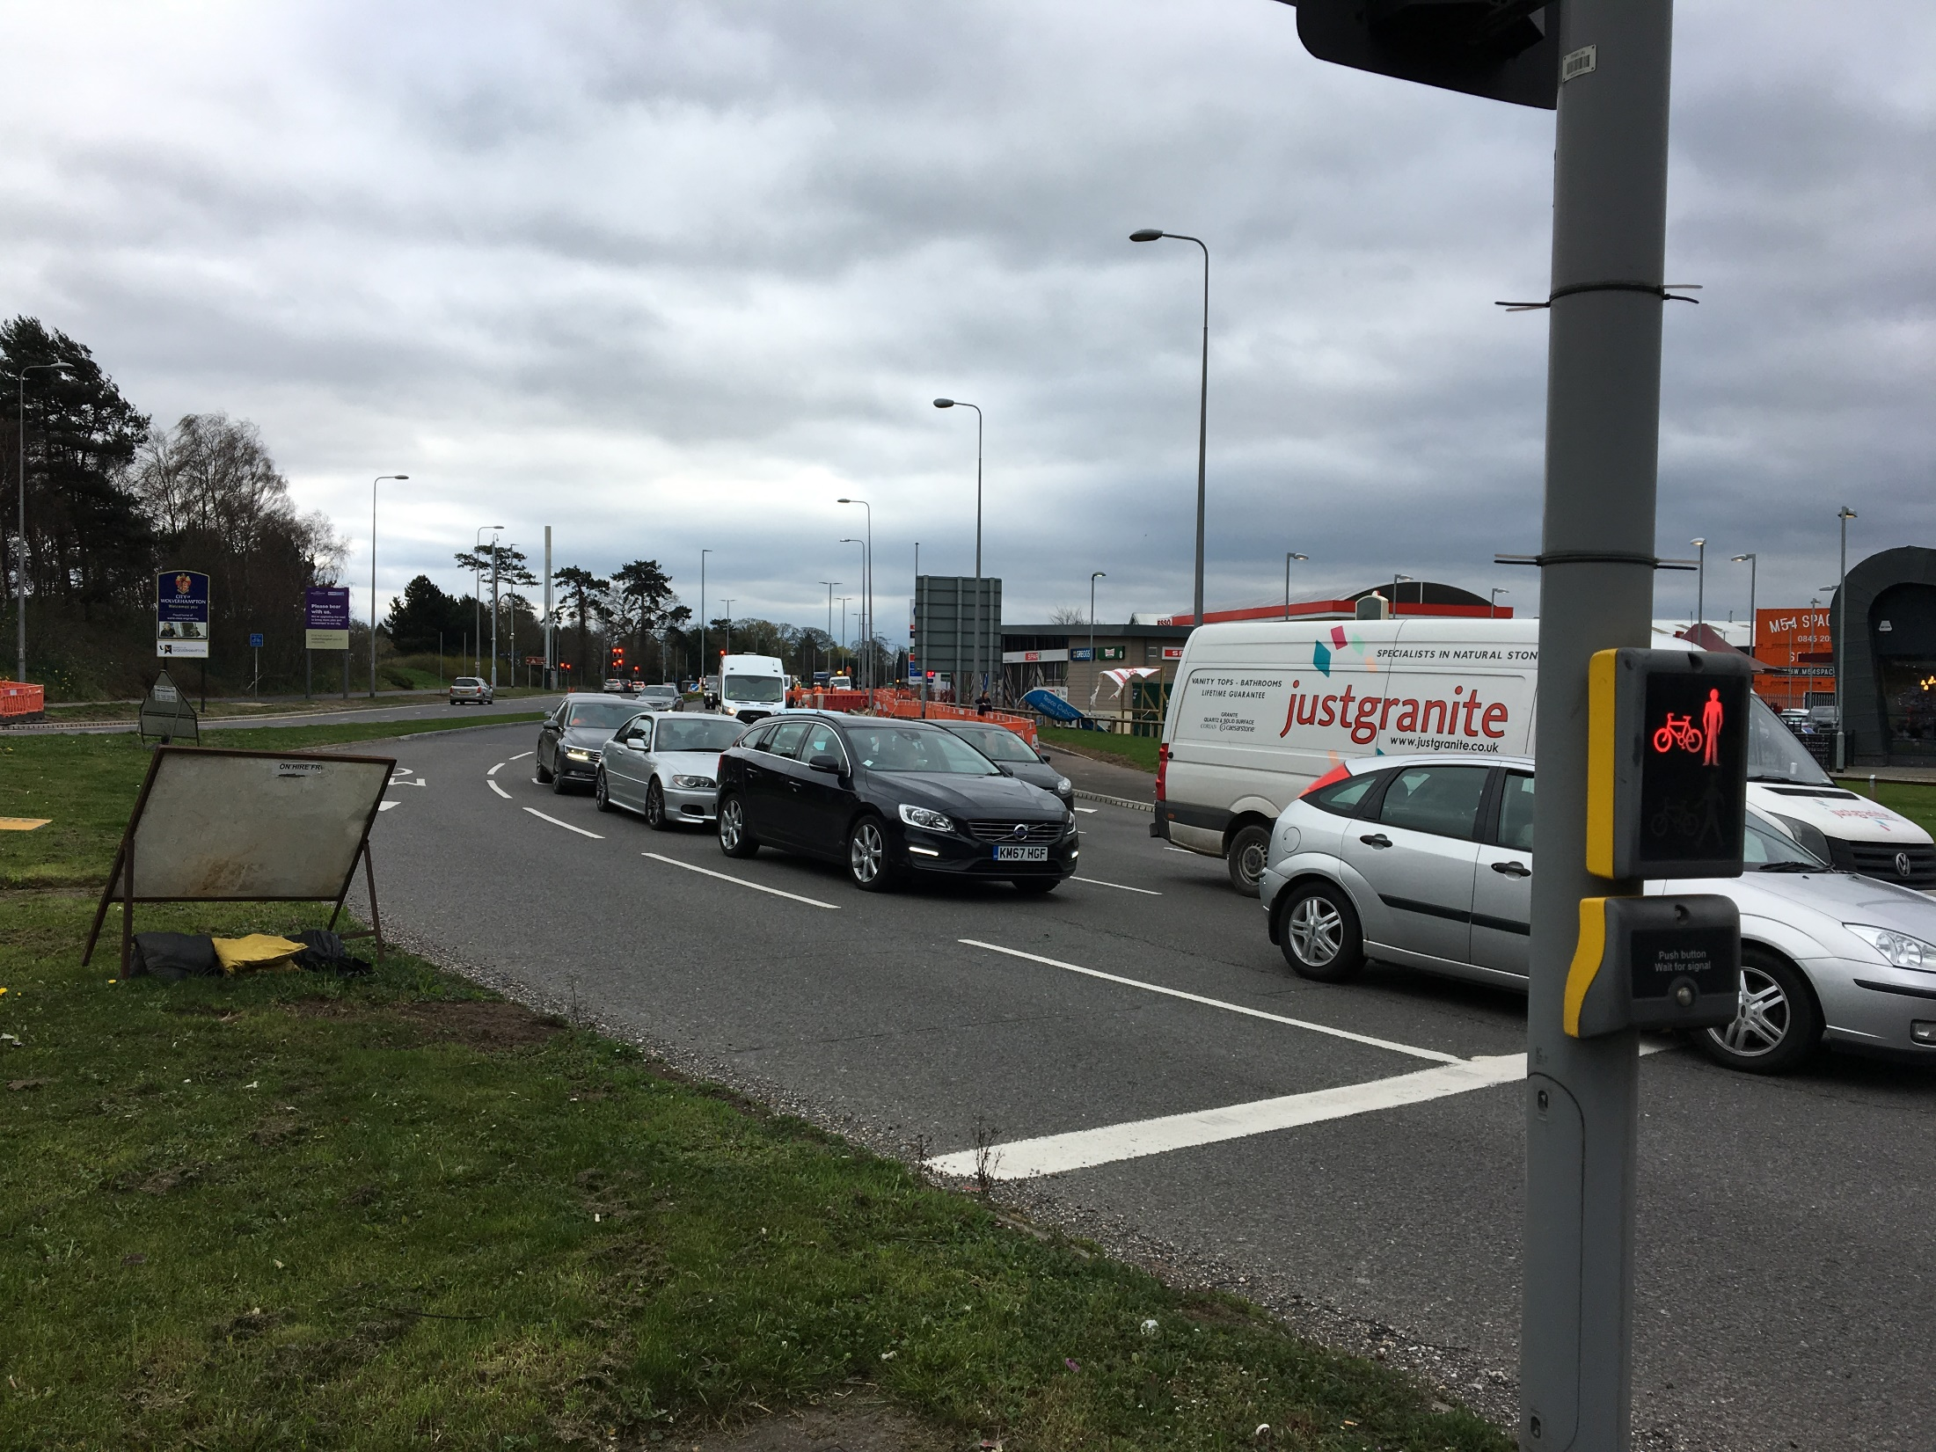
M54 Junction 2– Point 3
Area 9: sub area M54
Equestrians and Cyclists
Cyclists have to use this busy roundabout with fast traffic which feels very dangerous even for experienced cyclists
There is no dedicated cycle lane so users have to ride on a dual carriageway to join the roundabout- they avoid using this junction unless absolutely necessary
There is a lot of very fast traffic here so you have to be on your toes when you are cycling here. I’m not very keen to come here at all to be honest
CYCLIST
49

Slide 50
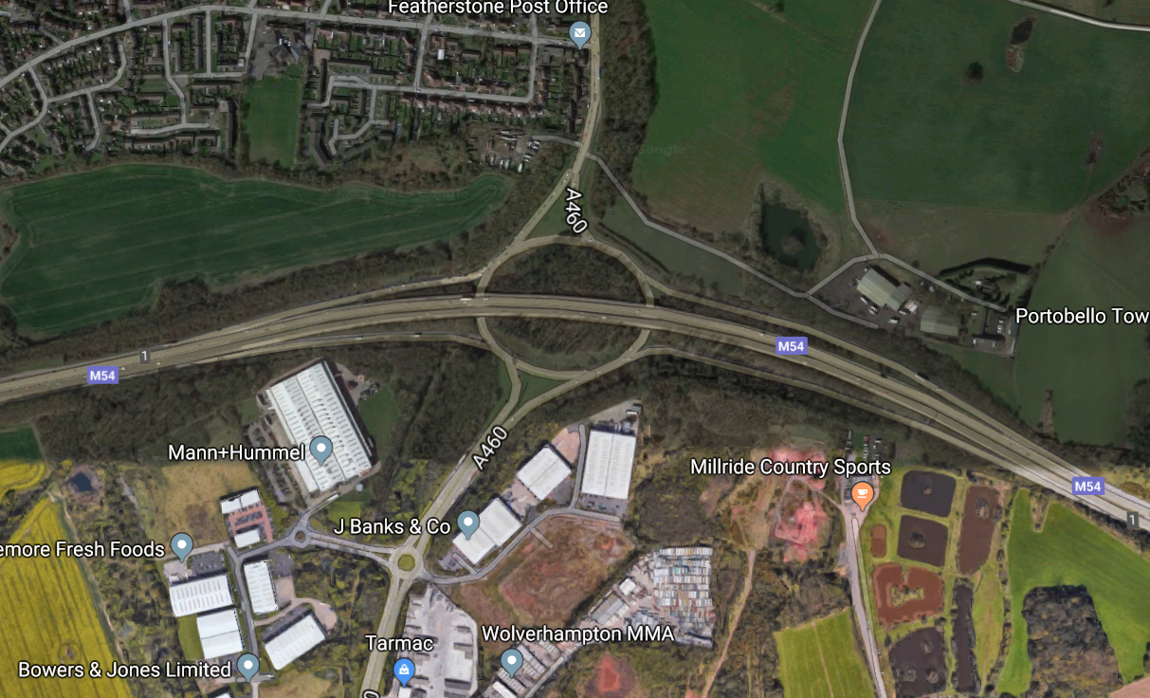
Area 9: sub area M54
M54 Junction 1 – Aerial view
Point 1
Lots of fast and congested traffic on roundabout for Equestrians
Point 2
No crossings available for users at the roundabout
Point 3
Lack of lights means area feels very risky to use at night
50
Notes:
50

Slide 51
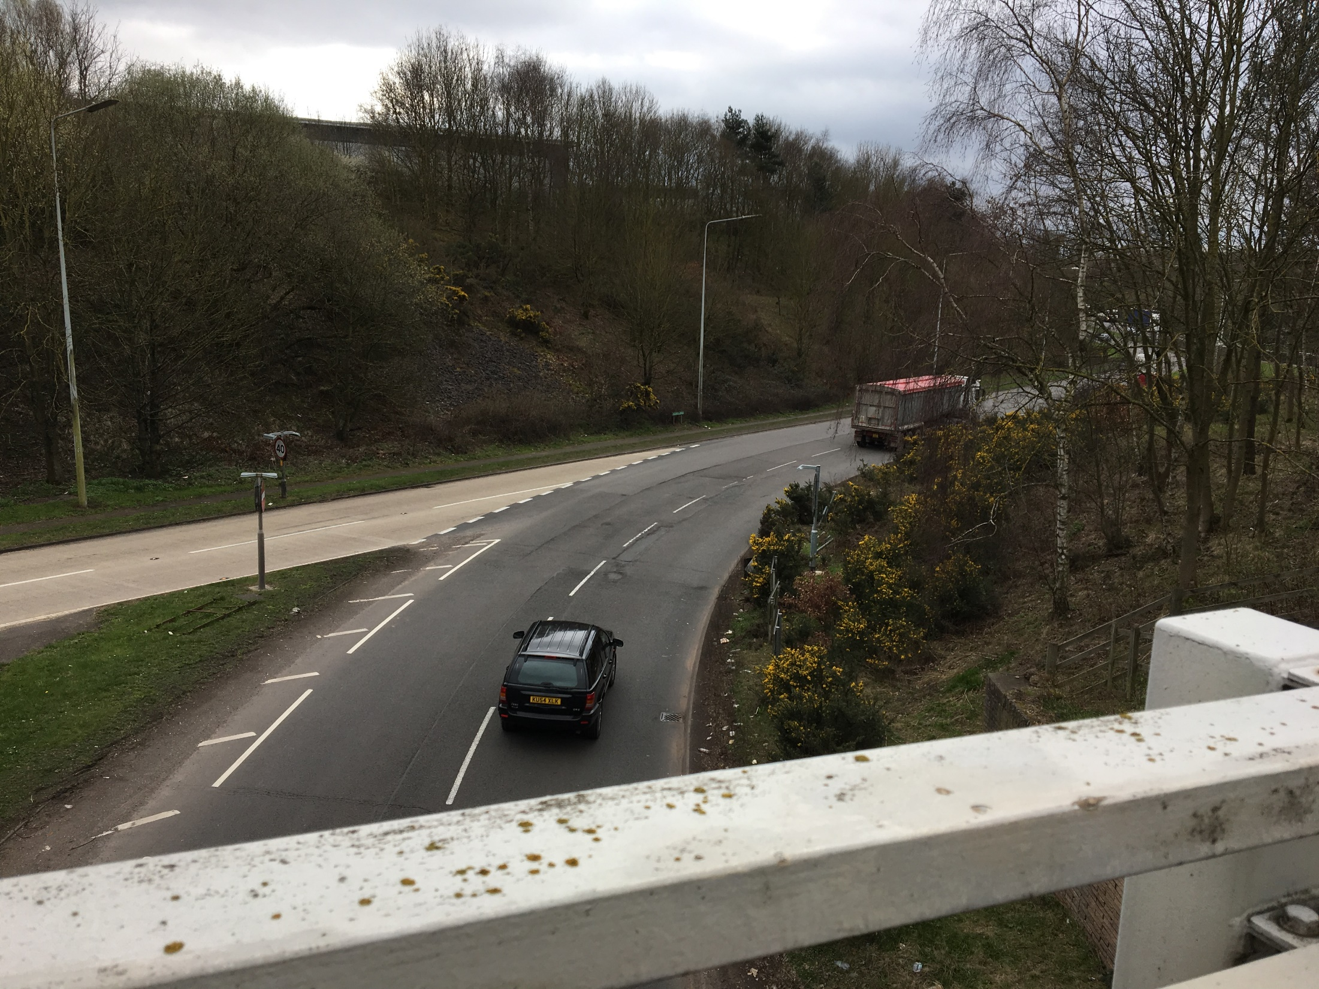
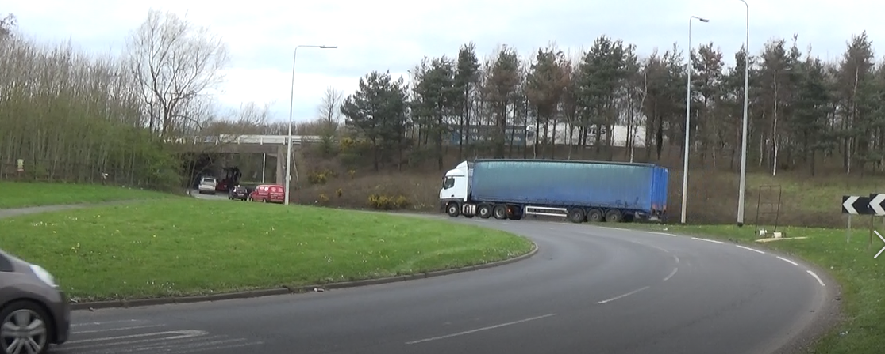
M54 Junction 1 – Point 1
Area 9: sub area M54
Equestrians
There is a lot of very fast traffic on the roundabout that makes equestrians worried their horse will get spooked and riders will get thrown off
Congested traffic means horses are close to cars which makes them anxious. Additionally there is risk of riders getting thrown off
Equestrians only use this roundabout if they have no other choice. A joined up bridal path system which is safer to use is preferred so they can avoid riding on roads completely
I think they should link all the bridal paths in the area so we don’t have to ride on the roads at all!
Although there were no pedestrians in the area, after a site visit it was felt these issues could also affect this group of users
EQUESTRIAN
51

Slide 52
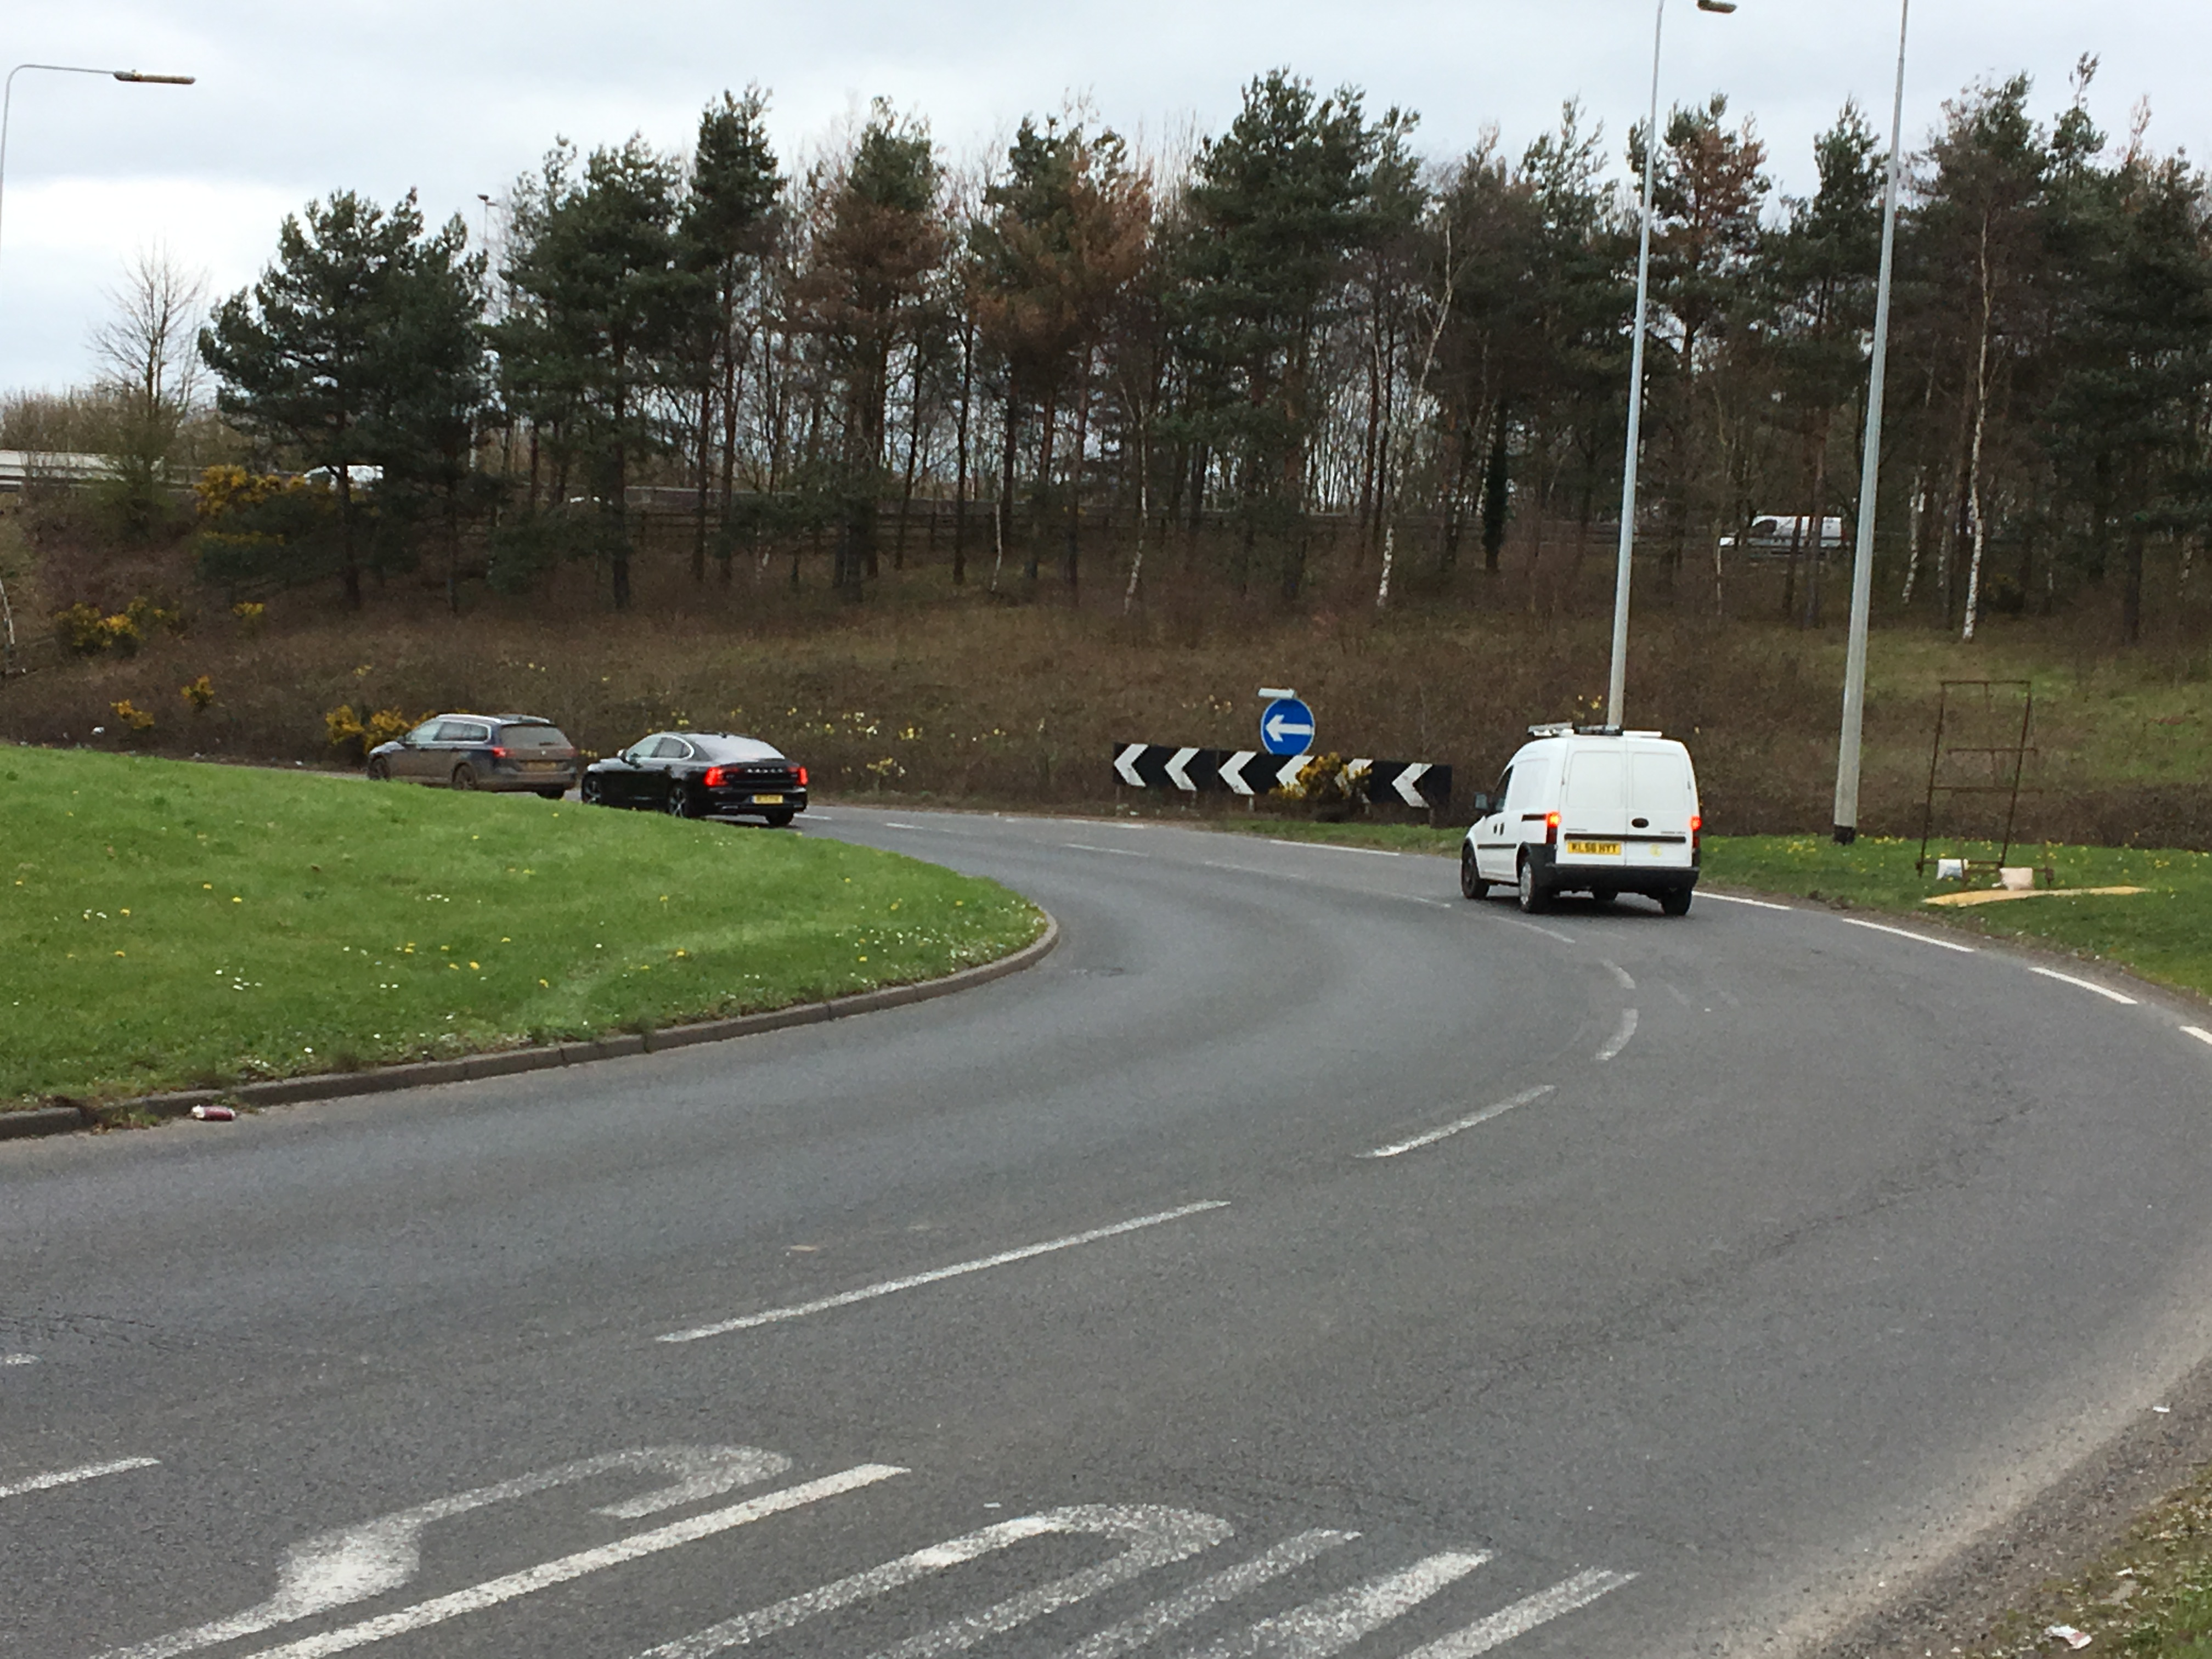
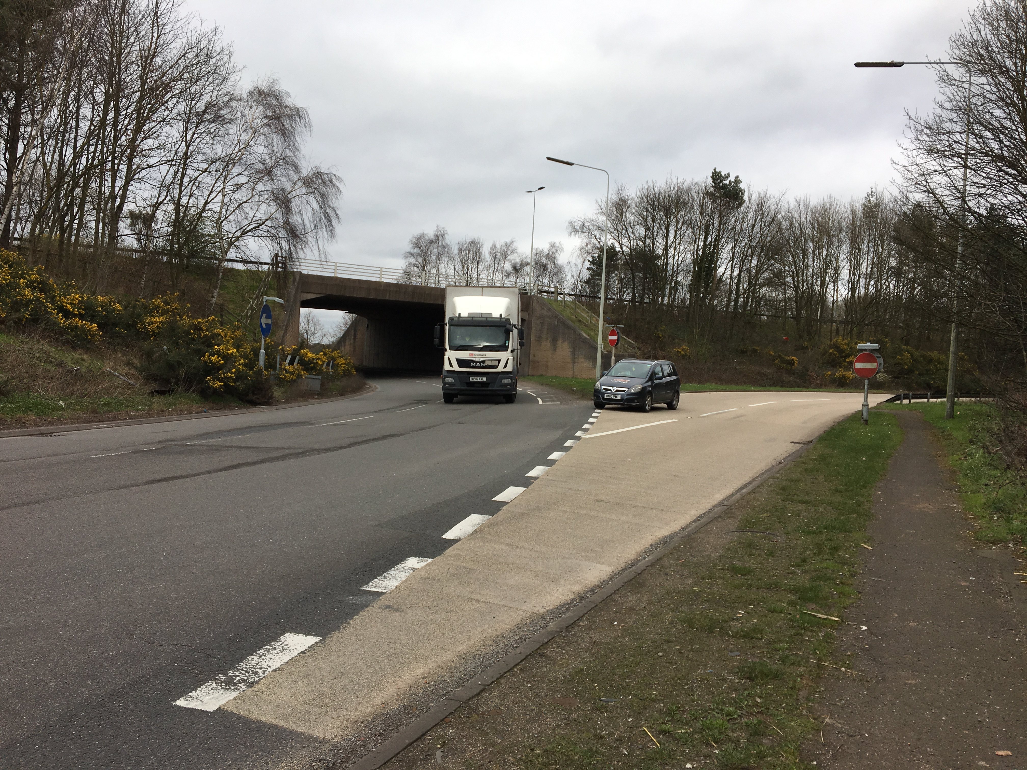
M54 Junction 1 – Point 2
Area 9: sub area M54
Equestrians
No crossings available at any point on the roundabout so the lack of traffic control makes it difficult to cross
Traffic is going very fast here so when equestrians have to use the roundabout it feels very unsafe
Although there were no pedestrians in the area, after a site visit it was felt these issues could also affect this group of users
There is a lot of very fast traffic here, so having lights would make the traffic coming around more controlled. Only very experienced riders would even think to use this!
EQUESTRIAN
52

Slide 53
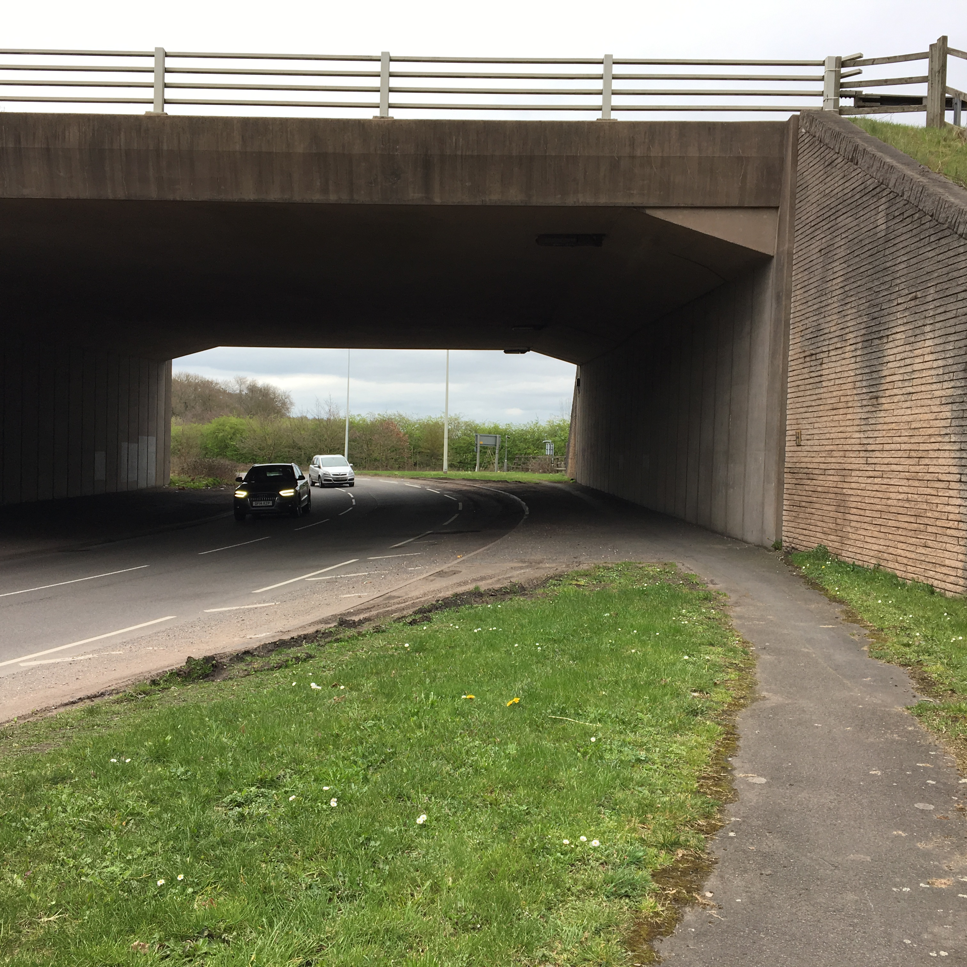
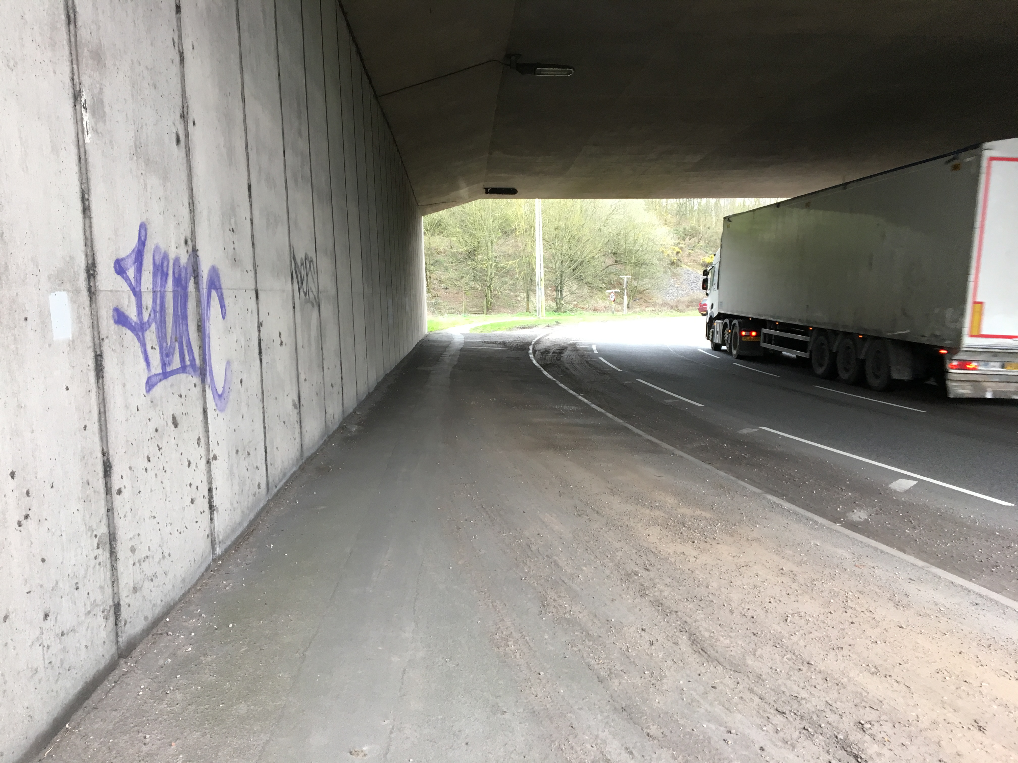
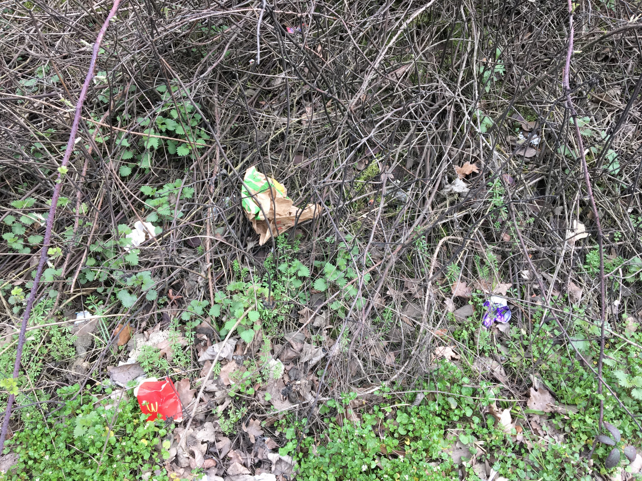
M54 Junction 1– Point 3
Area 9: sub area M54
Equestrians
Lack of lights in the area and underpass make it hard for equestrians to ride safely at dawn or dusk
It’s very noisy especially under/ over the bridge, which can make equestrians and horses anxious
Lot of debris makes the area and underpass feel very isolated and uncared for
Drivers need to be more respectful and slow down and not get to close, otherwise my horse will get scared of the noise and jump and maybe throw me off!
Although there were no pedestrians in the area, after a site visit it was felt these issues could also affect this group of users
EQUESTRIAN
53

Slide 54
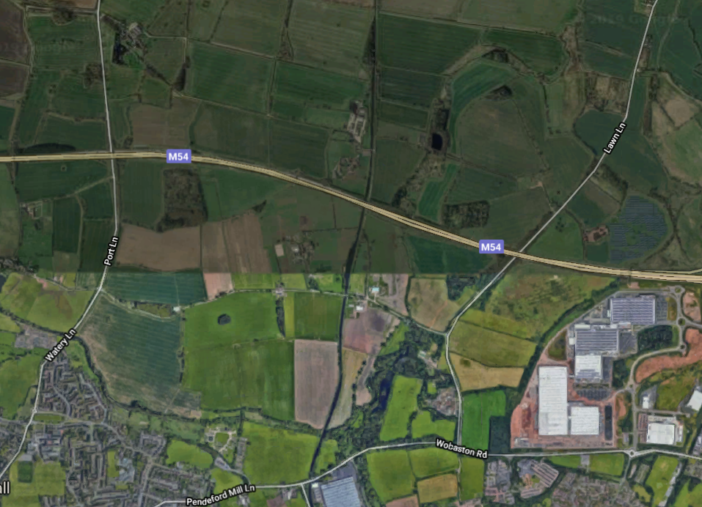
Area 9: sub area M54
M54 Lawn Lane– Aerial view
Point 2
Include more bridal paths around this area so equestrians don’t need to use the bridge
Point 1
For equestrians the bridge has low railings so feel dangerous to cross
Point 3
Pedestrians have to walk on the grass verge approaching the bridge which is near fast traffic and feels unstable
54
Notes:
54

Slide 55
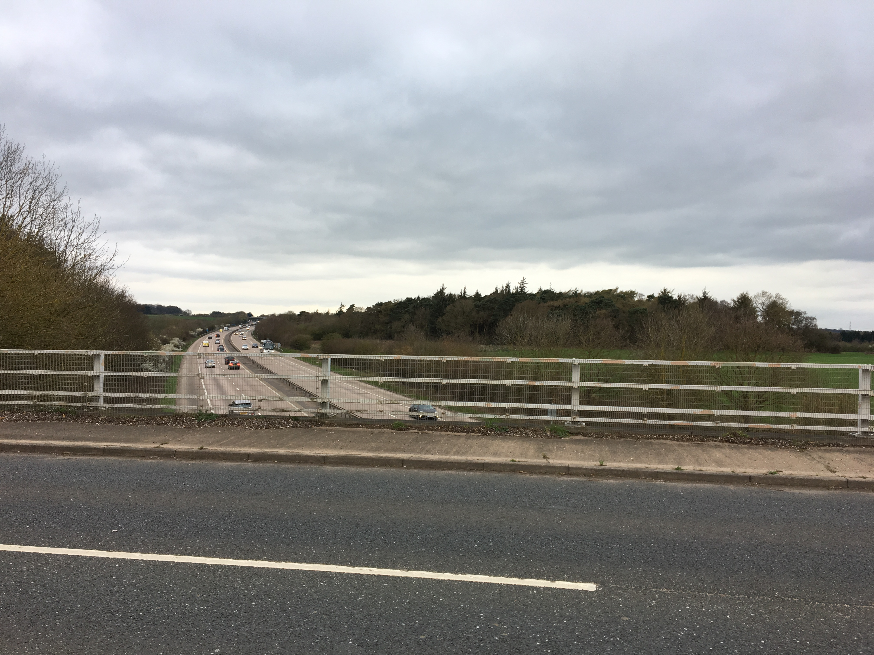
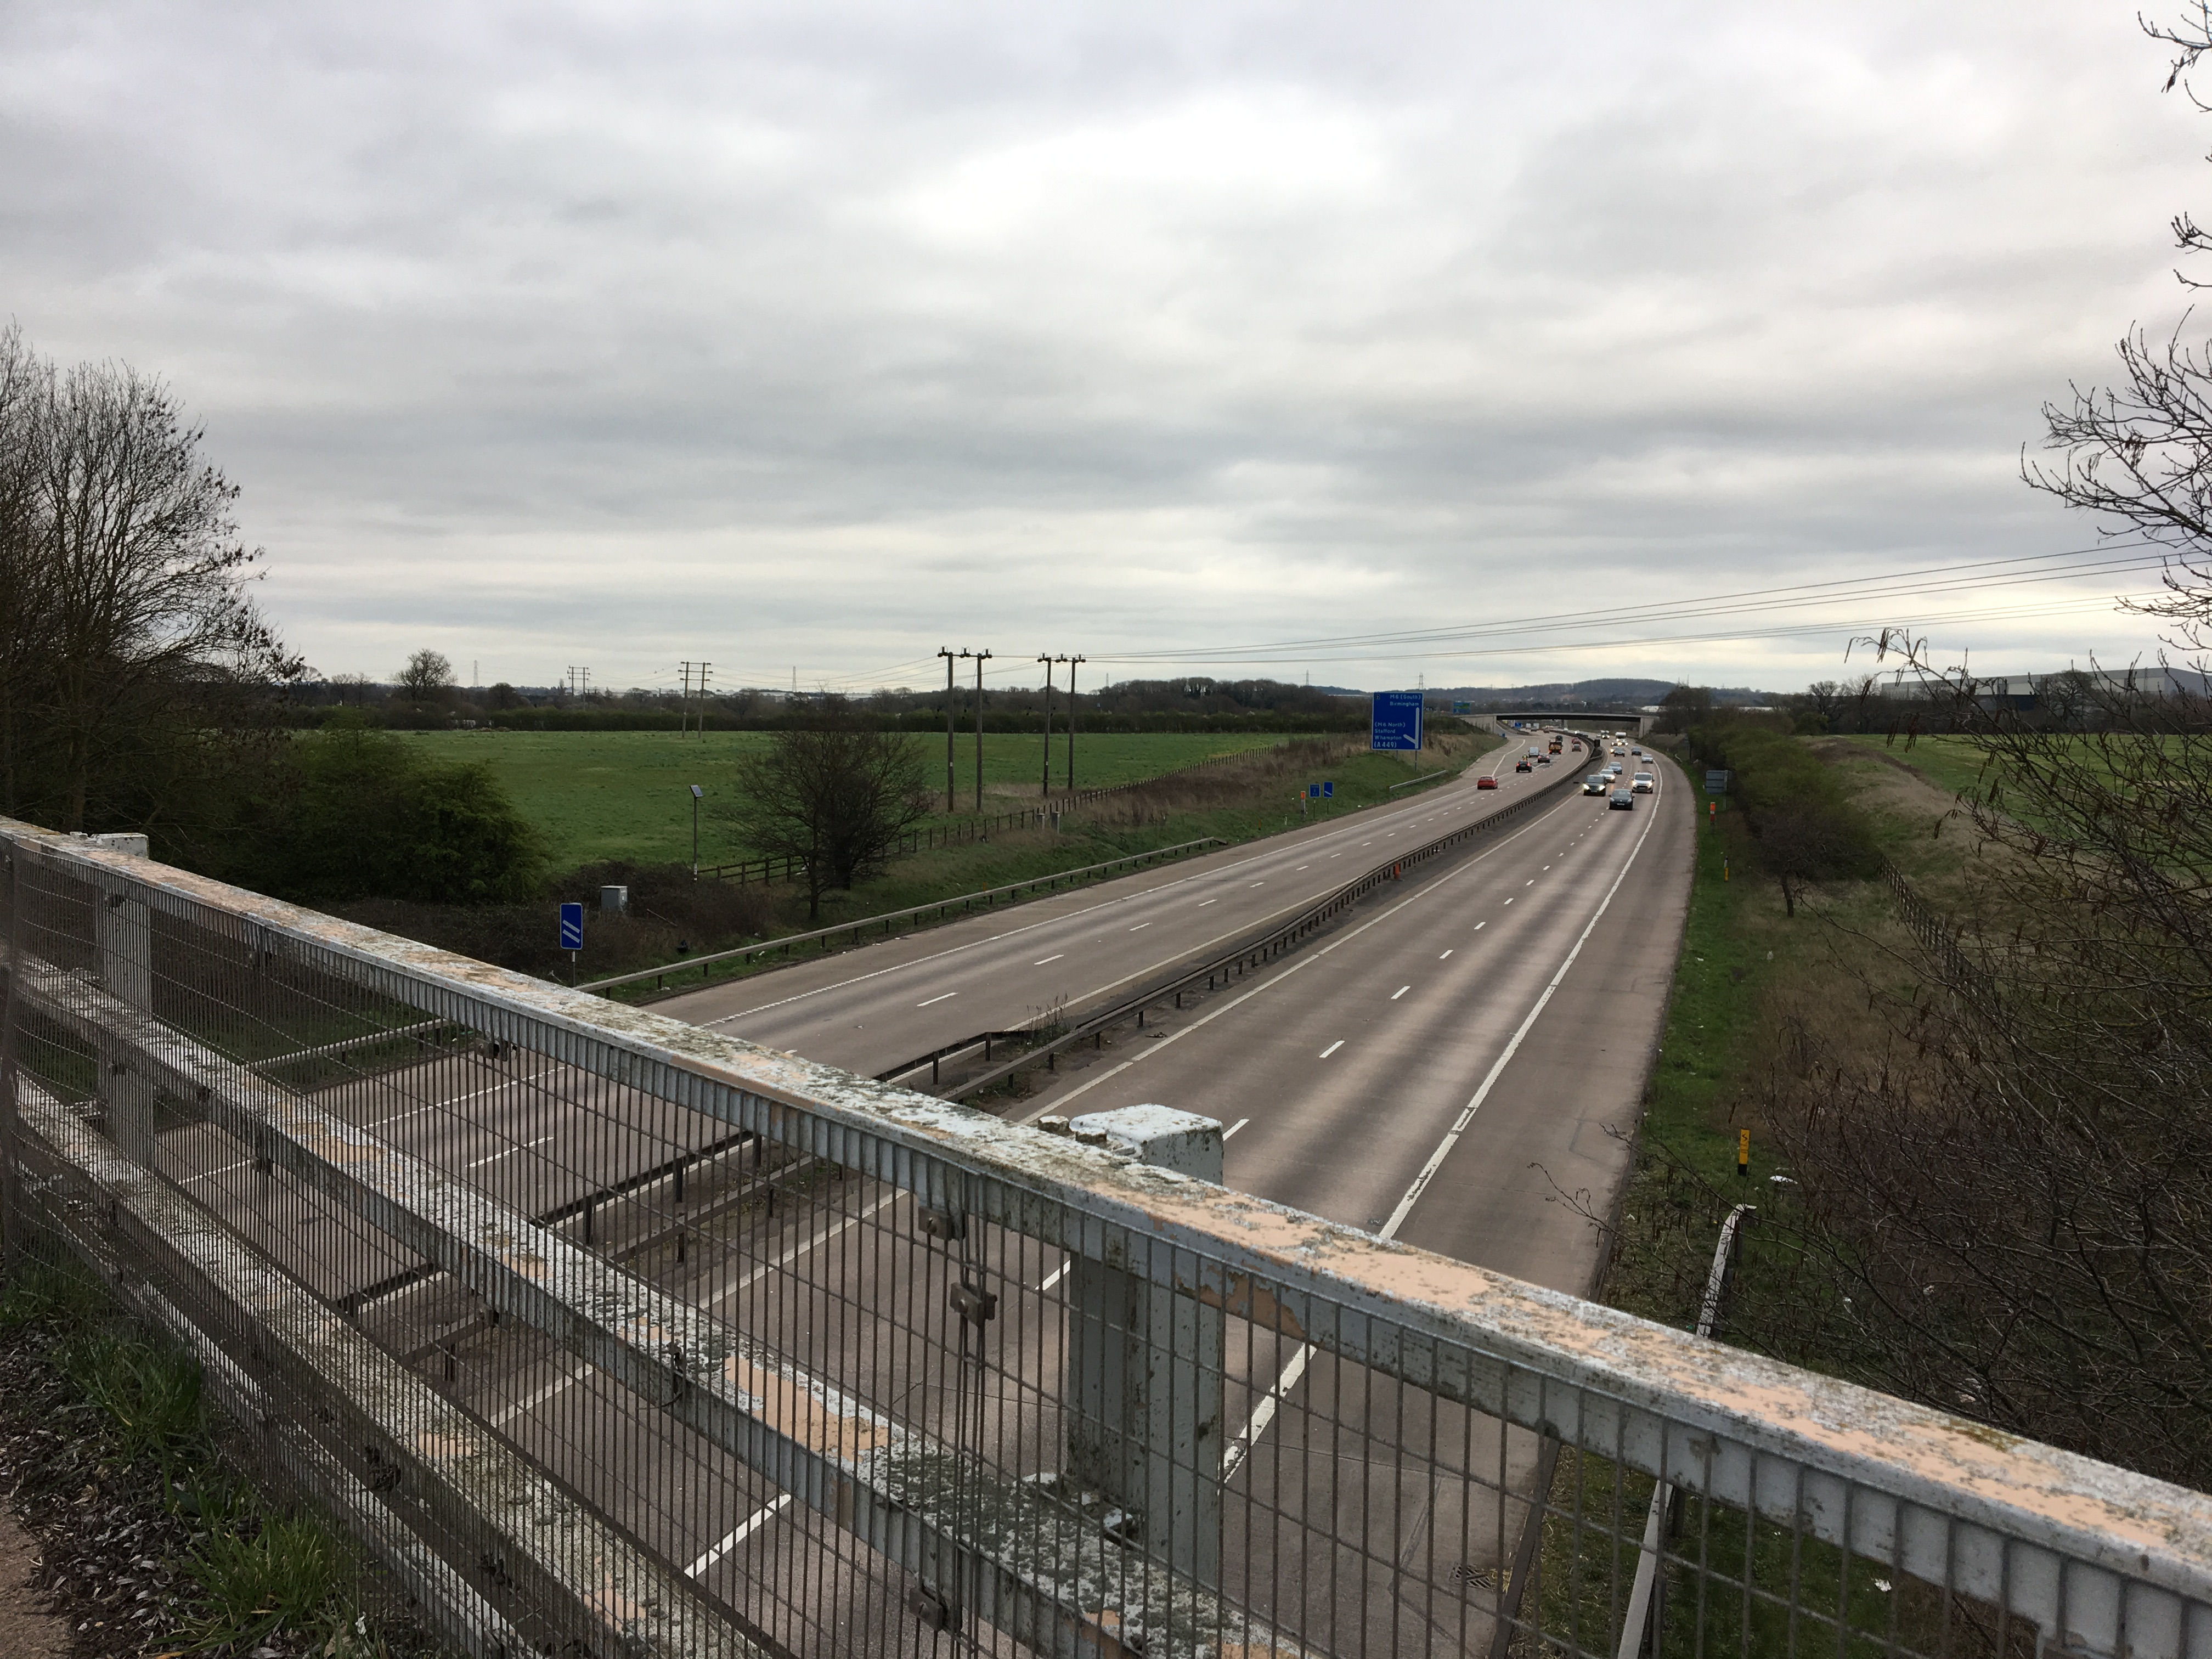
M54 Lawn Lane– Point 1
Area 9: sub area M54
Equestrians
For equestrians the bridge has low railings so feels dangerous to cross. Higher railings will make riders feel protected
A dedicated equestrian path would allow riders to walk their horses over the bridge instead and would alleviate the need to overtake cars which can be dangerous
Lack of mountain blocks at either end of the bridge don’t allow riders to mount/ dismount safely
Lack of signage to indicate equestrians are using this bridge
If I have to cross this bridge sometimes it’s safer to walk across with my horse because of the traffic. Mountain blocks so I can dismount safely on either side of the bridge would be really helpful
EQUESTRIAN
55

Slide 56
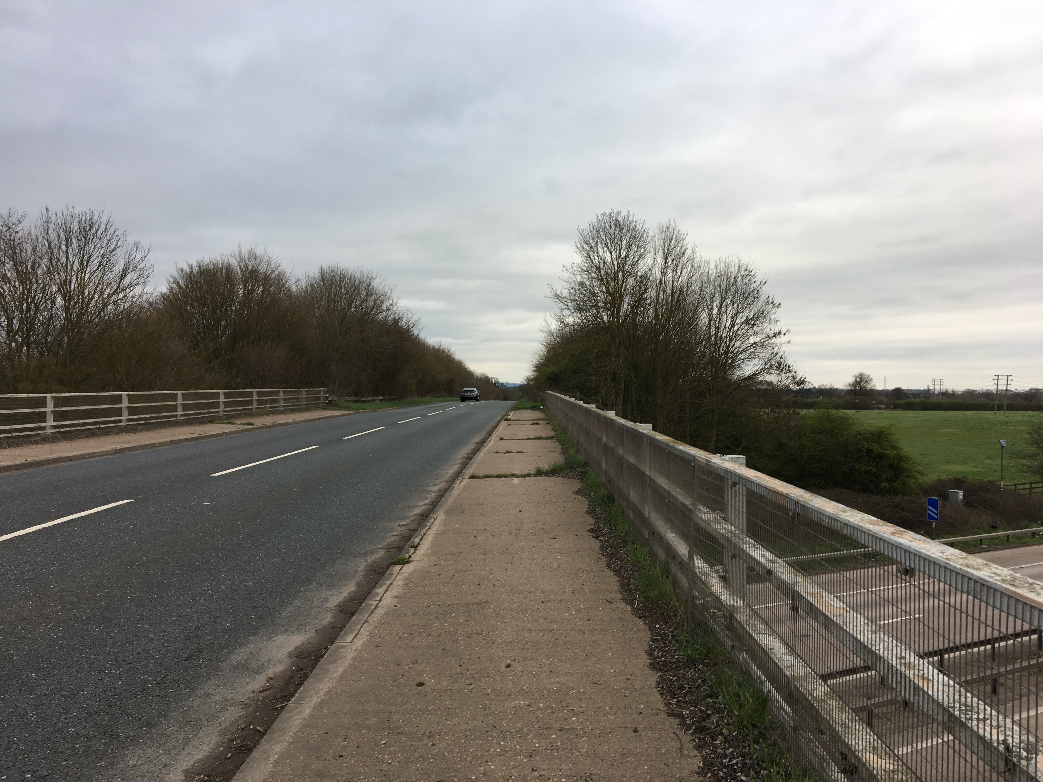
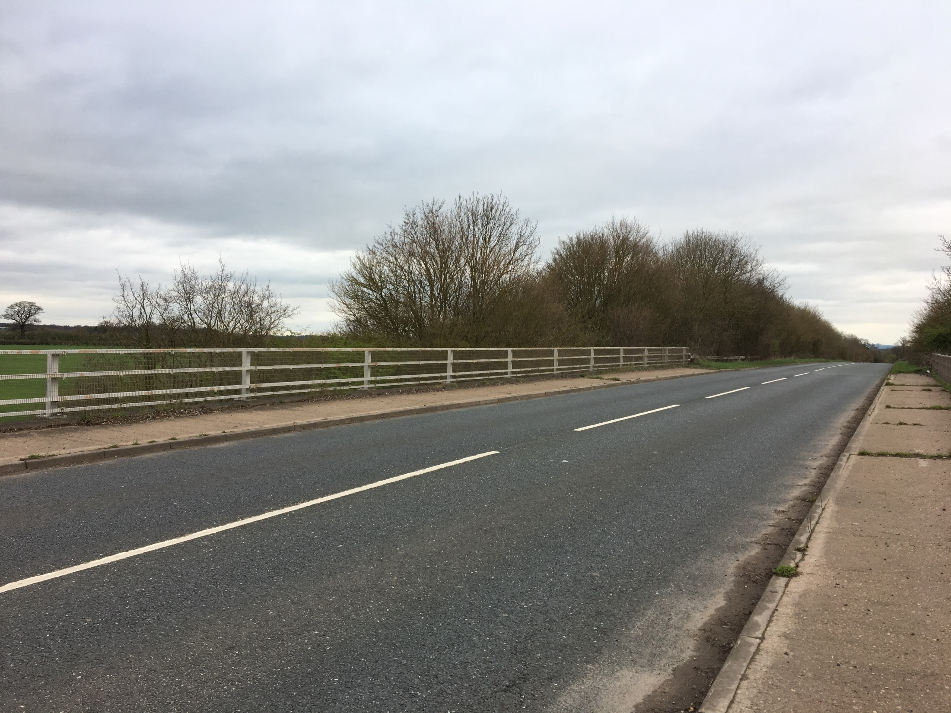
M54 Lawn Lane – Point 2
Area 9: sub area M54
Equestrians
Include more bridal paths around this area so equestrians don’t need to use the bridge at all
Traffic can go very fast here which can scares the horses and this bridge is used only as a last resort
Fly tipping in the lead up to this bridge happens often and prevents the horses from crossing the bridge safely as this is an obstacle which blocks their vision and leaves them with not enough room for them to pass
Fly tipping around here happens often and that’s a real problem as my horse gets anxious as there is not enough room to pass
EQUESTRIAN
56

Slide 57
M54 Lawn Lane – Point 3
Area 9: sub area M54
Pedestrians
Pedestrians have to walk on the grass verge approaching the bridge which is near fast traffic and feels unstable
The grass verge is overgrown and uneven to walk on. Often there is rubbish around
On the bridge the pavement is old and neglected, resulting in an uneven surface to walk on
Lack of signage to indicate pedestrians are using this bridge
It’s not easy to walk along the bridge here. The grass verge is overgrown and lumpy, you are constantly stumbling
PEDESTRIAN
57

Slide 58
Area 9 Sub Area A5
Qualitative Case studies

Slide 59
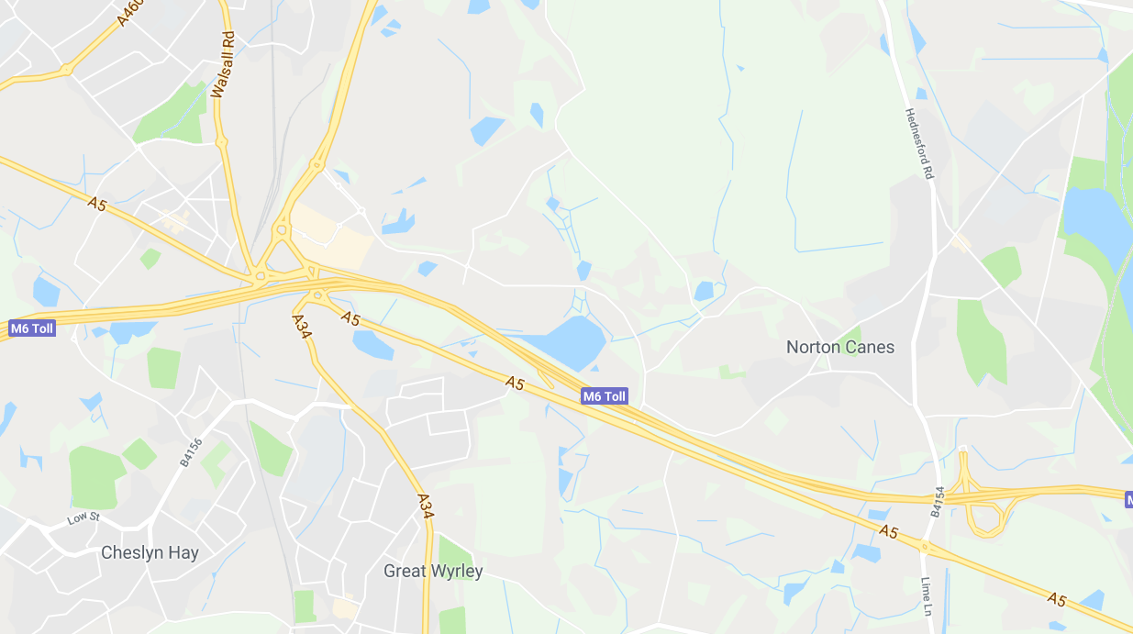
A5 - Map
Area 9: sub area A5
A5 Roundabout over or under the M6
Bridge over the M6 & A5 Road
A5 Roundabout
59
Notes:
59

Slide 60
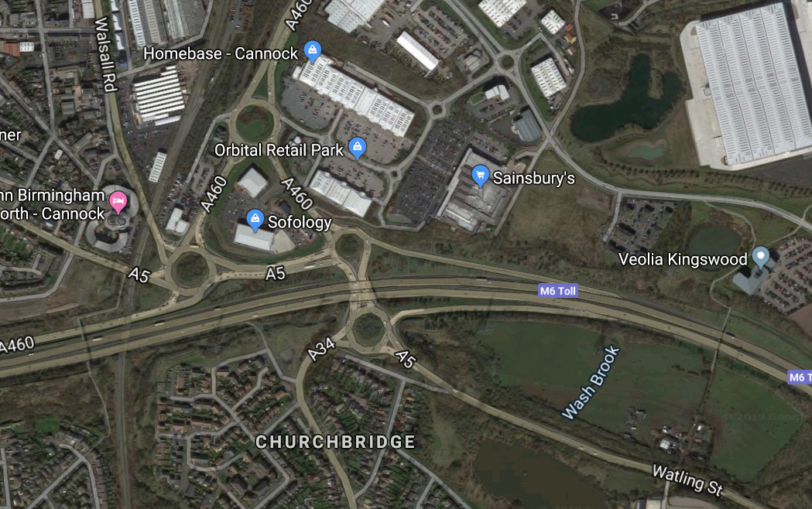
Area 9: sub area A5
A5 Roundabout over or under the M6– Aerial view
Point 2
Increased signage needed to indicate there are safe pedestrian walkways available and also that cyclists are using the area
Point 1
It’s unclear if there is a cycle lane, so cyclists feel they have to use these two roundabouts alongside very busy and congested traffic
Point 3
Traffic approaching the roundabout on the A5 goes high speeds so pedestrian walkway feel very exposed.
No cycle path is available
60
Notes:
60

Slide 61
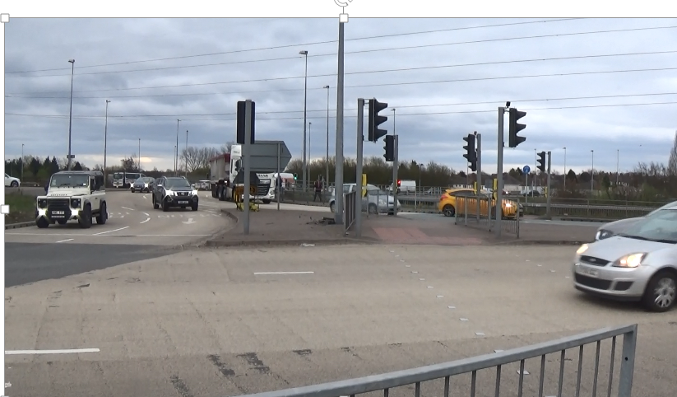
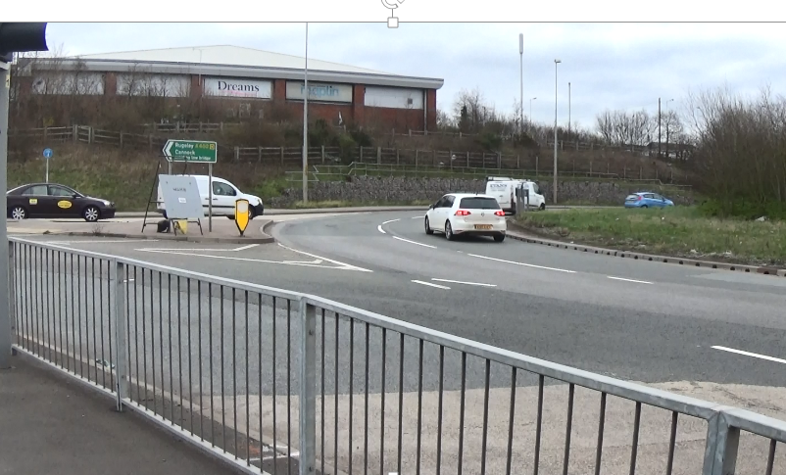
A5 Roundabout over or under the M6– Point 1
Area 9: sub area A5
Cyclists
It’s unclear if there is a cycle lane, so cyclists feel they have to use these two roundabouts alongside very busy and overcrowded traffic that includes multiple exits. A pelican crossing would ensure users could get off bikes to cross safely
Traffic lights should have a box to allow cyclists to be in clear view of drivers and to allow cyclists to get ahead of traffic
Constant and congested roadworks means cyclists worry about not having enough space and getting pushed around by traffic
I have to cycle on the main road and it’s never really safe because you are always navigating between all the cars and there are so many exits!
CYCLIST
61
Notes:
61

Slide 62
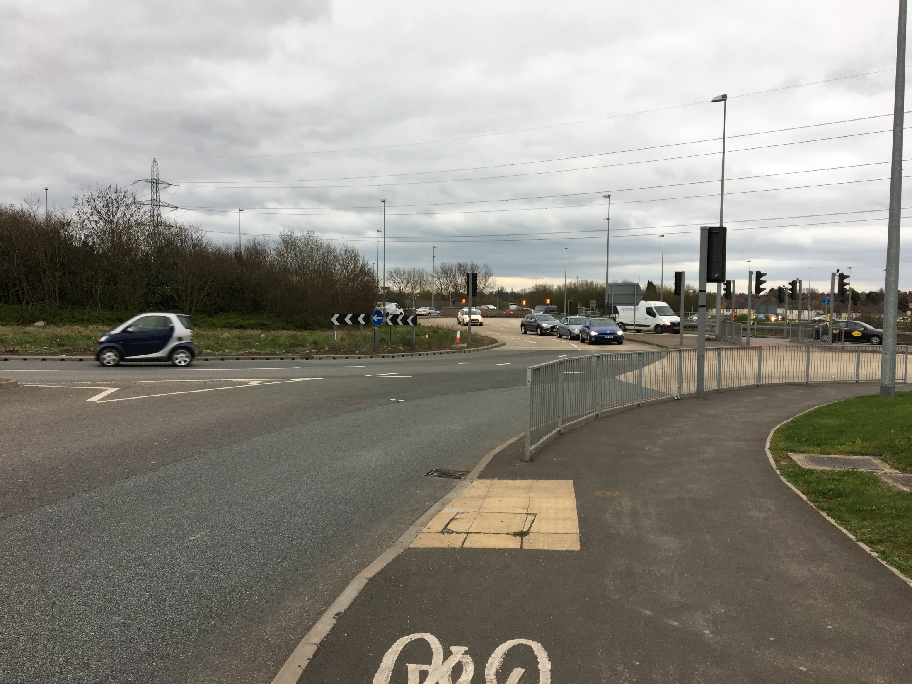
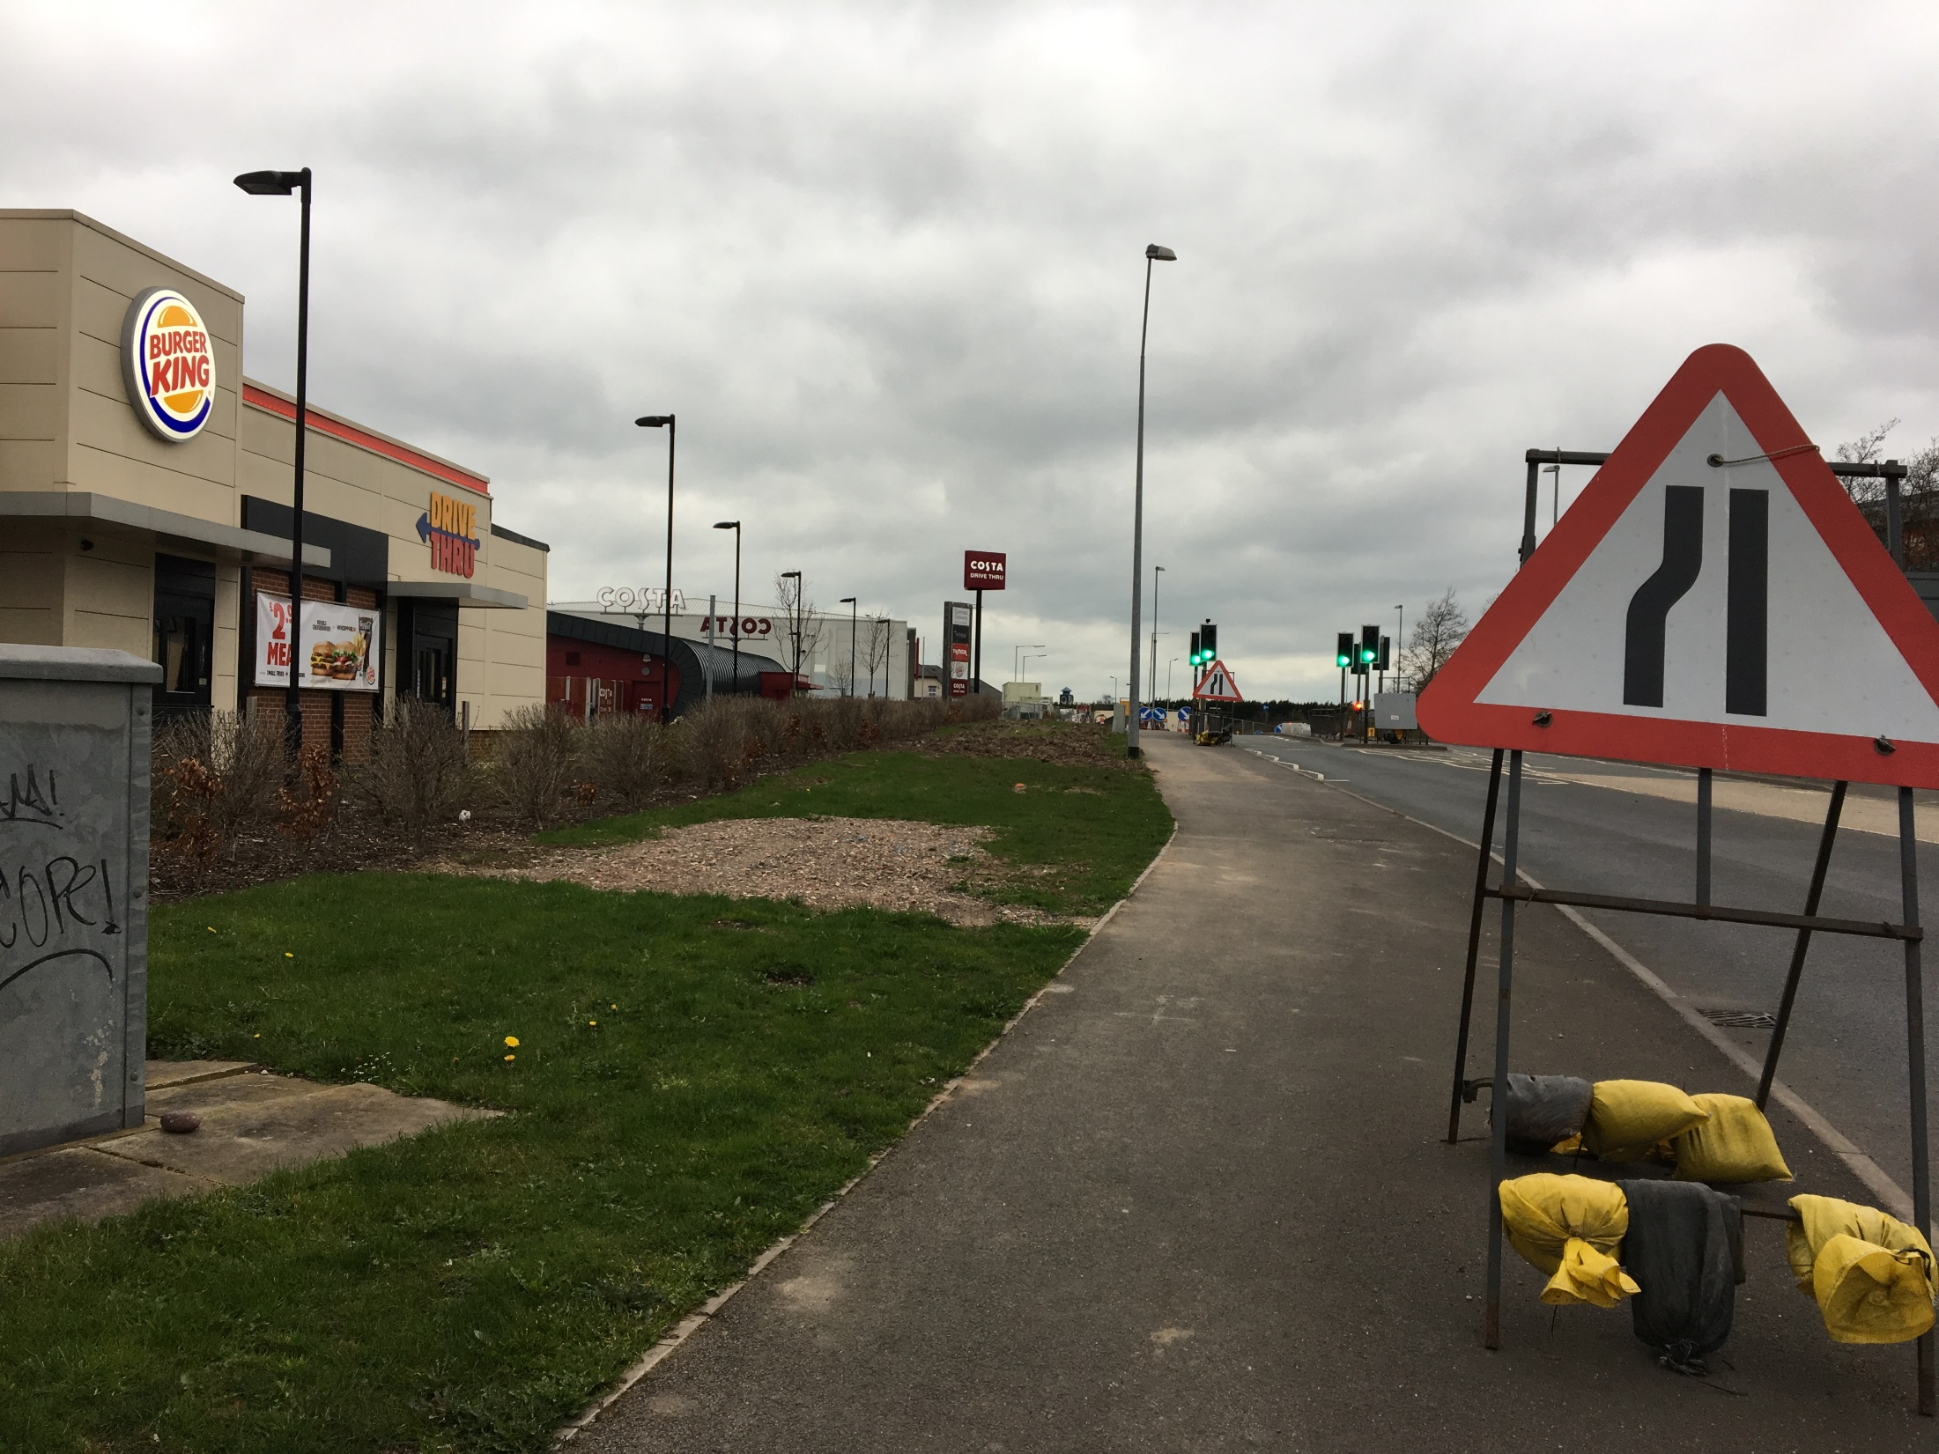
A5 Roundabout over or under the M6 – Point 2
Area 9: sub area A5
Pedestrians and Cyclists
Increased signage needed to indicate there are safe pedestrian walkways available. Clear signs also needed to indicate to motorists that cyclists are using the area/ roundabouts
Multiple potholes on the roundabout and adjacent roads near the Burger King/ Sainsbury's due to all the lorry deliveries- these can cause accidents and be dangerous for cyclists
Extremely busy traffic on these two roundabouts means pedestrians feel wary. Additional pedestrian crossings would allow time to cross safely
There may be a sign indicating a pedestrian pathway, but I don't recall seeing one
PEDESTRIAN
62

Slide 63
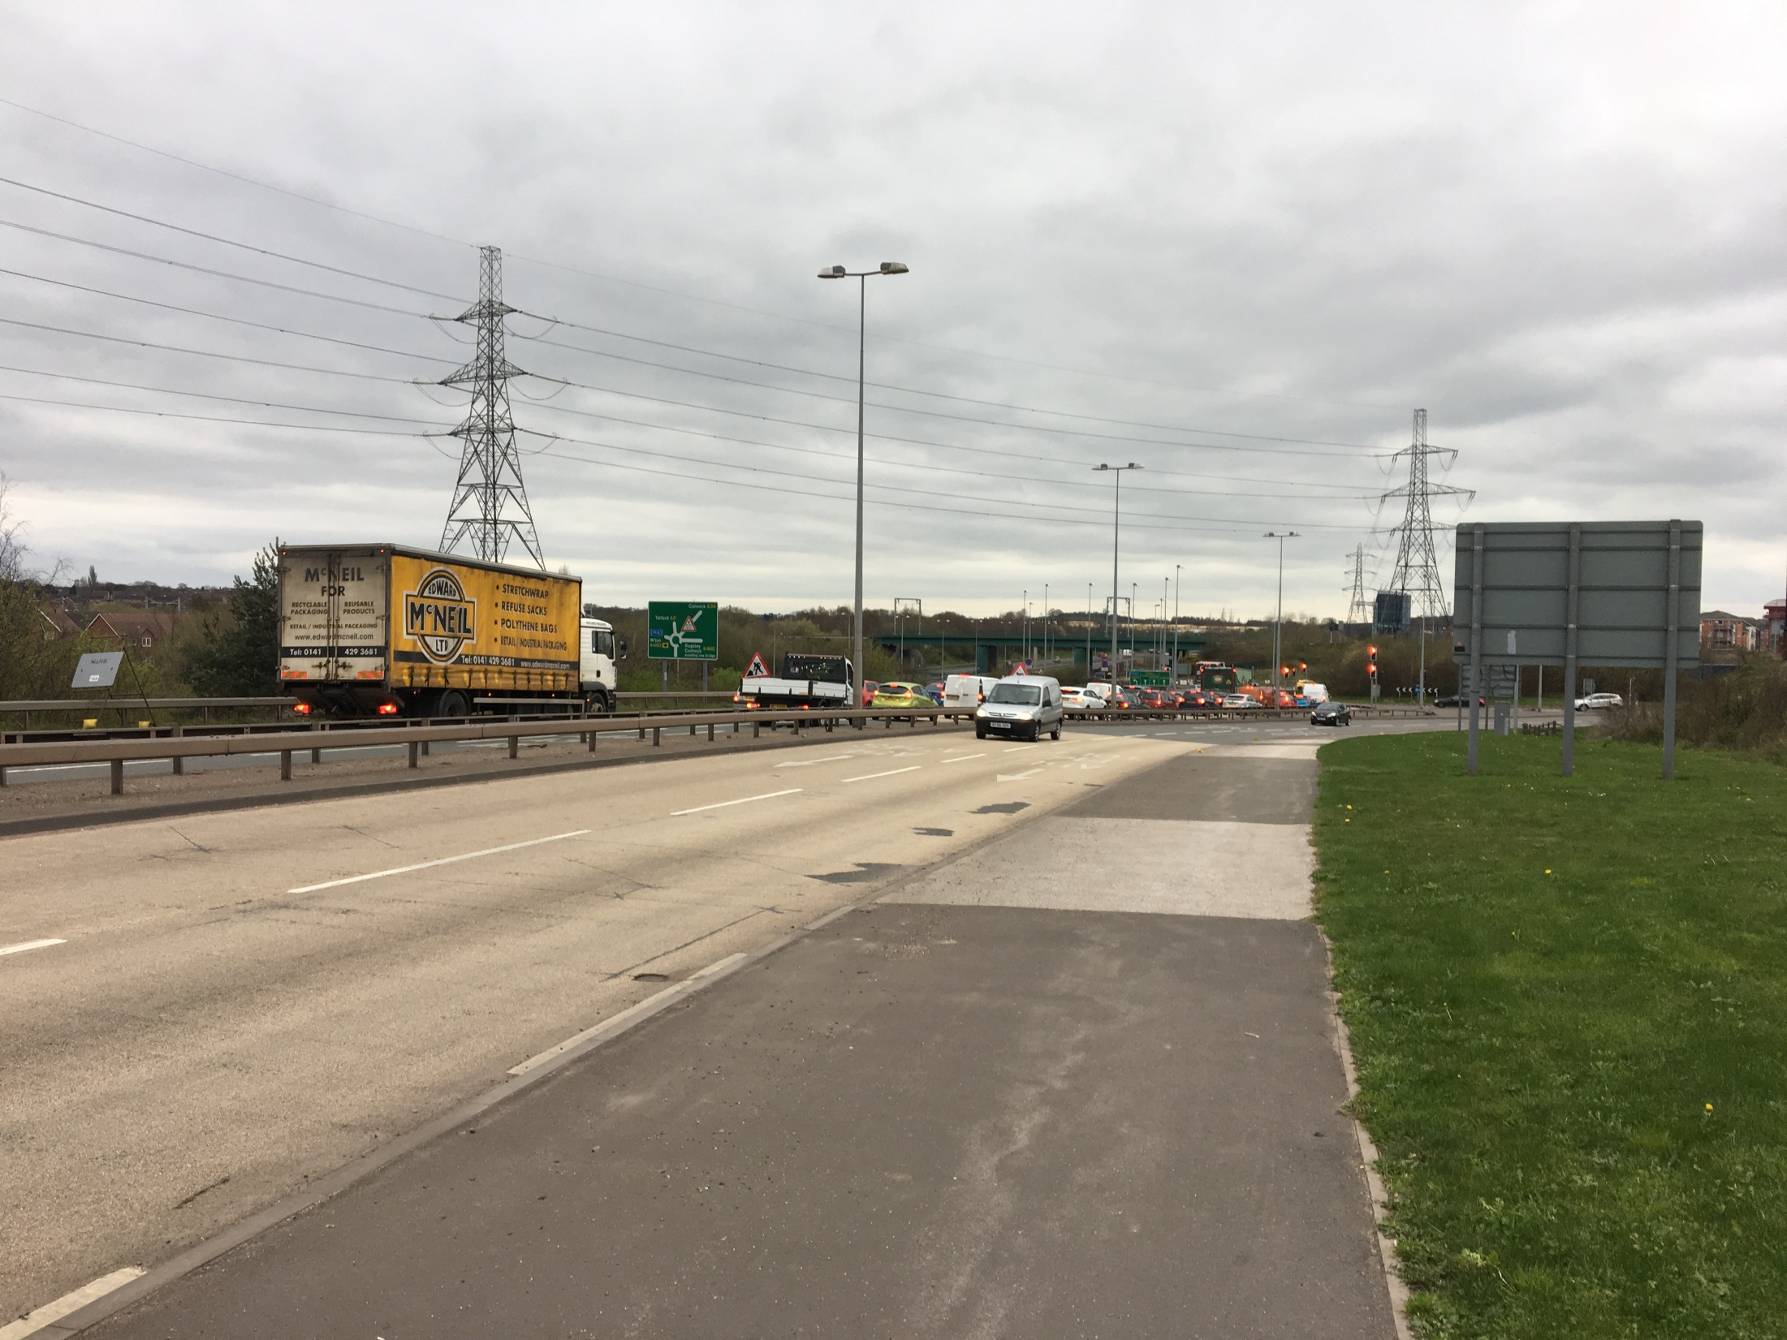
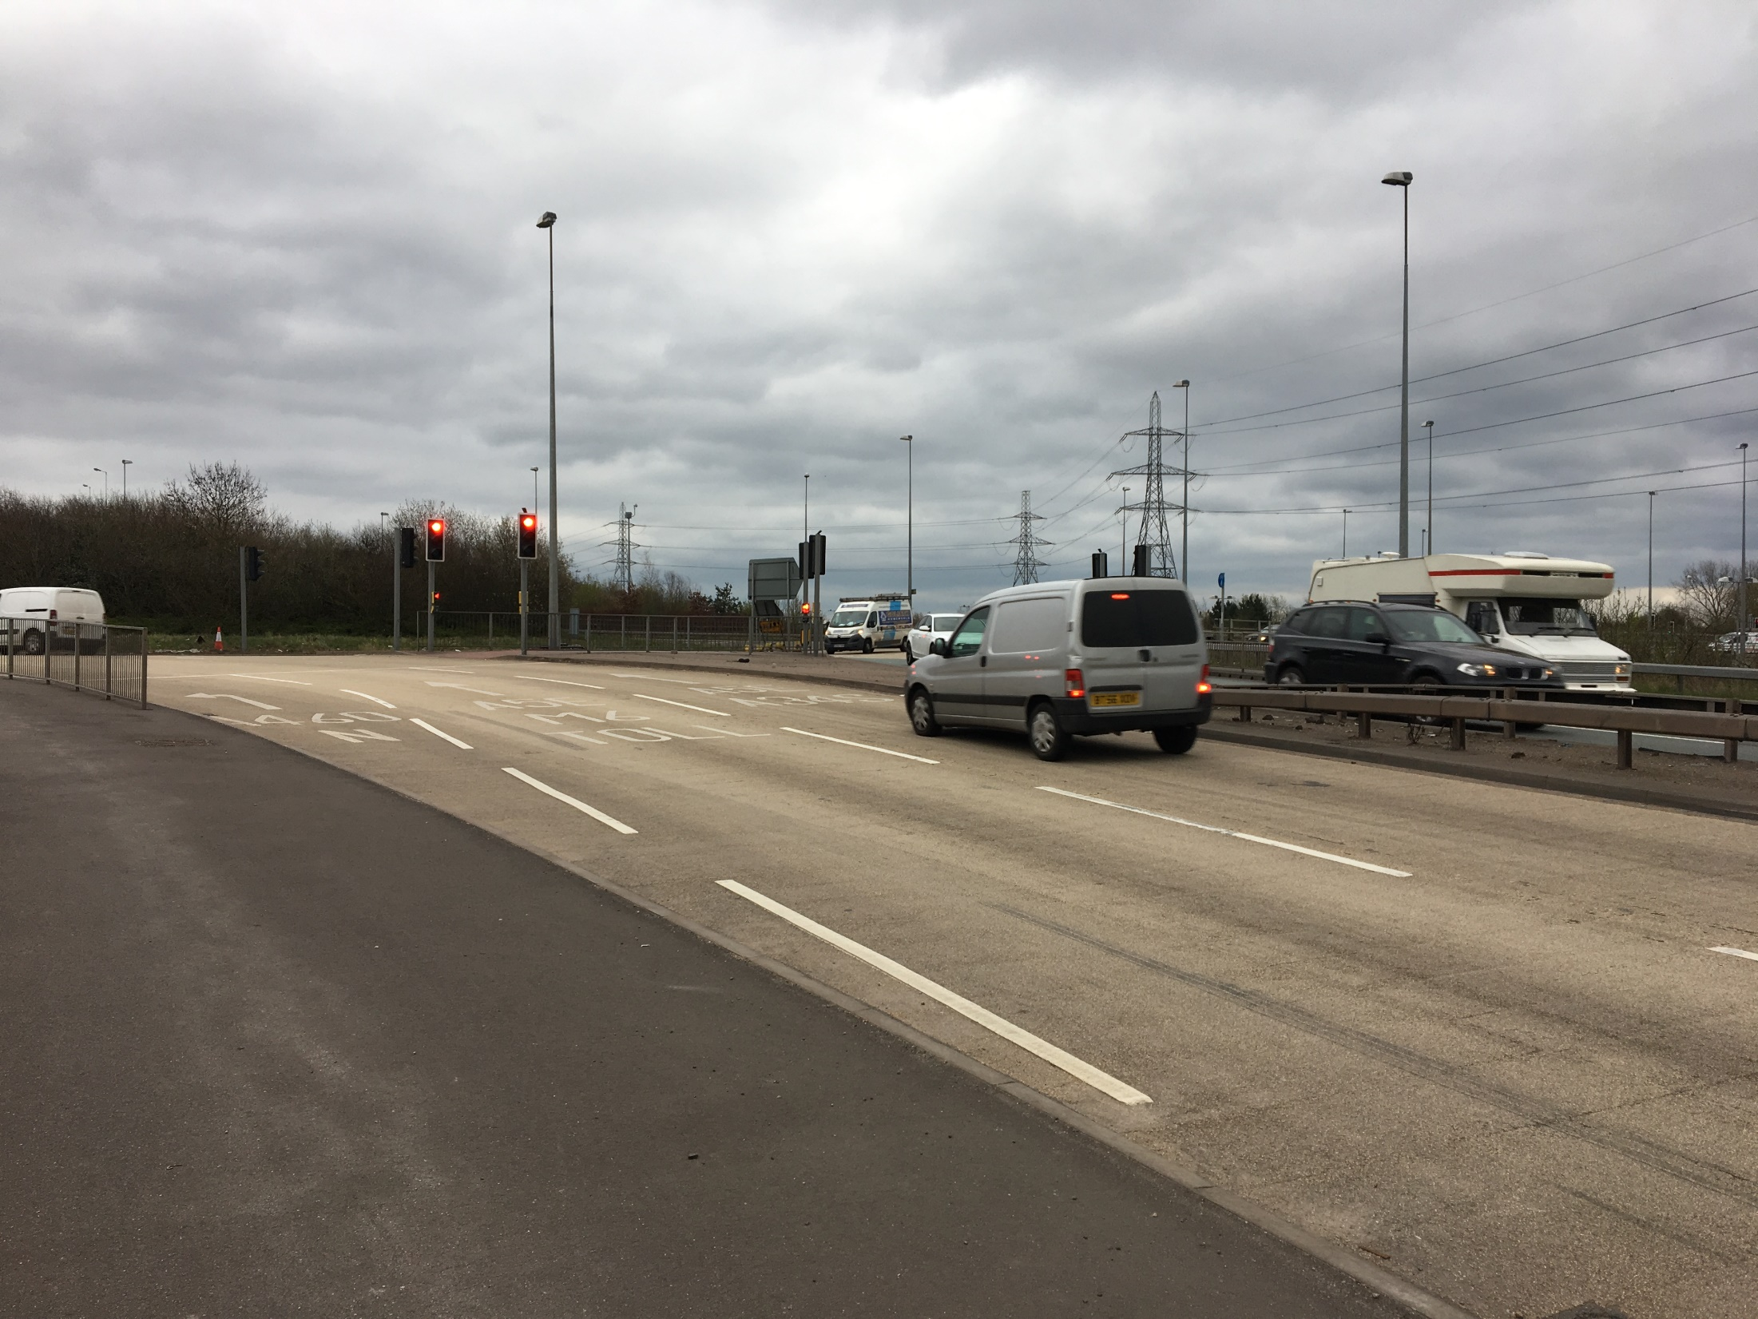
A5 Roundabout over or under the M6– Point 3
Area 9: sub area A5
Pedestrians and Cyclists
Traffic approaching the roundabout on the A5 goes high speeds so pedestrian walkway feel very exposed and scary. Users remember dangerous car crashes in the past. Recommendation to put up barriers to protect users from traffic
No cycle path here means cyclists have to ride alongside fast traffic which feels risky or share the path with pedestrians which can be crowded.
Adding a dedicated cycle path on the A5 would make cyclists feel safer as they would have their own designated area to ride in
The A5 is very busy so if a car were to lose control there is nothing to between me and it, which feels a bit threatening
PEDESTRIAN
63

Slide 64
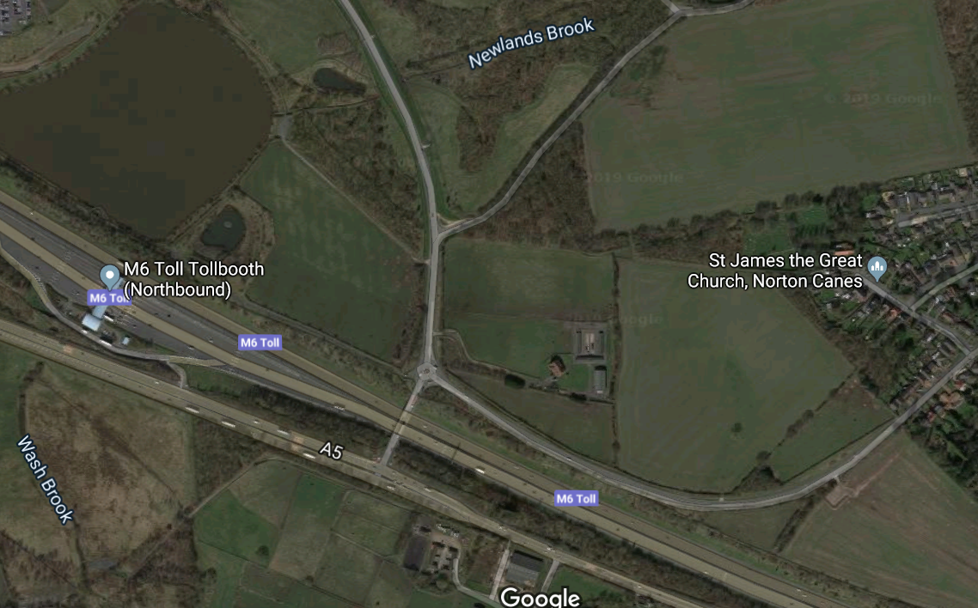
Area 9: sub area A5
A5 Bridge over the M6 & A5 Road – Aerial view
Point 1
Lack of lighting makes this bridge unusable for pedestrians and cyclists at night
Samaritan Signs give impression bridge is unsafe/ incidents have occurred
Point 3
Perception that pedestrian pavement on bridge is limited
No cycle path means users ride alongside motorists
Point 2
Coming off the A5 onto the bridge there is limited crossing options for users
64
Notes:
64

Slide 65
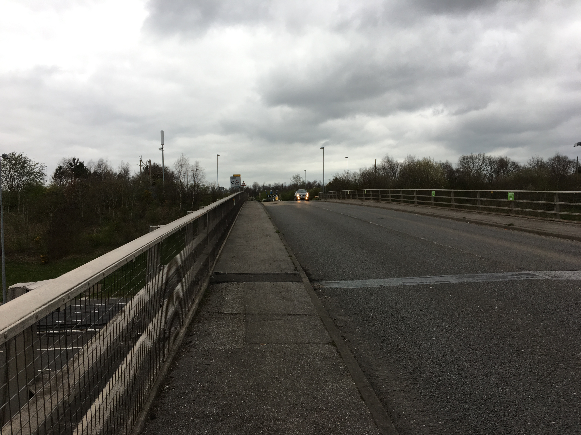
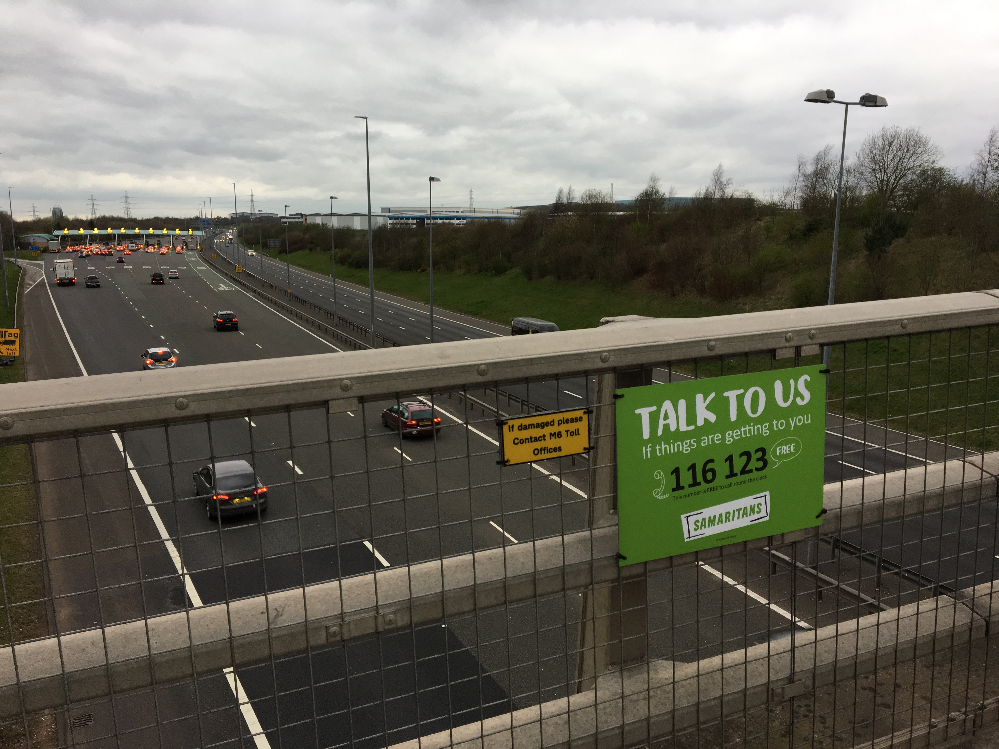
A5 Bridge over the M6 & A5 Road Point 1
Area 9: sub area A5
Pedestrians and Cyclists
Lack of lighting on the bridge makes this unusable for pedestrians and cyclist at night
Overall Samaritan Signs are positive and welcomed, but can give the impression that bridge is unsafe due to previous incidents that have occurred
A lot of pollution and noise on this bridge for all users due to close proximity to the M6 Northbound Tollbooth
I'm not overly keen on heights and it’s quite noisy on this bridge. You see the signs for the Samaritans all along the railings and it’s very sad
PEDESTRIAN
65

Slide 66
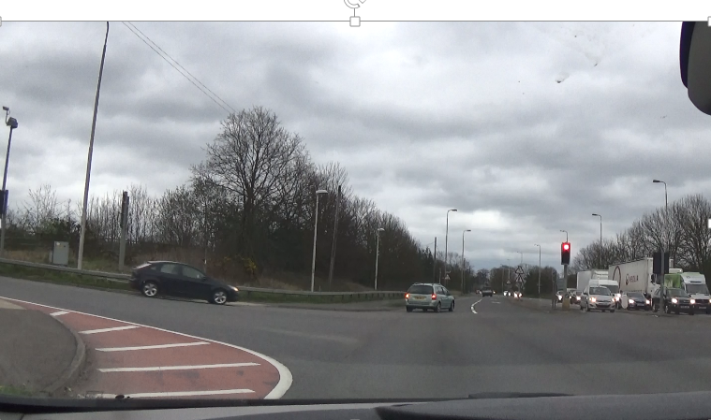
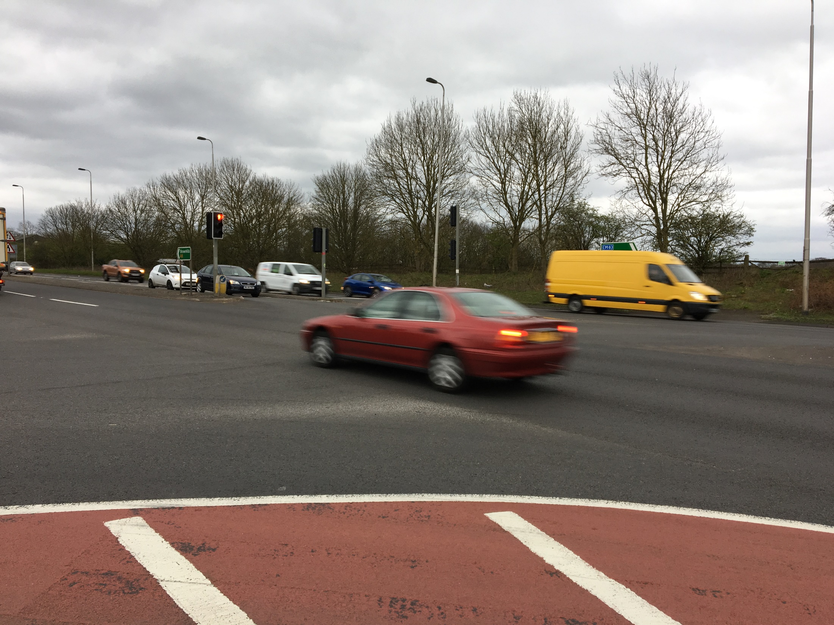
A5 Bridge over the M6 & A5 Road– Point 2
Area 9: sub area A5
Pedestrians and Cyclists
Coming off the A5 onto the bridge there is limited crossing options for users (e.g. only traffic lights available). A timed crossing is recommended – gives pedestrians and cyclists the right of way to safely cross and makes motorist more aware of users
Very small island in the middle to stop halfway. Expanding this would make crossing safer for users as they have adequate time to cross and a safe place to wait
The A5 is always so busy and there is a lot of traffic on this bridge and there isn’t really a place to cross. They should put more crossings here to be honest
PEDESTRIAN
66

Slide 67
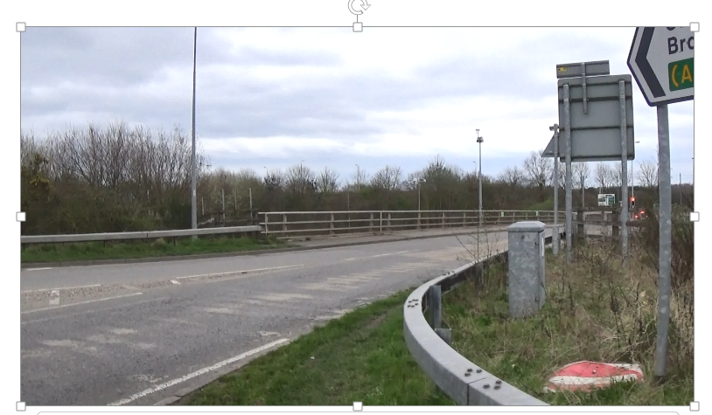
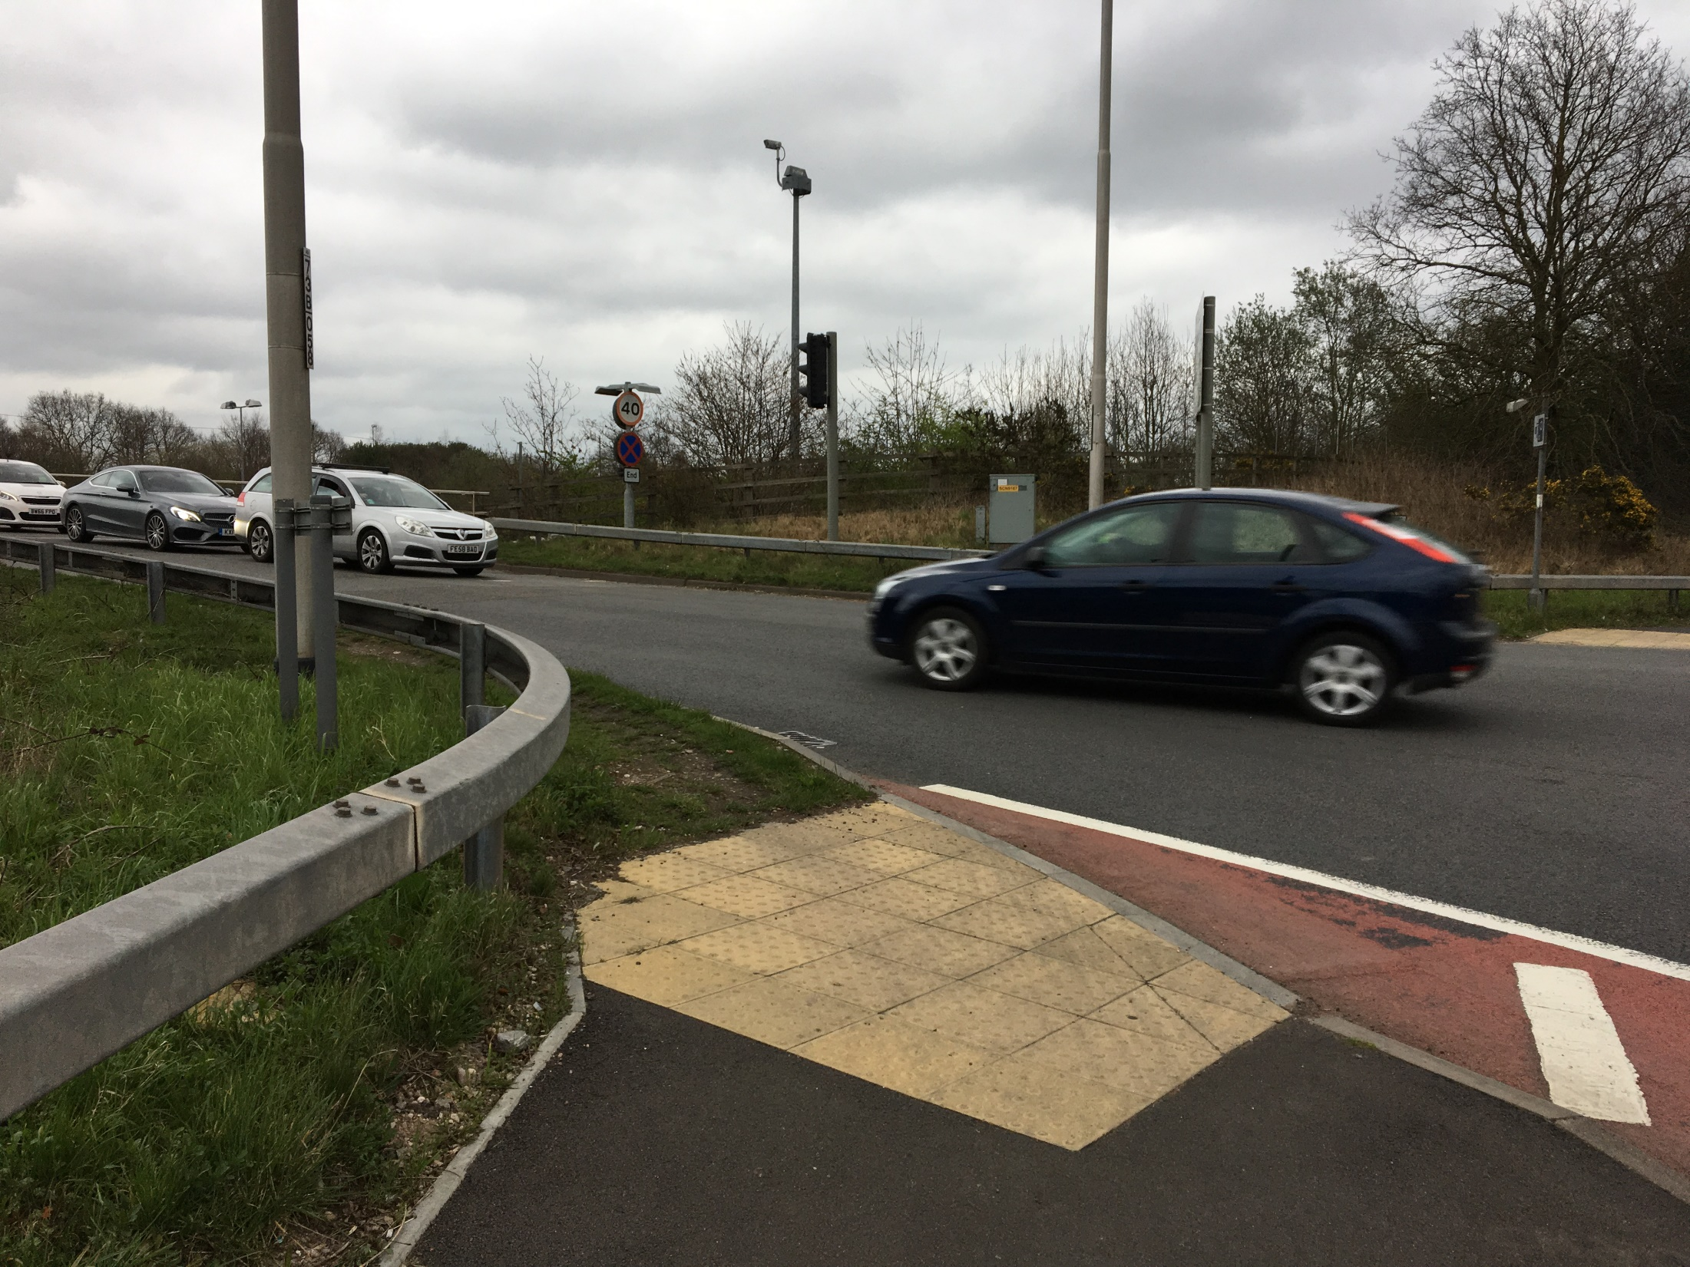
A5 Bridge over the M6 & A5 Road - Point 3
Area 9: sub area A5
Pedestrians and Cyclists
There is the perception that only one side of the bridge has pavement which give the impression pedestrian access to cross is limited
Then grass verge can get overgrown here which makes it slippery for pedestrians
Lack of cycle path means users have ride on the bridge alongside motorists to cross which feels very busy /unsafe
There is no designated cycle lane so vehicles don’t keep their distance. It’s a nightmare with all the traffic and feels really busy
CYCLIST
67

Slide 68
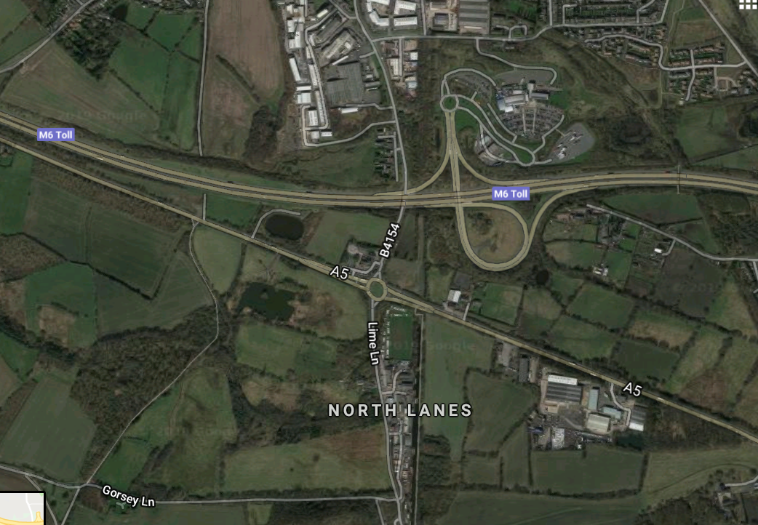
Area 9: sub area A5
A5 Roundabout – Aerial view
Point 1
Lack of cycle/pedestrian path on the roundabout which is very busy –cyclists have to get off bike to cross safely. Pedestrians access B4154 road instead
Point 3
Lack of pedestrian crossing here means it’s dangerous to cross the roundabout safely
Point 2
No cycle path on the roads approaching the roundabout so cyclists are required to ride on the busy A5 road
68
Notes:
68

Slide 69
A5 Roundabout – Point 1
Area 9: sub area A5
Pedestrians and Cyclists
No cycle/ pedestrian path on the roundabout, and traffic goes fast so cyclists have to get off bike to cross safely
Roundabout is congested with traffic as Lime Lane and B4154 join this roundabout. Lack of intersection lights means cyclists and pedestrians can’t cross securely
Some pedestrians feel they need to use B4154 instead as it’s easier to cross and to avoid this busy roundabout
Traffic lights would hold traffic for cyclists to get around safely and get up to the speed of the traffic as there is no dedicated cycle path
When I’m cycling with my daughter we get off our bikes to cross. Ideally there would be a light system because obviously then you're guided around safely
CYCLIST
69

Slide 70
A5 Roundabout – Point 2
Area 9: sub area A5
Cyclists
No cycle path on the road approaching the roundabout so cyclists are required to ride on the A5 road. They feel unsafe when the road gets narrower, as they can get pushed up on the curb by motorists
The road before/ after roundabout goes from 1 to 2 lanes so motorists can slow down suddenly -cyclists worry they can be hit
Traffic goes very fast on A5 which is daunting for cyclists. Railings/ barriers recommended to separate traffic from cyclists
Lots of congestion from large freight lorries who travel at very fast speeds on A5 and won’t pay for the M6 Toll road. Incentives recommended to convince lorries to use toll road instead
Lack of signage for motorist indicating cyclists don’t have a dedicated cycle lane and have to use the road
On the A5 it is very busy and there isn’t a cycle path. The biggest problem is that cars and lorries race along here. If a lorry swerved off the road I wouldn’t stand a chance
CYCLIST
70

Slide 71
A5 Roundabout – Point 3
Area 9: sub area A5
Pedestrians
Lack of pedestrian crossing at the roundabout means it’s dangerous to cross safely
Traffic goes fast here so it feels scary walking on the footpath approaching the roundabout. There are lots of lorries and wind so pedestrians worry about not being seen and being hit
Railings/ barriers recommended to separate traffic from pedestrians
Lack of signage for motorist indicating pedestrians are using the area
Some sort of railings along here to keep the traffic away from the pedestrians is needed, because if anything happens to somebody walking along there… well it’s very dangerous!
PEDESTRIAN
71

Slide 72
West Midlands (Area 9)
Conclusions

Slide 73
Combined Quant and Qual Conclusions for Area 9
Overall Pedestrians and Cyclists in the West Midlands are reasonably satisfied with their journeys on the SRN, however the majority travelled on the SRN in this area out of necessity rather than choice and preferred to seek out routes that had minimal interaction with the SRN where they could
Both personal safety (e.g. injury) and perceived safety of the infrastructure (e.g. perception of how well maintained a bridge or crossing is) are key concerns for all three audiences in this area
Feelings of safety can be fostered for cyclists, pedestrians and equestrians by creating dedicated (and complete) routes which keep them separate from the traffic resulting in a more relaxed and enjoyable experience
Increased awareness that equestrians travel in this area is paramount for this audience and can be prioritised by creating signage to clearly indicate their presence on these roads
Improved recognition (e.g. creating dedicated bridal paths) and route safety (e.g. higher railings on bridges) are key concerns for equestrians. They emphasised the need for educating motorists on shared responsibility and the serious impact of road accidents involving horses.

