Slide 1
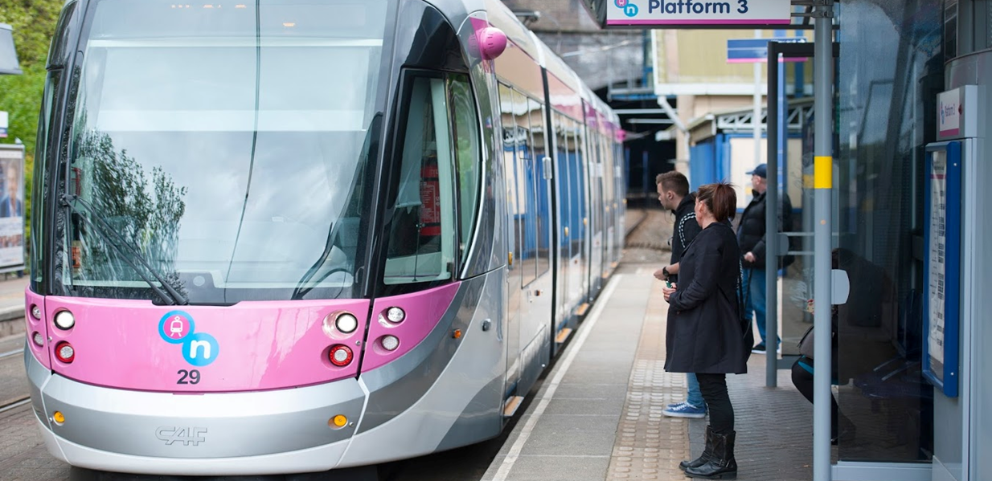
Tram Passenger Survey (TPS) – Midland Metro
Autumn 2017 results
Rosie Giles
Tel: 0300 123 0842 Email: Rosie.Giles@transportfocus.org.uk
Insight Team, Transport Focus, Fleetbank House, 2-6 Salisbury Square, London, EC4Y 8JX
March 2018
Notes:
1
Header: Relation
2004-02-04
Internal/Identier/File name
1

Slide 2

Contents
Overview
Context to the survey 3
Summary of 2017 findings 6
The findings
Experience and opinions of the journey 14
Waiting at the stop 22
The tram 29
Negative experiences during the journey 34
Passengers’ suggested improvements 38
Opinion of trams in local area 41
Further information
Appendix 1: Passenger and journey context 45
Appendix 2: Further detail on survey background and method 62
Appendix 3: Questionnaire 68
2

Slide 3


Tram Passenger Survey (TPS) – Midland Metro
Context to the survey
3

Slide 4
Background to the 2017 survey
The Tram Passenger Survey (TPS)
The TPS provides a consistent, robust measurement of passenger satisfaction with tram services in Britain
It also informs our understanding of barriers to (greater) tram use, how to encourage greater use, and how to improve the passenger experience
Comparisons can also be made with passenger experiences on buses and trains, as measured by the Bus Passenger Survey (BPS) and National Rail Passenger Survey (NRPS)
The 2017 TPS covered tram services in Manchester, Birmingham, Blackpool, Nottingham, Sheffield and Glasgow*. Edinburgh Trams was covered in 2014-2016.
The survey method
Passengers are approached while making a journey; they answer the survey about that journey specifically
The questionnaire is self-completion, with passengers offered a choice of online or paper
Interviewers approached passengers on all days of the week between 6am and 10pm, between 18 September and 8 December 2017
501 surveys were completed for Midland Metro in autumn 2017
For further details of the survey method, see Appendix
*Glasgow Subway was included for the first time in 2017. Due to the difference of this Subway network compared to tram networks it is excluded from this report, as well as any ‘All Networks’ results, and can be found in a separate report.
4

Slide 5







The Midland Metro network in context
 | The Network | Passenger Journeys | Ticket Purchasing | Information at stops | Frequency | Engineering disruptions/other notes
 | 1 line 26 stops 13 miles | 6.2* million | TVMs at stops Conductors on board | Info boards at some stops (TTs, fares) Passenger Info Displays | Mon-Sat: every 6-15 mins Sun: 15 mins | Network extension to Grand Central (New Street Station) opened on 30 May 2016 and was included in the TPS 2016 Network improvement works meant that two tram stops at the Wolverhampton end of the route were closed for the duration of fieldwork in 2017 (Wolverhampton St George’s and The Royal)
 | 7 lines 93 stops 57 miles | 40.7** million | TVMs at stops Conductors on board | Info boards all stops (TTs, fares) Passenger Info Displays (Not all stops on Bury and Altrincham lines) | Mon-Sat: every 6-12 mins Sun: 12-15 mins | Airport line opened late 2014, covered for first time in 2015 Exchange Square and link with Victoria opened in December 2015 Increasing use of double carriage trams Second City Crossing opened in February 2017 enabling quicker journeys across the city A tram collision on the 10th November 2017 affected two shifts which were rescheduled due to no trams running
 | 1 line 38 stops 11 miles | 5.1* million | TVMs at stops Conductors on board | Info boards at stops (TTs, fares) Passenger Info Displays | Mon-Sat: every 15-30 mins Sun: 15-30 mins | Blackpool illuminations 1 Sep to 5 Nov 2017 Heritage trams operate bank holidays, weekends and summer; not covered in this research No significant issues affected fieldwork
 | 2 lines 50 stops 20 miles | 16.4* million | TVMs at stops Conductors on board | Info boards all stops (TTs, fares) Passenger Info Displays | Mon-Sat: every 3-15 mins Sun: 5-15 mins | No significant issues affecting fieldwork
 | 3 lines 48 stops 18 miles | 12.6* million | TVMs at stops Conductors on board | Info boards at stops (TTs, fares) Passenger Info Displays | Mon-Sat: every 5-20 mins Sun: 10-20 mins | No significant issues affecting fieldwork
Midland
Metro
Manchester
Nottingham
Sheffield
*Source: Department for Transport, Passenger journeys on light rail and trams by system in England, 2016/17
**Source: Direct from operator
5

Slide 6

Tram Passenger Survey (TPS) – Midland Metro
Key findings
6
Notes:
6
Header: Relation
2004-02-04
Internal/Identier/File name
6

Slide 7
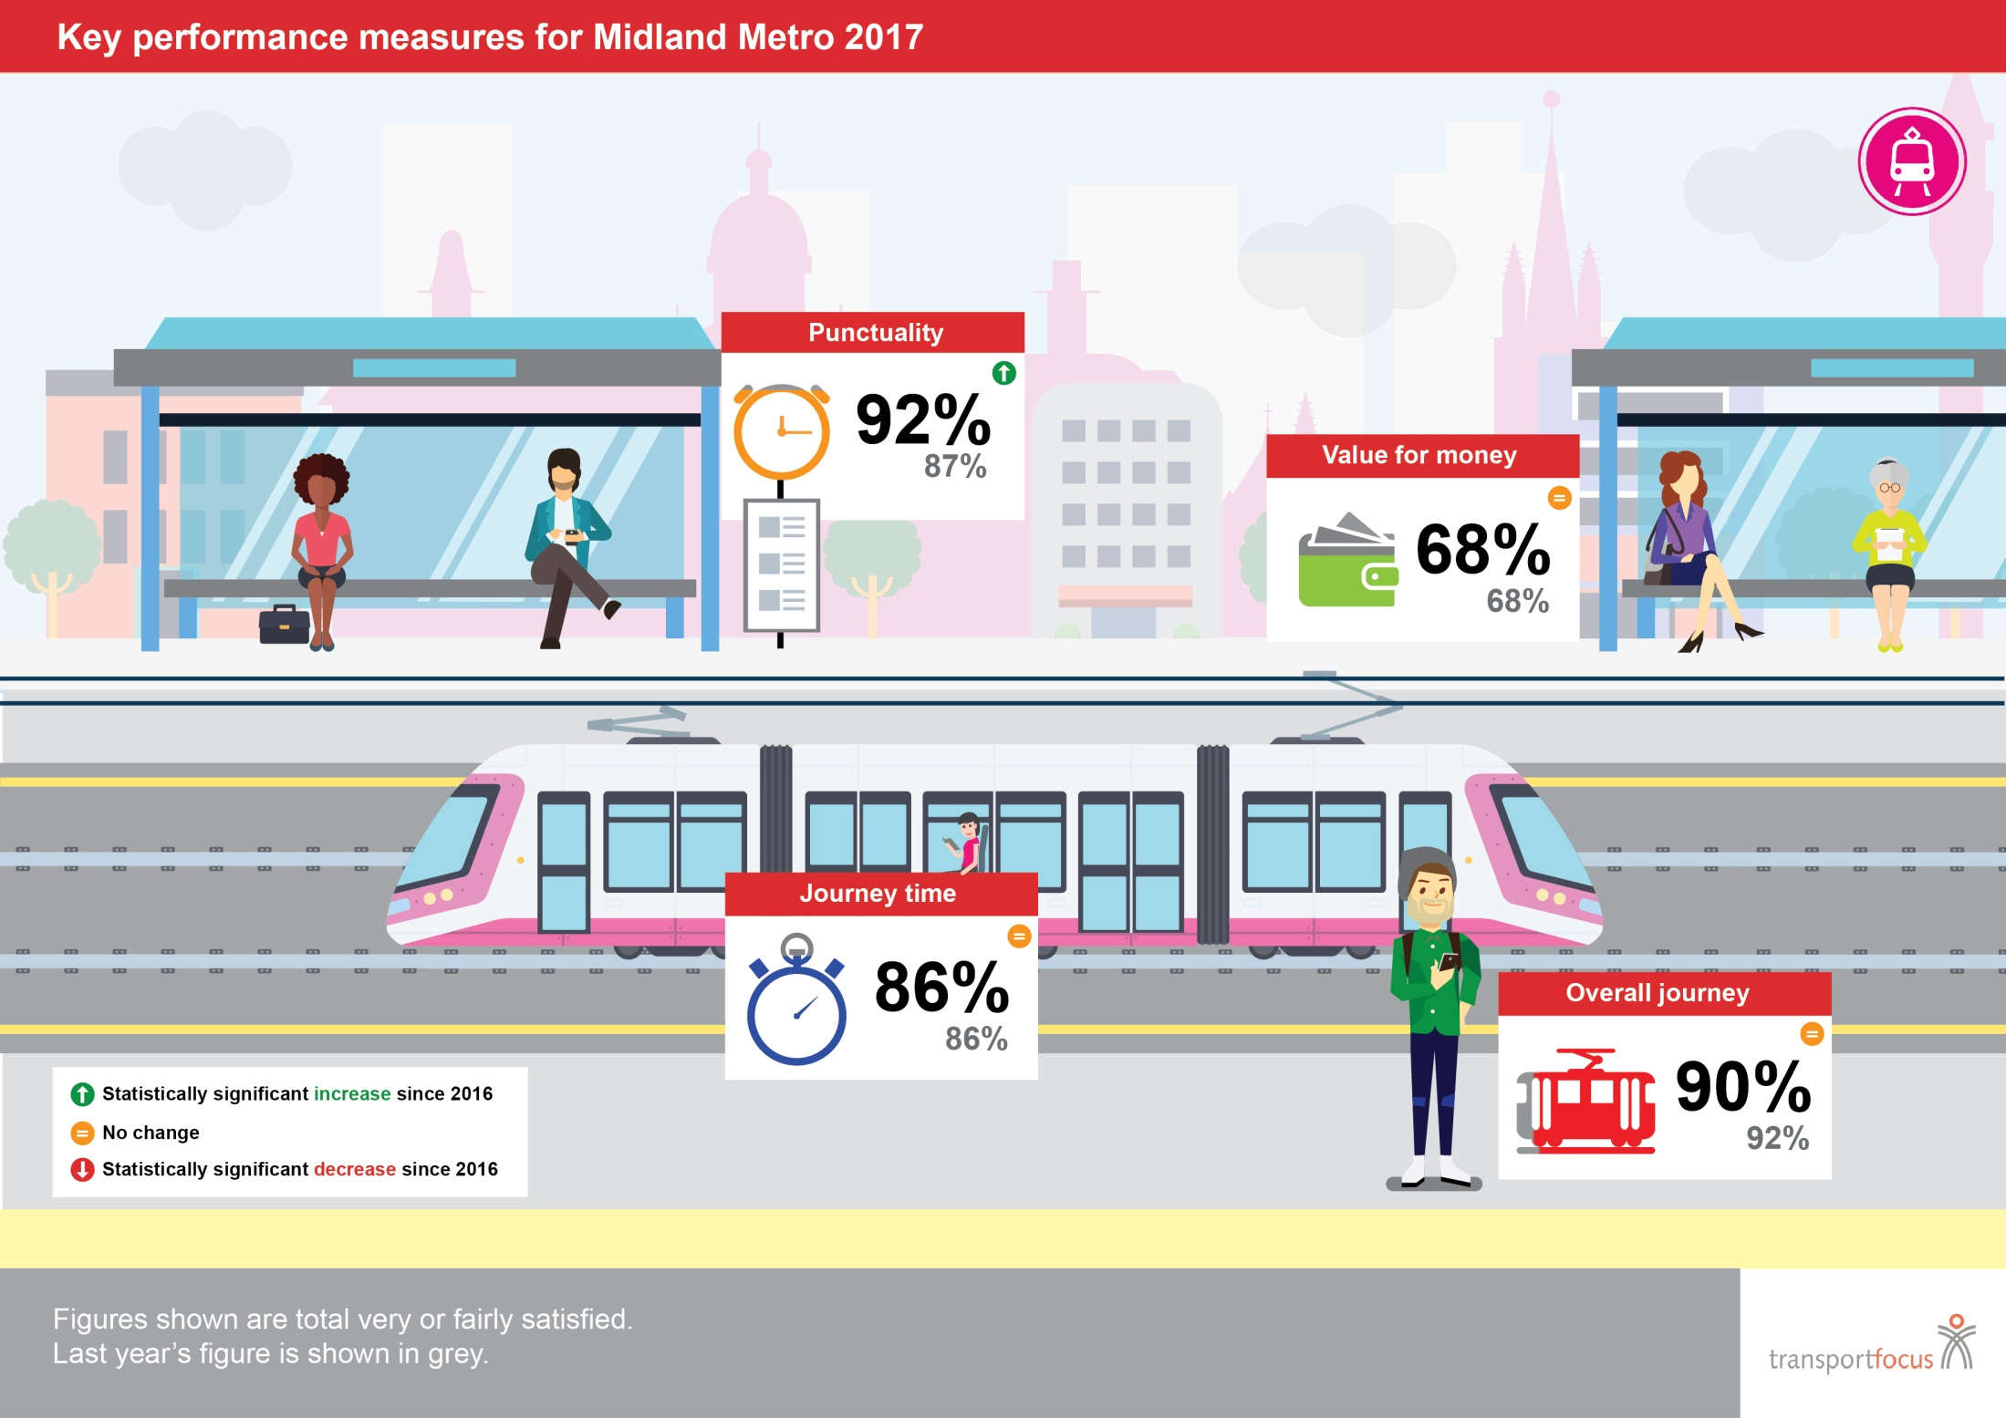
7

Slide 8



Passenger experience: a snapshot
[Headline]
[Second Headline]
Overall journey satisfaction: trend over time
Overall journey satisfaction: 2017
Midland
Metro
All Networks*
Manchester
Nottingham
Sheffield
*All networks includes different networks each year. 2013 and 2017 exclude Edinburgh Trams. 2013-2016 exclude Glasgow Subway
[Footnote]
8

Slide 9
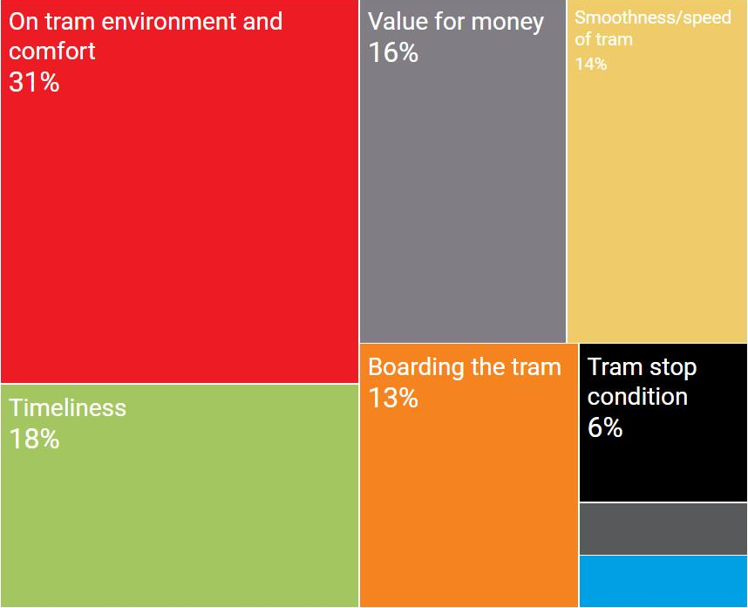
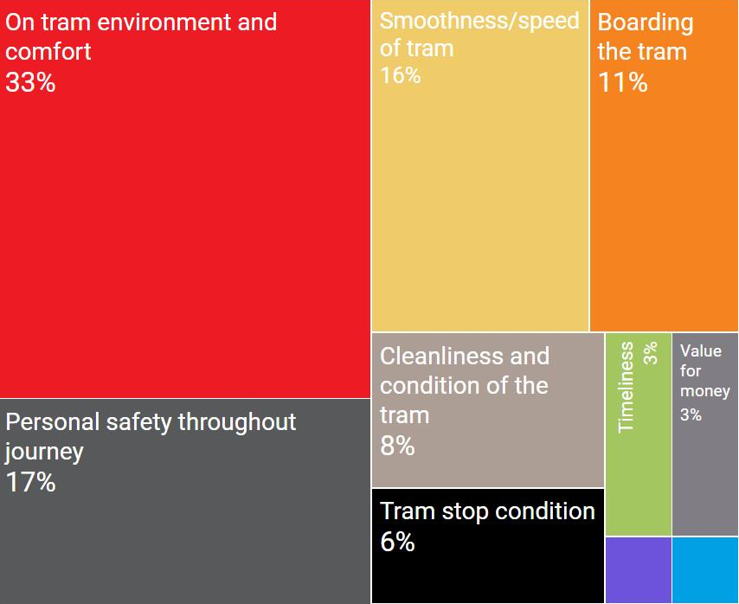
What makes a satisfactory or great journey on Midland Metro?
[Headline]
[Second Headline]
The top factors linked to overall journey satisfaction*
What makes a satisfactory journey?
What makes a great journey?
3%
2%
2%
1%
1%
Information throughout journey
Personal safety throughout journey
Access to the tram stop
*Key Driver Analysis looks at fare-paying passengers’ overall journey satisfaction response and their response to the 25 individual satisfaction measures in the survey (including value for money), which have been grouped into 10 themes based upon a statistical analysis of the responses.
The left hand chart shows which themes most differentiate between those not satisfied and satisfied overall – making a journey ‘satisfactory’.
The right hand chart shows which themes most differentiate between those fairly and very satisfied overall – making a ‘great’ journey.
The analysis combines data from 2016 and 2017 surveys to increase robustness. It also excludes satisfaction measures relating to tram staff; due to differences in staff availability across the networks not all TPS questionnaires feature questions about tram staff. In order to run the analysis in a consistent and practical manner all staff measures have been excluded.
See appendix 2 for a full explanation of the analysis to identify factors linked to overall journey satisfaction.
[Footnote]
9

Slide 10

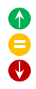
Passenger experience in the Midlands 2017: across the network
All Networks
Satisfaction with key measures:
91
68
88
90
Satisfaction with other measures which make a satisfactory or great journey:
75
75
72
81
82
88
*Drivers of satisfaction differ by network. The most common drivers across TPS are shown here
Statistically significant increase since 2016 (All networks)
No change (All networks)
Statistically significant decrease since 2016 (All networks)
10

Slide 11
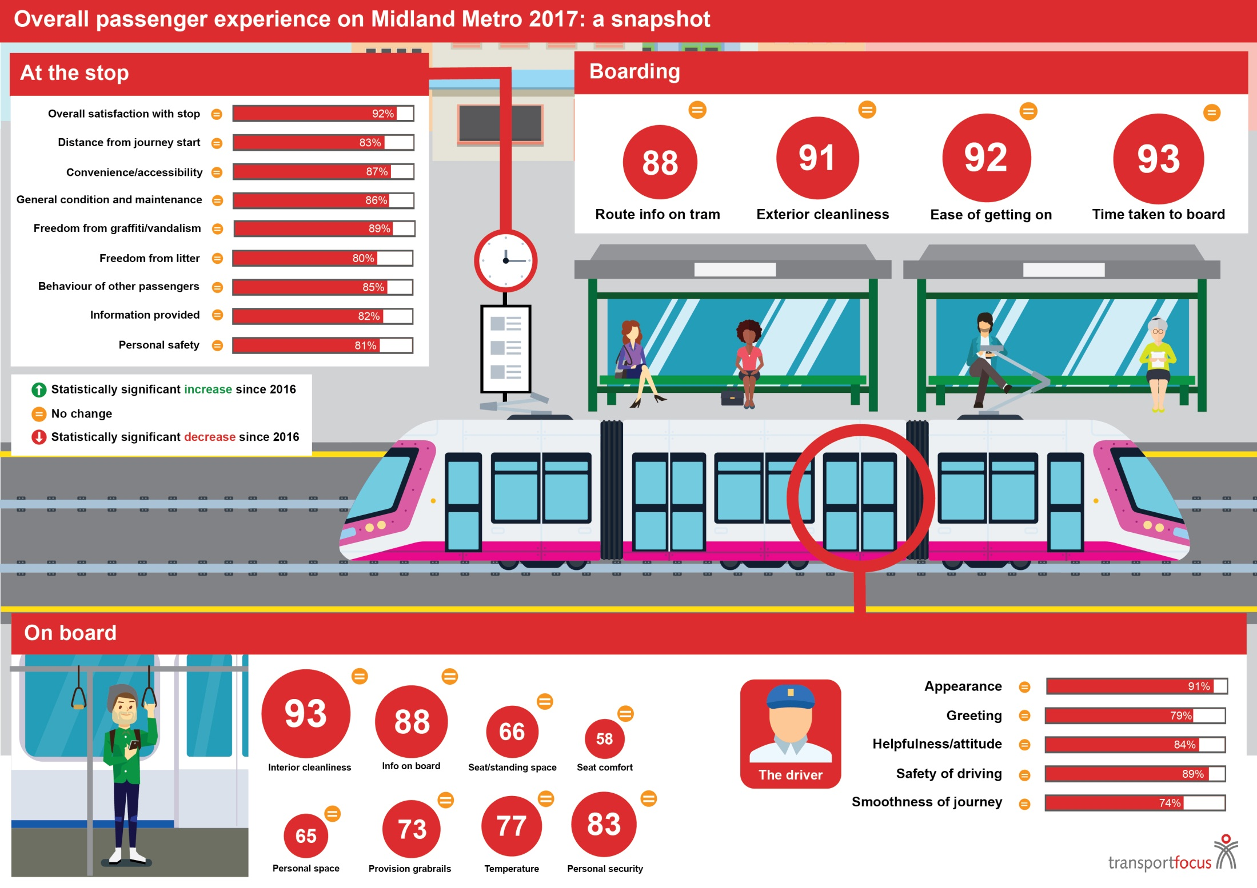

11

Slide 12
Midland Metro 2017: summary of key findings (1)
90 per cent of Midland Metro passengers are satisfied with their journey overall. This is slightly lower than last year, but not significantly so (2016: 92 per cent). Overall satisfaction is higher than the same measure on the Bus Passenger Survey in the West Midlands (85 per cent)
Overall satisfaction with the journey is lower amongst males (86 per cent), younger age groups (88 per cent for those aged 16-34) and commuters (88 per cent)
For Midland Metro the key factor which makes journeys both satisfactory and great is the on board environment and comfort of the tram. Satisfaction has remained quite consistent with last year but the comfort of the seats continues to be the lowest rated attribute by some way (58 per cent satisfied)
The next most important factor which makes a journey on Midland Metro satisfactory is the timeliness of the tram. Satisfaction with both punctuality and the length of time waiting for the tram have increased significantly (punctuality increases from 87 per cent in 2016 to 92 per cent; wait time increased from 86 per cent to 92 per cent)
The second most important factor which makes a journey great is personal safety during the journey. At the tram stop personal safety is the second lowest rated aspect (81 per cent satisfied); on board satisfaction with personal security is a little higher (83 per cent satisfied)
Amongst fare paying passengers, 68 per cent are satisfied with value for money. Similar to overall journey satisfaction, younger passengers and commuters are least satisfied (62 per cent amongst those aged 16-34 and 65 per cent of commuters)
12

Slide 13
Midland Metro 2017: summary of key findings (2)
When evaluating value for money the most important factor is the cost of the tram versus other modes of transport
4 per cent of passengers experienced a delay in 2017 (6 per cent in 2016), and when delays were experienced they lasted 7 minutes on average
40 per cent of passengers spontaneously mentioned an improvement that could have been made to their journey. The most common improvement related to the design, comfort and condition of the tram
Other improvements mentioned relate to the seating and capacity on board, as well as the frequency of trams and the route
Almost three quarters of passengers (69 per cent) are using Midland Metro to commute to work or education (52 per cent for work and 17 per cent for education)
The majority of passengers are travelling with a season ticket (61 per cent)
The profile of passengers travelling on Midland Metro is quite young, with 43 per cent falling into the 16-34 age group. This is a little lower than 2016, but not significantly so
13

Slide 14

Tram Passenger Survey (TPS) – Midland Metro
Experience and opinions of the journey
14

Slide 15




Experience and opinions of the journey: summary
[Headline]
[Second Headline]
Satisfaction with today’s journey:
Overall journey
Value for money
Punctuality
On-vehicle journey time
Autumn
2013
Autumn
2014
Autumn
2015
Autumn
2016
Autumn
2017
Buses in West Midlands
[Footnote]
15

Slide 16











Who are satisfied and not satisfied passengers? – Midland Metro
Midland Metro
Very satisfied passengers
are more likely to:
Fairly satisfied passengers
are more likely to:
Not satisfied passengers
are more likely to:
Journey purpose
Be split between commuting and leisure journeys (57% and 40% respectively)
Be commuting (82%)
Be commuting (84%)
Time of travel
Be travelling during off-peak weekday times (44%)
Be travelling at peak times (63% peak; 30% peak morning; 33% peak afternoon)
Be travelling at peak times (68%), particularly on peak morning journeys (37%) more than those who are fairly satisfied
Frequency of travel
Be travelling the least frequently (40%)
Be travelling less frequently than those who are no satisfied (62%)
Travel the most frequently (83%) more than very/fairly satisfied
Access to private
transport
Have moderate access to private transport (46%)
Have the most easy access to private transport (46%)
Have easy to moderate access to private transport (82%; 42% ‘easy’) less than fairly satisfied (46 ‘easy’)
Be from a relatively even set of age groups (37% 16-34; 37% 35-59; 26% 60+) with a close gender split (female 52%; male 45%)
Be between 16-34 (55%) with a close gender split (female 53%; male 45%)
Be between 22-34 (47%) and primarily male (71%)
Age and gender
Trust in the operator
Have high levels of trust (85% rated 6-7 on a 7-point scale)
Have medium to high levels of trust (91% rated 3-7 on a 7-point scale)
Have low levels of trust (78% rated 3-5 on a 7-point scale)
Base: those ‘very satisfied’ with journey overall (276)
Base: those ‘fairly satisfied’ with journey overall (164)
Base: those ‘neither/nor’, ‘fairly dissatisfied’ or ‘very dissatisfied’ with journey overall (39)
16

Slide 17
Overall satisfaction (%) – by gender and age
[Headline]
[Second Headline]
Total fairly/very satisfied
Autumn
2017
Autumn
2016
Autumn
2015
Autumn
2014
Autumn
2013
All passengers
90
86
95
88
90
96
92
91
93
92
89
100
81
78
84
79
76
92
90
87
92
87
91
94
92
91
92
90
91
99
[Footnote]
Q. Overall, taking everything into account from the start to the end of this tram journey, how satisfied were you with your tram journey today?
Base: All passengers – 479
17

Slide 18
Overall satisfaction (%) – by Passenger type
[Headline]
[Second Headline]
Total fairly/very satisfied
Autumn
2017
Autumn
2016
Autumn
2015
Autumn
2014
Autumn
2013
All passengers
90
90
95
88
95
92
92
94
91
94
81
77
92
77
89
90
87
99
84
98
92
90
98
90
95
[Footnote]
Q. Overall, taking everything into account from the start to the end of this tram journey, how satisfied were you with your tram journey today?
Base: All passengers – 479
18

Slide 19
Value for money (%) – fare-payers only
[Headline]
[Second Headline]
Total fairly/very satisfied
Autumn
2017
Autumn
2016
Autumn
2015
Autumn
2014
Autumn
2013
All passengers
68
62
72
65
80
68
64
69
66
76
62
56
68
62
56
62
59
69
58
74
67
65
65
65
70
[Footnote]
Q. How satisfied were you with the value for money of your journey?
Base: All fare-paying passengers – 360
19

Slide 20
What influenced value for money rating (%)
[Headline]
[Second Headline]
Those satisfied with value for money
Those not satisfied with value for money
NOTE: Those not satisfied with value for money includes respondents answering ‘Neither satisfied nor dissatisfied’
[Footnote]
Q. What had the biggest influence on the ‘value for money’ rating you gave in the previous question?
Base: All fare-paying passengers 337
20

Slide 21
Punctuality and on-vehicle journey time
[Headline]
[Second Headline]
Total fairly/very satisfied
Autumn
2017
Autumn
2016
Autumn
2015
Autumn
2014
Autumn
2013
Satisfaction with punctuality
92
86
87
86
88
89
88
85
87
86
Satisfaction with on-vehicle journey time
[Footnote]
Q. How satisfied were you with each of the following…Punctuality? Base: All passengers – 452
Q. How satisfied were you with the amount of time your journey on the tram took? Base: All passengers – 471
21

Slide 22

Tram Passenger Survey (TPS) – Midland Metro
Waiting at the stop
22

Slide 23

Waiting at the stop: summary
Buses
in the
West
Midlands
Buses
In the
West
Midlands
Waiting times:
Satisfaction:
expected waiting time
92
5 mins
4 mins
70
8 mins
8 mins
Overall satisfaction with stop
Distance from journey start
Convenience/accessibility
General condition and maintenance
Freedom from graffiti/vandalism
Freedom from litter
Behaviour of other passengers
Information provided
Personal safety
77
83
84
71
72
66
N/A*
71
72
92
83
87
86
89
80
85
82
81
Expected wait time
Actual reported wait time
Checking tram information:
Passengers who checked tram time
Info sources used before arriving at stop
Info sources used at stop
Among those that didn’t check…
85
79
Online tram times and paper timetable
Live position updates and online timetable
Electronic display at the stop 70%
Digital display
89% knew the trams ran frequently
50% knew the buses ran frequently
*Not asked in BPS
23

Slide 24
Satisfaction – with the tram stop (%)
[Headline]
[Second Headline]
Total fairly/very satisfied
Autumn
2017
Autumn
2016
Autumn
2015
Autumn
2014
Autumn
2013
92
89
87
86
85
83
82
81
80
88
90
89
89
83
85
79
80
84
90
91
86
85
86
82
80
85
85
88
88
81
84
87
78
78
80
88
90
87
88
83
84
83
79
79
83
[Footnote]
Q. Overall, how satisfied were you with the tram stop? & Q. Thinking about the tram stop itself, how satisfied were you with the following:
Base: All passengers – 478
24

Slide 25
Satisfaction with waiting time (%)
[Headline]
[Second Headline]
Total fairly/very satisfied
Autumn
2017
Autumn
2016
Autumn
2015
Autumn
2014
Autumn
2013
Length of time
had to wait
92
90
86
83
86
83
87
83
87
89
Total about the same or a little/much less than expected
Actual versus
expected waiting time
[Footnote]
Q. How satisfied were you with each of the following? & Q. Thinking about the time you waited for the tram today, was it […] than expected?
Base: All passengers – 482
25

Slide 26
Expected and reported waiting times
[Headline]
[Second Headline]
Autumn
2017
Autumn
2016
Autumn
2015
Autumn
2014
Autumn
2013
12
51
34
3
1
9
56
30
4
2
7
55
35
1
2
9
51
37
2
2
Expected tram waiting time
Average expected waiting
time 5.4 minutes (2016: 5.8 minutes)
27
45
23
3
1
27
44
22
4
4
24
47
24
1
3
25
45
26
2
2
Reported tram waiting time
Average reported waiting
time 4.3 minutes (2015: 4.9 minutes)
[Footnote]
Q. Approximately how long did you expect to wait for the tram? & Q. Approximately, how long did you wait for your tram
Base: All passengers – 501
26

Slide 27
How passengers checked tram times
[Headline]
[Second Headline]
Autumn
2017
Autumn
2016
Autumn
2015
Autumn
2014
Autumn
2013
3
15
9
2
6
5
7
7
5
7
4
8
6
3
11
5
8
5
3
10
Before Leaving the tram stop
70
66
2
1
2
1
4
68
3
1
2
2
4
68
4
1
2
1
4
68
6
2
1
0
2
At the tram stop
[Footnote]
Q. Did you check any of the following to find out when the tram was meant to arrive?
Base: All passengers – 501
27

Slide 28
Why passengers did not check tram times
[Headline]
[Second Headline]
Autumn
2017
Autumn
2016
Autumn
2015
Autumn
2014
Autumn
2013
77
16
2
9
21
N/A**
76
17
2
4
N/A*
1
73
8
7
5
N/A*
7
74
21
1
4
N/A*
2
89
N/A**
[Footnote]
Q. If you did not check to find out when the tram was meant to arrive, why was this?
Base: All not checking tram arrival information – 61
*Not asked before 2016 **Not asked in 2016 and 2017
28

Slide 29
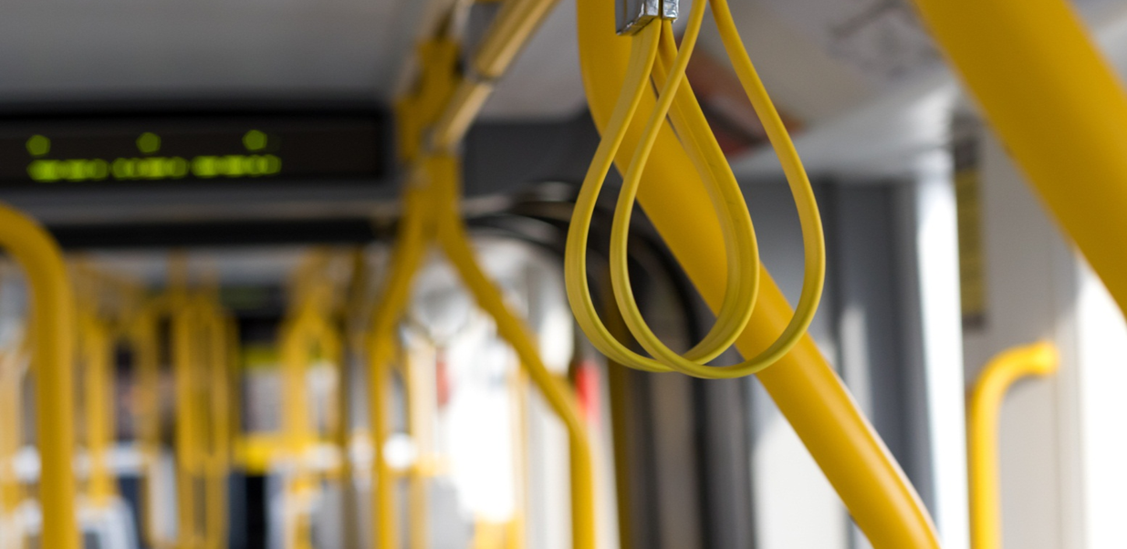
Tram Passenger Survey (TPS) – Midland Metro
The tram
29

Slide 30
The tram: summary
[Headline]
[Second Headline]
Buses in the West Midlands
Buses in the West Midlands
Buses in the West Midlands
Start of journey
On board
The staff
Route info on tram
Exterior cleanliness
Ease getting on
Time taken to board
88
91
92
93
83
78
89
87
Interior cleanliness
Info on board
Seat/standing space
Seat comfort
Personal space
Provision grabrails
Temperature
Personal security
93
88
66
58
65
73
77
83
74
70
84
77
74
83
77
78
Appearance
Greeting
Helpfulness/attitude
Safety of driving
Smoothness journey
91
79
84
89
74
87
63
66
86
75
[Footnote]
30

Slide 31
Satisfaction with start of journey (%)
[Headline]
[Second Headline]
Total fairly/very satisfied
Autumn
2017
Autumn
2016
Autumn
2015
Autumn
2014
Autumn
2013
93
92
91
88
95
94
92
87
90
90
91
86
91
90
86
81
88
87
84
84
[Footnote]
Q. Thinking about when the tram arrived, please indicate how satisfied you were with the following:
Base: All passengers – 463
31

Slide 32
Satisfaction on the tram (%)
[Headline]
[Second Headline]
Total fairly/very satisfied
Autumn
2017
Autumn
2016
Autumn
2015
Autumn
2014
Autumn
2013
93
88
83
77
73
66
65
58
93
89
86
78
72
70
61
53
93
86
86
75
69
74
67
52
88
77
83
77
74
76
69
64
85
83
81
73
63
61
56
69
[Footnote]
Q. Thinking about whilst you were on the tram, please indicate how satisfied you were with the following:
Base: All passengers – 480
32

Slide 33
Satisfaction with tram staff (%)
[Headline]
[Second Headline]
Total fairly/very satisfied
Autumn
2017
Autumn
2016
Autumn
2015
Autumn
2014
Autumn
2013
91
89
84
79
74
90
88
81
78
69
89
89
83
78
70
90
89
79
73
71
89
86
77
71
72
[Footnote]
TPS: Q. Thinking about any tram staff you encountered on your journey, please indicate how satisfied you were with each of the following:
Base: All passengers – 470
33

Slide 34

Tram Passenger Survey (TPS) – Midland Metro
Negative experiences during the journey
34

Slide 35
Negative experiences during the journey: summary
Passengers experiencing a delay to their journey
Average length of delay (perceived)
7 mins
Most common cause of delay
Tram failure*
*Caution: small base (13)
Passengers with worry or concern about others’ behaviour on board
35

Slide 36
Experience of delays (%)
4 per cent ( ) of Midland Metro passengers experienced a delay (2016: 6 per cent). Average length of delay was 7 minutes ( )
Autumn
2017*
Autumn
2016
Autumn
2015
Autumn
2014
Autumn
2013
19
10
5
23
6
24
5
6
5
21
28
4
28
0
13
6
9
24
1
0
15
18
25
9
16
0
22
6
0
24
0
0
24
28
5
9
7
0
9
18
7
11
2
10
2
36
N/A*
16
* ‘No reason given for delay’ not asked in 2013. Its addition could have caused the significant drops in the other factors
TPS: Q. Why was your journey delayed?
Base: All experiencing a delay – 13 *Caution: small base
36

Slide 37
Worry or concern at other passengers’ behaviour (%)
Autumn
2017
Autumn
2016
Autumn
2015
Autumn
2014
Autumn
2013
All passengers
8
8
6
9
5
8
5
6
4
7
2
5
5
7
3
5
5
6
6
6
7
7
7
2
% worried/concerned of other passengers’ behaviour
Types of worrying/concerning behaviour (%)
Autumn
2017*
Autumn
2016
Autumn
2015
Autumn
2014
Autumn
2013
Sample size of concerned passengers too small to report upon
Q. Did other passengers’ behaviour give you cause to worry or make you feel uncomfortable during your journey?
Base: All passengers – 483
Q. Which of the following were the reasons for [other passengers behaviour causing you concern]?
Base: All experiencing worrying/concerning behaviour – 24 (Caution small base) *Not asked in 2013
37

Slide 38
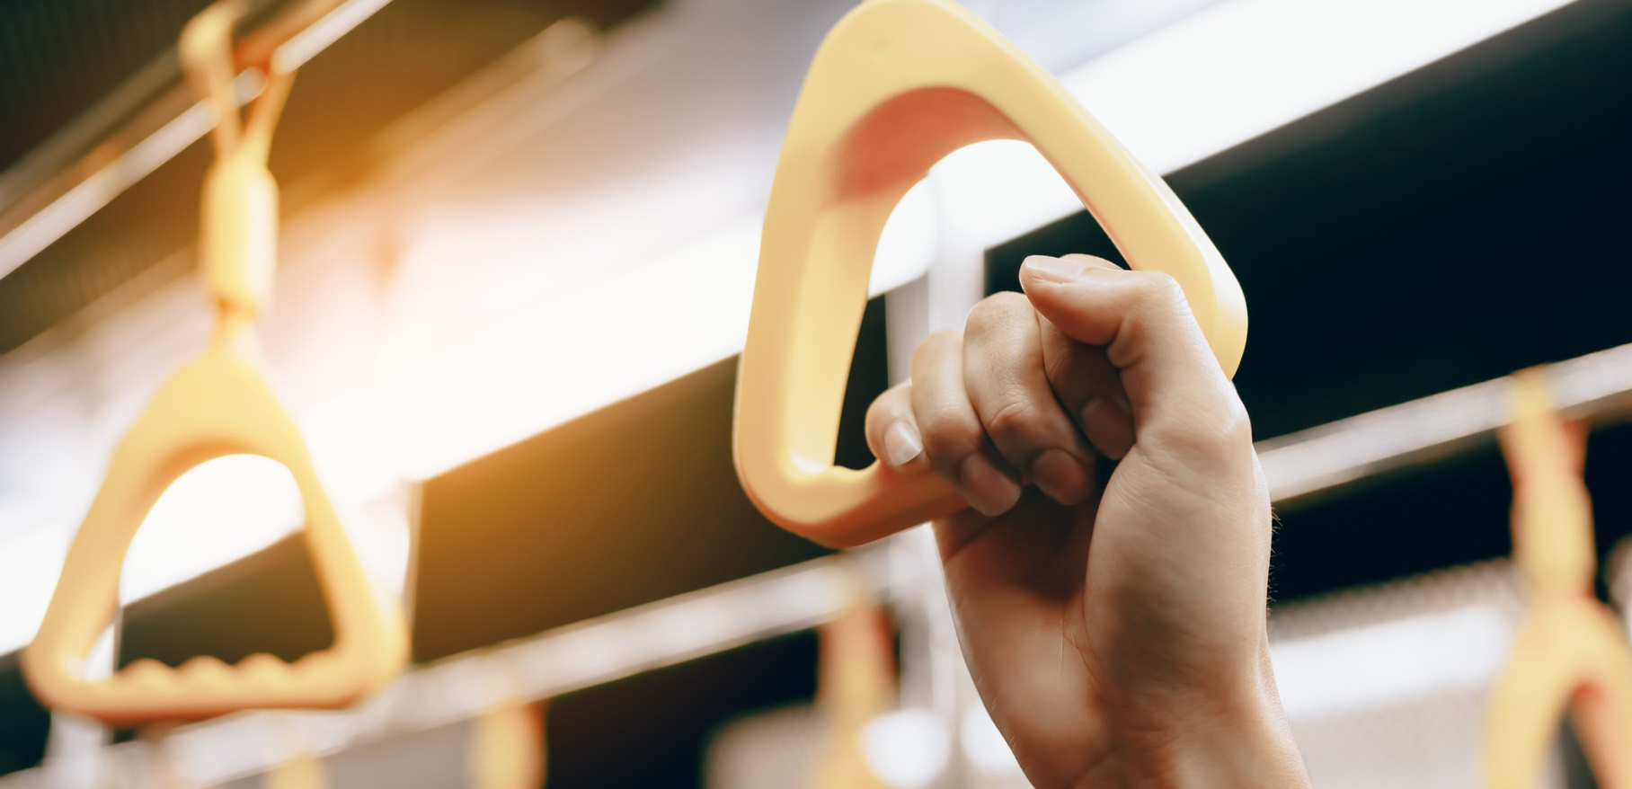
Tram Passenger Survey (TPS) – Midland Metro
Passengers’ suggested improvements
38

Slide 39
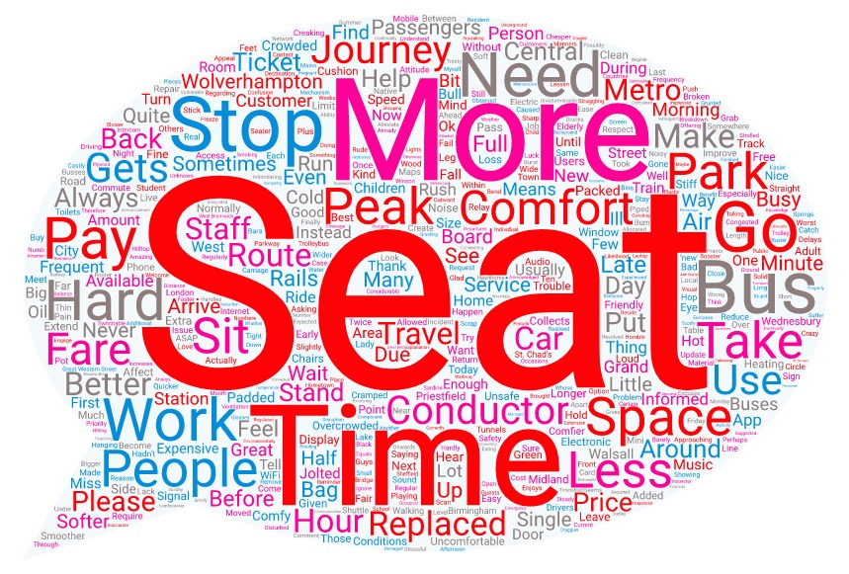
Passengers’ suggested improvements: summary
60%
of Midland passengers in 2016 had no suggestions for improvements
…of the 40% that did, the most common service areas for improvement were:
Q. If something could have been improved on your tram journey today, what would it have been?
Base: All suggesting an improvement - 223
39

Slide 40
Selected verbatim comments
The chairs are very stiff, softer ones would be better. Loss of signal and internet when going through tunnels, some kind of signal booster or relay within the tunnels would help.
Trams could be on time. More trams as they're too full. Rails damaged at Dartmouth/Dudley.
Never get a seat -always too full. More frequent trams at rush hour. Not enough car park spaces.
To have more times for trams between 6am and 8am, as it is always packed.
The route I take is peak commuting time. There are never any seats and the tram does become overcrowded. It would be great to have more trams running at peak times to alleviate this issue.
The drivers should use the intercom more often to update customers when things go wrong. Get customers to pay.
More space for bags or laptop bags like on the trains. Wi-Fi (Edinburgh trams have free Wi-Fi on trams - Why don't we?).
Sometimes the tram is too early, which means I miss it and get late for work. The tram should stay at stop until it's due to leave. Very expensive.
Real time tram information on app on mobile. Current Network West Midlands app only has timetabled departures, therefore, unknown of any delays before journey.
Seating uncomfortable - too hard sitting 40 minutes. Not enough seats. Tram too short. Passengers having to stand, if not get on at Grand Central.
The seats are very hard. People do push to get a seat and as I have a stick, I feel vulnerable. School children could take knapsacks off back instead of knocking me!!
40

Slide 41
Tram Passenger Survey (TPS) – Midland Metro
Opinion of trams in the local area
41

Slide 42
Opinion of trams in the local area: summary
General opinion of services in area:
Bus services in West Midlands (BPS)
N/A*
N/A*
N/A*
*Not asked in BPS
Q. And how satisfied are you overall with tram services for the following? Base: 392
Q. How would you rate tram services for the following? Base: 459
42

Slide 43
Satisfaction on the trams generally
[Headline]
[Second Headline]
Total fairly/very satisfied
Autumn
2017
Autumn
2016
Autumn
2015
Autumn
2014
Autumn
2013
88
87
87
86
77
90
89
89
86
84
89
79
89
89
88
89
N/A*
88
79
89
90
87
87
N/A*
87
76
86
85
90
90
N/A*
90
N/A*
89
83
Total good/very good
[Footnote]
Q. And how satisfied are you overall with tram services for the following: & Q: How would you rate your local tram services for the following: Base: All passengers – 548
*Not asked before 2016 **Statement changed in 2017 from ‘Punctuality’ to ‘Reliability’.
43

Slide 44
Proposed extensions and Midland Metro Alliance
[Headline]
[Second Headline]
Awareness of extension proposals (%)
Awareness of the further proposed extensions (%)
Centenary Square
Edgbaston
Birmingham Eastside
East Birmingham - Solihull
Wednesbury – Brierley Hill
Wolverhampton City Centre
Awareness of Midland Metro Alliance (%)
[Footnote]
Q. The Midland Metro has recently been extended into Birmingham City Centre. Are you aware of further proposed extensions? Base: All passengers - 501
Q. Which of the following extensions are you aware of? Base: All aware of proposed extensions - 312
Q. Are you aware of the Midland Metro Alliance? Base: All giving an answer - 501
44

Slide 45
Tram Passenger Survey (TPS) – Midland Metro
Appendix 1: the passenger and journey context
45
Notes:
45
Header: Relation
2004-02-04
Internal/Identier/File name
45

Slide 46


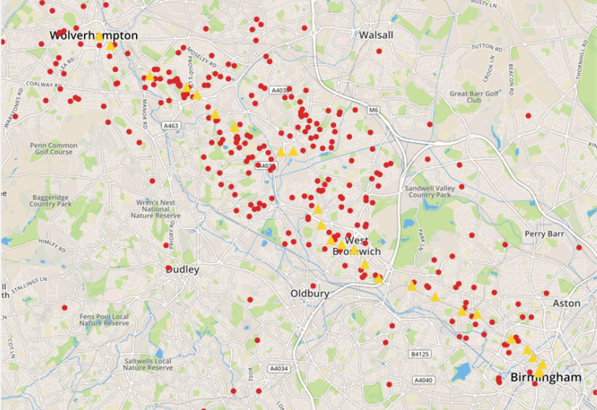
Midland Metro passengers: summary
[Headline]
[Second Headline]
Overview of passenger demographics
Age
Autumn
2016
Disability
Autumn
2016
Access to private transport
Autumn
2016
48
32
14
6
12
78
10
42
42
13
2
Passengers’ postcodes relative to tram network
[Footnote]
46

Slide 47
Passenger profile
 | Tram |  |  |  |  | Bus
 | Autumn 2017 | Autumn 2016 | Autumn 2015 | Autumn 2014 | Autumn 2013 | Autumn 2017 | Autumn 2016 | Autumn 2015 | Autumn 2014 | Autumn 2013
Age
16-34 | 43 | 48 | 40 | 50 | 50 | 39 | 44 | 44 | 44 | 37
35-59 | 35 | 32 | 32 | 27 | 34 | 34 | 29 | 29 | 33 | 40
Over 60 | 17 | 14 | 22 | 24 | 17 | 22 | 23 | 22 | 23 | 24
Not stated | 4 | 6 | 6 | N/A | N/A | 6 | 4 | 5 | N/A | N/A
Access to private transport
Easy | 42 | 42 | 25 | 32 | 31 | 18 | 16 | 16 | 18 | 17
Moderate | 43 | 42 | 51 | 54 | 50 | 36 | 38 | 34 | 37 | 36
Limited/none | 11 | 13 | 11 | 12 | 17 | 39 | 40 | 42 | 40 | 41
Not stated | 4 | 2 | 13 | 3 | 2 | 7 | 6 | 7 | 5 | 6
Has a disability
Yes | 15 | 12 | 16 | 13 | 12 | 24 | 22 | 21 | 33 | 28
Ticket type
Free pass holders | 16 | 11 | 21 | 23 | 15 | 25 | 24 | 25 | 28 | 28
Fare-payers | 84 | 89 | 79 | 77 | 82 | 72 | 73 | 71 | 72 | 72
47

Slide 48
Where Midland Metro tram passengers live
Autumn
2016
Autumn
2015
Autumn
2014
Autumn
2013
17
13
23
14
12
9
7
2
1
3
26
15
23
9
5
8
10
1
0
2
28
10
15
13
7
10
4
2
2
9
23
17
25
8
9
5
6
2
0
4
Q: What is your postcode?
Base: All giving a postcode – 410
48

Slide 49





Midland Metro journeys: summary (1)
Frequency using trams in area
Passenger journey details
5+ days
week
3-4 days
week
1-2 days a
week
Once a
fortnight
Once a
month
Less often
First time
Journey purpose
Commuting
Business
Leisure
49

Slide 50




Midland Metro journeys: summary (2)
Tickets used for today’s journey
Single/return 19
Season 61
Other 5
Tram only 37
Multi-mode 63
Ticket type
Fare-payer
Free pass
Free/fare-payers
Mode permitted
Purchased ticket via…
Ticket format
Conductor
Tram Operator
Travel Shop
Other
Paper
Photocard
Plastic card
M-ticket
50

Slide 51
Midland Metro journeys: summary (3)
Most used tram stops: journey start
Mode used to arrive at starting stop (all stops)
Grand Central | 19
Bull Street | 12
Priestfield | 9
Wednesbury Parkway | 8
Bilston Central | 7
West Bromwich Central | 7
Wednesbury, Great Western Street | 5
Black Lane | 4
On foot
Car
Bus
Train
Other
Most used tram stops: journey destination
Mode used to travel on from destination stop (all stops)
Bull Street | 19
Grand Central | 13
West Bromwich Central | 13
Priestfield | 6
Bliston Central | 6
The Crescent | 6
St Paul’s | 5
Jewellery Quarter | 3
On foot
Car
Bus
Train
Other
51

Slide 52
Midland Metro journeys: summary (4)
Journey direction
Outward
Return
One way only
Weather on day of journey
Dry
Light rain
Heavy rain
Other
Sitting/standing
Had a seat
Stood, would
have liked seat
Stood, happy
to stand
52

Slide 53
Journey purpose
Autumn
2017
Autumn
2016
Autumn
2015
Autumn
2014
Autumn
2013
56
15
2
2
1
6
6
11
2
55
11
2
3
2
12
6
6
3
44
17
1
6
2
14
5
9
2
51
14
2
2
1
13
5
10
3
71
2
27
66
2
32
61
1
38
65
2
33
Q. What is the main purpose of your tram journey today?
Base: All passengers – 486
53

Slide 54
Frequency of using Midland Metro
Autumn
2017
Autumn
2016
Autumn
2015
Autumn
2014
Autumn
2013
55
18
13
2
3
6
2
51
21
14
3
4
5
1
44
22
15
4
4
9
1
52
18
11
4
5
7
3
Q. How often do you typically travel by tram?
Base: All passengers – 478
54

Slide 55
Ticket type and modes of transport permitted
Autumn
2017
Autumn
2016
Autumn
2015
Autumn
2014
Autumn
2013
18
7
11
63
10
1
6
1
34
4
7
11
8
16
7
9
59
5
0
6
1
33
3
11
21
4
20
16
14
55
5
0
7
2
27
7
5
23
3
21
4
17
61
4
0
9
1
34
6
6
15
2
36
2
37
24
35
2
32
31
33
1
35
31
37
1
40
22
Q. What type of ticket/pass did you use for this tram journey today?
Base: All passengers – 480
Q. What modes of transport does your ticket allow you to travel on?
Base: All passengers – 496
55

Slide 56
Method of buying ticket and ticket format
Autumn
2017
Autumn
2016
Autumn
2015
Autumn
2014
Autumn
2013
3
30
19
16
6
5
4
10
6
N/A*
23
21
26
12
9
8
N/A*
2
N/A*
29
30
16
8
10
3
N/A*
2
N/A*
26
22
19
9
14
4
N/A*
4
35
33
30
0
1
28
58
13
0
1
30
57
11
0
2
33
64
2
0
1
*Not asked before 2016
Q. How did you buy that ticket or pass?
Base: All fare-paying passengers – 372
Q. In what format was your ticket?
Base: All passengers – 479
56

Slide 57
Midland Metro stops used by passengers surveyed
54 per cent of passengers were on an outward journey, 39 per cent on a return and 7 per cent on a one-way trip (2016: 41 per cent, 54 per cent and 6 per cent respectively)
69 per cent had a seat for their whole journey, while 11 per cent said they had to stand but would have liked to have a seat (2016: 71 per cent and 7 per cent)
Autumn
2017
Autumn
2016
Autumn
2015
Autumn
2014
Autumn
2013
Autumn
2017
Autumn
2016
Autumn
2015
Autumn
2014
Autumn
2013
Boarding*
Alighting*
Grand Central – for New Street | 19 | 14 | N/A* | N/A* | N/A*
Bull Street | 12 | 16 | N/A* | N/A* | N/A*
Priestfield | 9 | 3 | 6 | 17 | 4
Wednesbury Parkway | 8 | 3 | 4 | 3 | 5
West Bromwich Central | 7 | 7 | 8 | 12 | 8
Bilston Central | 7 | 3 | 5 | 6 | 4
Black Lake | 4 | 2 | 2 | 3 | 2
Bradley Lane | 4 | 2 | 2 | 1 | 2
Bull Street | 19 | 13 | N/A* | N/A* | N/A*
Grand Central – for New Street | 13 | 8 | N/A* | N/A* | N/A*
West Bromwich Central | 13 | 7 | 14 | 17 | 12
Bilston Central | 6 | 6 | 5 | 6 | 4
Priestfield | 6 | 4 | 3 | 10 | 2
The Crescent | 6 | 3 | 1 | 2 | 1
St. Paul’s | 5 | 2 | 7 | 3 | 3
Jewellery Quarter | 3 | 5 | 3 | 2 | 2
*Network improvement works meant that Wolverhampton St George’s and The Royal were closed for the duration of fieldwork in 2017
Q: Were you on your outward or return journey?
Q. Did you get a seat on the tram? Q: At which stop did you board/leave this tram?
Base: All passengers - 501
57

Slide 58
How got to and from the tram stop
Autumn
2017
Autumn
2016
Autumn
2015
Autumn
2014
Autumn
2013
52
64
1
0
4
1
9
6
6
4
N/A*
N/A*
27
23
7
4
1
0
1
1
52
61
1
0
4
4
8
7
3
3
N/A*
N/A*
28
25
8
6
2
1
1
1
53
63
1
1
5
3
5
3
6
2
N/A*
N/A*
30
27
4
5
1
2
1
1
55
69
0
0
7
4
4
2
5
2
N/A*
N/A*
28
22
3
3
0
0
2
1
* Not asked before 2017
Q: How did you get to/from the tram stop where you boarded/left the tram today?
Base: All passengers - 482
58

Slide 59
Weather conditions when journey made
Autumn
2017
Autumn
2016
Autumn
2015
Autumn
2014
Autumn
2013
68
22
4
0
4
1
72
23
3
0
2
1
77
17
2
0
4
1
74
20
2
0
1
2
Q. What was the weather like when you made your journey?
Base: All passengers - 484
59

Slide 60
Reasons for choosing the tram
Autumn
2017
Autumn
2016
Autumn
2015
Autumn
2014
Autumn
2013
48
34
28
14
12
11
9
2
2
28
30
13
6
14
2
4
0
2
26
28
15
6
15
3
4
2
1
27
27
16
7
13
3
4
N/A**
3
**Not asked in 2013
Q. What was the main reason you chose to take the tram for this journey?
Base: All passengers – 479
60

Slide 61
Factors preventing more journeys being made
Autumn
2017
Autumn
2016
Autumn
2015
Autumn
2014
Autumn
2013
42
35
18
19
11
11
19
4
13
3
4
40
30
35
19
16
10
18
11
9
5
1
33
27
25
18
9
8
20
7
10
2
1
39
47
N/A*
18
10
11
20
11
12
5
1
*Not asked in 2013. The addition of ‘Tram network improvement works’ in TPS 2014 could have caused the significant drops in other factors
Q. Have any of the following frequently stopped you making journeys by tram? (More than one answer permissible)
Base: All previously using the tram – 326
61

Slide 62
Tram Passenger Survey (TPS)
Appendix 2 – Further details on survey background and method
62
Notes:
62
Header: Relation
2004-02-04
Internal/Identier/File name
62

Slide 63
Methodology – fieldwork
Midland Metro (TPS)
Fieldwork: 18 September to 8 December 2016 (with a gap for half term from 23 October to 29 October)
Interviewer shifts: covered all days of the week and ran from 6am to 10pm. Each interviewer worked a three-hour shift; four hour shifts were conducted in a few cases.
Method: Choice of paper or online self-completion questionnaire
Sample size: 501 interviews (447 paper and 54 online)
In 2016 fieldwork took place between 26 September to 4 December 2016
Bus (BPS) data for West Midlands (TfWM) area
Fieldwork: 11 September to 17 December 2017
Interviewer shifts: covered all days of the week and ran from 6am to 10pm. Each interviewer worked a three-hour shift
Method: Choice of paper or online self-completion questionnaire
Sample size: 3198 interviews
63

Slide 64
Methodology – data analysis
[Headline]
[Second Headline]
Base definitions: All charts are based on those who gave an answer to an individual question. Those who either left the question blank or said ‘don’t know’ have been excluded from the base. For this reason the base sizes for those charts based on ‘All passengers’ vary slightly between the different charts in this report.
Significant changes are shown at the 95% confidence level. / / symbols are used throughout this report to indicate positive or negative significant changes.
Weighting: this was based on passenger count information collected by the interviewer during each interviewer shift. The weighting matrix used the following weighting cells:
Tram network: (for Manchester Metrolink, Nottingham Express Transit and Sheffield Supertram this was by line)
Age: 16-25, 26-59, 60+
Gender: male, female
Time/day travelled: weekday peak, weekday off peak and weekend
The full details of the weighting matrix can be found in the TPS Autumn 2017 technical report.
Waiver
Transport Focus has taken care to ensure that the information contained in TPS is correct. However, no warranty, express or implied, is given as to its accuracy and Transport Focus does not accept any liability for error or omission.
Transport Focus is not responsible for how the information is used, how it is interpreted or what reliance is placed on it. Transport Focus does not guarantee that the information contained in TPS is fit for any particular purpose.
[Footnote]
64

Slide 65
Methodology – themes that are affecting overall passenger satisfaction charts (1)
[Headline]
[Second Headline]
The approach to identifying themes that affect overall passenger satisfaction is split into two stages. At the first stage, we took all 25 individual satisfaction measures from the survey (apart from the overall journey satisfaction) and formed them into themes using a statistical technique known as factor analysis, which groups together those satisfaction measures that are responded to similarly within the data. For instance, where high or low scores are given for measure ‘x’, there tends to be a similar rating for measures ‘y’ and ‘z’, so the ‘factor’ or theme becomes ‘A’. Through this process we identified ten themes, which are shown below, alongside measures that formed each theme:
Theme (factor) | Questions
1 On tram environment and comfort | Sufficient room for all the passengers to sit/stand
 | The comfort of the seats
 | The amount of personal space you had around you
 | Provision of grab rails to hold on to when standing/moving about the tram
 | The temperature inside the tram
2 Tram stop condition | Its general condition/standard of maintenance
 | Its freedom from graffiti/vandalism
 | Its freedom from litter
3 Boarding the tram | The ease of getting on to and off of the tram
 | The length of time it took to board the tram
4 Timeliness | The length of time you had to wait for the tram
 | The punctuality of the tram
5 Access to the tram stop | Its distance from your journey start e.g. home, shops
 | The convenience/accessibility of its location
6 Personal safety throughout journey | Behaviour of fellow passengers waiting at the stop
 | Your personal safety whilst at the tram stop
 | Your personal security whilst on the tram
7 Cleanliness and condition of the tram | The cleanliness and condition of the outside of the tram
 | The cleanliness and condition of the inside of the tram
8 Smoothness/speed of tram | The amount of time the journey took
 | Smoothness/freedom from jolting during the journey
9 Information throughout journey | The information provided at the tram stop
 | Route/destination information on the outside of the tram
 | The information provided inside the tram
10 Value for money | How satisfied were you with the value for money of your tram journey?
[Footnote]
65

Slide 66
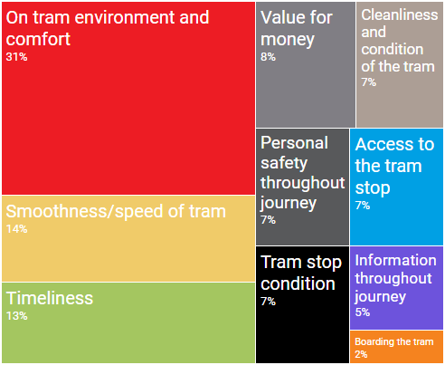
Methodology – themes that are affecting overall passenger satisfaction charts (2)
[Headline]
[Second Headline]
For the second stage, these themes were then used to identify how much effect each one has on passengers’ rating for overall journey satisfaction, by means of a key driver analysis.
The square diagrams show the proportional influence that each theme has on satisfaction for that area/operator. They should be read like a pie chart where the slices or portions are relative to each other and together add up to 100%. So in the example below, the theme of ‘on tram environment and comfort’ which is shaded red, has the greatest influence on satisfaction, followed by ‘smoothness/speed of tram’, while themes such as ‘boarding the tram’ and ‘information throughout journey’ have relatively less influence here.
This analysis was conducted on fare-paying passengers only, so that the influence of value for money could be included. It also combines data from 2016 and 2017 surveys to increase robustness. The analysis excludes satisfaction measures relating to tram staff; due to differences in staff availability across the networks not all TPS questionnaires feature questions about tram staff. In order to run the analysis in a consistent and practical manner all staff measures have been excluded.
There are noticeable and interesting differences in the impact of different themes between the various tram networks.
The process used for Glasgow differs slightly, in that only 24 out of 25 individual satisfaction measures are included in the Glasgow questionnaire. The first stage of the analysis was therefore conducted in isolation from the other networks and produces slightly different themes. A full description is included in the technical report.
[Footnote]
66

Slide 67
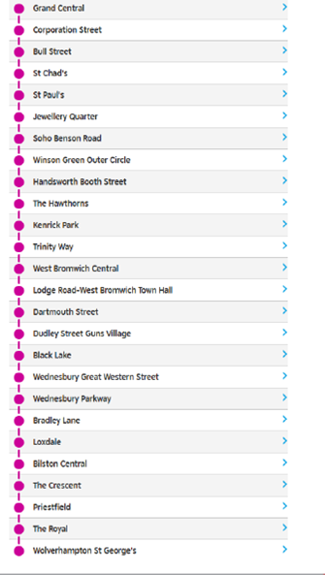
The Midland Metro route map
[Headline]
[Second Headline]
[Footnote]
67

Slide 68

Tram Passenger Survey (TPS)
Appendix 3 – Example of standard questionnaire
Individual network questionnaires differed slightly to reflect local geography, presence of conductors and/or ticket machines, ticket types available, etc
68
Notes:
68
Header: Relation
2004-02-04
Internal/Identier/File name
68

Slide 69
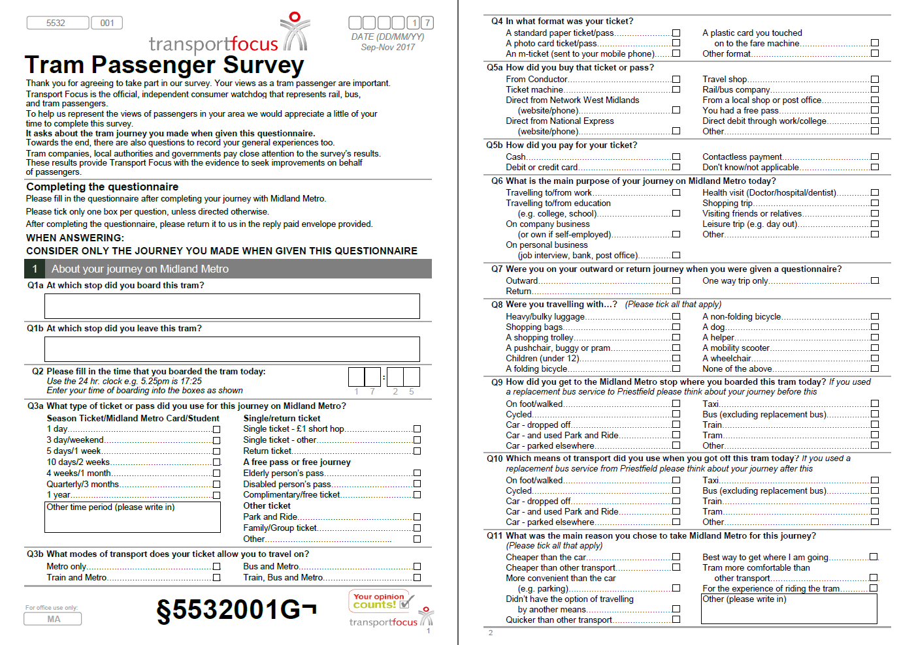
69

Slide 70
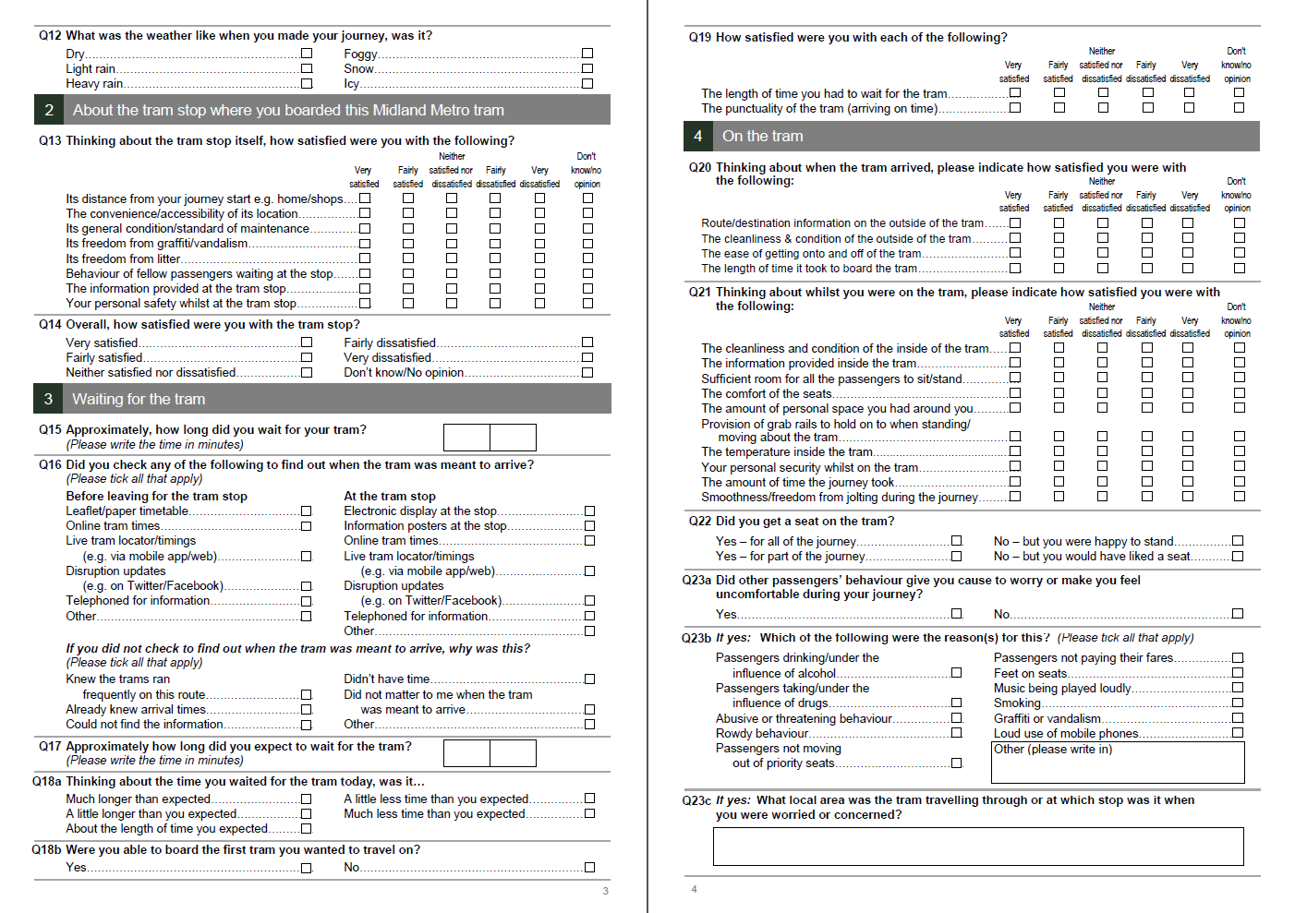
70

Slide 71
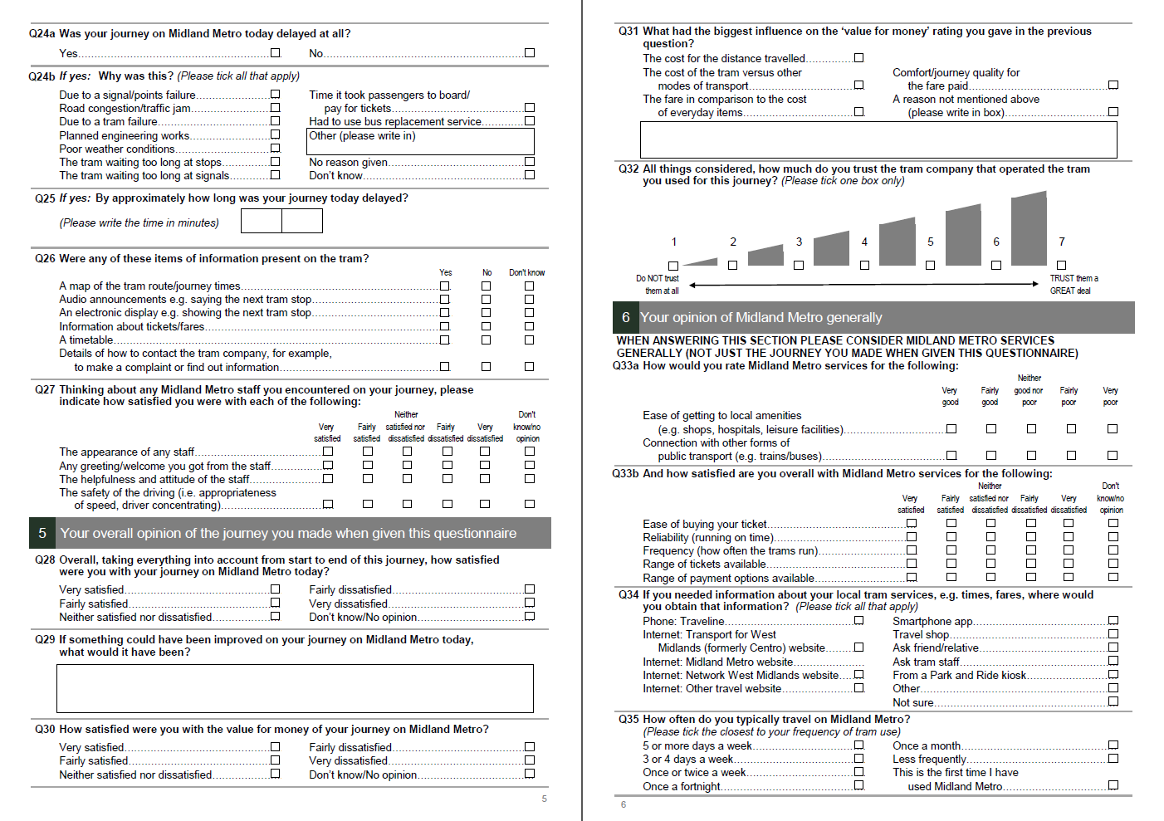
71

Slide 72
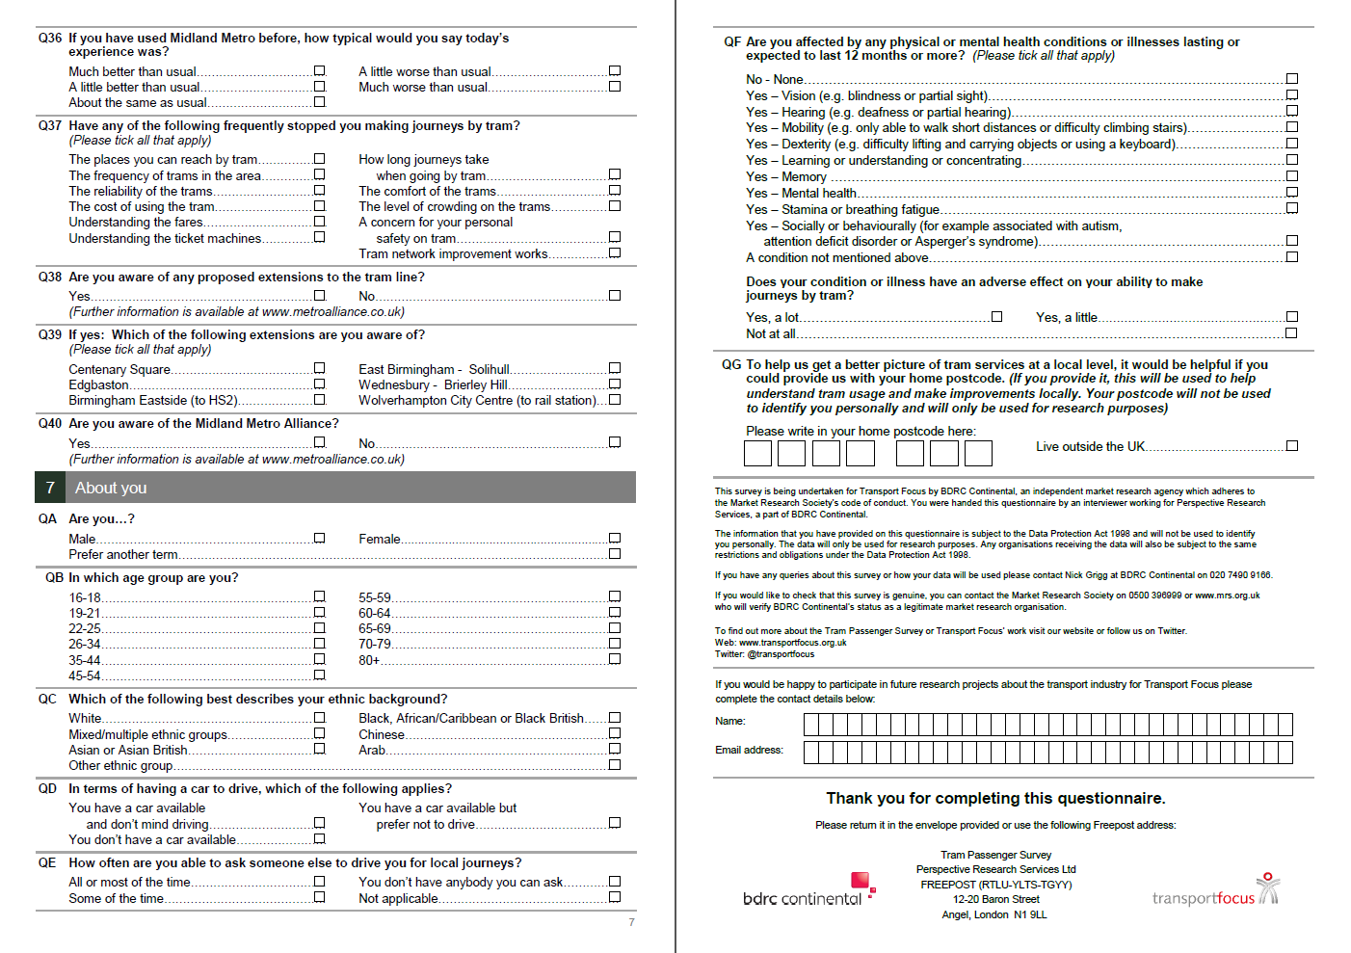
72

Slide 73
Tram Passenger Survey (TPS) – Midland Metro
Autumn 2017 results
Rosie Giles
Tel: 0300 123 0842 Email: Rosie.Giles@transportfocus.org.uk
Insight Team, Transport Focus, Fleetbank House, 2-6 Salisbury Square, London, EC4Y 8JX
March 2018
Notes:
73
Header: Relation
2004-02-04
Internal/Identier/File name
73

